Slide 1
Cranial Nerves
I & Xii
By
Dr. Mekha K Mathew

Slide 2
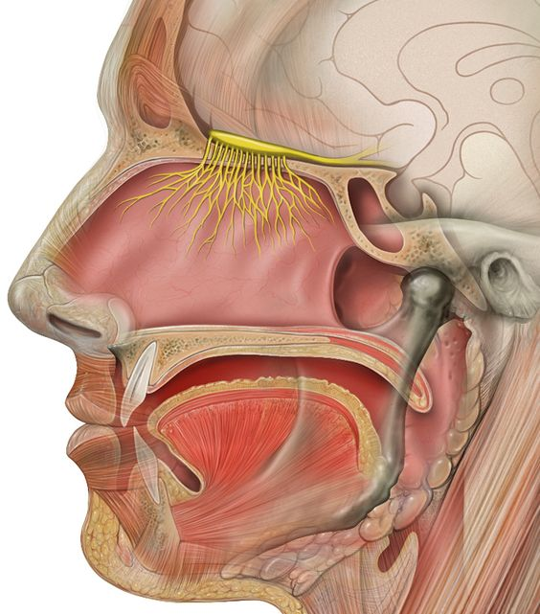
THE OLFACTORY NERVE
First order neurons- bipolar sensory cells that lie in the olfactory epithelium
Knobs on the cilia - sites of chemosensory signal transduction
Odorant binding to receptors causes ion ﬂuxes, excitation, and the activation of messenger systems
Notes:
which occupies a small area on the superior nasal concha, and roof of the nose.

Slide 3
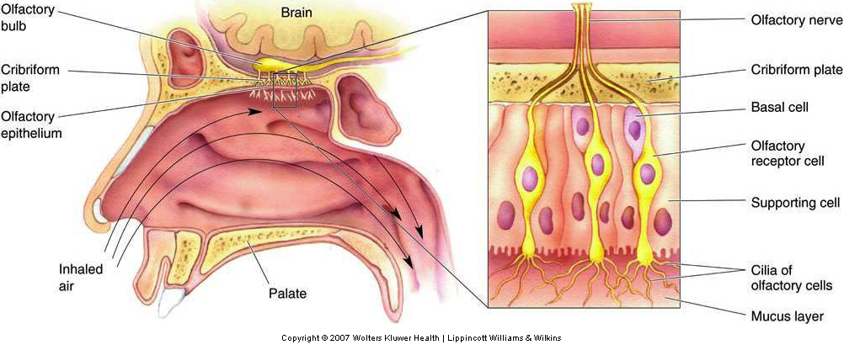
Notes:
6 MILLION
unmyelinated axons that form approximately 20 branches
They penetrate the cribriform plate of the ethmoid bone, acquire a sheath of meninges, and synapse in the olfactory bulbs
chemotherapy
Basal cells in the olfactory epithelium can regenerate

Slide 4
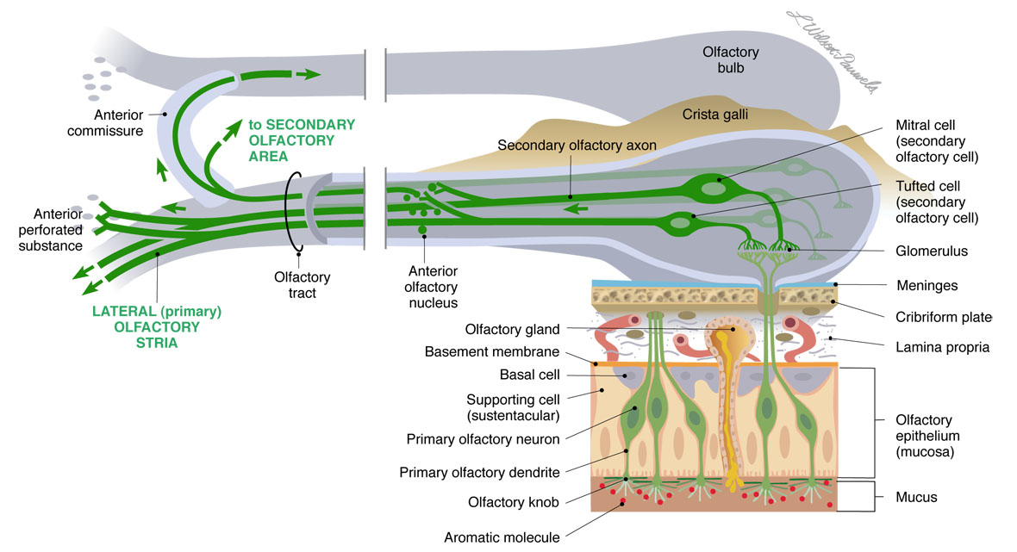
Notes:
the axons of the second order neurons, mainly the mitral cells, course posteriorly through the olfactory tracts,
which lie in the olfactory grooves beneath the frontal lobes in ﬂoor of the anterior cranial fossa.

Slide 5
Olfaction is the only sensation not directly processed in the thalamus
Chemoreceptors for smell and taste are the only examples of neuronal regeneration.

Slide 6
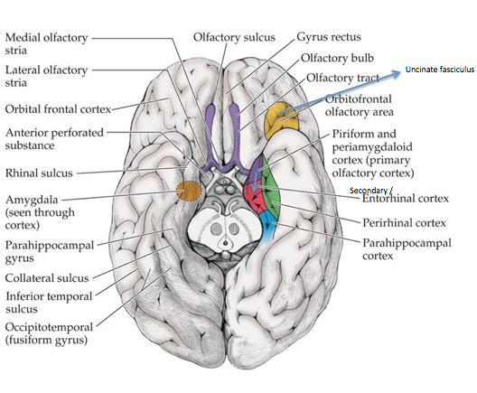
Notes:
The olfactory tracts divide into medial and lateral olfactory striae that run on either side of the anterior perforated substance. The triangular area thus formed is called the olfactory trigone.

Slide 7
PRIMARY OLFACTORY CORTEX
the piriform cortex
the anterior cortical nucleus of the amygdala
the periamygdaloid complex
the rostral entorhinal cortex.
SECONDARY OLFACTORY CORTEX..
Notes:
Ant end of hypp gyrus and uncus
34
28

Slide 8
Hippocampi and amygdaloid nuclei on the two sides are intimately related through the anterior commissure.
From medial dorsal nucleus of thalamus to orbitofrontal cortex
Communications with the superior and inferior salivatory nuclei are important in reﬂex salivation.

Slide 9
Volatile substances
In true anosmia, scents but also ﬂavors
Flavor is a synthesis of sensations derived from the olfactory nerves, taste buds, and other sensory end-organs.
A patient with olfactory impairment may complain of loss of taste rather than of smell.
Patients with unilateral anosmia may be unaware
Notes:
soluble in lipids or water are perceived as odors.

Slide 10
Conductive Deﬁcits..
Sensorineural /Neurogenic Deﬁcits
Notes:
miss out on some of life’s pleasures; they may also miss olfactory danger signals, such as spoiled food, smoke, and leaking gas
due to processes interfering with the ability of odorants to contact the olfactory epithelium, such as nasal polyps; and
due to dysfunction of the receptors or their central connections.

Slide 11
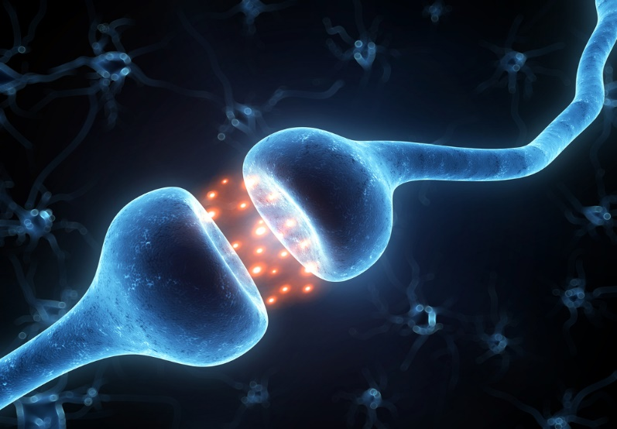
ANOSMIA
HYPOSMIA
HYPEROSMIA
PRESBYOSMIA
DYSOSMIA
PAROSMIA
CACOSMIA : Inappropriately disagreeable odors
COPROSMIA : Cacosmia with a fecal scent
PHANTOSMIA : Perception of an odor that is not real
OLFACTORY AGNOSIA : Inability to identify detected odors
Notes:
Impairment or defect in the sense of smell
Perversion or distortion of smell

Slide 12
HISTORY
Recent upper respiratory infection
Smoking
Past head injury
Systemic illness
Nutrition
Exposure to toxins

Slide 13
CLINICAL EXAMINATION
Smell is tested using non irritating stimuli.
Ammonia may stimulate the trigeminal nerve instead of the olfactory nerve
Examine each nostril separately while occluding the other. …
University of Pennsylvania Smell Identiﬁcation Test (Upsit) And Connecticut Chemosensory Test.
Notes:
With the patient’s eyes closed and one nostril occluded, bring the test substance near the open one.
Ask the patient to sniff and indicate whether she smells something and, if so, to identify it.
Repeat for the other nostril and compare the two sides.
The side that might be abnormal should be examined ﬁrst
Commercially available quantitative smell and taste tests include the

Slide 14
Perception of odor > accurate identiﬁcation.
Indicates continuity of the olfactory pathways;
Identiﬁcation indicates intact cortical function as well.
Lesion of the olfactory cortex does not produce anosmia.
The appreciation of the presence of a smell, even without recognition, excludes anosmia.
Notes:
Bilateral innervation
a lesion central to the decussation of the olfactory pathways never causes loss of smell, and

Slide 15
Local processes
Rhinitis
Nasal obstruction
Polyposis
Hansen's disease
Sjogren's syndrome
Tumors
Spinocerebellar ataxias
Friedreich's ataxia
Refsum's disease
Seizure disorders
Neurologic
Head trauma
CJD
Parkinson's disease
Alzheimer's disease
Huntington's disease
Korsakoff's syndrome
Multiple sclerosis
Migraines
Giant ACA aneurysm
Meningiomas
Temporal lobe tumors

Slide 16
Iatrogenic
Ethmoidectomy
Rhinoplasty
Postlaryngectomy
Submucous resection
Radiotherapy
Orbitofrontal lobectomy
Temporal lobectomy
Vitamin deficiency (B6, B12, A)
Zinc or copper deficiency
Congenital
Cleft palate
Down's syndrome
Kallmann's syndrome
Turner's syndrome
Endocrine/Metabolic
Adrenal insufficiency
Diabetes mellitus
Hypothyroidism
Pseudohypoparathyroidism
`

Slide 17
Psychiatric
Hypochondriasis
Major depression
PTSD
Schizophrenia
Infectious
HSV meningoencephalitis
HIV infection
Upper respiratory tract
Drugs
Cadmium toxicity
Antihistamines
Propylthiouracil
Antibiotics
Levodopa
Cocaine Amphetamines
Uremia/Dialysis
Liver disease
Cirrhosis

Slide 18
DISORDERS OF OLFACTORY FUNCTION
ANOSMIA
MCC of transient and b/l anosmia is the common cold.
Head injury the MCC of disruption of the olfactory fibers prior to their decussation.
Lesions of orbital surface of the brain may cause u/l

Slide 19
FOSTER KENNEDY SYNDROME
Anosmia
Unilateral ipsilateral optic atrophy
Contralateral papilledema
Large tumor involving the orbitofrontal region-olfactory groove meningioma.
First described by Sir William Gowers; later by R. Foster Kennedy.
Notes:
The anosmia and optic atrophy are due to direct compression; the contralateral papilledema occurs late when intracranial pressure increases. The atrophic optic disc cannot swell and the unusual picture of optic atrophy in one eye and papilledema in the fellow eye develops.

Slide 20
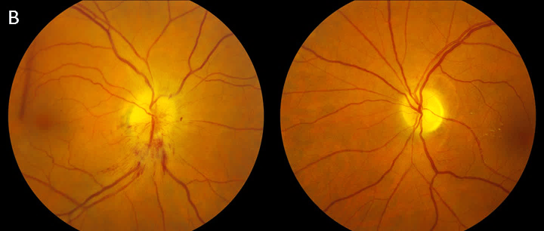

Slide 21
If no anosmia, more often due to AION, involving one eye, leading to atrophy, then the other, leading to disc edema (the pseudo–Foster Kennedy syndrome).
A mass causing asymmetric compression of both optic nerves may cause a similar picture.
Notes:
A pseudoâ€“Foster Kennedy syndrome may rarely be noted when increased intracranial pressure of any cause occurs in a patient who has previous unilateral optic atrophy

Slide 22
Anosmia - degenerative dementias; Alzheimer’s / Parkinson’s disease
May involve odor detection, identiﬁcation, and discrimination.
85% - 90% patients even in the early stages of the disease.
Hyposmia may precede the motor or cognitive dysfunction.
Conversely, anosmia in suspected progressive supranuclear palsy atypical
Notes:
and corticobasal degeneration is

Slide 23
The prevalence of anosmia may be even higher in lewy body dementia than in AD.
Disturbances of complex olfactory function (eg., Discrimination) despite preserved detection of odors in alcoholic Korsakoff's syndrome
Thalamic or prefrontal cortical lesions.

Slide 24
If signs of frontal lobe involvement, olfaction should be carefully tested.
Multiple sclerosis may cause impaired smell due to plaque formation in the central olfactory (Inferior frontal and temporal) brain regions

Slide 25
KALLMANN’S SYNDROME
  X-linked
  Hypogonadotropic hypogonadism
  Anosmia, due to hypoplasia or aplasia of the olfactory bulbs and tracts.
  Have cerebellar ataxia and mirror movements of hands

Slide 26
Hyperosmia is usually functional, substance abuse and in migraine.
Hyposmia in zinc and vitamin A deficiencies
Parosmia and cacosmia are often due to psychiatric disease but occasionally follow head trauma
Olfactory hallucinations are most often due to psychosis, lesion of the central olfactory system
Uncinate ﬁts are CPS preceded by an olfactory or gustatory aura, smacking of the lips or chewing movements - medial temporal lobe structures.

Slide 27
The Hypoglossal Nerve

Slide 28
Purely motor
Cells of origin are in the hypoglossal nuclei
From rostral to caudal, the innervation is
  Intrinsic tongue muscles,
  Then genioglossus,
  Hyoglossus,
  And styloglossus
Notes:
upward extensions of the anterior gray columns of the spinal cord;
they consist of large, multipolar cells, similar to the anterior horn motoneurons

Slide 29
Precentral gyrus
Corticobulbar tract
Genu of internal capsule
Cerebral peduncle
Cross midline at pontomedullary jn
Hypoglossal nucleus
Notes:
The cortical representation is huge
Cerebral center - lower part of precentral gyrus in sylvian ﬁssure.
Supranuclear control to the genioglossus muscle is primarily crossed;
supply to the other muscles is bilateral but predominantly crossed.

Slide 30
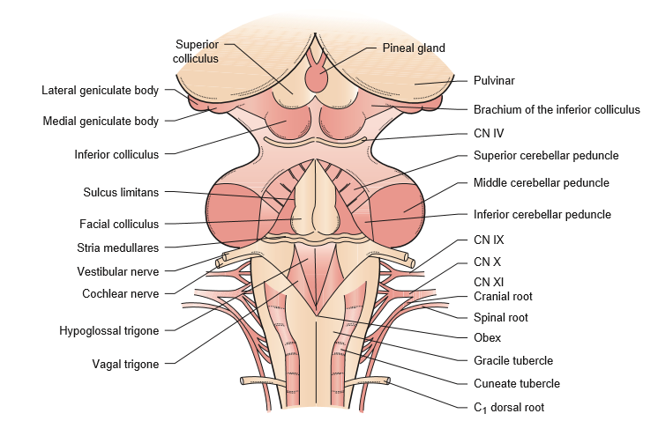
Notes:
The paired nuclei extend almost the entire length of the medulla just beneath the ﬂoor of the fourth ventricle, close to the midline, under the medial aspect of the hypoglossal trigone

Slide 31
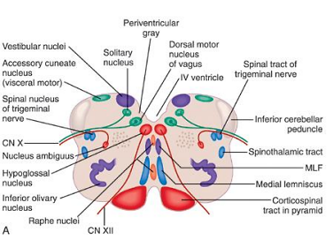
Notes:
Numerous ﬁ bers connect the nuclei of the two sides. The axons stream ventrolaterally through the reticular formation, just lateral to the medial longitudinal fasciculus and medial lemniscuses, and

Slide 32
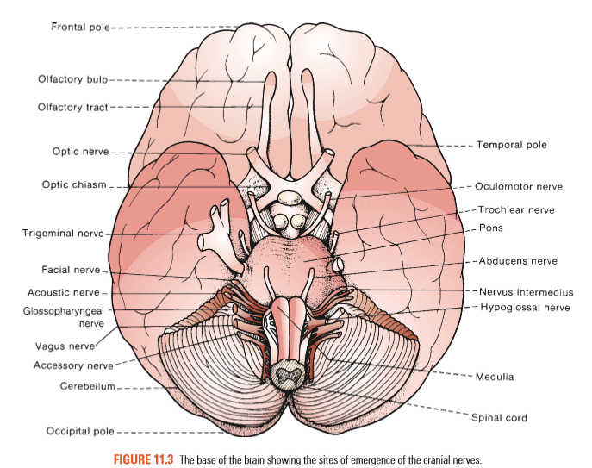
Notes:
the nerve emerges from the medulla in the sulcus between the pyramid and inferior olive (preolivary or ventrolateral sulcus) as a series of 10 to 15 rootlets on each side, anterior to the rootlets of CNs IX, X, and XI

Slide 33
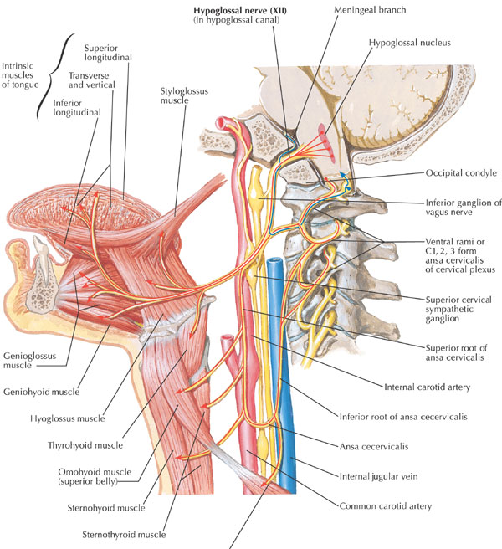
Notes:
The hypoglossal ﬁbers two bundles pass through the hypoglossal canal, and then unite. The nerve descends through the neck to the level of the angle of the mandible, then passes forward under the tongue (hence its name) to supply its extrinsic and intrinsic muscles .
In the upper portion of its course, the nerve lies beneath the internal carotid artery and internal jugular vein, and near the vagus nerve.
It passes between the artery and vein, runs forward above the hyoid bone, between the mylohyoid and hypoglossus muscles, and breaks up into a number of ﬁ bers to supply the various tongue muscles.
The nerve sends communicating branches to the inferior vagal ganglion and to the pharyngeal plexus.

Slide 34
Afferents are primarily proprioceptive, but some lingual somatic afferents present as well.
The neck-tongue syndrome
Consisting of pain in the neck and numbness or tingling in the ipsilateral half of the tongue on sharp rotation of the head
Due to damage to lingual afferent ﬁbers traveling in the hypoglossal nerve to the C2 spinal roots through the atlantoaxial space

Slide 35
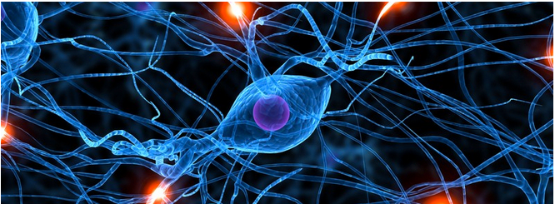
BRANCHES
Meningeal
Thyrohyoid
Descending
Muscular
Notes:
The meningeal branches send ﬁlaments from C1 and C2 to the dura of the post fossa.
The thyrohyoid branch supplies the thyrohyoid muscle.

Slide 36
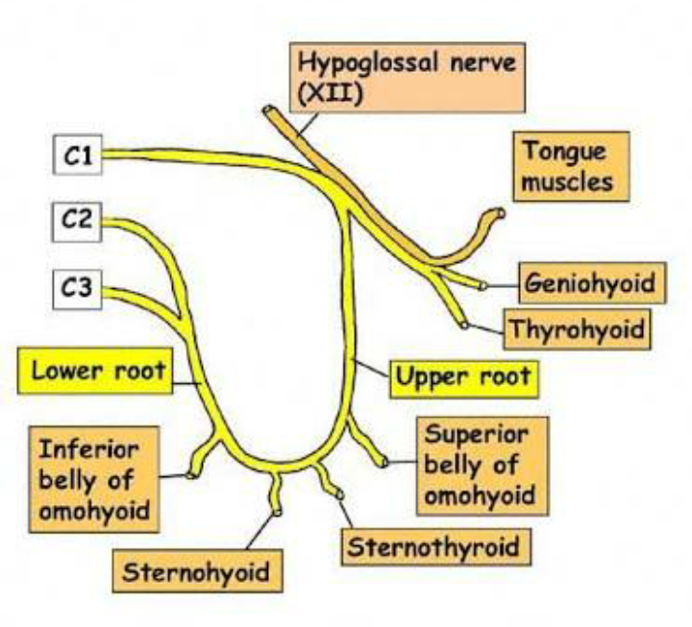
ANSA HYPOGLOSSI
The descending ramus join with ﬁbers from C1, sends a branch to the omohyoid,
then joins a descending communicating branch from C2 and C3 to form the ansa
supplies the omohyoid, sternohyoid, and sternothyroid muscles.

Slide 37
MUSCULAR BRANCH
Except the palatoglossus
The genioglossus is the largest and most important
The intrinsic muscles arise and end within the tongue.
The extrinsic muscles protrude and retract the tongue and move the root up and down.
The intrinsic muscles change the length, the width, the curvature of the dorsal surface, and turn the nonprotuded tip from side to side.
Notes:
CN XII supplies the intrinsic muscles, and all of the extrinsic muscles of the tongue
The paired extrinsic muscles (genioglossus, styloglossus, hyoglossus, and chondroglossus) pass from the skull or hyoid bone to the tongue.
It originates from the chin (Gr. geneion “chin”) and inserts into the tongue

Slide 38
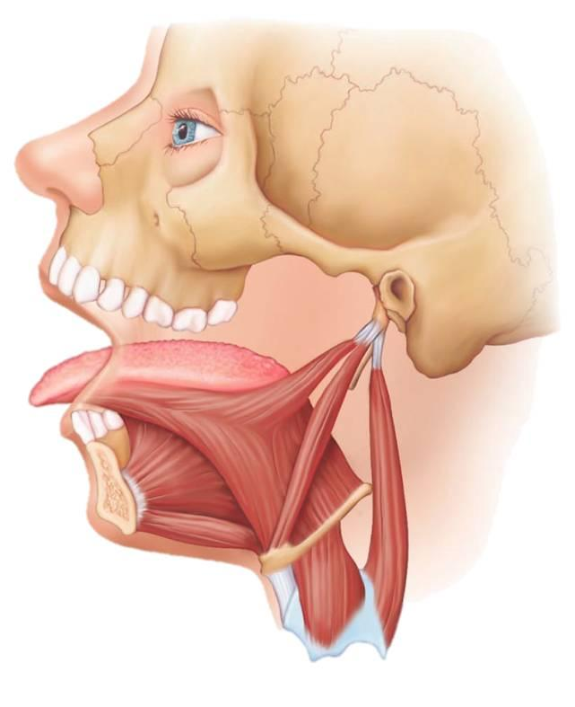
MUSCLE | ACTION
Genioglossi | Posterior fibers protrude the tip; Anterior fibers depress & retract tongue back Together draw tongue downward- sup surface concave Post. fibers on one side push the tongue to the opp side
Hypoglossi | Retract tongue & depress its sides; sup surface convex
Styloglossi | Aids in drawing root of tongue upward; by the vagus
Intrinsic muscles | Both longitudinales shorten the tongue; transversus narrows and elongates the tongue; verticalis flattens and broadens it.
Notes:
altering the tongue’s shape;
superior longitudinalis turns the tip, pulls the tip up, and makes the dorsum concave; inferior longitudinalis pulls the tip down and makes the dorsum convex

Slide 39
CLINICAL EXAMINATION
strength, bulk, and dexterity of the tongue
Goals
weakness
abnormal movements
impairment of rapid movements
atrophy
Notes:
After noting the position and appearance of the tongue at rest in the mouth, the patient is asked to protrude it, move it in and out, from side to side, and upward and downward, both slowly and rapidly
tip against each cheek as the examiner tries to dislodge it with ﬁnger pressure

Slide 40
U/L weakness, tongue deviates to weak side on protrusion
Paresis, atrophy, furrowing, fibrillations, and fasciculations that affect the corresponding half of the tongue
B/L LMN lesions of the tongue result in B/L atrophy, tongue cannot be protruded voluntarily.
Marked difficulty with articulation, pronunciation of d and t.
Dysphagia and breathing difficulties may occur when the flaccid tongue falls.
Notes:
because of the action of the normal genioglossus, which protrudes the tip of the tongue by drawing the root forward
Manually pulling up the weak side of the face eliminates the “deviation.”
It may also be helpful to gauge tongue position in relation to the tip of the nose or the notch between the upper incisors.

Slide 41
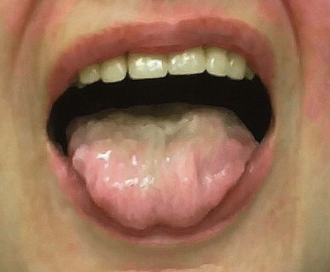
In progressive bulbar palsy and advanced ALS , the atrophy may be so severe that the tongue cannot be protruded (glossoplegia).
With bilateral UMN, for example, primary lateral sclerosis, the tongue may be of normal bulk but move slowly. In some patients, the tongue is tremulous
Tremors disappear when tongue in mouth not fasciculations
Profuse fasciculations -“bag of worms” appearance.
Notes:
; it lies inert on the ﬂ oor of the mouth )
,

Slide 42
Fine tremor
Thyrotoxicosis
Coarse tremors
Parkinsonism
Alcoholism
General paresis

Slide 43
Chorea (Snake, Trombone Or ﬂy-catcher Tongue)
Athetosis
Dystonia
Habit Spasms
Tics
Lingual Spasm - Tetanus
Notes:
CHOREA may cause irregular, jerky movements of the tongue, and often the patient is unable to keep the tongue protruded

Slide 44
Seizures -jacksonian seizure , subcortical seizures
Orofacial or buccolingual dyskinesias, - type of tardive dyskinesia in use of phenothiazines
Serpentine tongue refers to a dyskinesia
Palatal myoclonus
Unusual episodic, rhythmic tongue movements may occur after head and neck trauma (galloping tongue)

Slide 45
Morphologic changes
Ankyloglossia (tongue-tie)
Macroglossia in hypothyroidism, Down’s syndrome, amyloidosis, acromegaly, sarcoidosis, and myopathies, such as Pompe’s disease.
Angioedema
Tongue hypertrophy in excessive movement, like lingual dyskinesias.
Tongue pseudohypertrophy due to denervation
Neoplasm

Slide 46
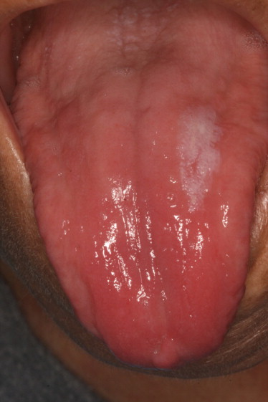
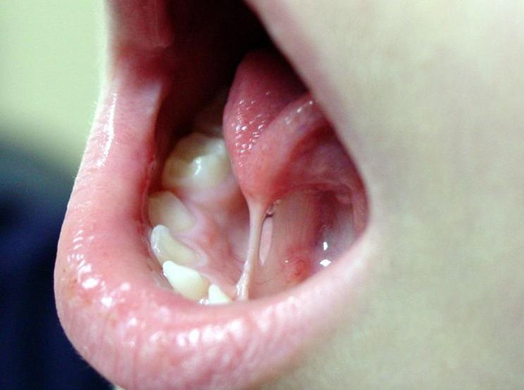
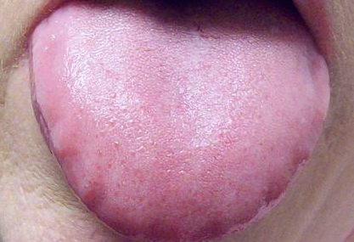

Slide 47
Atrophic Glossitis - Vitamin B12, Folate, Iron
Pernicious anemia- tongue is smooth, translucent, with papillae atrophy
Pellagra acutely it is scarlet red and swollen and may have ulcerations.
Melkersson - Rosenthal syndrome causes facial palsy & scrotal tongue.
Syphilitic glossitis - Longitudinal lingual ﬁssuring
Ulcerations in primary syphilis (lingual chancre) and Behçet’s disease.
Notes:
punctate, erythematous lesions from atrophic, hyperemic papillae
No neurogenic atrophy
In riboﬂavin deﬁciency, the tongue may be a purplish or magenta hue, with prominent, edematous fungiform and ﬁ liform papillae that resemble cobblestones.

Slide 48
DISORDERS OF FUNCTION
Supranuclear
Nuclear
Infranuclear Lesion

Slide 49
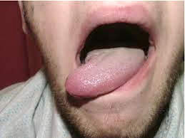
SUPRANUCLEAR LESIONS
Cause weakness but no atrophy, weakness is rarely severe.
Tongue protrudes toward the weak side, ie to side opposite the supranuclear lesion.
Medial pontine lesions tend to cause c/l tongue weakness, lateral pontine lesions cause i/l tongue weakness.
Medullary lesions interrupt ipsilateral corticolingual ﬁbers.
Notes:
Supranuclear tongue weakness - lesion of the cerebral cortex or the corticobulbar tract in the internal capsule, cerebral peduncle, or pons.
Pontine lesions depending on the relationship to the decussating corticolingual ﬁbers.
cortical or large subcortical infarctions , facial and prominent UL weakness

Slide 50
In U/L ischemic strokes above the lower brainstem, tongue deviation occurred in 29%, always toward the side of limb weakness;
Spastic dysarthria due to tongue weakness and incoordination
Isolated dysarthria in lacunar infarct of supranuclear corticolingual pathways.

Slide 51
Pseudobulbar palsy b/l UMN may cause bilateral tongue weakness;
The tongue may appear small and unable to protrude it beyond teeth.
Patients with hemispheric lesions may have apraxia of tongue movements and are often unable to protrude it on command.
Extrapyramidal disorders may cause slowing of tongue movements, with thickness of speech and difﬁculty in protrusion.

Slide 52
NUCLEAR LESIONS
Atrophy of the involved side, protrudes toward the weak side
Progressive nuclear lesions, such as MND, often cause fasciculations
Common disorders that may involve the hypoglossal nucleus include neoplasms, vascular lesions, and motor neuron disease.
Rarely syringobulbia, abscess, granuloma, syphilis, polioencephalitis or postpolio syndrome, and infectious mononucleosis.
Notes:
the close proximity of the two hypoglossal nuclei, dorsal medullary lesions (e.g., multiple sclerosis, syringobulbia) often result in bilateral lower motor neuron lesions of the tongue

Slide 53
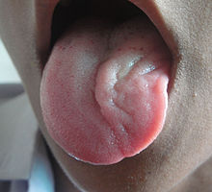
MEDIAL MEDULLARY SYNDROME (DEJERINE'S ANTERIOR BULBAR SYNDROME)
Anterior spinal artery or vertebral artery.
Ipsilateral paresis, atrophy, and fibrillations of the tongue protruded tongue deviates toward the lesion
Contralateral hemiplegia with sparing of the face.
Contralateral loss of position and vibratory sensation
Because the more dorsolateral spinothalamic tract is unaffected, pain and temperature sensations are spared.
Notes:
The anterior spinal artery supplies the ipsilateral pyramid, medial lemniscus, and hypoglossal nerve; its occlusion therefore results in three main signs

Slide 54
Lesions of the medullary tegmentum may involve X, XI, and XII (Jackson’s syndrome)
Progressive bulbar palsy is a form of MND where the disease begins in the bulbar motor nuclei; hypoglossal involvement is common.
There are rare forms of bulbar motor neuron disease in childhood (e.g., Fazio-Londe’s disease).

Slide 55
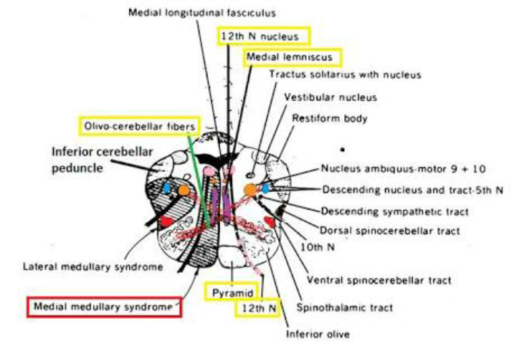

Slide 56
INFRANUCLEAR LESIONS
Fibers between the nucleus and the point of exit
Extramedullary, intracranial course of the nerve include disorders involving the meninges, SAH, neoplasms and schwannoma, inflammation, and trauma.
Processes involving the skull base - fractures, platybasia, Chiari malformation, increased intracranial pressure, or dislocation of the upper cervical vertebrae

Slide 57
Lesions along the clivus may cause bilateral hypoglossal palsies.
Combined CN VI and XII palsies are usually due to a lesion of the clivus, typically malignant, or to nasopharyngeal carcinoma (Godtfredsen’s syndrome).
Lesions near occipital condyle cause isolated hypoglossal palsy and a characteristic pain pattern (occipital condyle syndrome)
most often due to metastatic disease to the skull base.

Slide 58
Collet-Sicard syndrome
Paralysis of the trapezius and sternocleidomastoid muscles (XI)
Paralysis of the vocal cord and pharynx (cranial nerve IX, X)
Hemianesthesia of the palate, pharynx, and larynx (IX and X)
Hemiparalysis of the tongue (cranial nerve XII)
Loss of taste on the posterior third of the tongue (cranial nerve IX)
Notes:
CN XII may be involved with other lower CNs and the cervical sympathetics in lesions in the retroparotid space (Collet-Sicard or Villaret syndromes).

Slide 59
Extracranially
Trauma, carotid aneurysms vascular entrapment by the vertebral artery, tumors or infections in the retroparotid or retropharyngeal spaces, deep cervical adenopathy, cranial irradiation, and tumors involving the neck, tongue base, or salivary glands.
Idiopathic syndrome that resolves spontaneously.
Rarely, primary neural tumors involve CN XII extracranially.

Slide 60
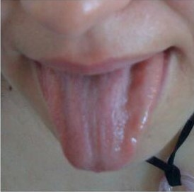
Unilaterally or bilaterally in Guillain-Barré syndrome, hereditary neuropathy with liability to pressure palsies
It has been reported as a manifestation of Lewis-Sumner syndrome
Tongue weakness and fatigability may occur in MG only severe involvement.- The triple furrowed appearance

Slide 61
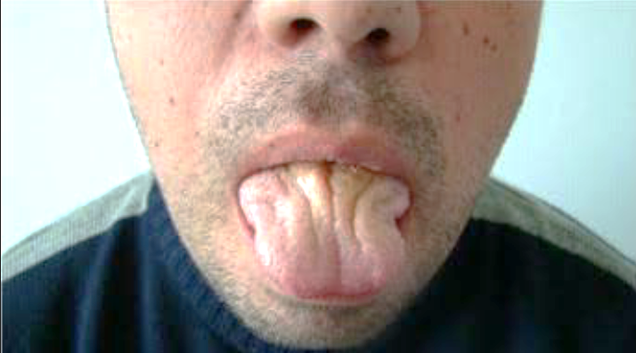
MYOTONIC DISORDERS
Place the edge of a tongue blade across the tongue, then percuss it sharply.
Myotonia may cause a temporary focal contraction along the line of percussion, causing the tongue to narrow sharply at that point.
Napkin ring sign.

Slide 62
DYSARTHRIA
Dysarthria refers to impaired speech due to abnormal neuromuscular control and is manifest by abnormalities of articulation, respiration, prosody, resonance of voice, and phonation.
Motor speech disorders may result from dysfunction at the UMN, LMN, cerebellar, extrapyramidal, or muscular level, with various characteristics of the dysarthria being of localizing value

Slide 63
Evaluation of three speech activities
Reading of a paragraph & evaluation of spontaneous speech
Vowel prolongation
Alternate motion rate of the lips, tongue, and mandible,
which is tested by having the patient repeat m, b, p (labial), t, l (lingual), and nk, ng (guttural or posterior aspect of the tongue) rapidly and evenly

Slide 64
Spastic dysarthria (from B/L UMN) has a
harsh, strained, or strangled quality
slow rate during contextual speech,
with slow, regular rate during alternate motion testing and
strained harshness with low pitch in attempting vowel prolongation.
Notes:
Flaccid – slurred and less distinct breathiness

Slide 65
When multiple levels of the neuraxis are affected, motor speech abnormalities are mixed
mixed flaccid and spastic dysarthria with amyotrophic lateral sclerosis
mixed spastic and ataxic dysarthria with multiple sclerosis; and
mixed spastic, ataxic, and hypokinetic dysarthria with Wilson's
Notes:
Patients with progressive supranuclear palsy may have predominantly spastic, hypokinetic, and ataxic components, or a mixed dysarthria with a combination of spastic, hypokinetic, and ataxic components

Slide 66
Flaccid dysarthria (multiple cranial nerve palsies) | Breathiness, red. loudness, hypernasality, stridor, short phrases, vowel prolongation | Breathiness, red. Loudness n duration | Red. duration of repetition, rate of repetitions normal, breathiness
Spastic dysarthria (bilateral UMN lesion) | Slow rate: harsh, strained, strangled; imprecise consonants; mono and low pitch; grunts at end of phrases; | Strained harshness, red. duration, low pitch | Slow, regular rate: reduced duration of syllable repetition
Ataxic dysarthria (cerebellar lesion) | Irregular, seemingly random breakdowns in articulatory precision: vowel distortions; excess and equal stress. |  | Constantly changing intervals between syllables, variation in duration and loudness
Hypokinetic dysarthria (parkinsonism) | Short rushes of speech: accelerated rate, monopitch, monoloudness, | Harshness, breathiness, low pitch | Rapid, imprecise repetition: sounds like continuous blur
Hyperkinetic dysarthria (chorea) | Variable rate, inappropriate silences, imprecise consonants, irregular articulatory breakdowns | linterruptions, voice strained and harsh | Irregularity and inability to sustain syllable repetitions
Notes:
Hyperkinetic dysarthria (Gilles de la Tourette)
Paroxysmal automatic or uncontrolled grunting, barking, coughing, throat clearing, whistling, etc.; occasional coprolalia

Slide 67

Thank You….

