Slide 1
IMAGE OF THE WEEK
DR AMRITA KURIAN

Slide 2
CASE HISTORY
16/ MALE
PRESENTING COMPLAINTS
Progressive weakness of both lower limbs since 4 years.

Slide 3
HISTORY OF PRESENT ILLNESS
Insidious onset, gradually progressive weakness of both lower limbs since 4 years
Started as tripping episodes while walking.
Difficulty in upsquatting, inserting undergarments , inserting feet into chappals , getting onto his bicycle.
At present he needs assistance to walk with c/o swaying while walking.

Slide 4
No difficulty to roll over in bed, or assuming sitting position in bed.
No symptoms of upper limb weakness .
No history s/o cranial nerve involvement.
No sensory symptoms.
No bowel or bladder disturbances.

Slide 5
PAST HISTORY
Delay in achieving language milestones , slurred speech
No delay in achieving motor milestones
Following an evaluation at the age of 6, mother was informed that the child was autistic

Slide 6
FAMILY HISTORY
h/o progressive paraparesis in 3 successive generations.
Grandmother, mother, maternal uncle and elder brother.
Younger age of onset in the succeeding generations.

Slide 7
EXAMINATION (POSITIVE FINDINGS)
Head to foot examination
Broader upper face with wide eyes
No neurocutaneous markers
Inverted feet

Slide 8
Central nervous system
HMF
Attention and concentration : normal
Speech : lingual dysarthria.
Writing : normal Education : class XI
Motor system
Bulk normal
Hypertonia of lower limbs

Slide 9
Power
  Upper limbs : 5
  Lower limbs - hip flexors and extensors : 3
  - hip adductors and abductors : 4
  - knee flexors :3
  - knee extensors: 4
  - plantar and dorsiflexion: 4
  - EHL and FHL :4

Slide 10
Deep tendon reflexes :3+ in lower limbs
Superficial abdominal reflex : absent
Plantars : extensor
Beevors sign : negative
Tests for co-ordination: normal
Sensory system : impaired vibration upto ankle.

Slide 11
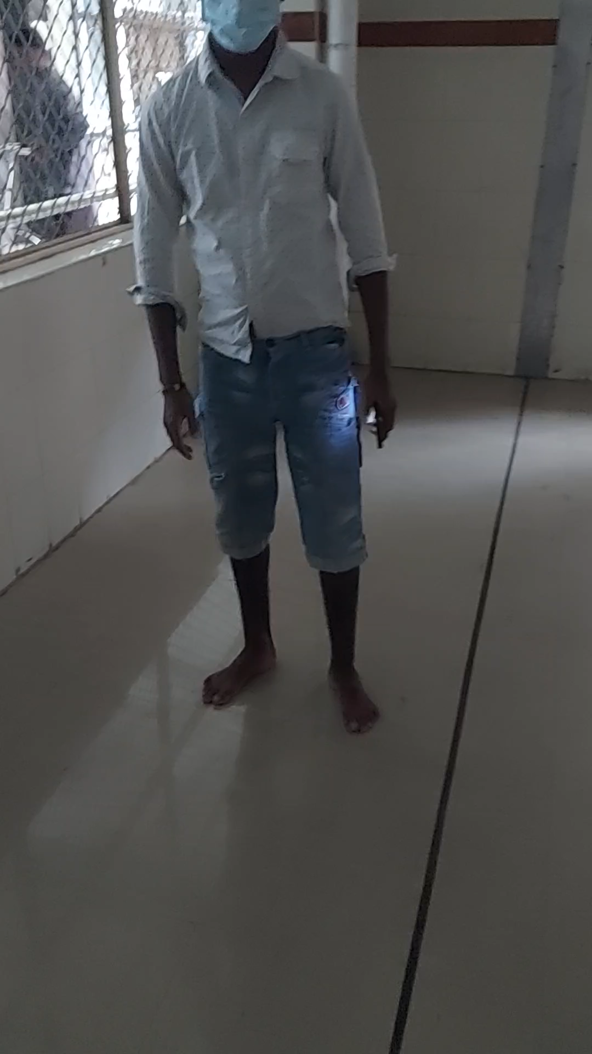
GAIT

Slide 12
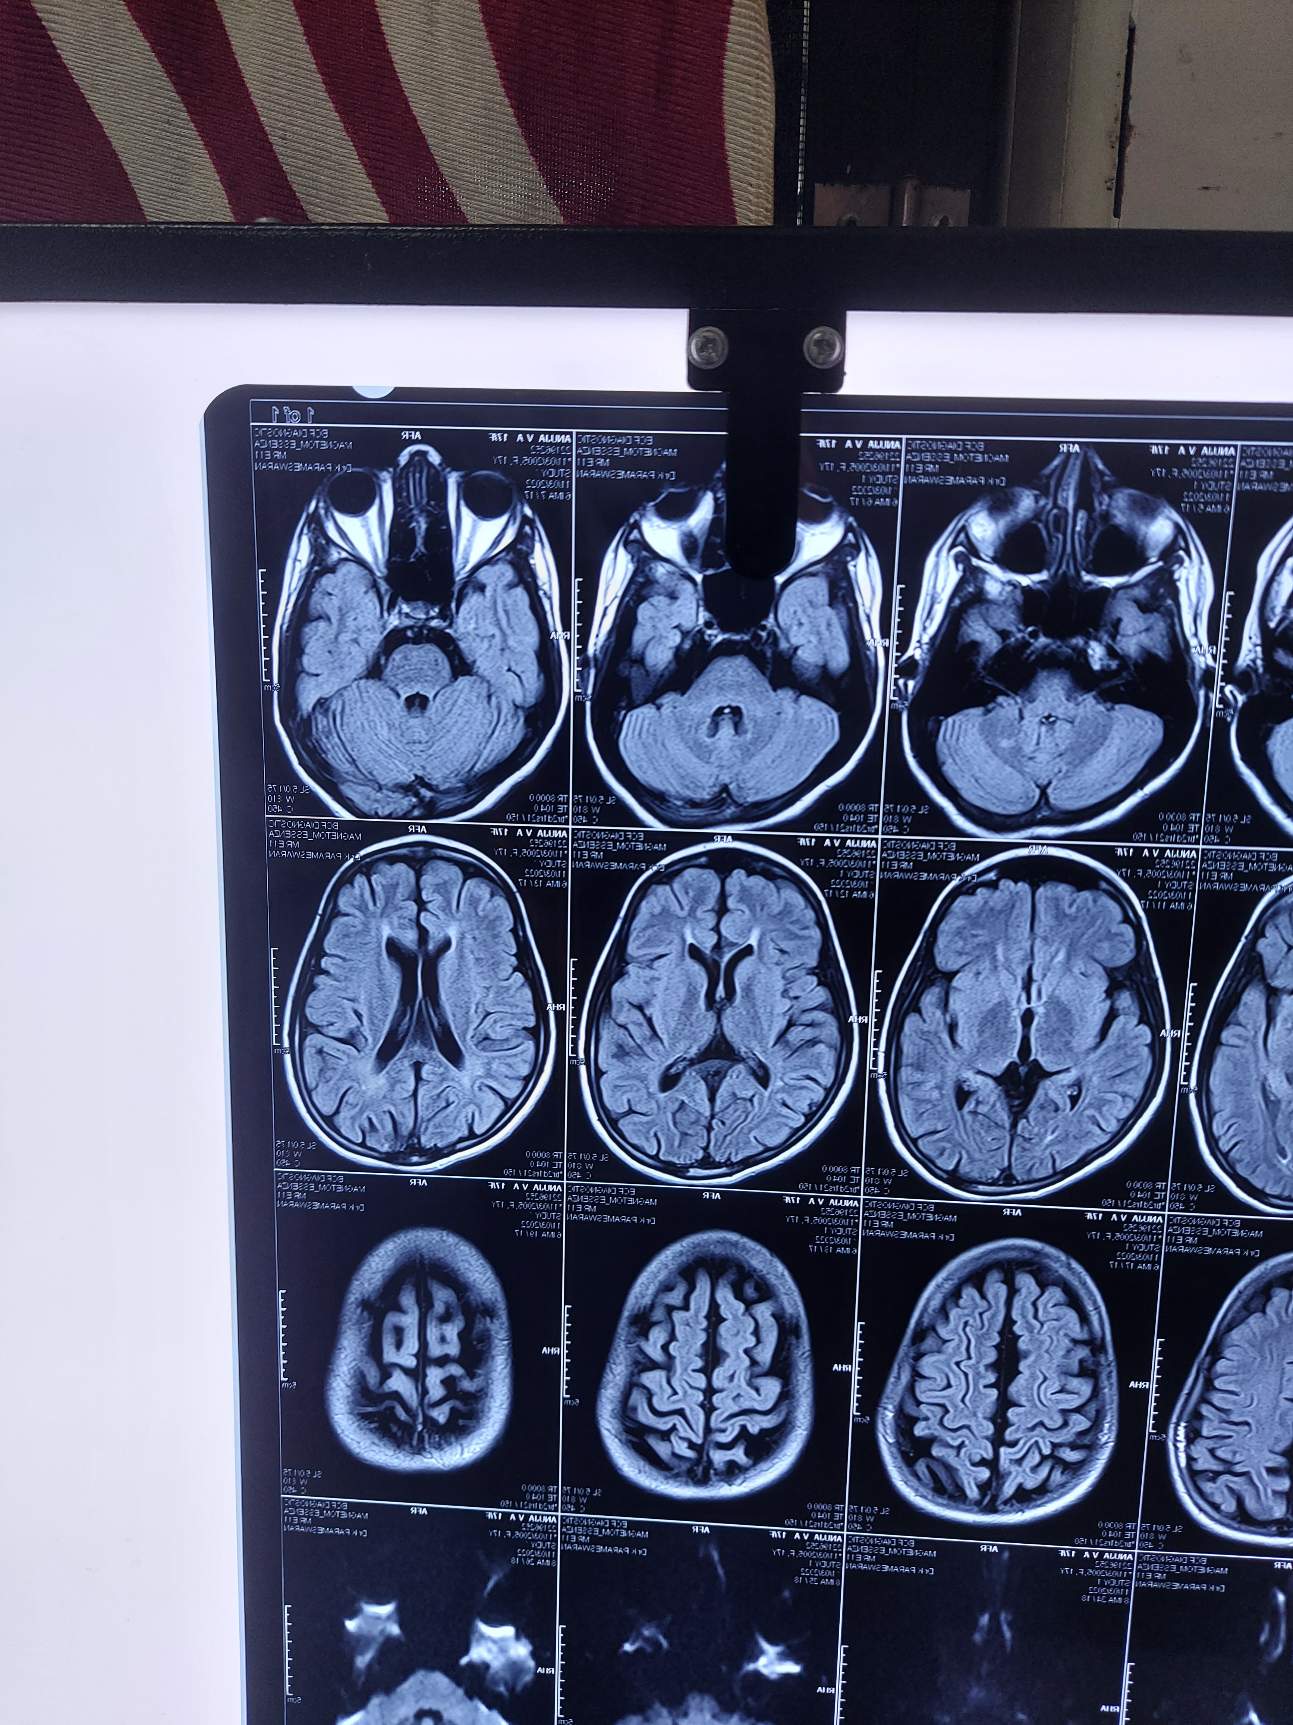
MRI BRAIN

Slide 13
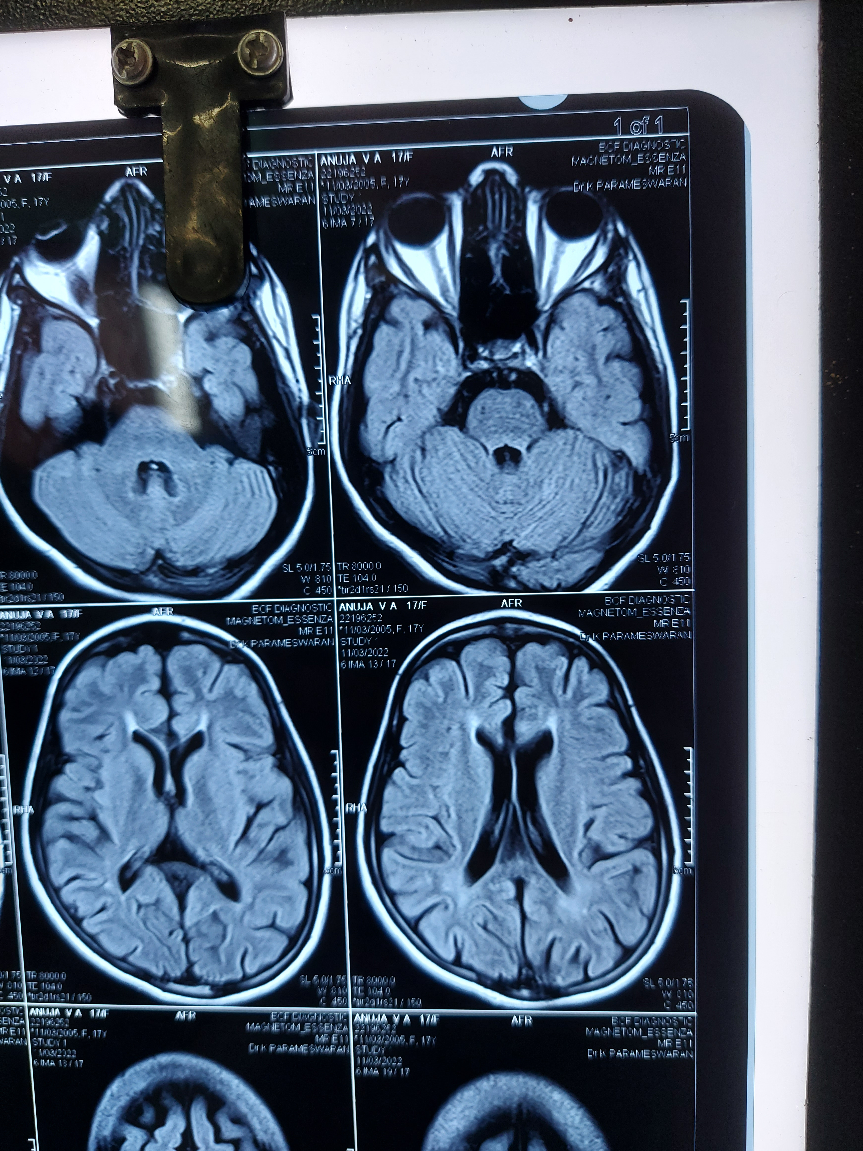

Slide 14
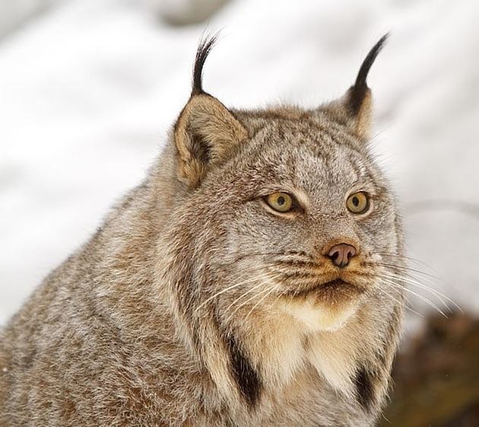
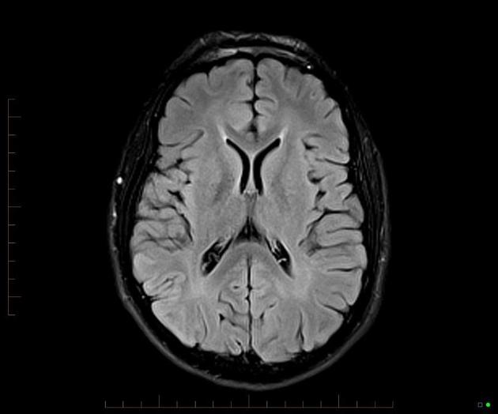
EARS OF THE LYNX SIGN

Slide 15
The ears of the lynx -
  abnormal T2/FLAIR cone-shaped hyperintensity at the tip of the frontal horn of the lateral ventricles
  in the region of forceps minor which resembles the tufts of hair crowning the ears of a lynx.

Slide 16
This sign is seen in
  hereditary spastic paraplegia with thin corpus callosum (HSP-TCC),
  the commonest form of which is spastic paraplegia
  mutation of spatacsin , beta glucosidase 2
  mos
The sign may also be seen in:
  Marchiafava-Bignami disease
  Progressive neurological disease in chronic alcoholics
  Corpus callosum demyelination and necrosis

Slide 17
HEREDITARY SPASTIC PARAPLEGIA
Autosomal dominant >autosomal recessive > X linked
Similar presentation in multiple family members
Symptoms usually begin in 3rd or 4th decade
Simple HSP :
  progressive spastic weakness beginning in lower limbs
  associated bladder and posterior column abnormalities

Slide 18
Complex HSP:
  Optic atrophy
  Mental retardation
  Seizures
  Dementia
  LMN features
  Sensory neuropathy
Pathology : degeneration of corticospinal tracts
Most common genes : SPASTIN , ATLASTIN

Slide 19
THANK YOU

