Slide 1
An Interesting ECG Rhythm
Dr Varsha S Nair

Slide 2
68 year old male.
k/c/o SHTN ,T2DM
Brought with h/o unknown poisoning - Herbal medicine.
Followed by c/o palpitation.

Slide 3
On examination
Conscious, oriented
BP 100/80 mm hg
PR -110/min
CVS – s1 s2 heard , no murmurs , no jvp
Respiratory system – normal vesicular breath sounds .
no adventitious sounds.
air entry bilaterally equal.

Slide 4
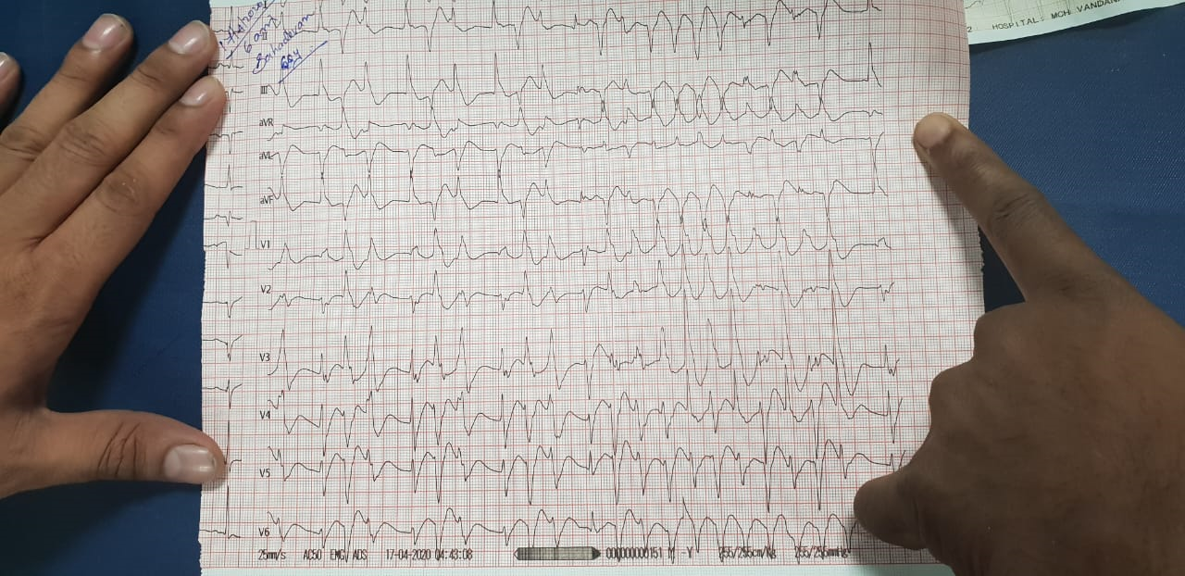

Slide 5
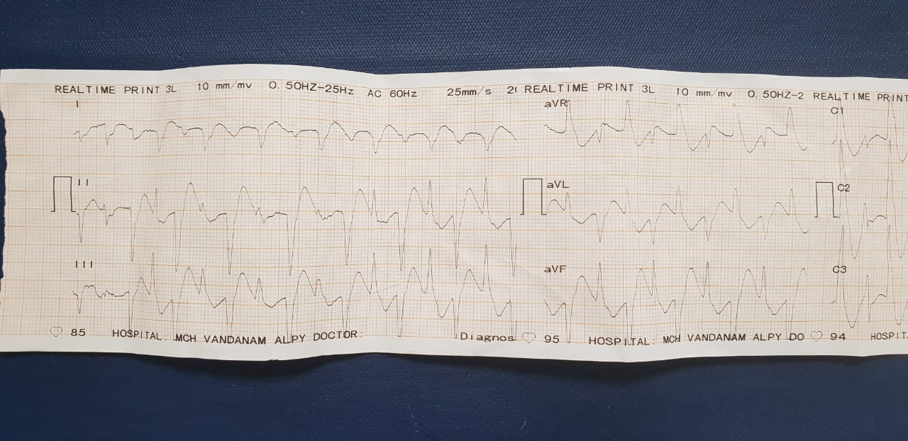

Slide 6
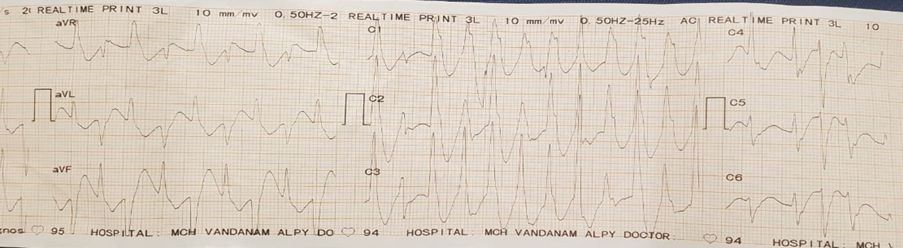

Slide 7
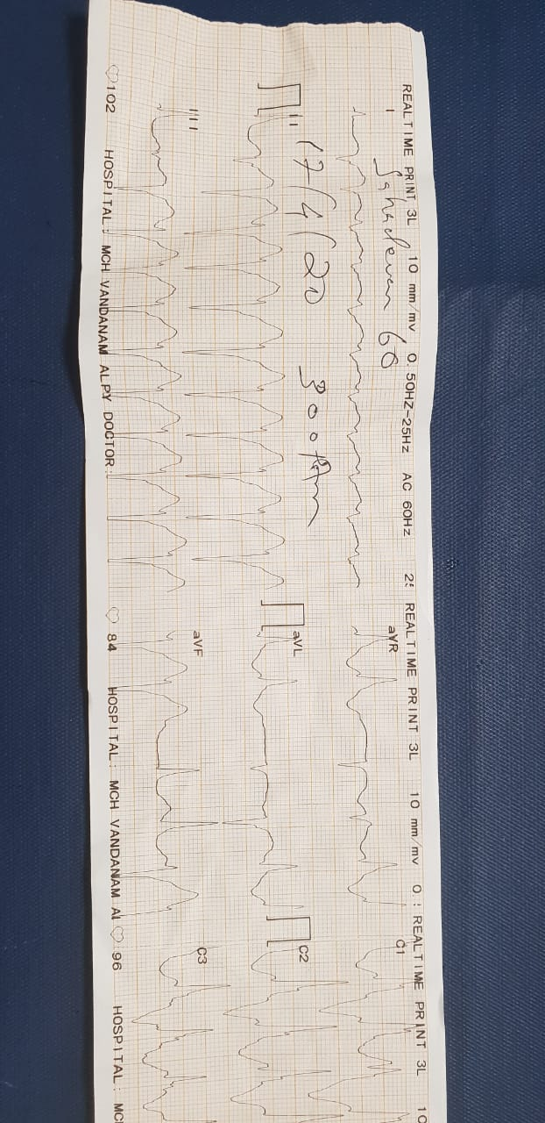

Slide 8
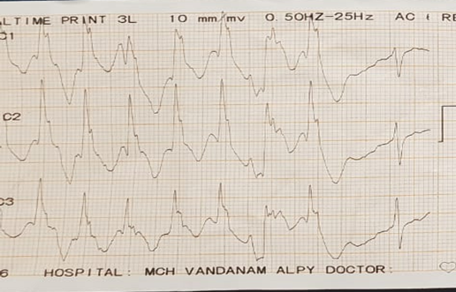
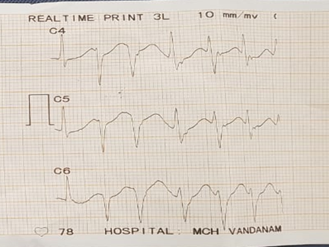

Slide 9
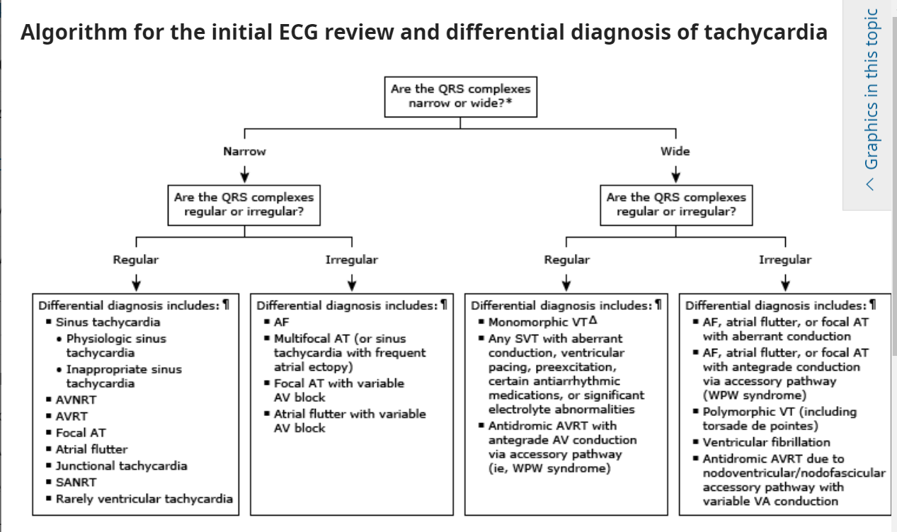

Slide 10
Causes of a wide QRS complex tachycardia
Ventricular tachycardia (VT)
Any type of supraventricular tachycardia (SVT) with a preexistent bundle branch block or a rate-related (functional) bundle branch block
Any SVT which occurs in a patient receiving an antiarrhythmic drug, primarily class IA or IC, or in a patient with severe hyperkalemia
Any SVT with antegrade conduction via an accessory pathway (Wolff-Parkinson-White syndrome)
Electronic pacemaker in certain specific settings

Slide 11
VENTRICULAR TACHYCARDIA
The occurrence of a series of three or more consecutive, abnormally shaped QRS complexes longer than 120 milliseconds, with the ST-T vector pointing opposite the major QRS deflection.
The R-R interval can be regular or varying.
Multiple morphologies originating at the same or closely adjacent sites with different exits, OR have multiple sites of origin.
Atrial activity can be independent of ventricular activity (AV dissociation), or the atria can be depolarized retrogradely (ventriculoatrial [VA] association).
Rates range from 70 to 250 beats/min

Slide 12
Onset can be paroxysmal (sudden) or nonparoxysmal.
QRS contours during the VT can be unchanging (uniform, monomorphic) or can vary randomly (multiform, polymorphic, or pleomorphic) in a more or less repetitive manner (torsades de pointes), in alternate complexes (bidirectional VT), or in a stable but changing contour (i.e., right bundle branch contour changing to a left bundle branch contour).
VT can be sustained- as lasting longer than 30 seconds or requiring termination because of hemodynamic collapse, or nonsustained when it stops spontaneously in less than 30 seconds.

Slide 13
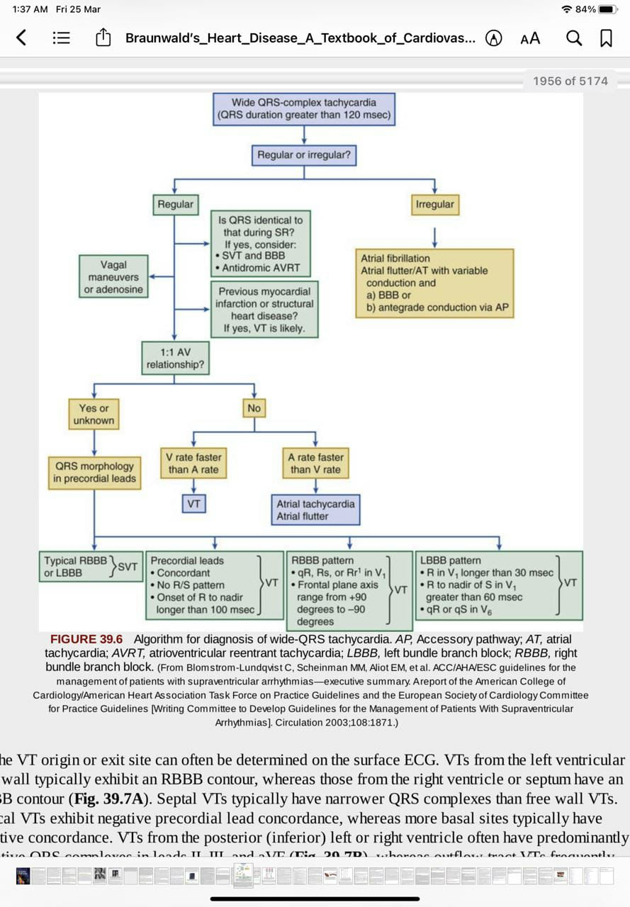

Slide 14
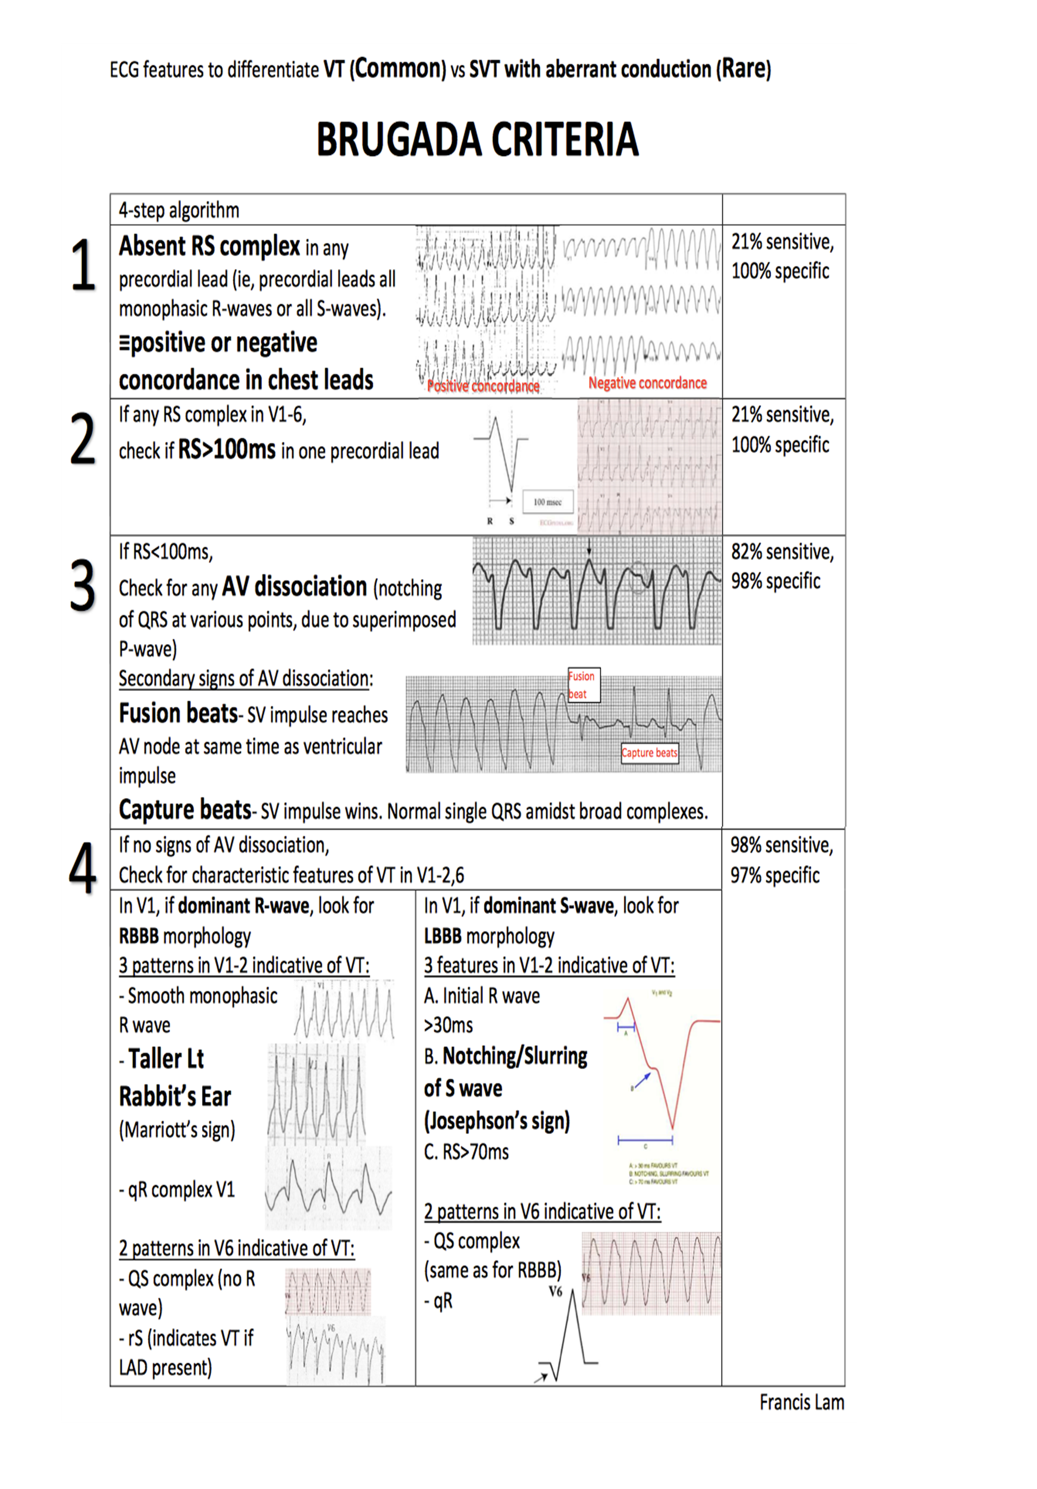
BRUGADA CRITERIA

Slide 15
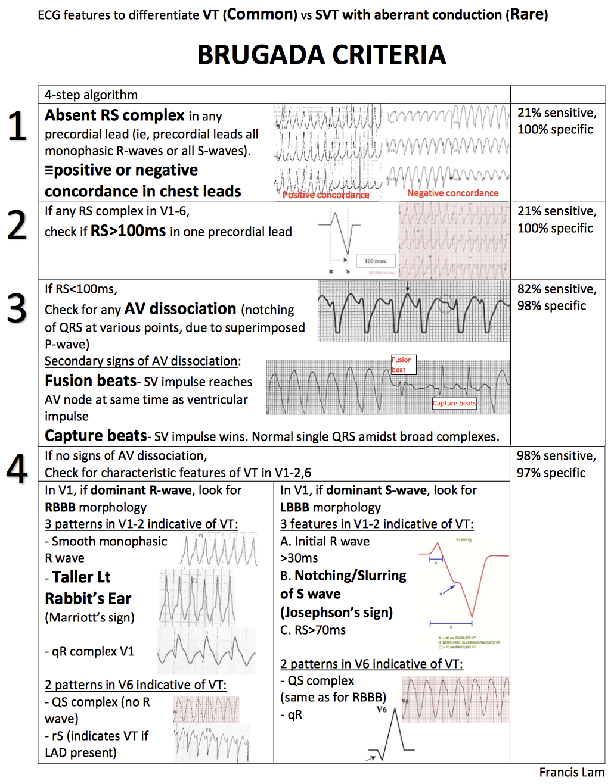
BRUGADA CRITERIA

Slide 17
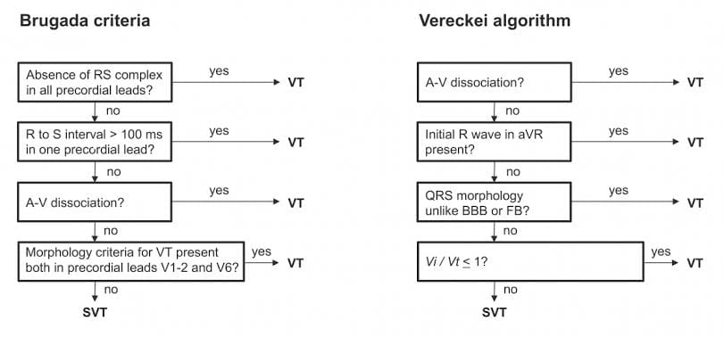

Slide 18
Identifying the VT origin
Location should be defined in 3 axes
    Septal vs lateral walls
    Superior vs inferior walls
    Apical vs basal regions
Bundle branch block patterns

Slide 19
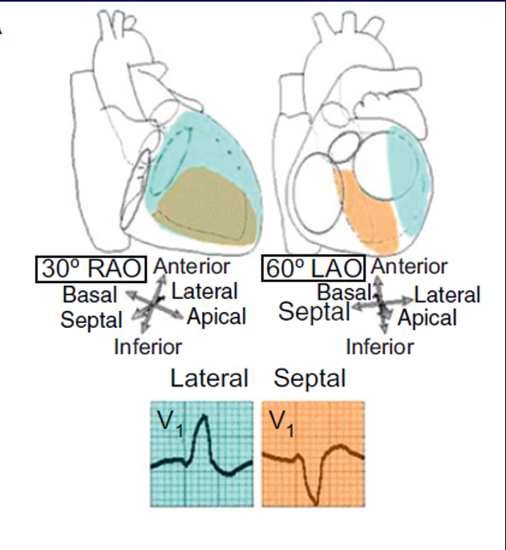
Lateral wall VT
    RBBB pattern
    Wider QRS complexes
Septal VT
    LBBB pattern
    Narrower QRS complexes

Slide 20
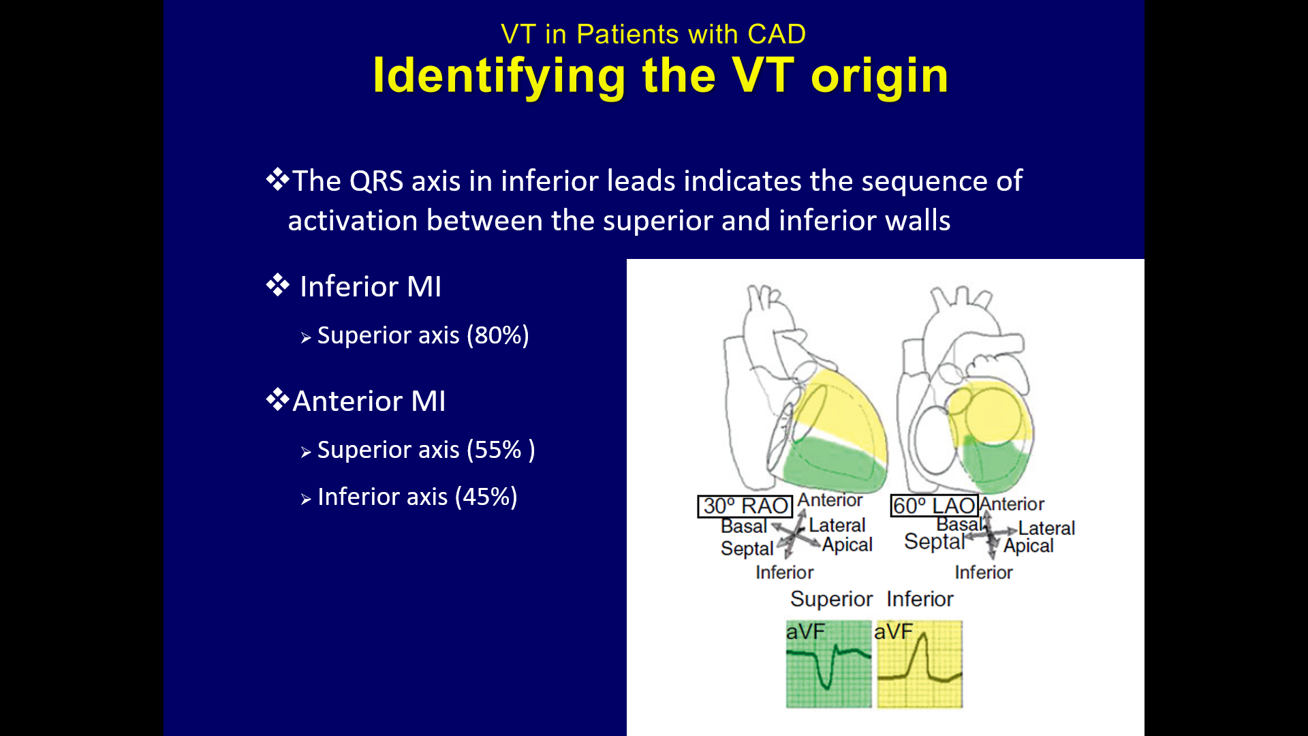
The QRS axis in inferior leads indicate the sequence of activation between the superior and inferior walls.
Inferior MI
    - SUPERIOR AXIS (80%)
Anterior MI
    SUPERIOR AXIS (55%)
    INFERIOR AXIS (45%)

Slide 21
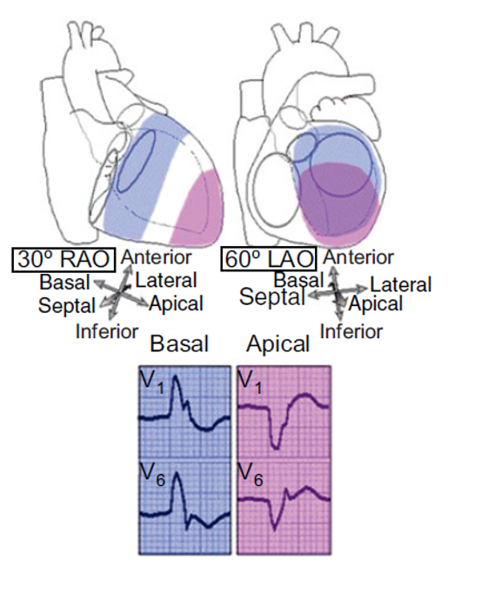
Predominant polarity of QRS complexes in precordial leads can help discriminate between VTs from the basal or the apical regions.
VT from the apex - negative concordant R progression.
VT from the basal – positive concordant R progression.

Slide 22
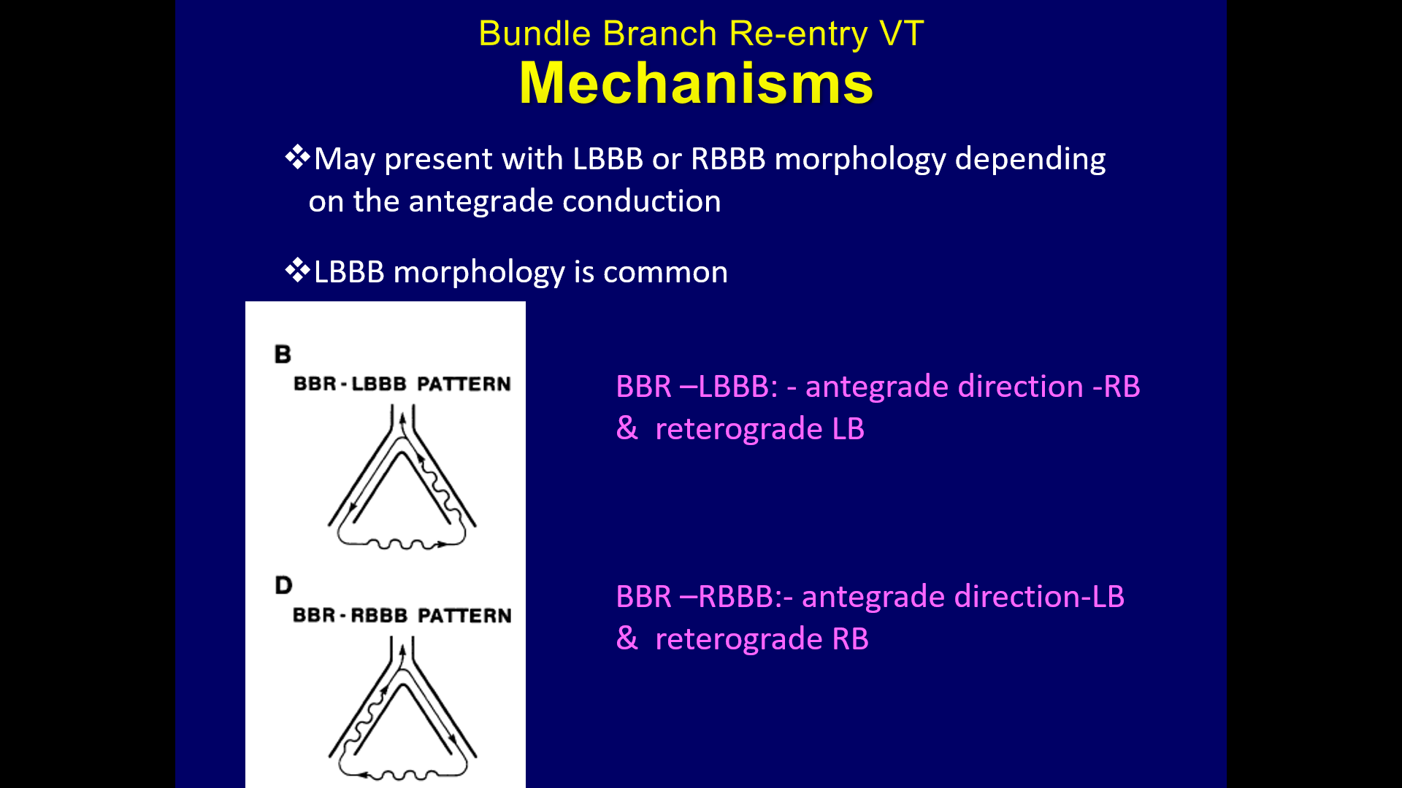
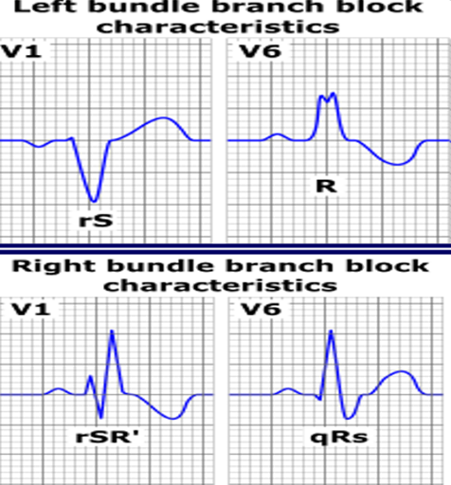
May present with LBBB or RBBB morphology depending on the antegrade conduction.
LBBB morphology : Antegrade direction- RB & Retrograde LB
BBR – LBBB : Antegrade direction –LB & Retrograde - RB

Slide 23
BI DIRECTIONAL VT
Rare ventricular dysrhythmia characterised by a beat-to-beat alternation of the frontal QRS axis. (QRS axis shifts 180 degrees from left to right with each alternate beat)
most commonly associated with severe digoxin toxicity.
Patients with familial catecholaminergic polymorphic ventricular tachycardia (CPVT)
BVT has also been reported with herbal aconite poisoning.

Slide 24
Treatment given
Inj magnesium sulphate.

Slide 25
THANK YOU

