Slide 1

BONE SO BRITTLE
CLINICAL CLUB – M2
03/02/2023
Dr. Varsha

Slide 2
Mrs. Sindhu
49 year old female
Home maker
Place : Alappuzha
DOA : 10/01/2023

Slide 3
Chief complaints:
One episode of generalized tonic clonic seizures followed by weakness of bilateral lower limb * 1 day

Slide 4
HISTORY OF PRESENT ILLNESS
One episode of seizure – generalized tonic clonic movements around 3 am on the day of admission
Up rolling of eye movements & froathing from mouth present.
Loss of consciousness for about 30 mins.
Unaware of the event.
No h/o loud cry /automatism
No h/o fall on to the ground/other trauma.
not associated with aura/tongue bite/ involuntary urination/ defecation/no external injuries.
H/o post ictal confusion.
Precipitating factor – sleep deprivation

Slide 5
f/b weakness of both lower limbs ,
Acute onset
Unable to lift both legs from the bed ,limited sidewise movements of leg
Difficulty to get up from the supine position on her own.
This was associated with pain in the lower back and bilateral hip region
Painful limitation of all movements of both lowerlimbs
No h/o any upper limb weakness/ truncal weakness
No h/o difficulty in speech
No h/o blurring of vison, ptosis, diplopia, facial asymmetry, hearing loss , dysphagia, nasal regurgitation, dysphonia, deviation of tongue ,vertigo, vomiting

Slide 6
No h/o numbness , loss of sensation or paresthesia
No h/o swaying while attempt to sit, no h/o overshooting acts or smearing of face while having food
No h/o headache, fever ,neck pain
No bladder / bowel symptoms
No h/o loss of weight , loss of appetite
No h/o bony pain/radicular pain

Slide 7
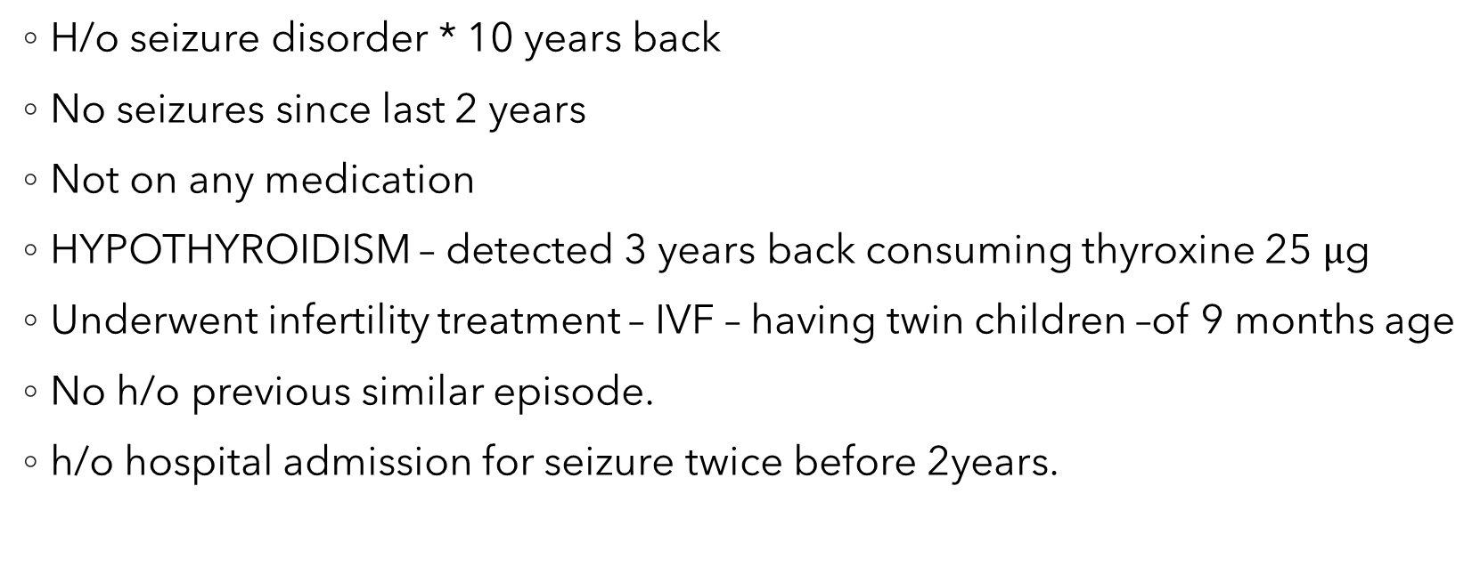
Past history
H/o seizure disorder * 10 years back
No seizures since last 2 years
Not on any medication
HYPOTHYROIDISM – detected 3 years back consuming thyroxine 25 $μ$g
Underwent infertility treatment – IVF – having twin children –of 9 months age
No h/o previous similar episode.
h/o hospital admission for seizure twice before 2years.

Slide 8
Personal history
Married at the age of 22 years
Peri menopausal
Lactating mother of twin children
Last child birth 9 months back
Taken infertility treatment from multiple centres .
No addictions
No h/o any drug allergy
Bladder / bowel habits – normal
Family history – GI malignancy to mother

Slide 9
General examination
Conscious, oriented, afebrile
Vitals :
PR -110/min, regular ,normal volume and character
all peripheral pulses palpable
SPO2-99@ RA, BP- 100/70 mm hg
RR – 18/’

Slide 10
Moderately built and nourished
Pallor +
No icterus ,cyanosis ,clubbing, pedal edema
No lymphadenopathy
No skin rashes
BMI-23.8kg/m2.
B/L hip tenderness present ,over iliac crest and PSIS
Oral hygiene – good, dental caries present.
Palate & posterior pharyngeal wall visualized- normal
No injuries to tongue / lip
No external injuries to head
Breast And Thyroid examination - normal

Slide 11
RESPIRATORY SYSTEM
Examination of abdomen.
Shape and symmetry – normal
No deformities.
No dilated veins
Chest expansion – 2cm
No spinal tenderness.
Normal vesicular breath sounds heard in all areas.
B/L rhonchi heard. No other added sounds.
Soft, no visible mass/scars
No warmth
No organomegaly
Bowel sounds heard.

Slide 12
Cardio-vascular system.
Central nervous system
HMF – NORMAL
PUPIL – B/L REACTIVE.
CRANIAL NERVES – NORMAL
TONE – Normal, Both lower limbs externally rotated.
Moving both upper limbs grade 5/5
Lower limbs grade 1/5 –B/L
Abdominal reflex present in all quadrants
B/L PLANTAR – flexor response
DTR 2+ In both UL & LL
No upperlimb incordination
No involuntary movements
No sensory signs
No meningeal signs
No vertebral tenderness
Apex – palpable in left 5 th intercostal space one cm medial to midclavicular line.
S1 and S2 heard.
No murmurs
JVP normal

Slide 13
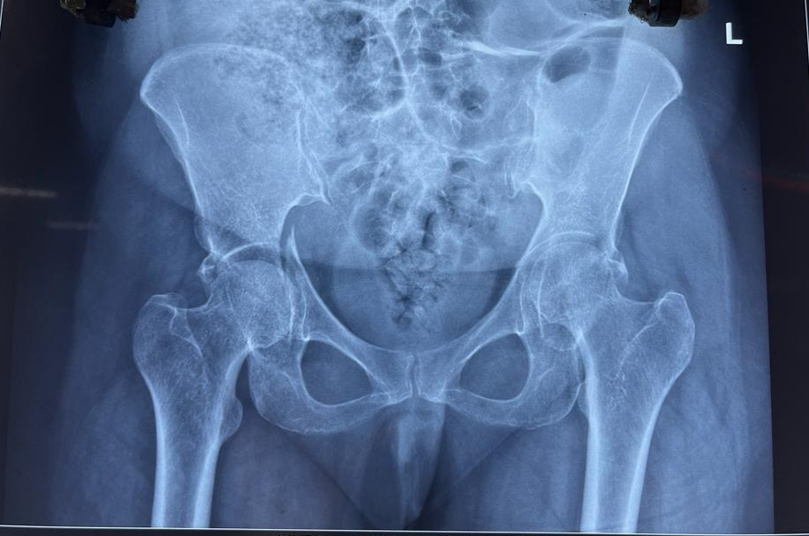
X – RAY
Pelvis

Slide 14
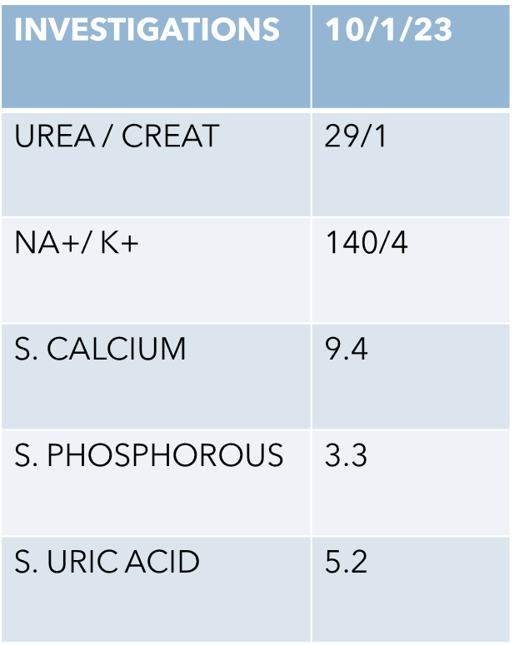
Investigations | 10/01/23
Hb | 9.1
Total count | 9800
DC | P 82 L 11 Mxd 7
PLATELET COUNT | 2.13 L
ESR | 155
MCV | 79.5

Slide 15
INVESTIGATIONS | 10/1/23
S. BILIRUBIN | 0.4
T. PROTEIN | 9.6
S.ALBUMIN | 3.5
SGOT / PT | 59/32
ALP | 146

Slide 16
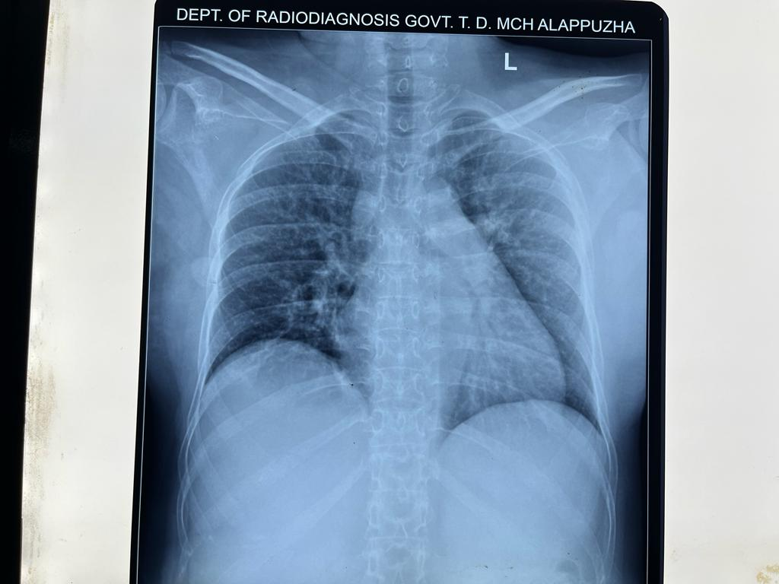
Chest X-RAY
PA view

Slide 17
CT BRAIN – no significant abnormality detected .
ECG – sinus tachycardia with VR @ 110/’, normal axis, no ST-T changes.
URE – ALB – TRACE, SUG – NIL, PUS CELL -10-15/hpf ,RBC – 1-2/hpf

Slide 18
NCCT PELVIS
Anterior and Posterior column fracture of acetabulum on both sides with superior extension into ileum. – Harris Coope type 2 B

Slide 19
Management
Loading dose of inj. Levetiracetam 1 gm → T. Levetiracetam 500 mg BD
T . Thyroxine 50 microgram OD
T . Tramadol (37.5mg) + Paracetamol (325 mg)bd
Packed red blood cell transfusion – 1 pint
CBD – Foley catheter
Proximal tibial skeletal traction – after orthopaedic consultation .
Neurology consultation sought – EEG taken.

Slide 20
Peripheral smear
Normocytic normochromic anemia
Reticulocyte count < 0.5%
Relative neutrophilia
Reactive lymphocytes seen

Slide 21
INVESTIGATIONS
TSH | 14.1
S. FERRITIN | 201.9
TSAT | 13.4%
S.IRON | 55
TIBC | 409
VIT D3 | 37.09 (N)
iPTH | 48.5 pg/mL(N)
S. Mg2+ | 2 mg/dL
Stool occult blood | negative

Slide 22
EEG (14/1/23) – NORMAL
URE – ALB – TRACE, SUG – NIL, PUS CELL -10-15/hpf ,RBC – 1-2/hpf
URINE PCR – 0.5 :1
Tumor markers ( CEA,CA 19-9,CA 125,AFP ) - Negative

Slide 23
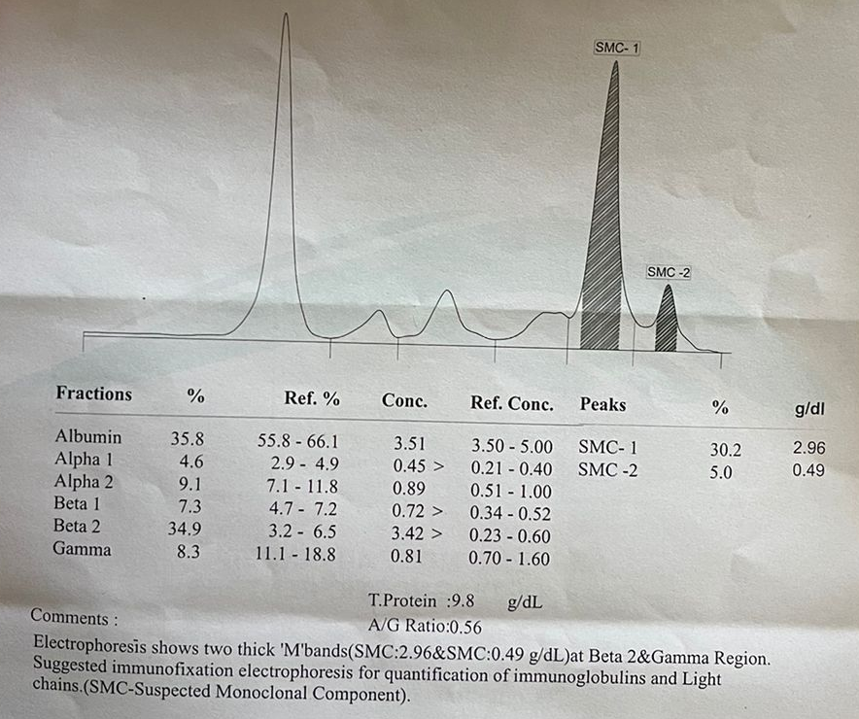
SPEP –
M BAND – POSITIVE
(2.96 gm/dl)

Slide 24
Serum immunofixation and free light chain assay
Kappa / lambda ratio – 45.06 ( 0.26 – 1.65 )
IgG – 596.07 ( 700 – 1600)
IgM – 43.83 (40 -230)
IgA – 455.62 (70-400)
IgA Kappa Monoclonal gammopathy.

Slide 25
Investigations | 10/01/23 | 20/01/23
Hb | 9.1 | 7.6
Total count | 9800 | 6280
DC | P 82 L 11 Mxd 7 | P 91 L 6.5 Mxd 3
PLATELET COUNT | 2.13 L | 4.3 L
ESR | 155
MCV | 80.5

Slide 26
INVESTIGATIONS | 10/1/23 | 11/1/23 | 14/1/23 | 20/1/23 | 31/1/23
UREA / CREAT | 29/1 | 34/1 | 32/1 | 31/0.9 | 42/0.7
NA+/ K+ | 140/4 | 130/4.4 |  | 129/4.6
S. CALCIUM | 9.4 | 9.34 | 9.2 | 9.4
S. PHOSPHOROUS | 3.3 |  | 4.3 | 4.2
S. URIC ACID | 5.2 |  | 4.8 | 4.9

Slide 27
INVESTIGATIONS | 10/1/23 | 11/1/23 | 12/1/23 | 16/1/23
S. BILIRUBIN | 0.4 | 0.5
T. PROTEIN | 9.6 | 9 | 8.8 | 9.8
S.ALBUMIN | 3.5 | 3.2 | 3.1 | 3.5
SGOT / PT | 59/32 | 62/45
ALP | 146 | 133

Slide 28
BONE MARROW ASPIRATION AND BIOPSY
Pauci cellular marrow shows predominantly blood.
Biopsy : section shows spicules of cancellous bone and adipose tissue. No hematopoietic elements seen.

Slide 29
Whole body PET scan

Slide 30
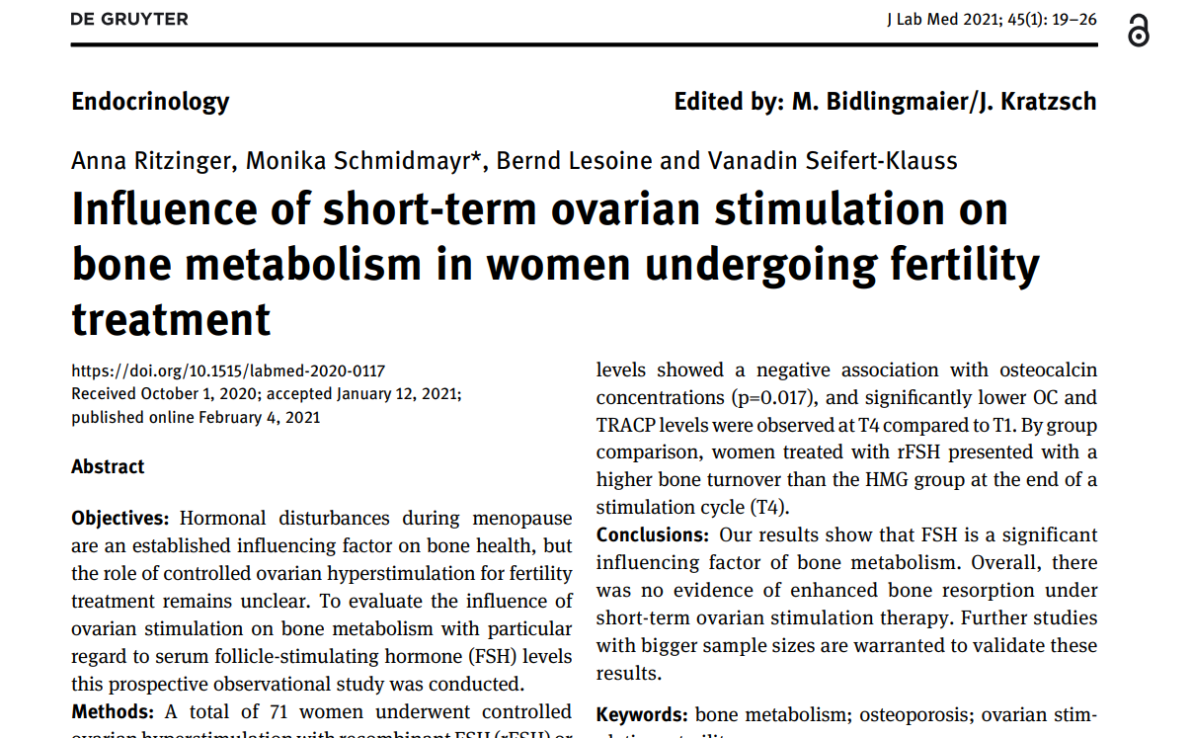

Slide 31
OSTEOPOROSIS
It is characterized by low bone mass, microarchitectural disruption, and skeletal fragility, resulting in decreased bone strength and an increased risk of fracture.
A clinical diagnosis of osteoporosis may be made in the presence of
Fragility fracture, particularly at the spine, hip, wrist, humerus, rib, and pelvis
or
T-score ≤-2.5 standard deviations (SDs) at any site based upon bone mineral density (BMD) measurement by dual-energy x-ray absorptiometry (DXA) .

Slide 32
Fragility fracture
A clinical diagnosis of osteoporosis may be made in the presence of a fragility fracture, particularly at the spine, hip, wrist, humerus, rib, and pelvis, without measurement of BMD.
Those occurring spontaneously or from minor trauma, such as a fall from a standing height or less.
These result from mechanical forces that would not ordinarily result in fracture.
The most common sites of fragility fracture are the spine (vertebral compression fractures), hip, and wrist. Fragility fractures also occur at the humerus, rib, and pelvis.

Slide 33
Causes of osteoporosis
Marrow-related disorders
Amyloidosis
Hemochromatosis
Hemophilia
Leukemia
Lymphoma
Masto cytosis
Multiple myeloma /MGUS/SMM
Pernicious anemia
Sarcoidosis
Sickle cell anemia
Thalassemia
Drugs
Glucocorticoids
Immunosuppressants (cyclosporine)
Antiseizure medications (particularly phenobarbital and phenytoin)
Aromatase inhibitors
GnRH agonists and antagonists
Heparin
Cancer chemotherapy

Slide 34
Endocrine disorders
Acromegaly
Adrenal insufficiency
Cushing's syndrome
Eating disorders
Endometriosis
Hyperparathyroidism
Hyperprolactinemia
Hyperthyroidism
Hypogonadism (primary or secondary)
Diabetes mellitus
Gastrointestinal disease/nutritional disorders
Alcohol-related liver disease
Celiac disease
Chronic active hepatitis
Chronic cholestatic diseases
Gastrectomy
Inflammatory bowel disease
Jejunoileal bypass
Malabsorption syndromes
Pancreatic insufficiency

Slide 35
Organ transplantation
Bone marrow
Heart
Kidney
Liver
Lung
Genetic disorders
Hypophosphatasia
Osteogenesis imperfecta
Homocystinuria due to cystathionine
deficiency
Miscellaneous causes
Ankylosing spondylitis
Chronic obstructive pulmonary disease
Epidermolysis bullosa
Idiopathic hypercalciuria
Multiple sclerosis
Rheumatoid arthritis

Slide 36
Lifestyle measures —
adequate calcium and vitamin D, exercise, smoking cessation, counseling on fall prevention, and avoidance of heavy alcohol use.
Pharmacological therapy-
oral bisphosphonates (over other osteoporosis drugs) as initial therapy
either alendronate or risedronate as the initial choice of bisphosphonate
Zoledronic acid administered intravenously should be used instead of a bisphosphonate administered orally in patients who have esophageal disorders, GI intolerance to oral bisphosphonates.

Slide 37
Monoclonal gammopathy of undetermined significance (MGUS)
It is a clinically asymptomatic premalignant clonal plasma cell or lymphoplasmacytic proliferative disorder.
Defined by the presence of a serum monoclonal protein (M protein) at a concentration <3 g/dL, a bone marrow with <10 percent monoclonal plasma cells, and absence of end organ damage (lytic bone lesions, anemia, hypercalcemia, renal insufficiency, hyperviscosity) related to the proliferative process

Slide 38
CLINICAL TYPES OF MGUS
Non-IgM MGUS (IgG, IgA, or IgD MGUS) – most common subtype of MGUS and has the potential to progress to smoldering (asymptomatic) multiple myeloma and to symptomatic multiple myeloma.
IgM MGUS – approximately 15 percent of MGUS cases. It is considered separately from the non-IgM MGUS because it has the potential to progress to smoldering Waldenström macroglobulinemia and to symptomatic Waldenström macroglobulinemia.
Light chain MGUS (LC-MGUS) –unique subtype of MGUS in which the secreted M protein lacks the immunoglobulin heavy chain component. LC-MGUS may progress to light chain smoldering multiple myeloma (idiopathic Bence Jones proteinuria) and to light chain multiple myeloma, AL amyloidosis, or light chain deposition disease.

Slide 39
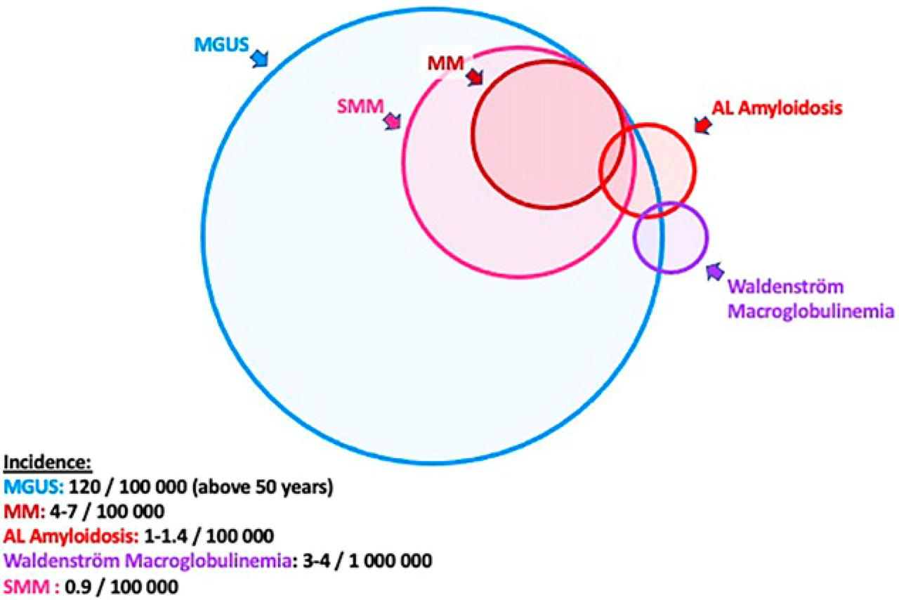

Slide 40
EVALUATION
The diagnosis of MGUS is usually incidental when a monoclonal (M) protein <3 g/dL (30 g/L) is found as part of the evaluation of another disorder, such as unexplained age-inappropriate bone loss, unexplained proteinuria, an elevated total protein in the blood, or peripheral neuropathy without a defined etiology.
Complete blood count
Serum calcium and creatinine
Serum protein electrophoresis and immunofixation
Serum free light chain (FLC) assay
Quantitative immunoglobulin

Slide 41
Imaging and bone marrow evaluation — Imaging and bone marrow evaluation are indicated for to evaluate for multiple myeloma.
Cross sectional imaging –
Whole body low dose computed tomography (CT) without contrast or whole body magnetic resonance imaging (MRI) for most patients with MGUS. These modalities are more sensitive than plain radiographs for the detection of most skeletal lesions in myeloma

Slide 42
DIFFERENTIAL DIAGNOSIS
1.MULTIPLE MYELOMA :
Clonal bone marrow plasma cells ≥10 percent or biopsy-proven bony or soft tissue plasmacytoma –
Plus one of the following:
Presence of related organ or tissue impairment (often recalled by the acronym CRAB) – End-organ damage is suggested by increased plasma calcium level, renal insufficiency (kidney impairment), anemia, and bone lesions

Slide 43
For these purposes, the following definitions are used:
Anemia – Hemoglobin <10 g/dL
Hypercalcemia – Serum calcium >11 mg/dL
Renal insufficiency (kidney impairment) – Estimated or measured creatinine clearance <40 mL/min or serum creatinine >2 mg/dL
Bone lesions – One or more osteolytic lesions ≥5 mm in size on skeletal radiography, magnetic resonance imaging (MRI), computed tomography (CT), or combined positron emission tomography/computed tomography (PET/CT).
Manifestations of non-CRAB end-organ damage (eg, hyperviscosity, recurrent bacterial infections, AL amyloidosis, peripheral neuropathy) are nonspecific and not diagnostic of MM.

Slide 44
●Presence of a biomarker associated with near inevitable progression to end-organ damage
•≥60 percent clonal plasma cells in the bone marrow
•Involved/uninvolved FLC ratio of 100 or more (provided involved FLC level is at least 100 mg/L)
•MRI with more than one focal lesion (involving bone or bone marrow)

Slide 45
2. Smoldering multiple myeloma
M protein ≥3 g/dL and/or 10 to 60 percent bone marrow plasma cells, plus
No end-organ damage or other myeloma-defining events, and no amyloidosis
Thus, for the diagnosis of SMM, patients should not have any of the myeloma-defining events:

Slide 46
3. Waldenström macroglobulinemia
lymphoplasmacytic lymphoma (LPL) in the bone marrow with an IgM monoclonal gammopathy in the blood.
Patients may present with symptoms related to the infiltration of the hematopoietic or other tissues (eg, anemia, lymphadenopathy, hepatosplenomegaly) or the effects of monoclonal IgM in the blood (eg, hyperviscosity, peripheral neuropathy)

Slide 47
4. AL amyloidosis and light chain deposition disease
Primary (amyloid light chain) amyloidosis and light chain deposition disease are plasma cell proliferative disorders associated with the pathologic deposition of monoclonal light chains.
In primary (AL) amyloidosis, there is deposition of linear non-branching fibrils that are derived from monoclonal immunoglobulin light chains.
The deposition of these fibrils within organs can produce the nephrotic syndrome, heart failure, hepatomegaly, vascular fragility and abnormal coagulation times with associated excess bruising, and other findings that are not seen in MGUS

Slide 48
5. POEMS syndrome —
Osteosclerotic myeloma: Polyneuropathy, Organomegaly, Endocrinopathy, Monoclonal protein, Skin changes) is a monoclonal plasma cell disorder accompanied by symptoms and/or signs of peripheral neuropathy, osteosclerotic lesions, Castleman disease, organomegaly, endocrinopathy (excluding diabetes mellitus or hypothyroidism), edema, typical skin changes, and/or papilledema.

Slide 49
6. Metastatic carcinoma — The presence of lytic bone lesions in a patient with a monoclonal gammopathy suggests the possibility of MM.
However, metastatic carcinoma (eg, kidney, breast, non-small cell lung cancer) can produce lytic lesions,
a subset of patients will have metastatic cancer with an associated, unrelated monoclonal gammopathy (eg, MGUS).

Slide 50
