Slide 1
An Interesting case of diarrhea
DR VARSHA S NAIR, JR2
* See slide notes for page directions
Notes:
When listing all project collaborators, either use commas or bullets

Slide 2
Mr. Bhadran
72/M
From mannanchery, north aryadu.
Farmer
DOA: 04/03/2022
M5 casualty

Slide 3
Presenting complaint :
c/o loose stools * 1 month
c/o breathlessness * 1 day

Slide 4
History of presenting illness
c/o breathlessness since 10 pm ,on the day of admission
  Acute onset
  a/w orthopnoea
  a/w profused sweating
  a/w chest pain- retrosternal as heaviness , non radiating
  No h/o pnd
  No h/o fever
  No h/o cough with expectoration

Slide 5
History of presenting illness
c/o loose stools since 4 weeks,
  insidious onset
  gradually increasing in frequency
  8-10 episodes/day
  small volume
  watery in consistency
  occasional passage of blood in stools
  not a/w mucus
  no h/o blackish tarry stools
  associated with tenesmus
  a/w abdominal pain- spasmodic in nature in the left lower part of abdomen.
  No h/o fecal incontinence

Slide 6
History of presenting illness
h/o loss of weight
h/o loss of appetite.
No h/o hematuria
No h/o decreased urine output
No h/o vomiting
No h/o yellowish discolorations of eyes

Slide 7
Past history
k/c/o T2DM * 10 years on inj . Insulin
SHTN * 8 years on regular medications
No h/o drug default
CAD old ACS – CAG – TVD ,advised CABG – not done
h/o covid infection 2 months back in January 2022 , category c . Admitted and treated in the hospital for 6 days. Received iv medications.
Right diabetic foot ulcer – h/o admission in local hospital , 3rd week of January ,h/o iv antibiotics.

Slide 8
FAMILY HISTORY
Family h/o T2DM for his mother, detected when she was 35 yrs old, now on OHA
No family h/o CAD
No H/o similar illness in the family.

Slide 9
Personal history
Sleep, appetite – decreased
Mixed diet
Bladder – normal
Non smoker
Reformed ethanolic
No h/o any illicit drug use/indigenous medications/ unusual food intake.

Slide 10
Clinical
Examination
O/E
Conscious,oriented
Moderately built and poorly nourished
Ht- 170cm, wt -60 kg, BMI 20.8kg/m2
Pallor present
No icterus/ clubbing/cyanosis/Lymphadenopathy/pedal edema
Tongue dry ,skin turgor goes back slowly – dehydration +

Slide 11
Vitals
Pulse – 72/min, regular ,normal volume and character , condition of vessel wall –good, no radioradial or radio femoral delay, absent radial peripheral pulse in right upper limb, all other peripheral pulses are palpable
BP – 110/70 mmHg in lying down position in left upperlimb.
RR – 20/MIN, REGULAR , abdomino- thoracic
Temp – afebrile

Slide 12
Local examination
Diabetic foot ulcer –right foot
Ulcer of size 2*3 cm over medial side of right ankle.
Ulcer of size 1*2 cm on base of right big toe.
Ulcer between big toe and second toe right foot
Healthy , granulation tissue present, no pus discharge.

Slide 13
Gastro intestinal system examination
Lips, oral cavity, tongue, pharynx – normal
Abdomen- not distended
P/A – soft, tenderness in left iliac fossa and epigastrium
No hepatosplenomegaly
Liver span – 14 cm
Traubes space- tympanic
Normal bowel sounds heard.

Slide 14
Respiratory system examination
trachea central
chest movements equal on both sides
vesicular breath sounds heard equally over all areas
no bronchial breathing.
Fine inspiratory crepitations heard in b/l basal region.

Slide 15
Cardiovascular system examination
Precordium – normal. JVP not elevated
Apical impulse – left 5th intercostal space 1.5 cm medial to midcalvicular line
No significant palpatory findings
S1, S2 heard, normal
No murmurs or additional heart sounds.

Slide 16
CNS
Examination
Higher mental functions normal
Cranial nerves - wnl
No sensory or motor deficits
No signs of incoordination
Spine and cranium – normal
No flap

Slide 17
INVESTIGATIONS
Day 1- 4/3/22
Day 4 -7/3/22
HB : 8.8 g/dl
TC : 15600
DC : P 82% L 14%
PLATELET COUNT :2.57 L
PCV : 25.7
MCV : 81.8
RDW : 16.1
ESR : 80
HB : 9.3 g/dl
TC : 13300
DC : P 70% L 26%
PLATELET COUNT : 2.66 L
PCV : 27.5
MCV : 82.6
PERIPHERAL SMEAR (5/3/22)
Microcytic hypochromic anemia
Polychromatic cells seen
Neutrophilia with shift to left
Toxic granules seen
Platelets adequate.
Notes:
Think about the questions/situations listed above and answer them.
Can you think of anything else in regards to transportation that you would like to add?

Slide 18
INVESTIGATIONS
Day 1 -Trop I – 0.770 (+)
Day 2 – trop I – 1.45 (+)
NT PRO BNP - 9538
4/3/22
7/3/22
5/3/22
Ur/cr – 28/1.1
Na+/K+ - 138/3.3
S Bil – 1.6
SGOT/PT/ALP – 39/15/95
T.Pr/S Alb -6.1/2.8
RBS -298
S Ca2+ - 7.7 (8.66)
S.Ph -1.7
S UA -5.4
Ur/cr – 30/1.1
Na+/K+ - 137/3.4
S Bil – 0.7
SGOT/PT/ALP – 69/28/156
T.Pr/S Alb -5.4/2.5
PT-14.3 INR -1.07
URE – Alb +, sug – nil, pc 2-4 /hpf
TSH – 0.862
FT3 – 2.11
FT4 – 1.76
FBS – 215
S.Chol- 94, tgl -85,hdl/ldl – 25/52

Slide 19
Investigations
S amylase -33
S lipase - 18
S CEA – 1.81
AFP – 2.58
CA 19-9 -19.21
CXR –WNL
ECG – NSR @100/’, qs III , Avf ST I,AVL,V5-V6
Stool R/E – ova ,cyst ,trophozoite – not present
Stool c&s – no specific organism isolated
HBSAG
HIV NON REACTIVE
ANTI HCV
IRON STUDIES
TSAT – 25% (20-50)
TIBC – 305 (250-450)
S.Iron – 77 ( 60-130)
S .Ferritin – 907.5 ( 30 -400)
Fecal calprotectin - absent

Slide 20
Investigations
ECHO – (14/3/22)
RIGHT UL ARTERIAL DOPPLER
S/O echogenic thrombus in right mid and distal radial artery.
RWMA ,Global LV hypokinesia with preserved thickness.
CAD –AWMI(? Multivessel disease)
Mild LV systolic dysfunction
LVDD grade I
USG abdomen
Large bowel loop in LIF and sigmoid colon shows circumferntial wall thickening -8mm noted.
Notes:
What is the name of your colony song?
Write lyrics to the song and, if you are feeling creative, use a computer program or instruments to create the music that goes along with it!
To insert an audio file, click on Recording -> Audio -> Audio on My PC and choose your file

Slide 21
Patient was initially heparinized and treated with diuretics, dual antiplatelets, ACE inhibitors, statins, inj insulin, inj ceftriaxone and inj metronidazole.
As patient went into hypotension ace inhibitors and diuretics stopped in v/o persistent diarrhea.
Heparin was withheld in v/o bleeding pr.
Potassium supplements were given.
As there was suspicion of CDI ,3rd generation cephalosporin was stopped on the 3rd day.
Gastro consultation given and added on probiotics and rifaximine.
The patient was posted for colonoscopy.

Slide 22
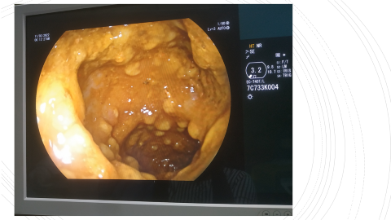
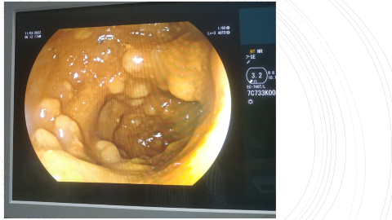
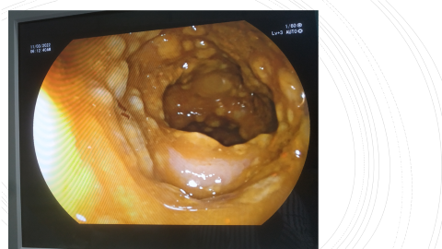
FLEXIBLE
SIGMOIDOSCOPY
DONE ON 09/03/2022
PREPARATION – INADEQUATE
P/R EXAMINATION – NORMAL
SCOPE passed up to descending colon
Findings: multiple raised yellowish exudate covered lesions seen throughout visualized mucosa suggestive of PSEUDOMEMBRANOUS COLITIS

Slide 23
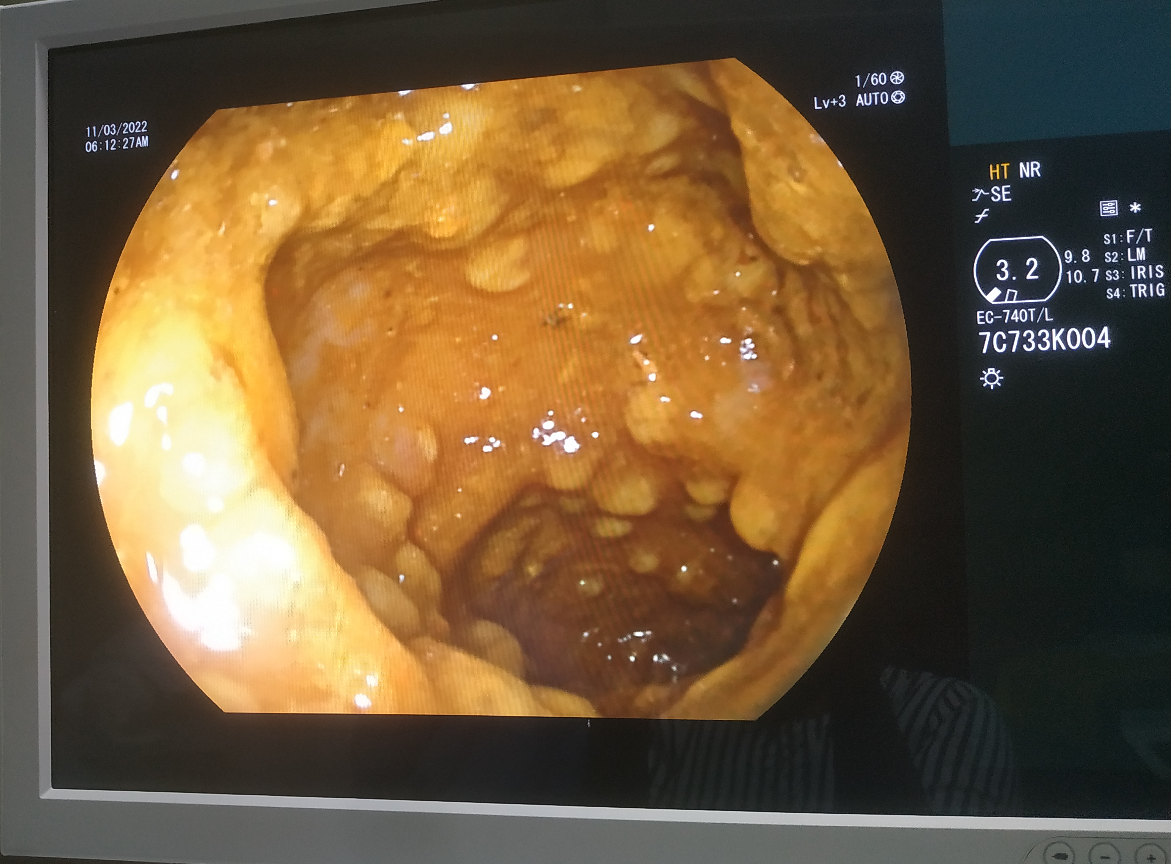

Slide 24
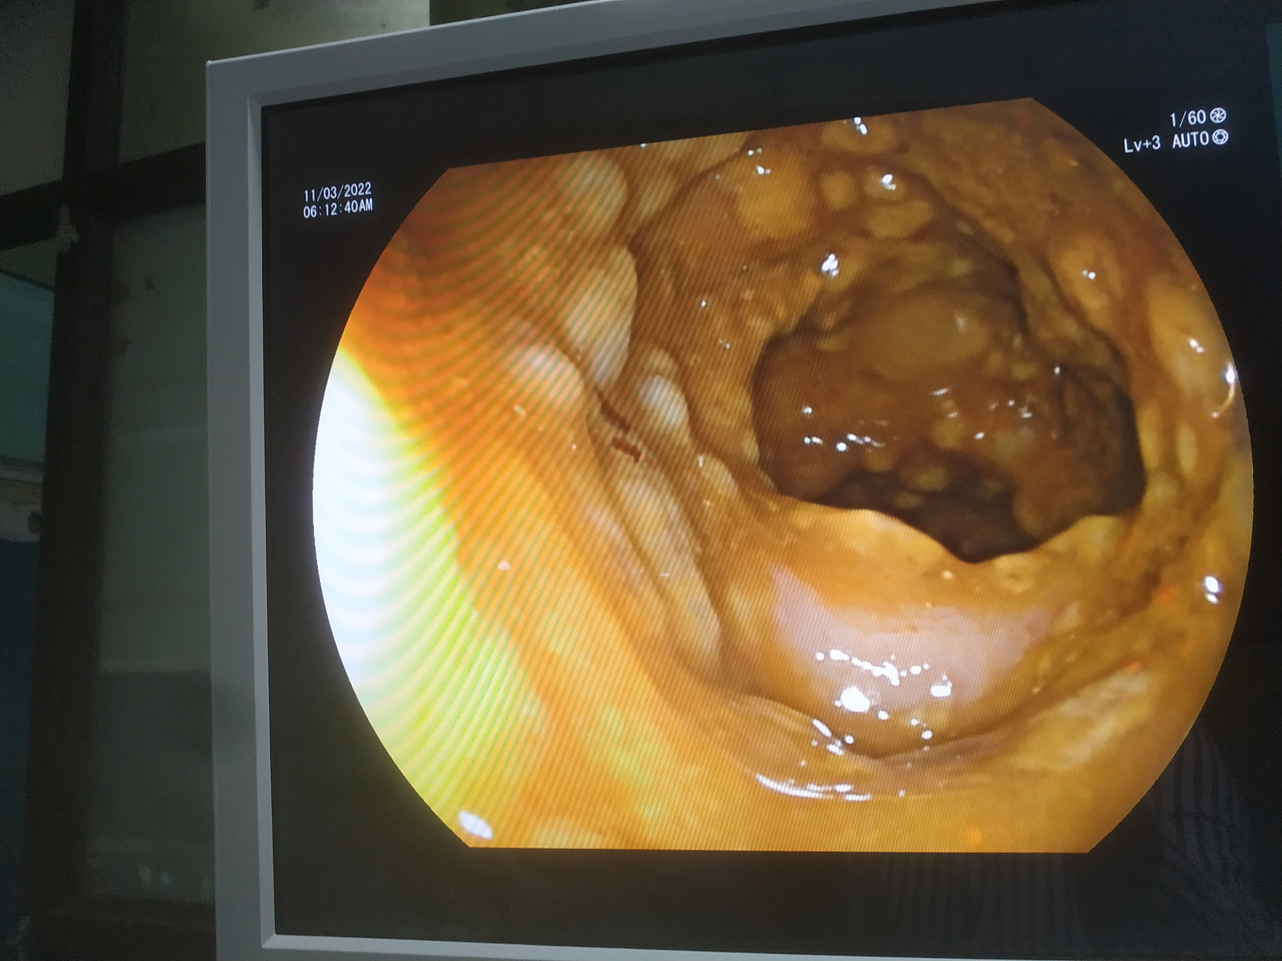

Slide 25
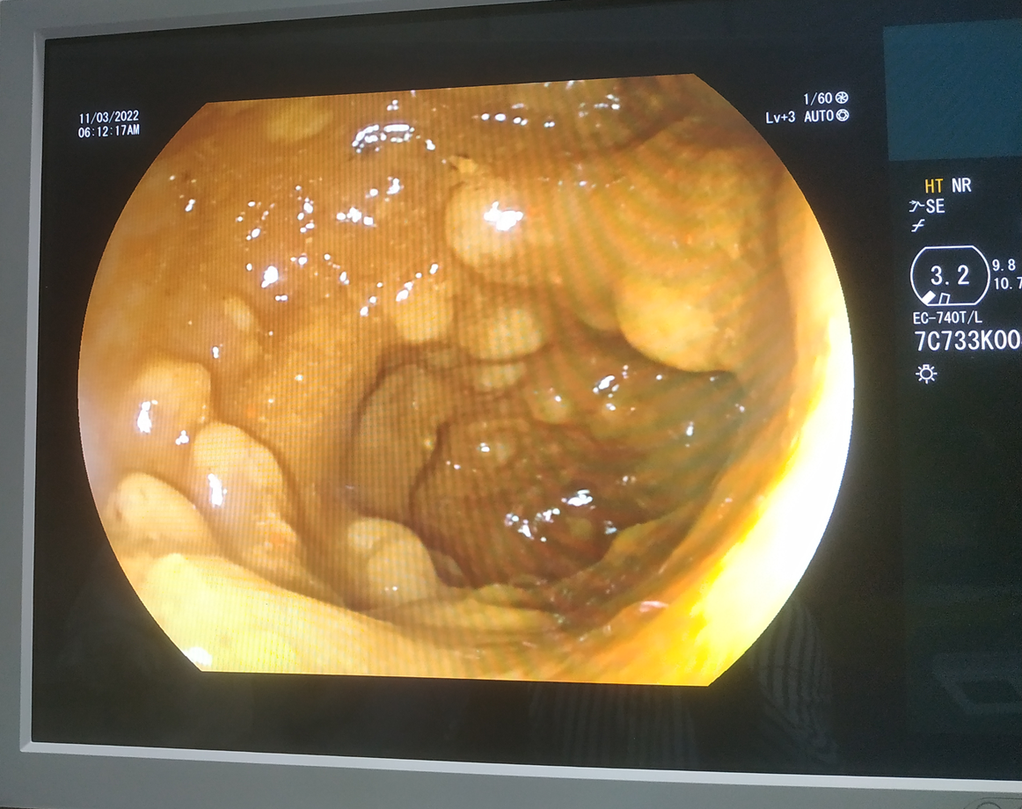

Slide 26
Patient was continued treatment with inj. Metronidazole 500mg iv q8h
Started on T vancomycin 125 mg 1-1-1-1 for 10 days
While awaiting biopsy report

Slide 27
16/3/22
Tc – 9200
Dc – p 68% l 28%
Hb -9.6
Pcv -30
Pt discharged on 18/3/22

Slide 28
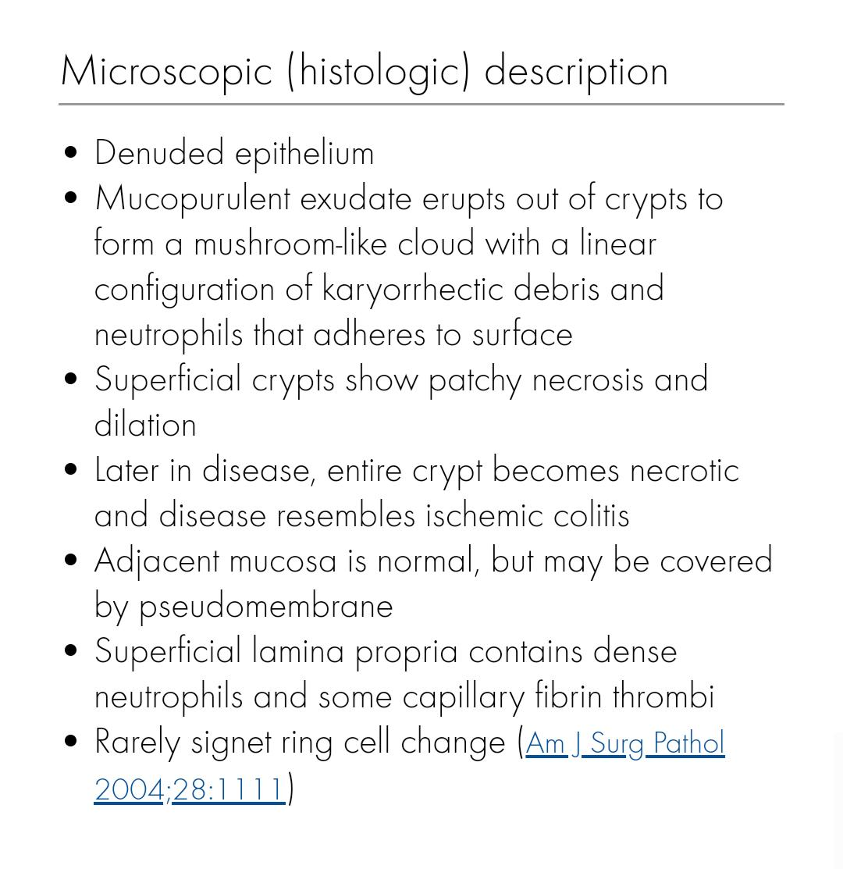
Biopsy from sigmoid colon – taken on 9/3/22
Imp – consistent with pseudomembranous colitis
No e /o CMV

Slide 29
INVESTIGATIONS
CECT ABDOMEN
Diffusely distributed atheromatous plaque noted through out the course of abdominal aorta with no significant luminal narrowing
Atheromatous plaque noted at the origin of IMA causing significant stenosis.Rest of the IMA shows normal contrast opacification.
Bulging duodenal papilla noted.
No evidence of mesenteric ischemia in the present study.
Stool clostridium difficile toxin A & B - NEGATIVE

Slide 30
DIFFERENTIAL
DIAGNOSIS
1
2
3
C. DIFFICILE INFECTION
INFLAMMATORY BOWEL DISEASE
H/O iv antibiotic use
Symptoms within 2 weeks of it.
Improvement on vancomycin.
sepsis
ISCHEMIC COLITIS
Colonoscpic typical appearance absent.
No h/o hematochezia
MI/Ischemic LVF
Older adult.
4
5
Neoplasia – colon cancer
Invasive bacterial,parasitic,ulcerating viral infections
Notes:
What are the rules and laws of your colony? Think about what helps the colonists stay safe and maintain a healthy, happy colony.
In each shape…
Name the rule/law
Describe why it’s important for the colony/colonists
Explain the consequences for not following this rule/law
To add more shapes, click on the last shape, then on SmartArt Tools -> Design -> Add Shape After

Slide 31
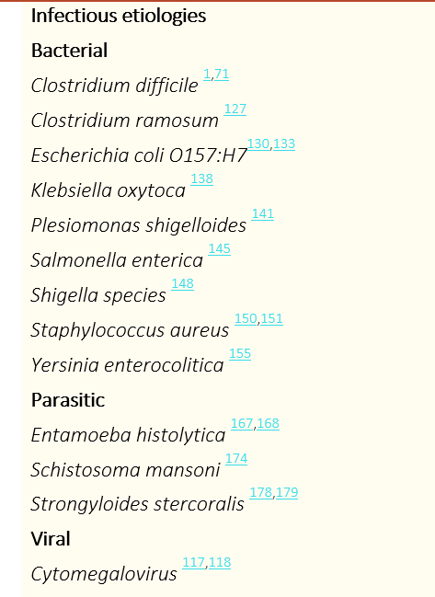
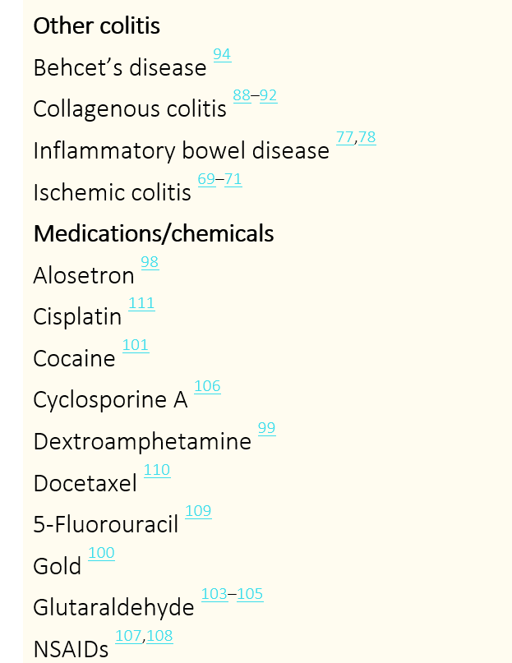






PSEUDOMEMBRANOUS COLITIS

Slide 32
C.DI
Clostridioides difficile - a spore-forming, toxin-producing, gram-positive anaerobic bacterium that causes antibiotic-associated colitis.
It colonizes the human intestinal tract after the normal gut flora has been disrupted (frequently in association with antibiotic therapy).

Slide 33
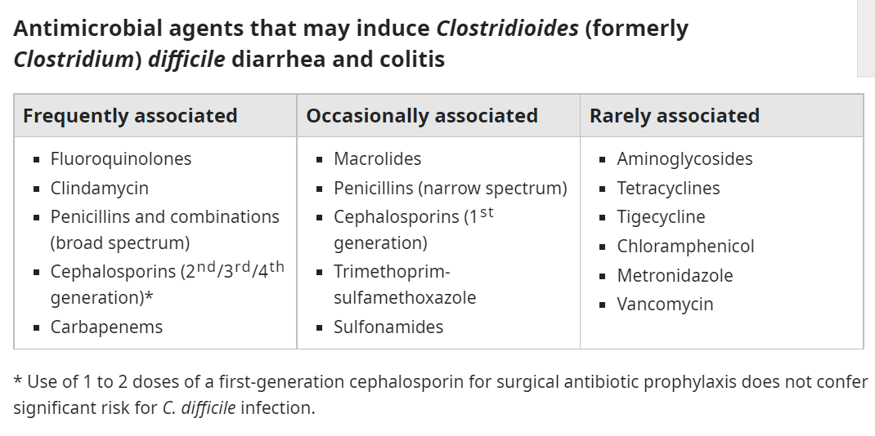







Slide 34
Diarrhea with colitis
  Nonsevere disease — Watery diarrhea (≥3 loose stools in 24 hours) is the cardinal symptom of CDI.
    Lower abdominal pain and cramping, low-grade fever, nausea, and anorexia
    Associated with mucus or occult blood, but melena or hematochezia are rare.
    Symptoms of CDI may begin during antibiotic therapy, and most cases occur within two weeks of antibiotic therapy.
    However, a lack of antibiotic use does not rule out the possibility of CDI.
    Risk factors -CDI age >65, recent hospitalization, and use of proton pump inhibitors
    CDI – LAB CRITERIA proposed for nonsevere CDI (based on expert opinion) include white blood cell count ≤15,000 cells/mL and serum creatinine <1.5 mg/DL.

Slide 35
Severe and fulminant colitis —
  Clinical manifestations- diarrhea, lower quadrant or diffuse abdominal pain, abdominal distention, fever, hypovolemia, lactic acidosis, hypoalbuminemia, elevated creatinine, and marked leukocytosis (white blood cell count up to 40,000 cells/mL or higher)
  Criteria for severe CDI -white blood cell count >15,000 cells/mL or serum creatinine ≥1.5 mg/Dl

Slide 36
  Fulminant colitis (previously referred to as severe, complicated CDI) - hypotension or shock, ileus, or megacolon
  ● Severe hypotension –MODS, bowel perforation with peritonitis.
  ● ileus, with little or no diarrhea.
  ● Megacolon should be suspected in patients with severe systemic toxicity together with radiographic evidence of large bowel dilatation (>7 cm diameter in the colon and/or >12 cm diameter in the cecum).
      Megacolon may be complicated by bowel perforation; manifestations include abdominal rigidity, involuntary guarding, diminished bowel sounds, rebound tenderness, and severe localized tenderness in the left or right lower quadrants;
      Recurrent disease — Recurrent CDI is defined by resolution of CDI symptoms while on appropriate therapy, followed by reappearance of symptoms within two to eight weeks after

Slide 37
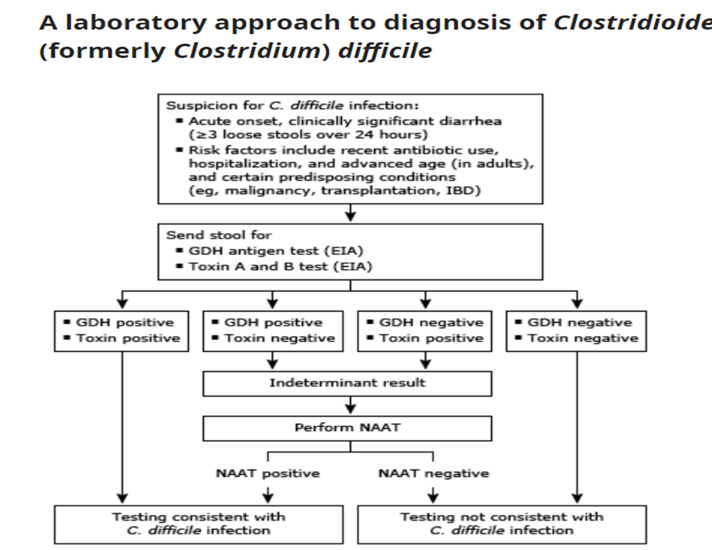
The diagnosis of CDI is established via either a positive nucleic acid amplification test (NAAT) for C. difficile toxin B gene or a positive stool test for C. difficile toxin(s).

Slide 38
There is also no role for laboratory testing in asymptomatic patients or in patients receiving treatment for acute CDI
C. difficile toxin degrades at room temperature and may be undetectable within two hours after collection; therefore, specimens for testing based on toxin detection (EIA for C. difficile toxins and cell culture cytotoxicity assay) should be kept at 4ºC if delay in laboratory testing is anticipated

Slide 39
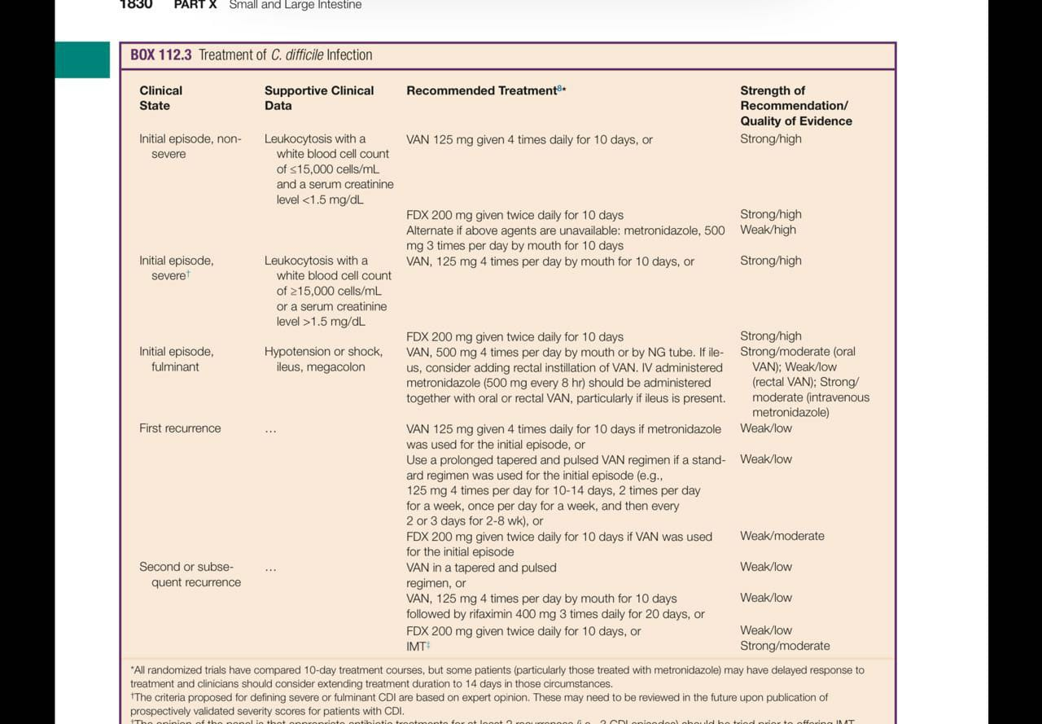

Slide 40
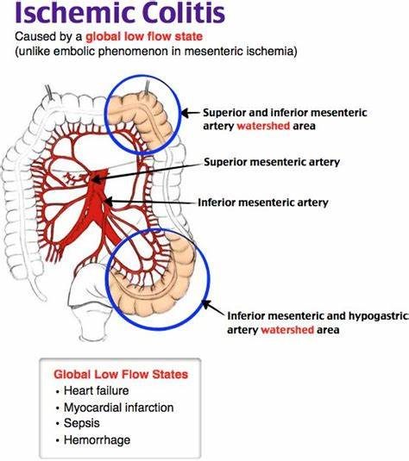
Nonocclusive mesenteric ischemia —
Nonocclusive mesenteric ischemia (NOMI) is thought to occur as a result of splanchnic hypoperfusion and vasoconstriction
Nonocclusive colonic ischemia or ischemic colitis most commonly affects the "watershed" areas of the colon that have limited collateralization, such as the splenic flexure and rectosigmoid junction.

Slide 41
THANK YOU!

