Slide 1
CLINICAL SPOTTER
DR POOJA VENU
JUNIOR RESIDENT
GTDMCH

Slide 2
A 37 years old male from punnapra,working as a fisherman came to the opd came with b/l swelling of the legs since birth
History of presenting illness : the patient gave a history of bilateral swelling of the legs since birth
Not associated with pain
No h/o exertional dyspnoea,palpitation or chest pain
No variation with postural changes
No history of reduced urine output
No h/o puffiness of face
No h/o abdominal distension/yellowish discolouration of eyes and urine
no history suggestive of filarial attacks
no hlo prolonged drug intake
No h/o similar illness in family

Slide 3
On examination,patient conscious oriented afebrile
Moderately built and nourished
No pallor
No icterus
No clubbing
No cyanosis
No generalised lymphadenopathy
b/l pitting pedal edema +

Slide 4
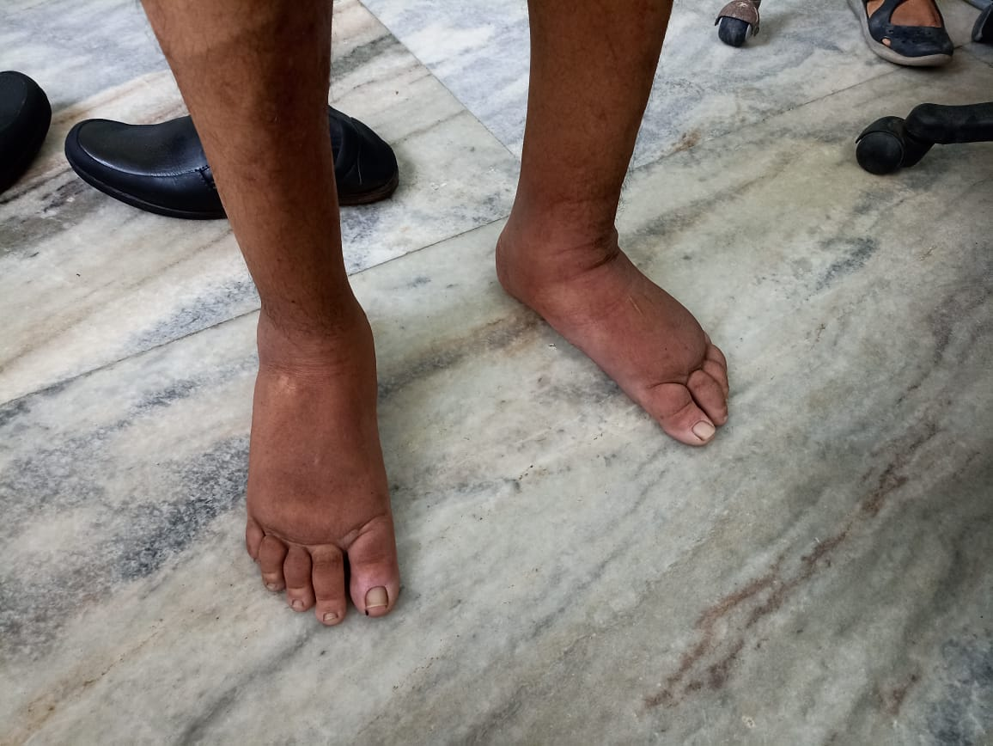

Slide 5
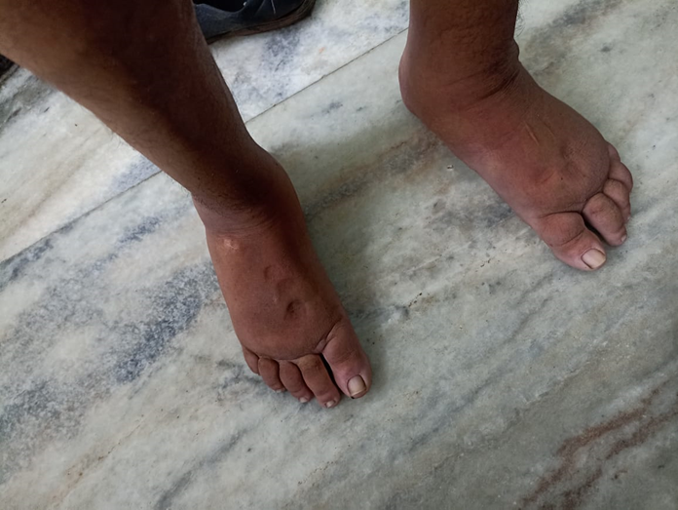

Slide 6
vitals : bp : 120/80 mm hg,pulse rate 80/min,regular
Cvs : s1 s2 heard,no added sounds
Rs: bae +,chest clear
Cns : nfnd
p/a : soft,no organomegaly
LOCAL EXAMINATION : no warmth no tenderness observed
no local changes in skin
Kaposi stemmer sign: positive

Slide 7
INVESTIGATIONS
CBC : HB 14.5 g/dl
tc 7800 /cm3
neut 58% lymp 40 %platelets : 2.5 lakhs
esr : 20 mm
RFT : urea 21 creatinine 0.6 mg/dl
Lft : bilirubin 0.6
total protein 6mg/dl albumin 3.8 mg/dl
SGOT 20 SGPT 26 ALP 90
SERUM ELECTROLYTES : NA 138 K 3.7 Meq/l
Serum tsh free t3 free t4 : normal
Urine R/E : albumin : nil,pus cells 1-2 per hpf
ECG : Sinus rhythm,VR 75 bpm, no significant ST T changes
Chest XRAY : within normal limits
Peripheral ssmear for microfilaria at 10pm : negative

Slide 8
ECHO : Good LV systolic function
USG ABDOMEN AND PELVIS : no abnormal findings seen
LOWER LIMB VENOUS DOPPLER STUDY : Normal

Slide 9
APPROACH TO EDE
Unilateral causes of pedal edema
Bilateral causes of pedal edema
acute | chronic | acute | chronic
Unilateral dvt | Primary venous disease | b/l dvt | Chronic venous disease
Ruptured bakers cyst | Iliac vein compression | Acute heartfailure | Pulmonary hypertension
Ruptured leg muscle | lymphedema | Acute renal/liver failure | Heart/renal/liver disease
Compartment syndrome | Vascular malformation | Ivc thrombosis | Chronic ivc occlusion /a ivc aplasia/hypoplasi
Intramuscular hematoma | Reflux sympathetic dystrophy | Ivc tumours | lymphedema
infection | infection | Drugs | lipedema
Supercficial venous thrombosis | Atrophy/hypertrophy | b/l infection | obesity
Mass/tumor | Overgrowth syndromes |  | Malabsorption/hypoalbunemia
fracture | Post trombotic syndrome |  | Thyroid disorder
Insect bites |  |  | Obstructive sleep apnoea

Slide 10
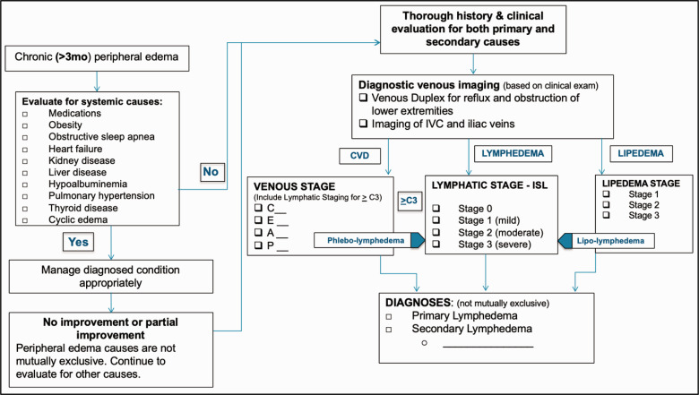

Slide 11
Based on history taking,clinical examination,and investigations, a diagnosis of PRIMARY CONGENITAL LYMPHEDEMA –MILROY DISEASE was made

Slide 12
LYMPHEDEMA
Lymphedema can be divided into two types : primary and secondary lymphedema
PRIMARY LYMPHEDEMA : 1)Congenital lymphedema : present since birth;familial autosomal dominant form is known as Milroy disease
2)Lymphedema praecox : most common form;onset 2-35 years
females>males affected,usually unilateral
familial AD form is MEIGS DISEASE
3)Lymphedema Tarda : onset after 35 years

Slide 13
MILROY DISEASE
Onset at birth
Occurs due to autosomal dominant mutations in FLT4 (VEGFR3) gene
b/l assymetric lower limb lymphedema: most typical
Rare risk of complications :intestinal lymphangiectasia,pleural effusion,recurrent septic arthritis
Atypical nonne-Milroy syndrome : when associated chylothorax,chylous ascites,chylopericardium occurs between 20 to 40 years

Slide 14
DIAGNOSIS OF LYMPHEDEMA
Diagnosis of lymphedema is usually clinical
Gold standard for diagnosis : LYMPHOSCINTIGRAPHY
It utilises tc99m colloid injected intradermally into 2nd and 3rd web spaces for assessment of lymph movement from feet to the chest

Slide 15
Management of lymphedema
Multicomponent /complex decongestive physiotherapy
:compression bandage,skin care,exercises,manual lymphatic drainage
SURGERY : liposuction
Bypass procedures : lymphatic bypass
lymphaticovenular anastomosis
Limb reduction procedures :Sistrunk
homans
Charles
thompson

Slide 16
THANK YOU

