Slide 1
Mr P’ s Magic world
CLINICAL CLUB
Mohammed fazil k
M5 unit

Slide 2
CLINICAL SCENARIO
67 / Male patient
No known past medical illness
Non – smoker , occasionally alcoholic

Slide 3
COMPLAINTS
Apparently normal four days back
Then, according to bystander ….. In the morning , the patient was telling about seeing colourful flowers stacked on his left side.
Daughter noticed that the patient was persistently turning the head to the left side during the episode
Lasting for 3 to 5 minutes, occurring on multiple occasions.

Slide 4
At times patient was seeing strange people standing in crowd
Occasionally he saw baskets of vegetables kept on the left side.
The daughter revealed that each episodes lasted for about 3 – 5 minutes and these things were totally imaginary which others may not seeing.

Slide 5
No history fever , headache , vomiting, altered sensorium
No history of any motor weakness, altered sensation of body
No history of LOC, bower and bladder incontinences.

Slide 6
ON EXAMINATION
Conscious cooperative
General examination
Nervous system - WNL

Slide 7
CLINICAL DIAGNOSIS
OCCIPITAL LOBE SEIZURES

Slide 8
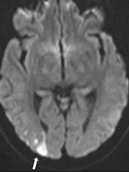
INVESTIGATIONS
Blood Routines - WNL
Imaging – occipital lobe infarct
CSF study - norml
Ophthalmology consultation – no visual field defect.

Slide 9
FINAL DIAGNOSIS
Occipital lobe epilepsy – right occipital lobe infarct

Slide 10
DISCUSSION
For localising the site of ictal activity - Onset of seizure

Slide 11
According to ONSET
MOTOR – Tonic , clonic
NON- MOTOR - Sensory features, autonomic features,
hallucinations
UNKNOWN
Focal – with or without awareness
Generalised

Slide 12
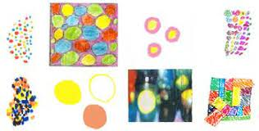
OCCIPITAL LOBE
All of its functions concerned either directly or indirectly with vision
Broadmann’s area – 17, 18 and 19
Primary visual cortex (17)– Elementary visual hallucinations
- lines/ cross / rings/dots
Visual association cortex (18 & 19)
– Well formed images ( complex visual hallucination)
- Polyopia
- Metamophopsia
- Advancing visual field

Slide 13
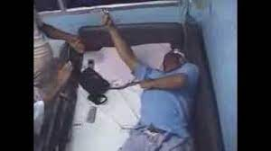
FRONTAL LOBE
Motor manifestations
Opposite motor cortex
Figure of 4 epilepsy/ Asymmetric tonic limb posturing (ATLP)
Flexion of limb on the I/L side of lesion and extension of limb on the c/L side
Supplementary motor area

Slide 14
Frontal lobe and head position( hyper motor manifestation)
I/L SCM – clonic movt of head to opposite side
C/L PPRF – conjugate movt of eyes to opposite side

Slide 15
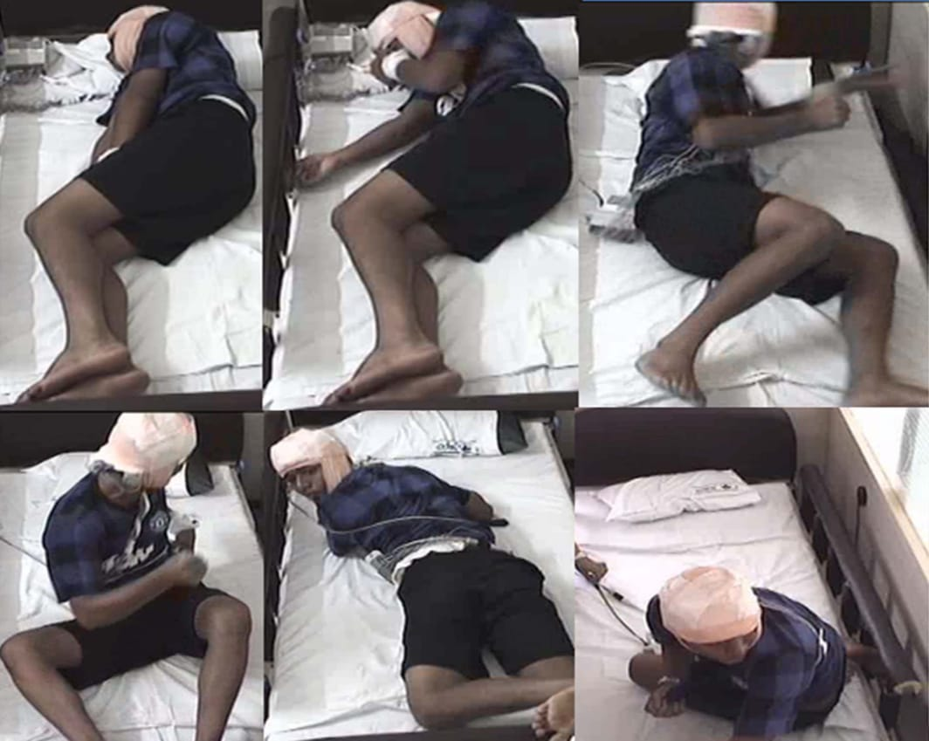
GYRATORY SEIZURE
- Frontal lobe with ictal spread to B/L frontal lobe

Slide 16
TEMPORAL LOBE
1 ] MEDIAL TEMPORAL LOBE
- Complex partial seizure
- Sudden behavioural arrest
- Automatism- lip smacking
- Autonomic disturbances - SUDEP
- De javu
- Dystonia ( adjacent to BG)
2 ] LATERAL TEMPORAL LOBE
- auditory hallucinations
- sudden blocked ear sensation

Slide 17
PARIETAL LOBE
Sensory - paresthesia

Slide 18
THANK YOU

