Slide 1
CLINICAL CLUB
01/10/2021
DR AMRITA KURIAN
JUNIOR RESIDENT
GENERAL MEDICINE

Slide 2
SEIZURES IN A MOODY SMOKER

Slide 3
BENNY
60/MALE
GUARD
MARARIKULAM
DOA: 07/09/21

Slide 4
PRESENTING COMPLAINTS
Acute onset confusion followed by an episode of convulsions at around 11:30 am on 07/09/21

Slide 5
HISTORY OF PRESENT ILLNESS
Apparently well patient woke up normally that day; did his chores.
Around 11am wife noticed an acute onset confusion in the patient.
Inability to recognize the people being referred to in their conversations, asking her to repeat the sentences.
Within 20 minutes, he developed an episode of convulsions – twitching of the corner of his mouth, uprolling of eyes and tonic clonic movements of right upper limb.

Slide 6
Event lasted for 10 minutes.
Post ictal drowsiness for 30 min.
No history of tongue bite, bowel or bladder incontinence or post convulsion weakness of limbs.
No history of fever, headache, vomiting, trauma to head or significant loss of weight.
Dysphagia to solids since 10 days.

Slide 7
PAST HISTORY
Cough since 3 months with scanty mucoid sputum.
History of hospital admissions for alcohol intoxication and alcohol withdrawal symptoms .

Slide 8
FAMILY HISTORY
Father died of an accident at 80yrs of age.
Mother died of old age related illness
3 elder sisters and one elder brother; Brother expired due to complications of Carcinoma bladder.
Married with no children.

Slide 9
PERSONAL,SOCIAL,OCCUPATIONAL HISTORY
Married
Follows non vegetarian diet
Decreased sleep and appetite.
Normal bowel and bladder habits.
ADDICTIONS
Heavy alcoholic since 40 years. Consumes one pint beer or rum daily.
Following a period of abstinence, binge drinking for 5 days followed by abstinence the day prior to seizures.

Slide 10
Smoker since the age of 20.
Smokes 2 packets of beedi or 1 packet cigarette per day.
Pack years 40
Low income group
Works as a guard.

Slide 11
GENERAL EXAMINATION
Conscious, cooperative.
Looks well, well dressed.
Moderately built and well nourished
Height 168 cm, weight 78 kg BMI:27.5kg/m²
No pallor, conjunctival hyperemia +
Grade 2 clubbing +
Left supraclavicular lymph node felt – soft , mobile, non tender, approx. 1cm
No cyanosis, icterus or pedal oedema.

Slide 12
VITAL SIGNS
PR: 80/mt, regular, normal volume and character, vessel wall not palpable, No radiofemoral delay
BP: 180/100 (Right brachial artery in sitting position)
Resp Rate: 22/mt, SpO2:94 % in RA
Afebrile
GRBS:104

Slide 13
Head to Foot Examination
Male type baldness, madarosis
Conjunctival hyperemia.no Bitot’s spots, No arcus senilis or KF ring.
Glossy tongue, no angular stomatitis.
Nails: normal. No ridges, subungual keratosis, whitening of nails, Nicotine staining of fingers +
No palpable neck swelling
Gynaecomastia +

Slide 14
No neurocutaneous markers
No features of atherosclerosis ( transverse ear lobe crease)

Slide 15
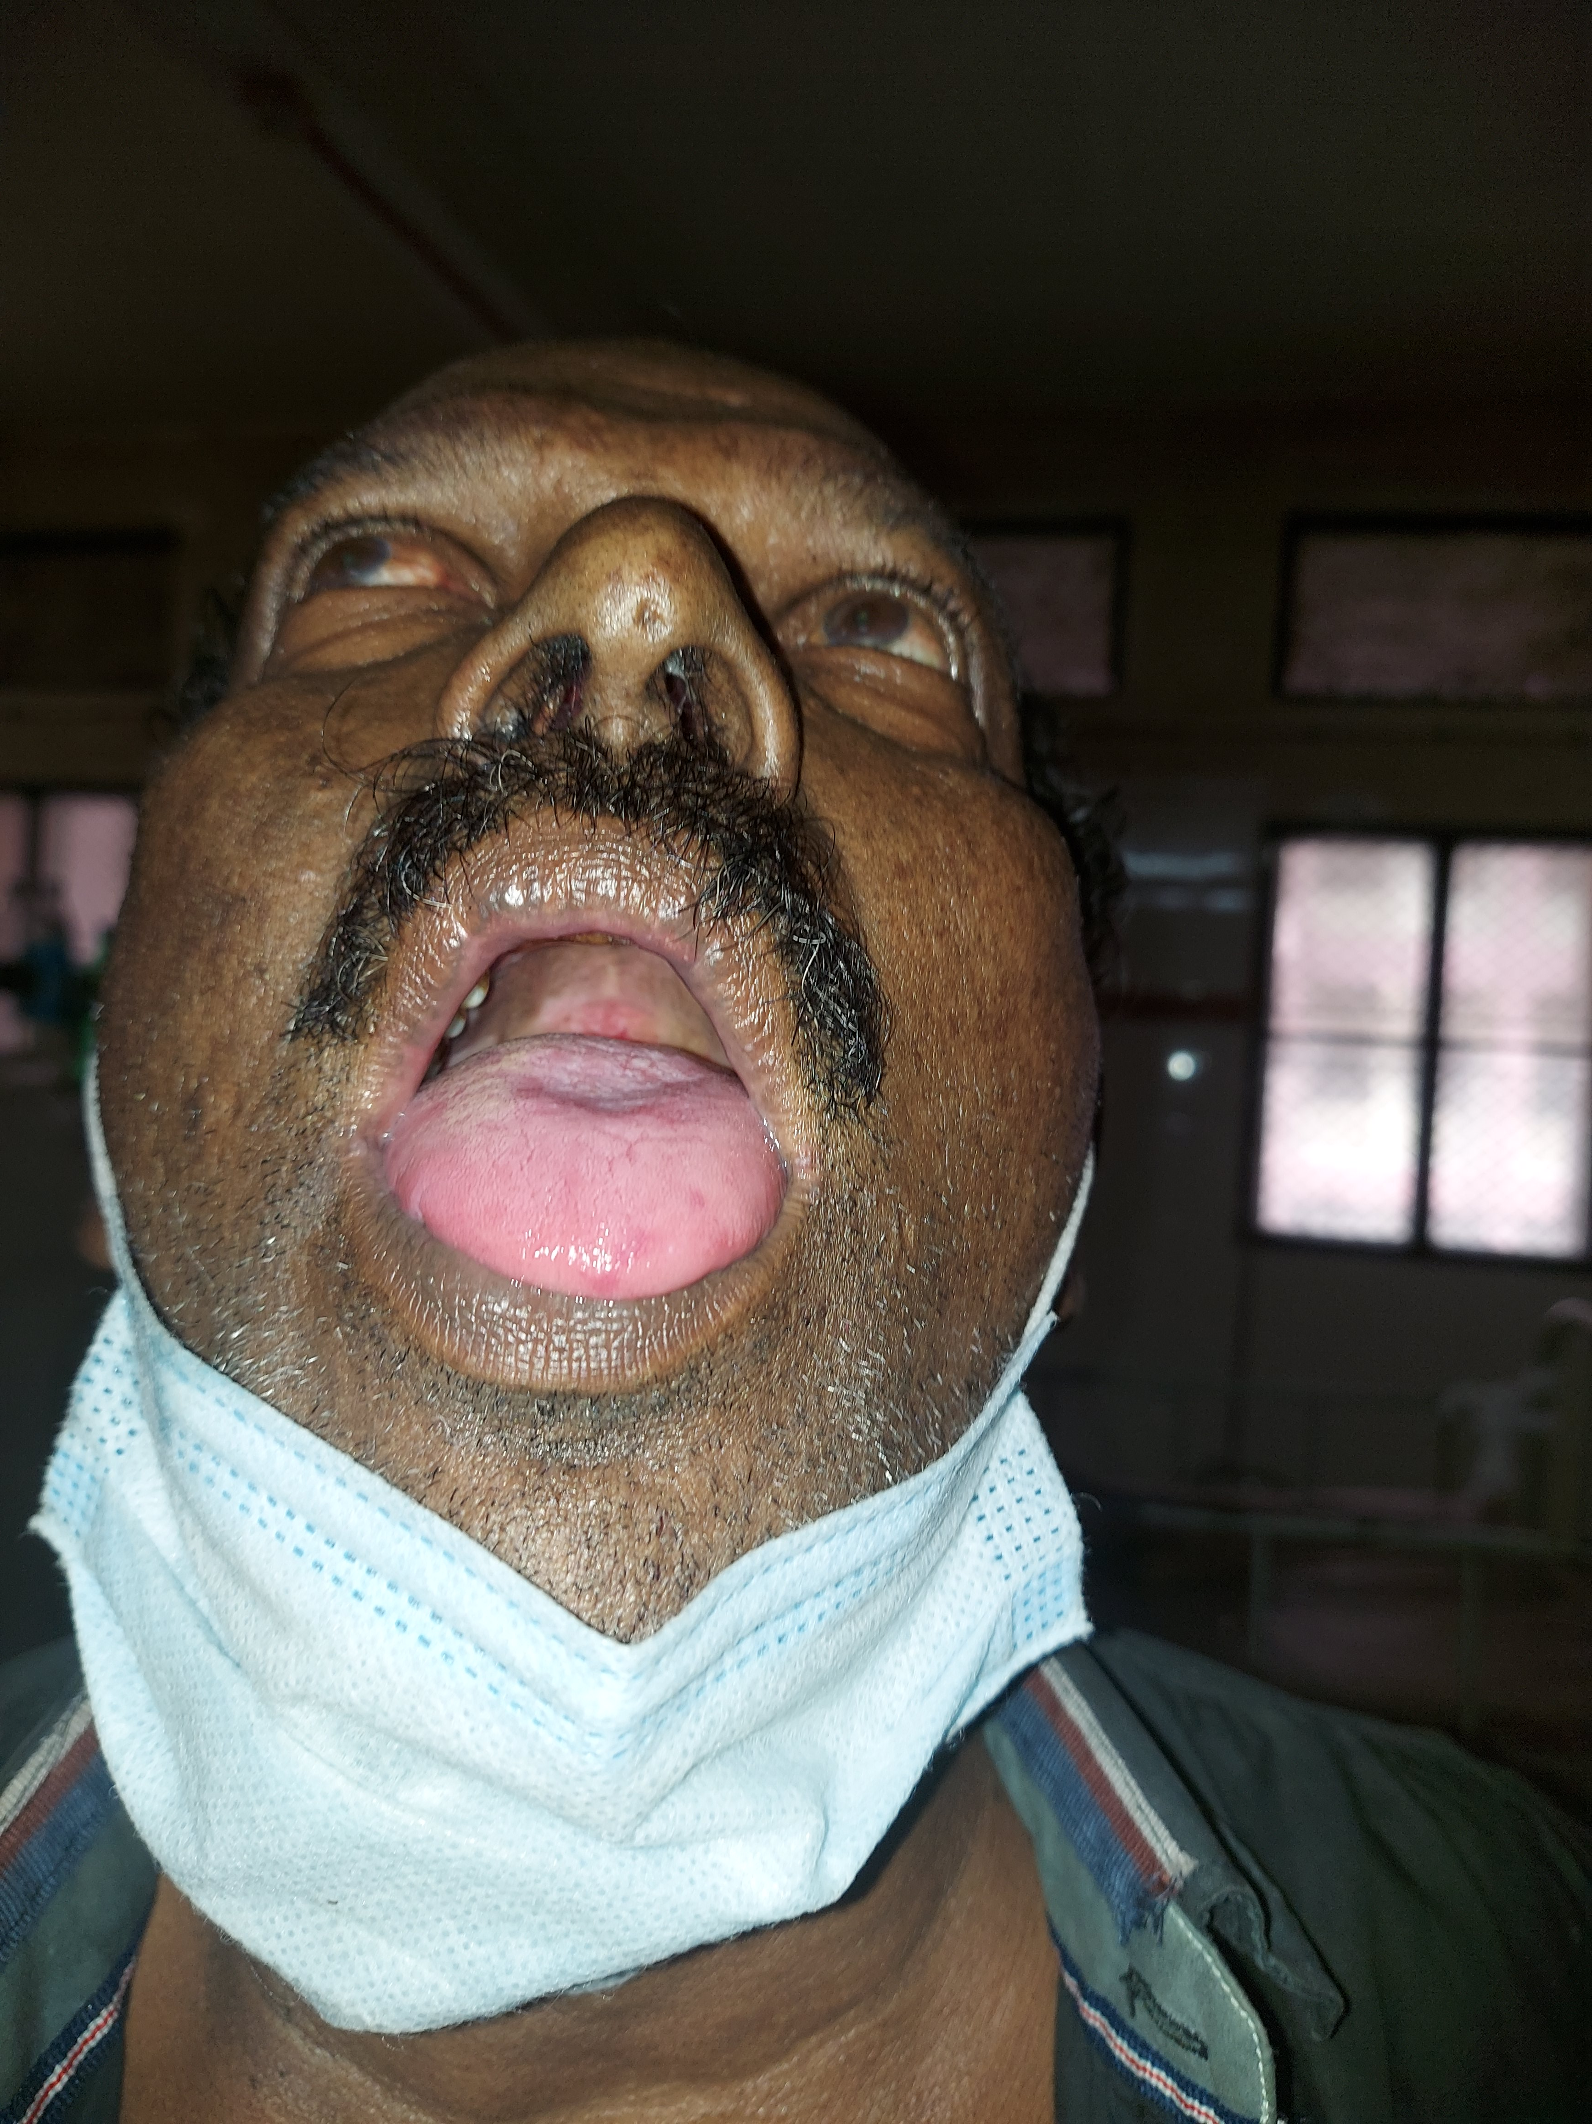
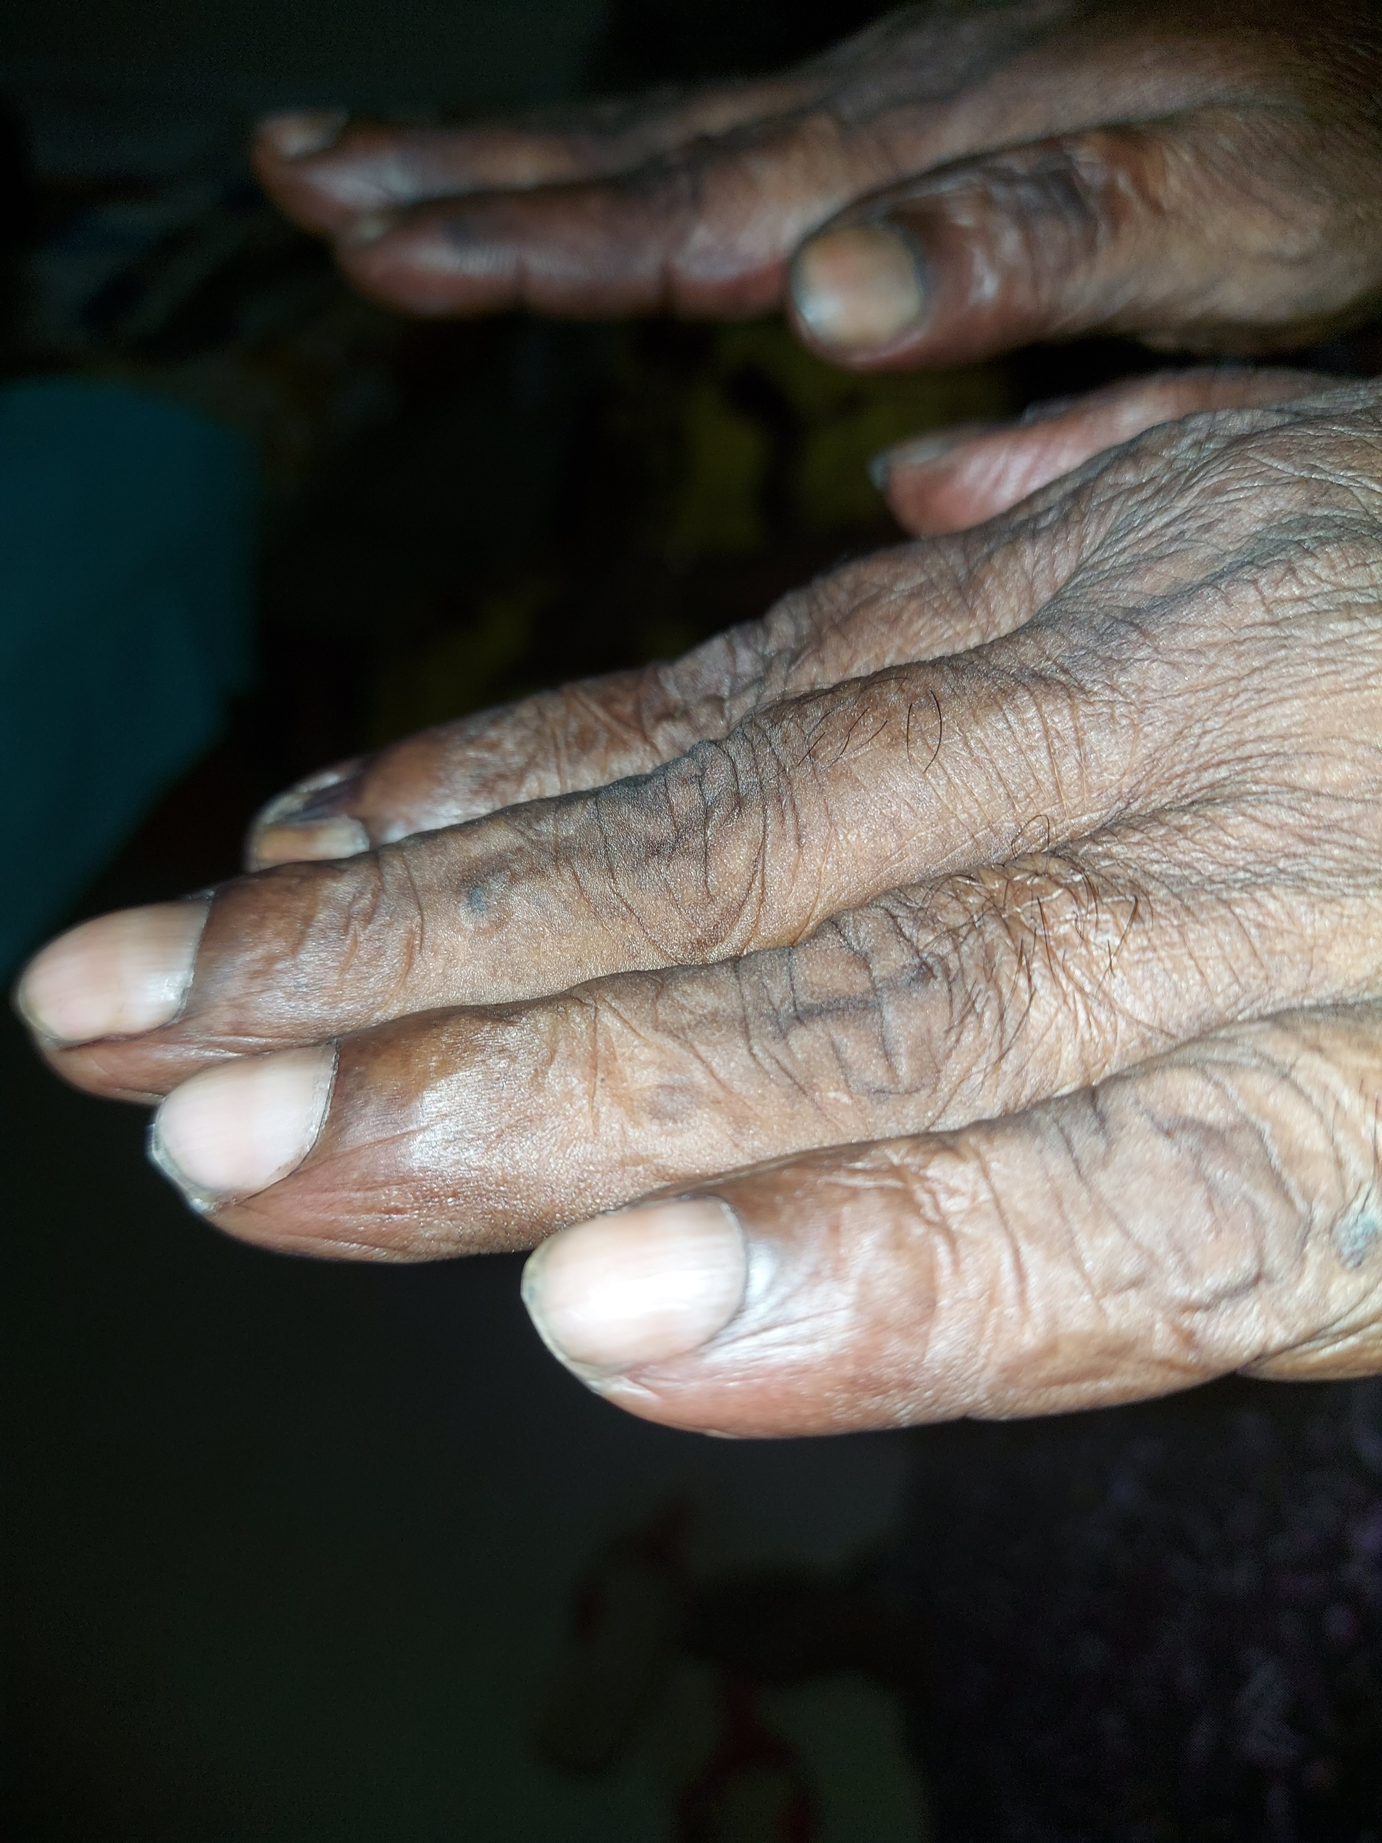

Slide 16
EXAMINATION OF CNS
HIGHER MENTAL FUNCTIONS
Conscious, GCS : 15/15, oriented in place time and person
Appears well dressed.
Labile affect
Patient is attentive
Memory:
Registration and immediate recall: Digit forward :5 digits, normal
Digit backward: 3 digits, but in the wrong order

Slide 17
Short term, recent and remote memory intact.
No delusions or hallucinations.
Intelligence: studied till 10th standard, Can perform simple calculations and interpret common proverbs.
He has insight.
Judgement: unimpaired.
Speech: Fluent – no hesitancy, normal expressivity, normal grammar, no paraphasias or neologisms

Slide 18
Comprehension : normal
Repetition: normal
Naming and word finding: normal
Reading and writing: normal

Slide 19
TESTS FOR FRONATL LOBE FUNCTION
Insight: +
Judgement: normal (Q: His room is on fire and there’s a kid in it)
Attentive. Could perform the serial subtraction test.
Abstraction : normal (can interpret the given proverb)
Estimation: normal
Conceptual series completion (completing the Malayalam alphabet series) impaired.

Slide 20
Self cued lists: (Q: some animals whose name begin with “pa” (in Malayalam))
Couldn’t name any. But could name 3 places starting with the same letter.
Word fluency : normal
Fund of knowledge: normal
Simultaneous simple motor tasks can be performed (keep one hand open and the other a fist and alternate the position): Slowness in following.
No primitive reflexes.

Slide 21
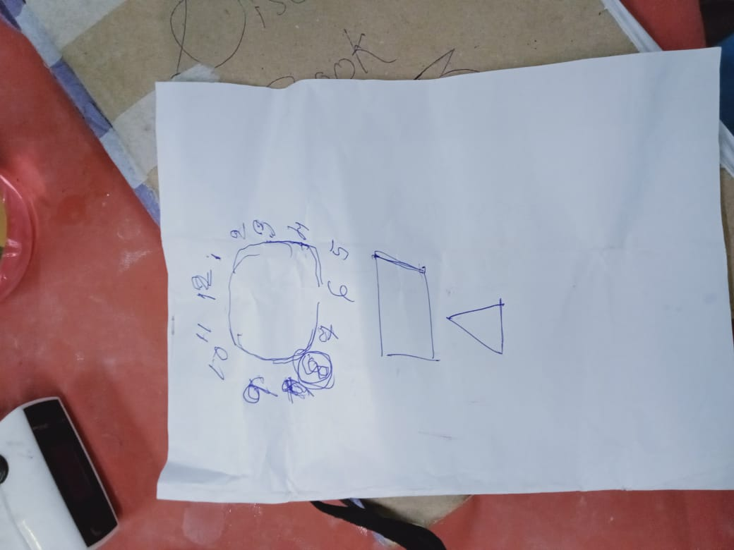
PARIETAL LOBE:
Tests for apraxia:
Copying orientation of fingers: normal
No ideomotor apraxia (can cut an imaginary cake)
? Ideational apraxia
Q: Draw a clock face, put the numbers inside, draw
hands on the clock to indicate 8

Slide 22
Stereognosis :normal
Graphaesthesia: normal
No neglect, dyscalculia or finger agnosia
No left and right confusion
No dressing apraxia.

Slide 23
TEMPORAL LOBE:
Oriented in place, time, person
Confrontation test for visual field defects normal
Memory : immediate recall – digit backward is impaired.
short term, recent and remote memory :intact
No hallucinations
Comprehension : normal

Slide 24
OCCIPITAL LOBE:
Confrontation test : normal
No prosopagnosia or color agnosia.
No visual illusions or hallucinations
No evidence of visual anosognosia : patient takes a turn on nearing the wall.

Slide 25
Examination of Cranial Nerves
Olfactory (1): appreciates smell introduced in both nostrils
Optic(2):
B/l pupils equal and reactive to light.
Visual acuity :6/6
Color vision, field of vision : normal
Direct and consensual light reflexes + accommodation reflex: normal
Fundus : bilateral papilloedema present

Slide 26
CN 3,4,6: Ocular movements full, no nystagmus, saccades and pursuit normal, no ptosis
Trigeminal (5):
Touch, pain , temperature : normal bilaterally
Conjunctival reflex : normal
Muscles of mastication :normal, no restriction of jaw opening, jaw jerk –
Facial (7) :
wrinkling of forehead : normal
Right nasolabial fold less prominent with deviation of angle of mouth to left on smiling

Slide 27
No drooling of saliva
Taste sensation form anterior part of tongue normal
Vestibulocochlear (8) : no tinnitus, vertigo, Rinnes test : positive b/l, Weber’s test : central
Glossopharyngeal and vagus (9 + 10):
Nasal bleating of voice
No nasal regurgitation, Palatal movements normal b/l with central uvula
Gag reflex : exaggerated
CN 11 and 12 ; normal functioning

Slide 28
Examination of Motor system
Normal bulk, tone and grade V power of muscles of both upper and lower limbs
Superficial reflexes:
Conjunctival reflex: normal b/l
Abdominal reflex: absent b/l
Plantars : mute (patient in post ictal period )
Deep tendon reflexes: 2+ bilaterally except right knee jerk :3+
No primitive reflexes

Slide 29
Coordination of movements
Finger nose test : normal b/l
No Dysdiadochokinesia
No rebound phenomena
No truncal ataxia
Wide based gait, swaying while changing direction rapidly.
Romberg’s: negative

Slide 30
Examination of Sensory System, Skull and Spine and Tests for meningeal irritation
Superficial, deep and cortical sensations normal b/l
No involuntary movements
No signs of meningeal irritation
Skull and spine : normal

Slide 31
EXAMINATION OF RESPIRATORY SYSTEM
Examination of upper respiratory tract:
No nasal discharge, no DNS, No PNS tenderness, no postnasal drip, Accessory muscles of respiration not used
Examination of Chest: INSPECTION
Trachea central
Shape of chest : bilaterally symmetrical, no drooping of shoulders, supra or infraclavicular hollowing , no kyphoscoliosis
No dilated veins , swellings or scars

Slide 32
Respiratory rate:22/mt, abdominothoracic
Movements of chest: normal bilaterally, accessory muscles of respiration not used.
PALPATION:
Trachea: central
Apex beat felt in the 5th left intercostal space 2cm medial to the left midclavicular line
Chest movements : equal bilaterally

Slide 33
Tactile Vocal fremitus decreased in right infraclavicular, mammary and axillary areas.
No swelling or tenderness
PERCUSSION:
Impaired note over right infraclavicular area
Upper border of liver dullness in 5th right ICS along the mid clavicular line.

Slide 34
AUSCULTATION:
Vesicular breath sounds heard with decreased intensity in right infraclavicular, mammary and axillary areas.
No added sounds
Vocal Resonance decreased in the above areas.

Slide 35
EXAMINATION OF GIT
EXAMINATION OF ORAL CAVITY: Few erosions seen on the hard palate and posterior pharyngeal wall
INSPECTION: No swellings, striae or dilated veins
PALPATION:
Soft, non tender
Liver and spleen not palpable
Normal tympanic note
No shifting dullness
Bowel sounds heard normally

Slide 36
EXAMINATION OF GENITOURINARY SYSTEM :No testicular atrophy
EXAMINATION OF CARDIOVASCULAR SYSTEM:
PR:80/mt, regular, normal volume and character, vessel wall not palpable, No radiofemoral delay
BP:180/100 mm Hg
No JVP
S1 S2 +
No S3/S4/clicks or murmurs
No carotid or vertebral artery bruit

Slide 37
SUMMARY
60 year old chronic smoker and heavy alcoholic, with h/o chronic cough and a family history of malignancy, was brought to the ER with Right focal motor seizures.
On General Examination : newly detected hypertension, clubbing and left supraclavicular lymph node
Examination of CNS revealed mild impairment of higher mental functions ( namely frontoparietotemporal lobe functions), along with minimal pyramidal signs, wide based gait with mild ataxia and a labile affect.
Respiratory system examination suggestive of right lung pathology characterised by decreased intensity of breath sounds and VR in areas corresponding to upper and middle lobes

Slide 38
IN THE ER
Patient was loaded with antiepileptic (phenytoin)
CT Brain was attempted multiple times but the patient continued to be restless in the CT Room despite giving sedatives.
Hence shifted to ward under the impression of probable alcohol withdrawal seizures.

Slide 39
IN WARD
Patient remained drowsy for 6-8 hrs, thereafter he was confused for another 6 hrs. No further episodes of seizures.
Routine investigations :
CBC
TC: 11400 (N50 L40)
Hb :14.8
PLT:2.73 L
ESR:25
MCV:77

Slide 40
LFT
TP/ALBUMIN: 7.8/3.9
BIL:1.3
OT/PT/ALP:40/19/100
RFT
Urea/creat :19/0.9
RBS:107
s.Na : 131
s K+ : 3.7
S Calcium: 10.2

Slide 41
ECG: ventricular rate at 75 per minute, irregular, with absent p wave, normal axis with no ST-T changes
CXR : not taken on post admission day despite multiple requests since the only female bystander said she had no means of shifting the patient.

Slide 42
CT Brain taken on the post admission day evening revealed a hyperdense area of HU 75 of size 1.4 x 1.1 cm in the right temporal lobe with minimal perilesional edema, likely hemorrhagic.
Multiple well defined hyperdense areas of approximately 5mm, some of them showing cystic component within, in bilateral frontal, parietal, occipital and capsuloganglionic regions.

Slide 43
Impression: Tuberculoma/other CNS Infections (Toxoplasmosis, neurocysticercosis,cryptococcosis) / Metastasis from Unknown primary
(? Lung Primary)

Slide 44
In addition to antiepileptic, Thiamine and lorazepam, IV Dexona and IV Mannitol was added
MRI Brain with contrast + MRS was planned.
USG Abdomen taken :revealed heteroechoic liver parenchyma, size 15.6cm
Tumor markers assay revealed
elevated CA 19-9: >1200
CEA:74.7 (high)
Normal AFP and PSA

Slide 45
Neuromedicine opinion was sought : Advised MRI Brain with MRS and LP study (to look for cryptocoocus, TB and toxoplasma in CSF).
By post admission day evening, patient’s sensorium had returned to normal, he was oriented, but continued to have labile affect and wide based gait.
No events of aggressive behaviour or anger outbursts or hallucinations while in ward
Viral markers came out negative

Slide 46
The next day CXR and MRI Brain was taken and XRAY revealed……..

Slide 47
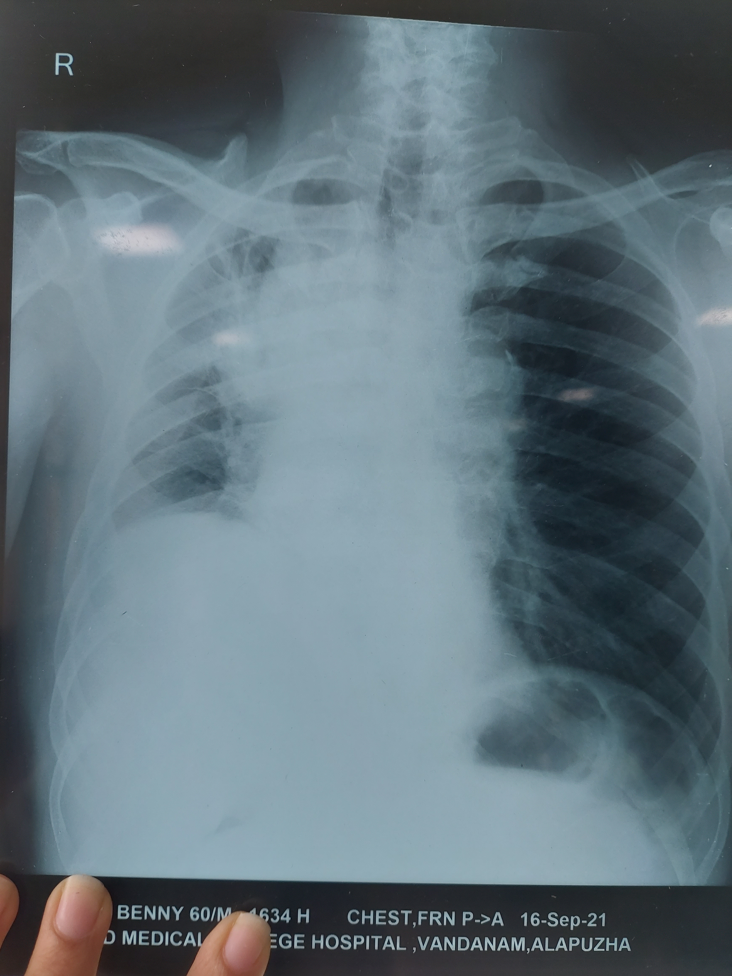

Slide 48
THIS REAFFIRMED THE SUSPICION OF METASTATIC BRAIN LESIONS WITH POSSIBLE PRIMARY BRONCHOGENIC MALIGNANCY

Slide 49
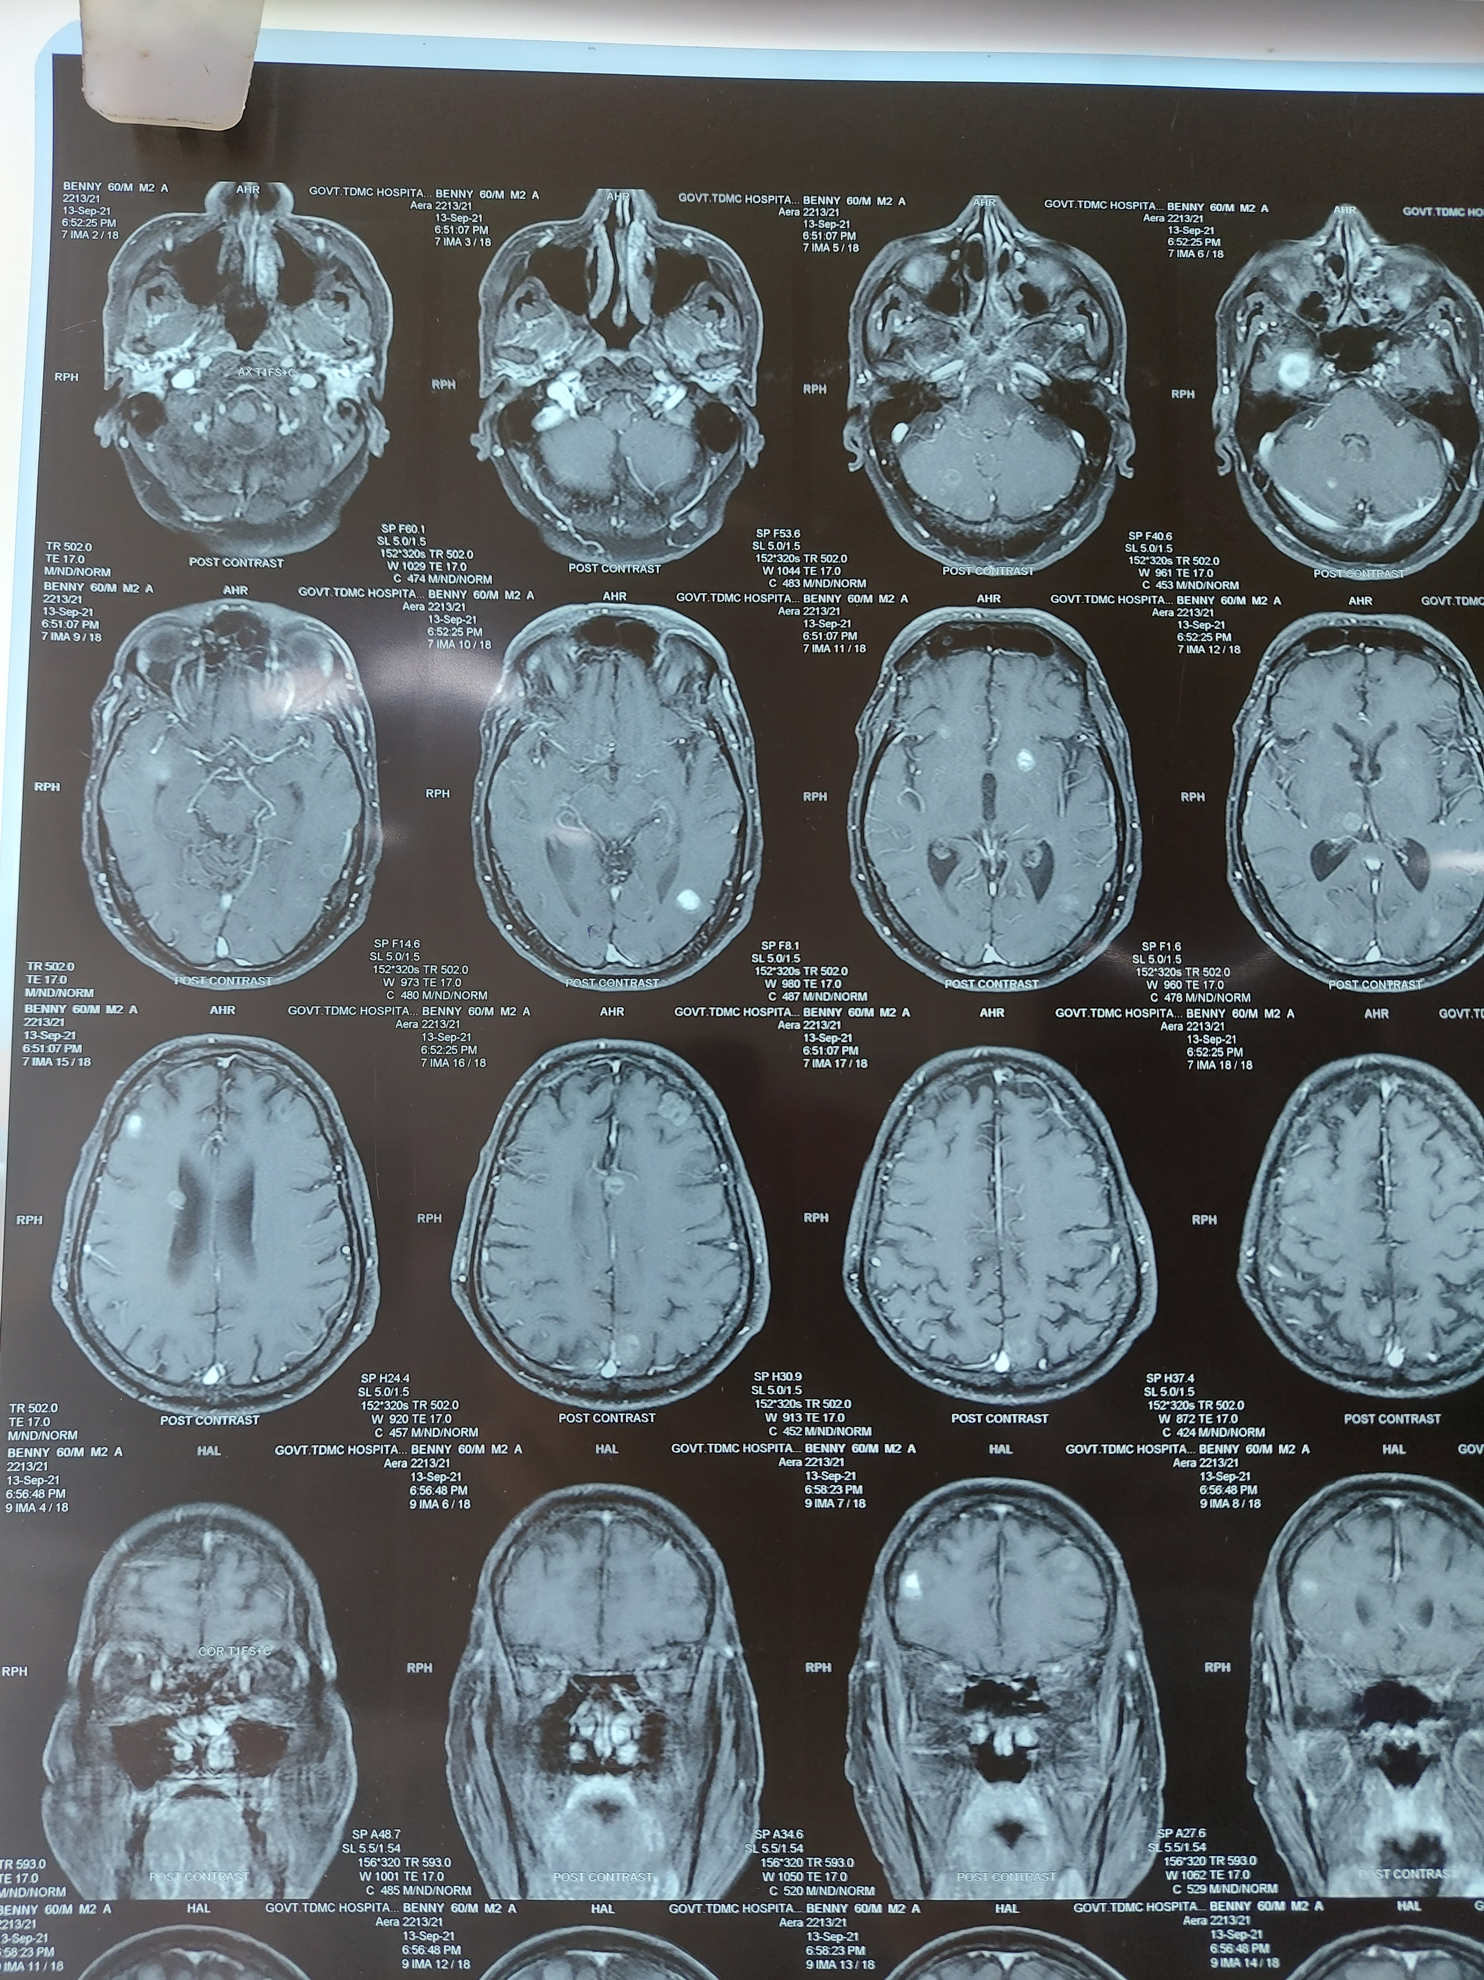
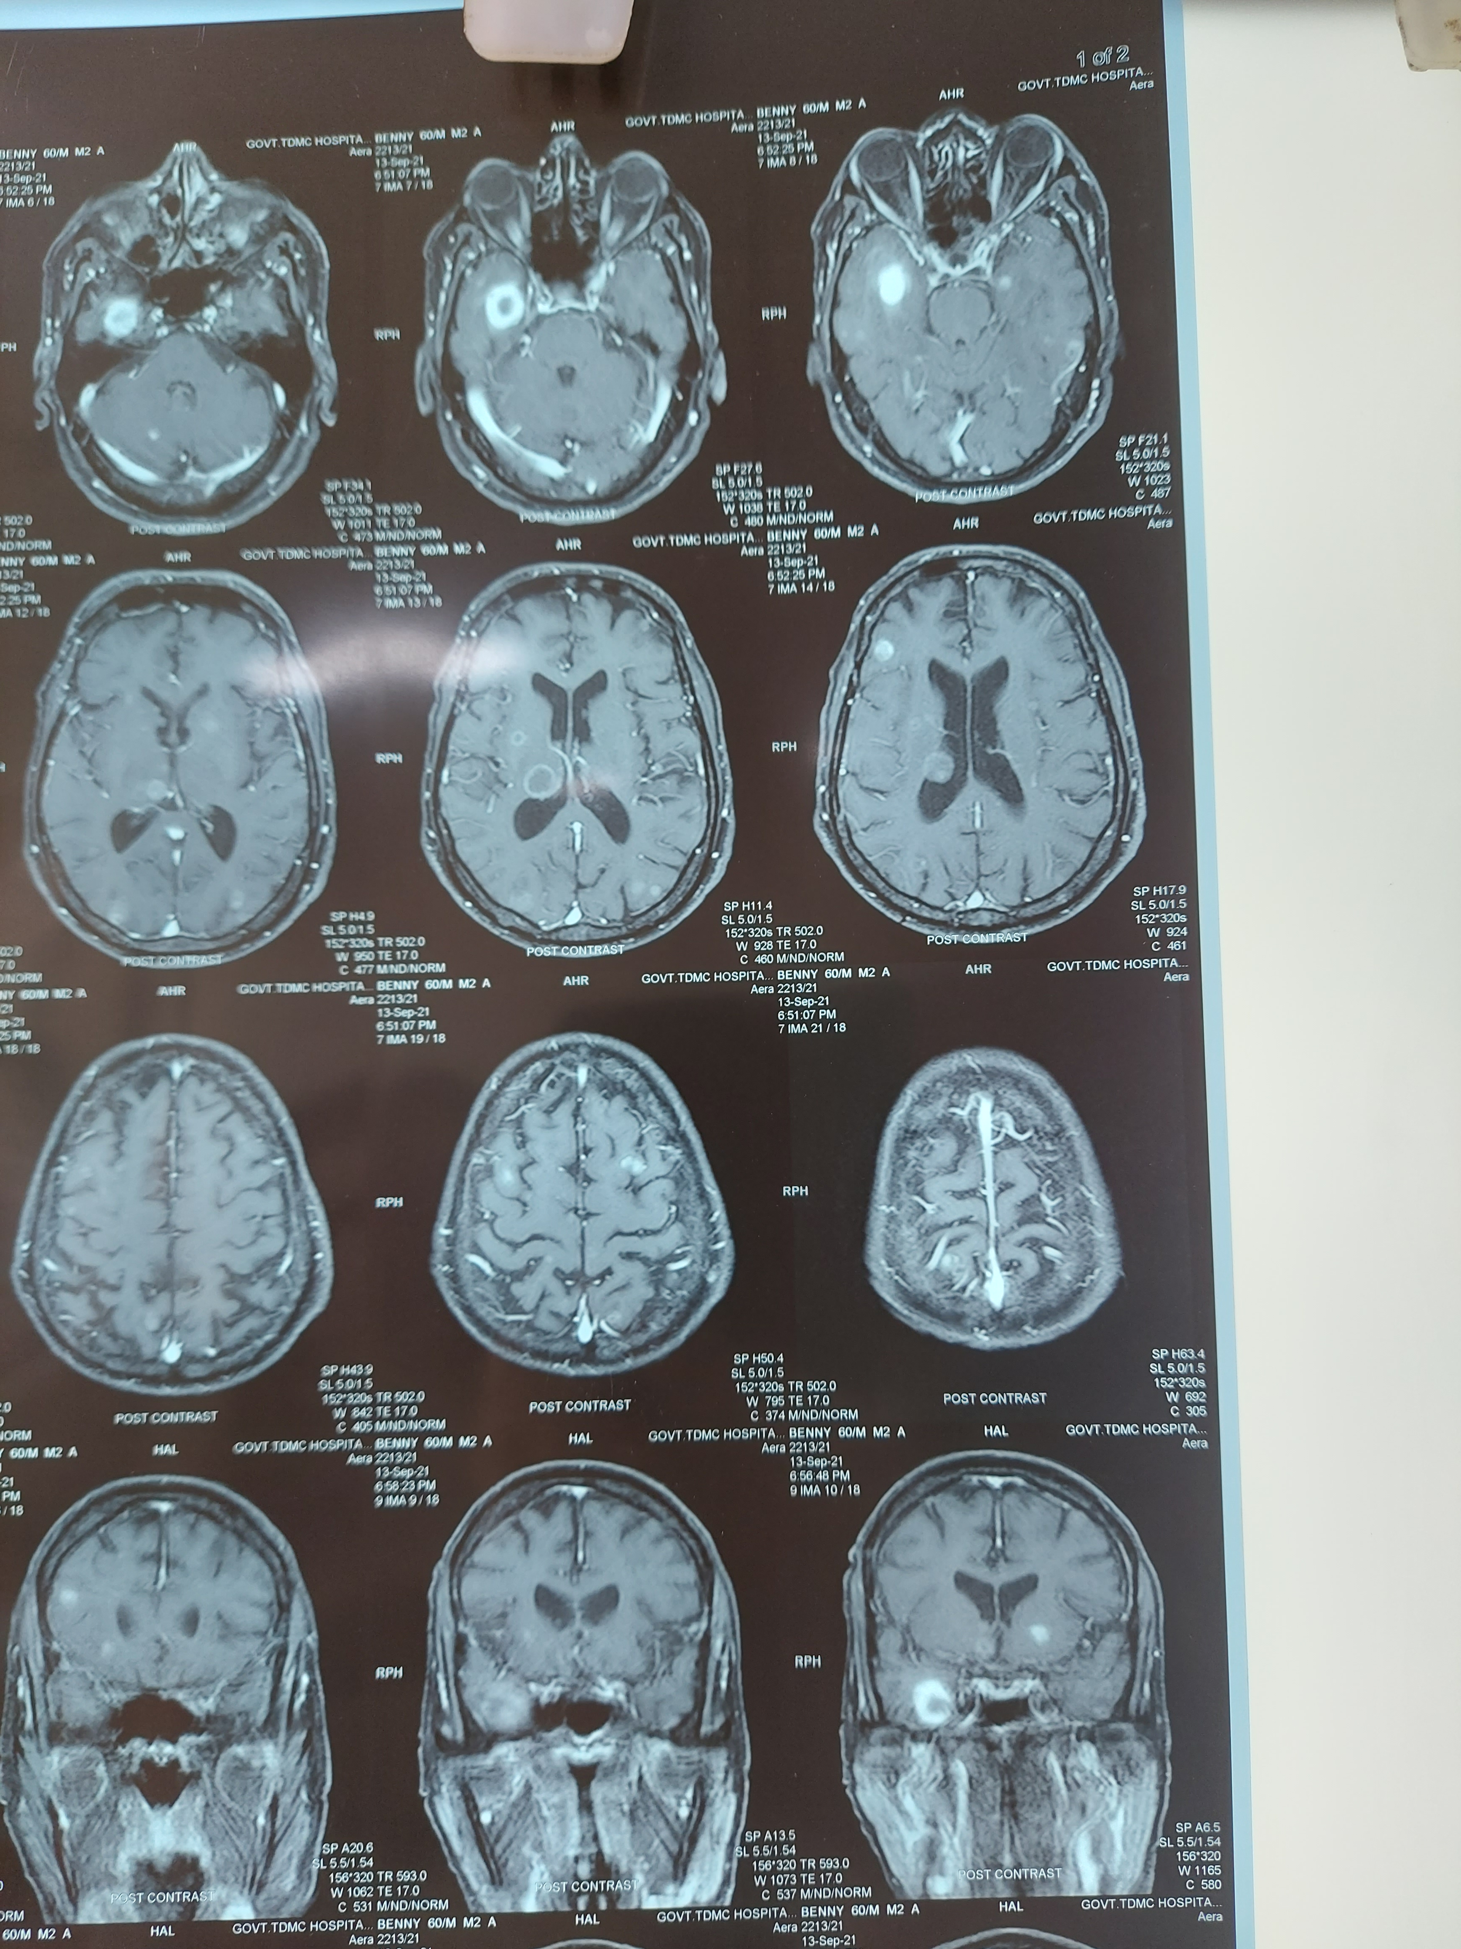
MRI BRAIN

Slide 50
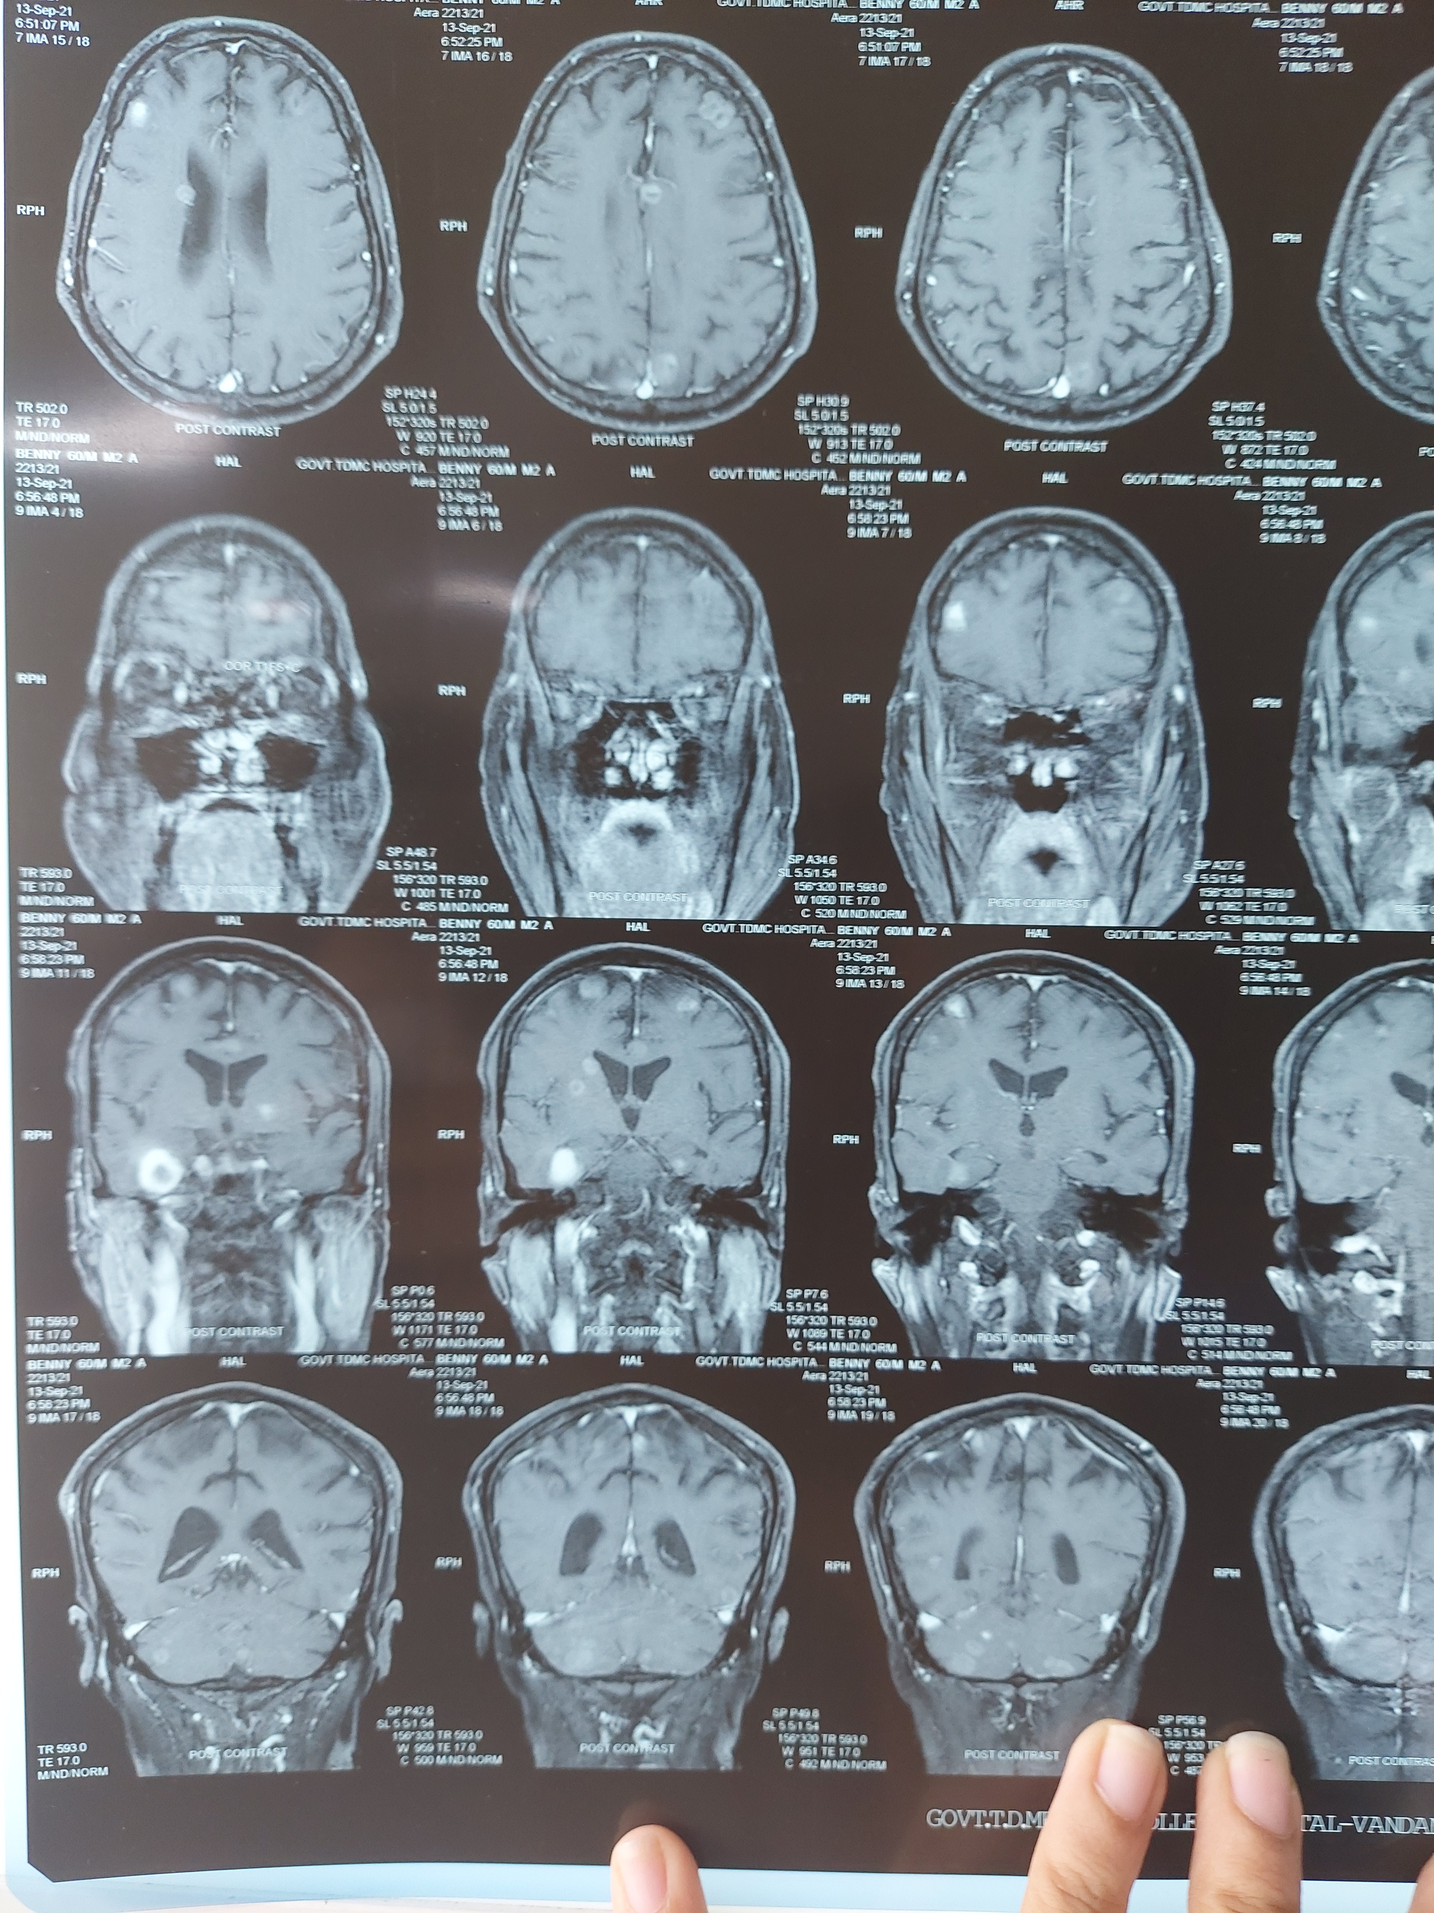
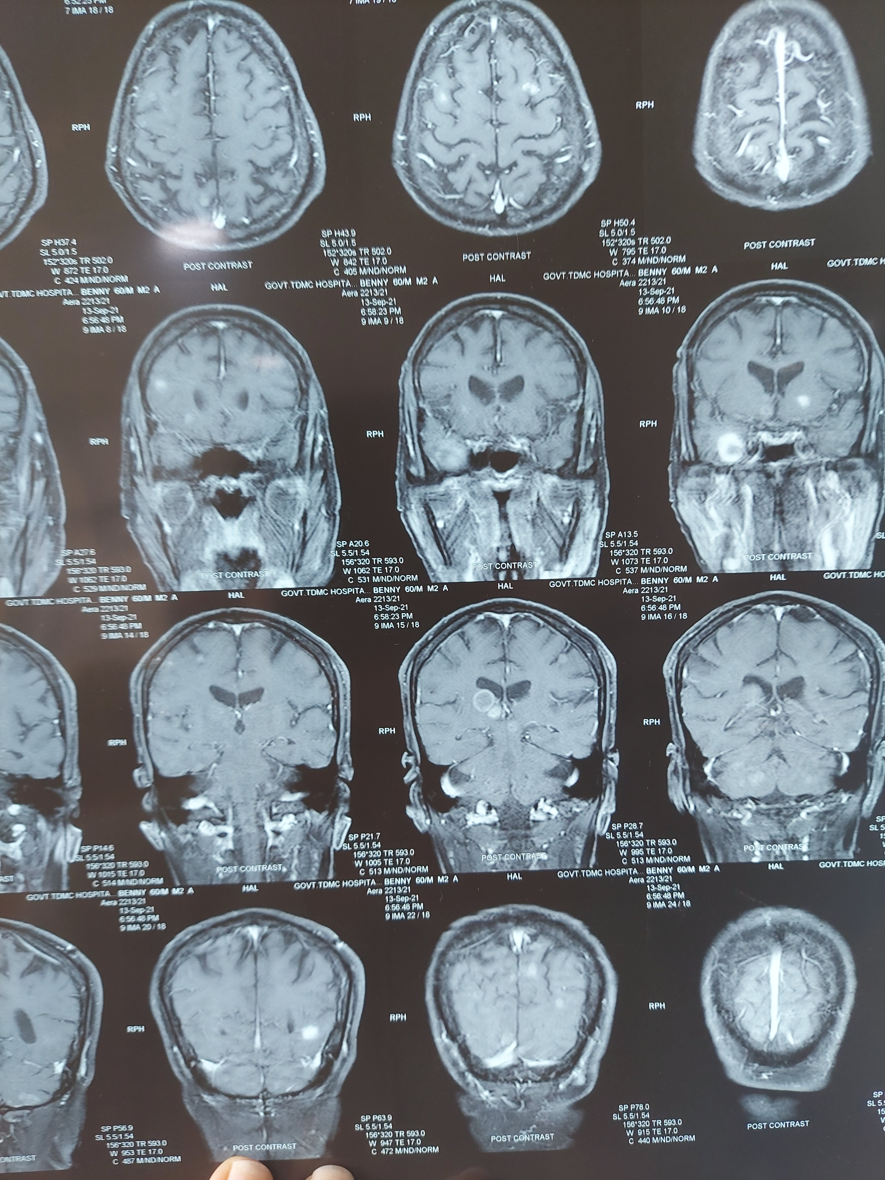

Slide 51
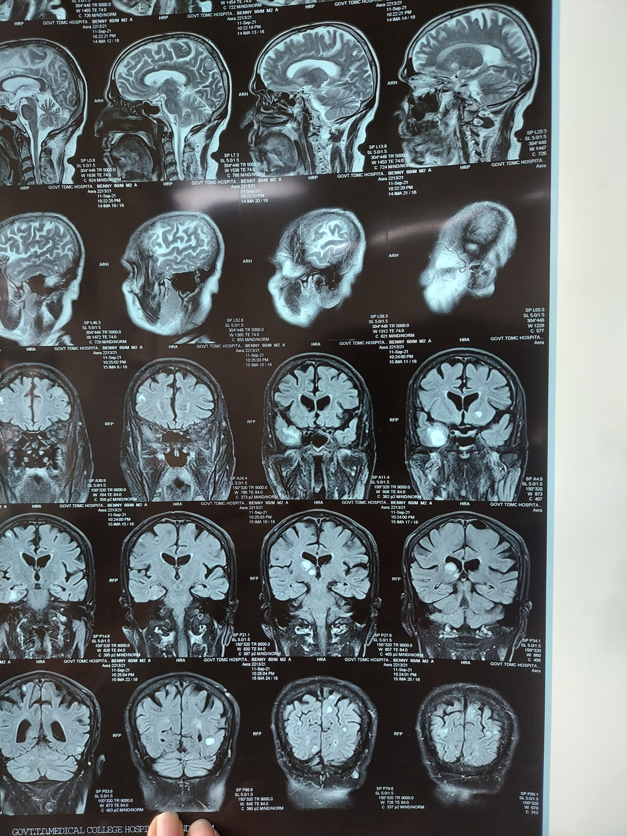
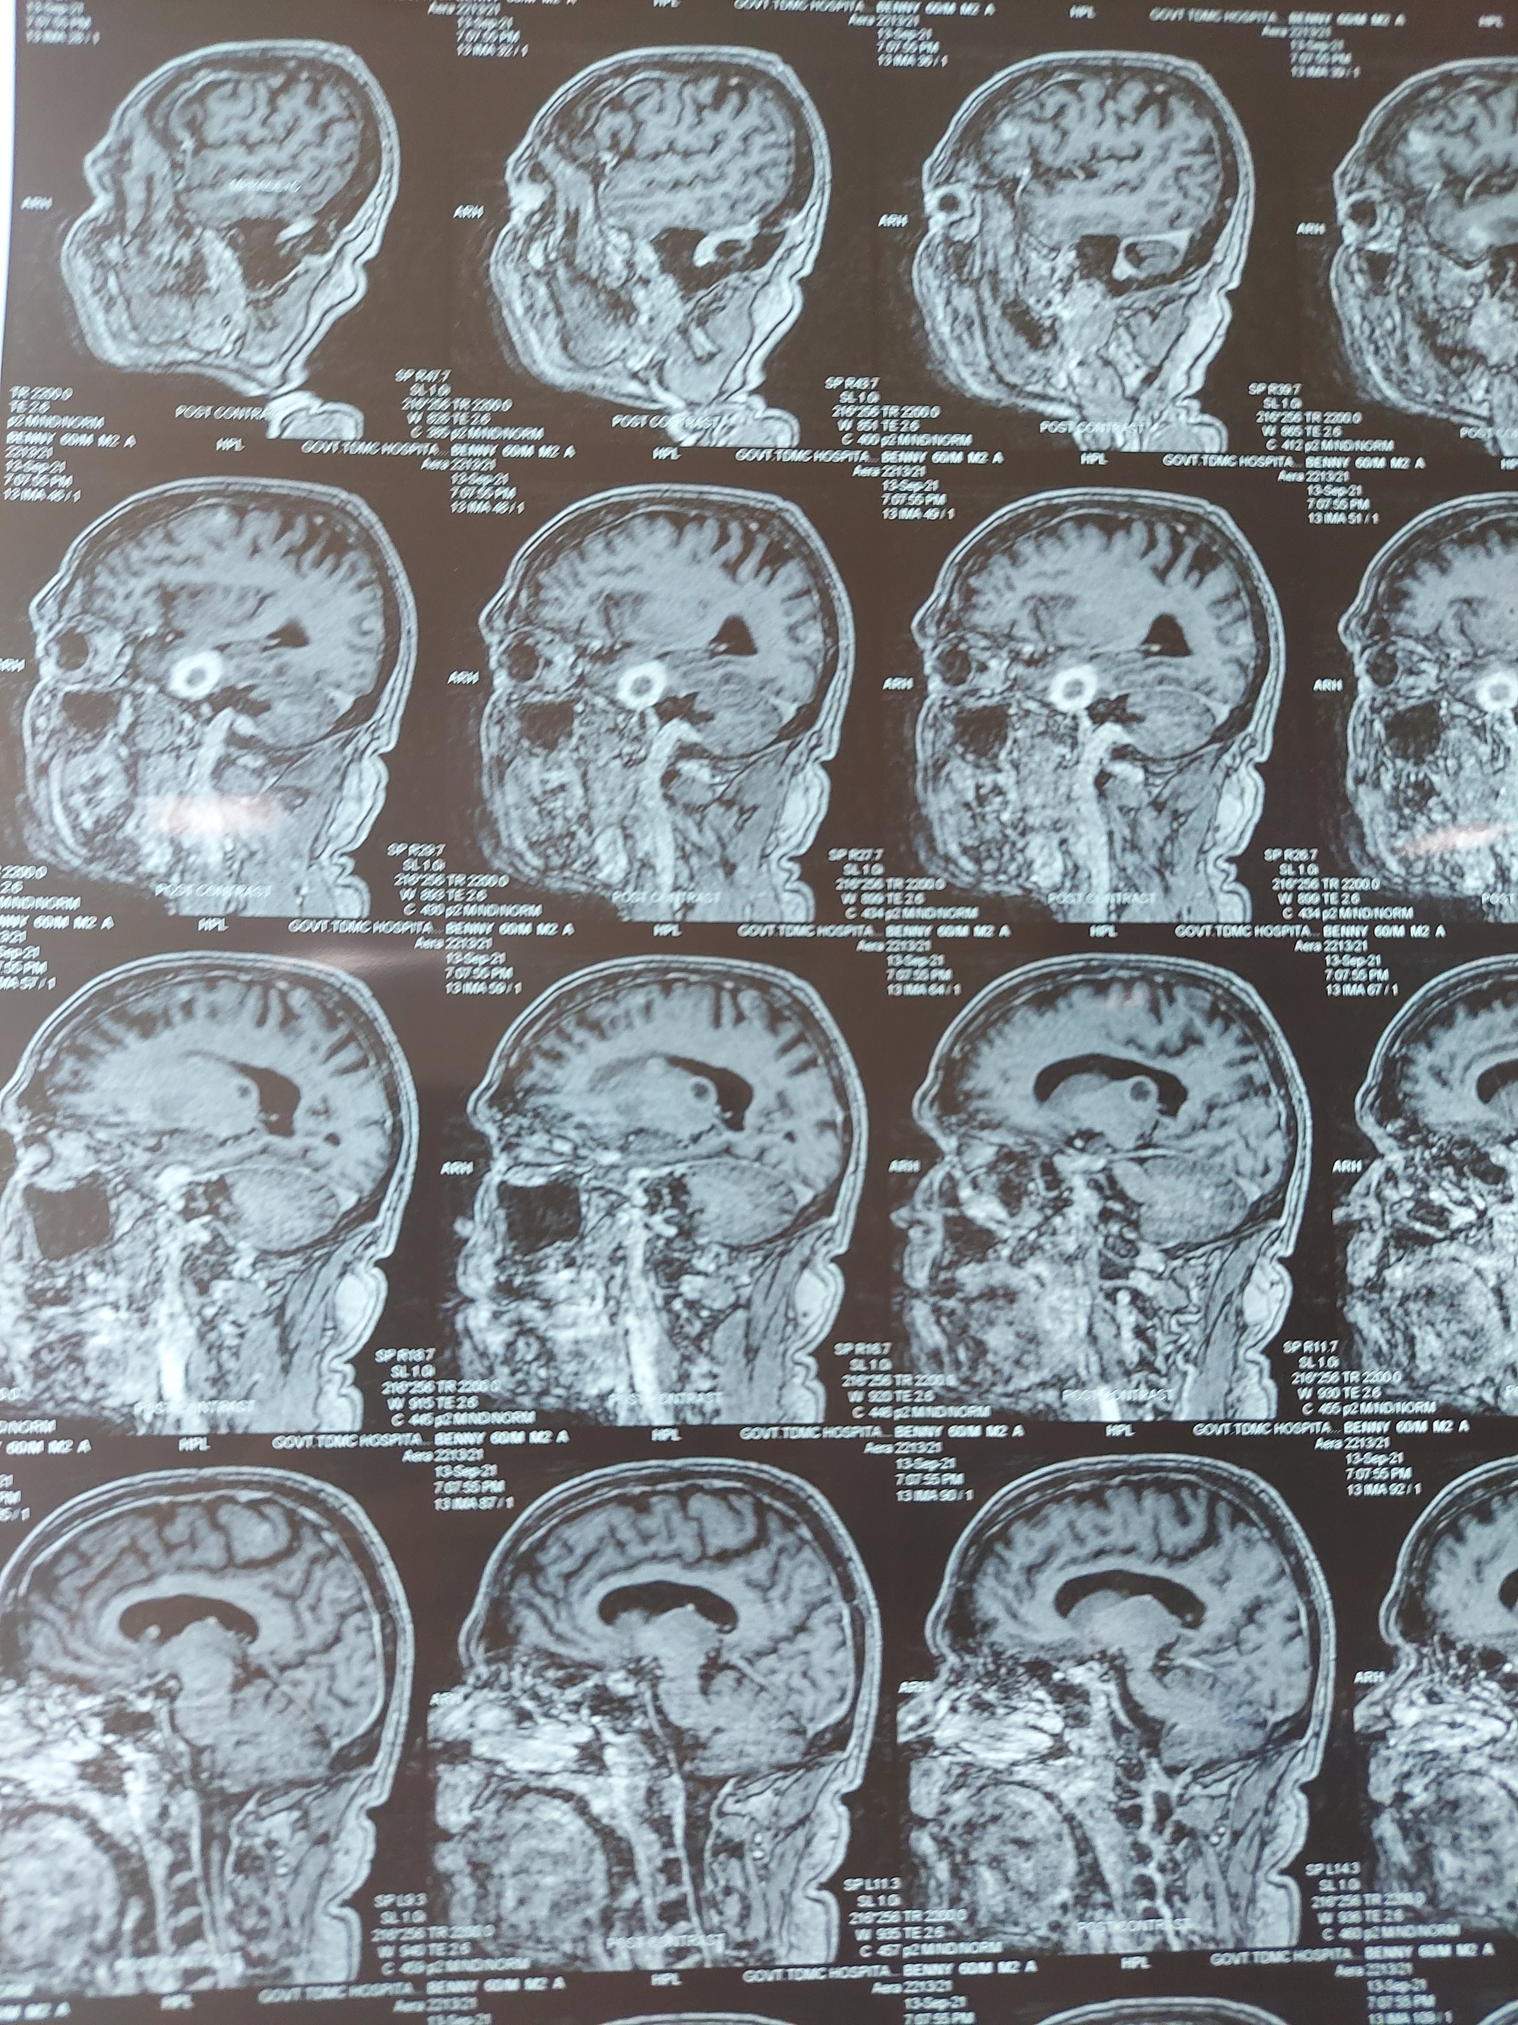

Slide 52
Multiple well defined lesions of varying sizes noted in b/l frontal, parietal, occipital, temporal lobes, bilateral thalamic and CG region, bilateral cerebellar hemisphere and midbrain.
Largest of 2.4 x 2 x 1.8 cm in right temporal lobe
Lesions show heterogenous T2 and FLAIR hyperintensity ,variable T1 signals.
On spectroscopy, elevated choline levels.
Lesions show variable enhancement ranging from uniform ,punctate and ring shaped enhancement.
No midline shift or herniation.
Thoracic screening: right lung mass lesion of 12.5 x 7.2 x 6 cm involving the hilum with mediastinal extension (likely malignant)

Slide 53
FINAL IMPRESSION
Probable primary bronchogenic carcinoma with hemorrhagic brain metastasis presenting as right focal motor seizures.
Ethanol related CLD
Newly detected systemic hypertension

Slide 54
LP study was not done since patient and bystanders weren’t willing for the same
A Mantoux test was done along with sputum studies for TB. Mantoux was negative.
Patient was planned for a CECT Thorax plus Abdomen .
After reviewing with Neurosurgery and Neuromedicine, he was discharged at request with thiamine, antiepileptic, Acetazolamide. Hepatoprotective agents and laxatives added in view of CLD. He was advised to review with reports of CECT Thorax.

Slide 55
TAKE HOME NOTES
Bronchogenic carcinoma went undetected in this patient due to his poor socioeconomic status and lack of awareness. So is the case for majority of the population.
The acute presentation in this case might be due to hemorrhage into the metastasis.
Late onset seizures should never be ignored.

Slide 56
THANK YOU

