Slide 1
Clinical Club M3
Clinical Spotter
DR.SHIFA.C
JR3

Slide 2
A 47 years old male with congenitally short right lower limb, dyslipidemia, systemic hypertension, was admitted with recurrent episodes of chest pain.
H /o previous admission with atypical chest pain.
Evaluated, non-cardiac chest pain – musculoskeletal.

Slide 3



















We noticed a characteristic facies.

Slide 4
Spot diagnosis?
Long and narrow face
Temporal wasting
Hollow cheeks
Frontal balding

Slide 5
He also had,
Grip myotonia
Wasting of distal muscles of upper limb, especially small muscles of hand.
Tongue myotonia

Slide 6
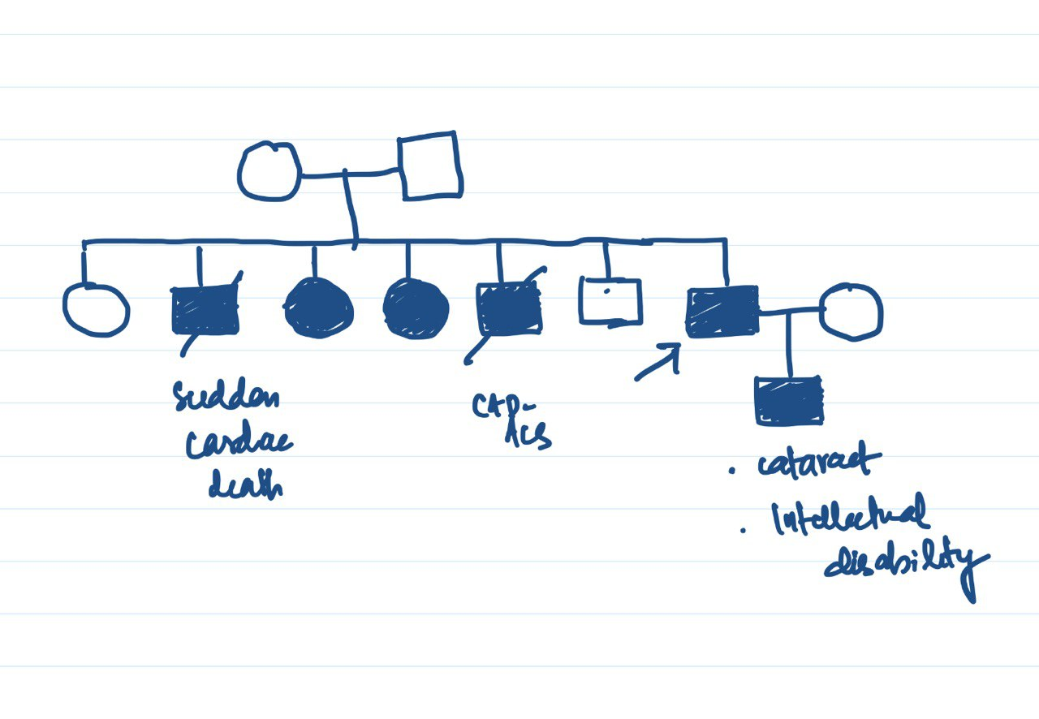
Family history

Slide 7
Myotonic dystrophy
The most common forms of adult onset muscular dystrophy.
Skeletal muscle weakness and myotonia, cardiac conduction abnormalities, cataracts
The 2 major forms are:
DM1 (dystrophia myotonica type 1)
DM2

Slide 8
MYOTONIC DYSTROPHY TYPE 1(DM1)
Genetics - expansion of CTG repeat in the untranslated region of DMPK gene.
Autosomal dominant
The length of CTG repeat expansion and somatic mosaicism- variable disease severity & age of onset.
Pathophysiology –RNA toxicity from the expanded repeat in the transcripts

Slide 9
Phenotypes
Congenital DM1 – hypotonia, poor feeding, respiratory failure, death in neonatal period.
Childhood DM1- onset before 10 years. Cognitive & behavioural problems.
Mild DM1
Classic DM1

Slide 10
Classic DM1- 2nd to 4th decade of life
Skeletal and respiratory muscle weakness, myotonia, muscle pain, cataracts, cardiac arrhythmias, excessive daytime somnolence.

Slide 11
Mild DM1
The mild form
Mild weakness, myotonia and cataracts.
Onset between 20-40 years, typically after 40 years.
Normal life expectancy

Slide 12
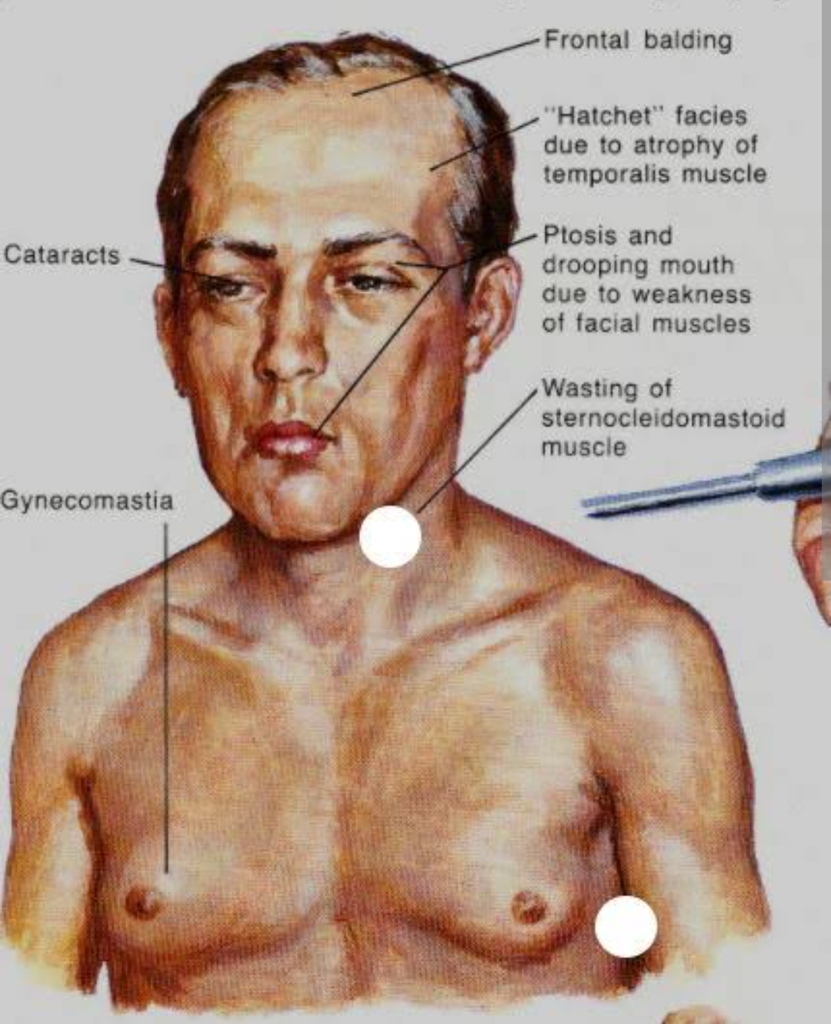
Hatchet facies
Skeletal muscle weakness
Facial muscles(levator palpebrae, temporalis, sternocleidomastoids), distal muscles of forearm, intrinsic hand muscles, ankle dorsiflexors.
Long & narrow face, high arched palate, hollow cheeks, saggy jaw, ptosis.

Slide 13
Involvement of quadriceps, respiratory muscles, palatal & pharyngeal muscles, tongue, EOM –less common
Pelvic girdle, hamstrings, ankle plantar flexors are spared.
Over time, weakness progresses – proximal muscles are also involved- abnormal gait. Frequent falls.
In DM2, neck flexors, finger flexors, muscles of hip girdle are involved first; facial weakness is less prominent and late.

Slide 14
Myalgia
Muscles pain, stiffness and fatigue- common.
Usually in proximal muscles; and in legs > arms.
Unrelated to myotonia, day-to-day variability, even at rest.
Chest pain – often worked up for cardiac disease.

Slide 15
Myotonia
Slowed relaxation following a normal muscle contraction
Most prominent in early stages; aggravated by cold and stress.
in facial, jaw, tongue, and hand intrinsic muscles.
As weakness progresses, clinical myotonia becomes less evident.

Slide 16
Cardiac abnormalities-cardiomyopathy, heart failure, conduction disorders, arrhythmia.
Respiratory complications –pharyngo-oesophageal weakness, weakness and myotonia of respiratory muscles.
Hypersomnia and excessive daytime sleepiness.
primary hypogonadism, testicular atrophy, low sperm count, infertility.

Slide 17
Smooth muscle involvement in GI tract – dysphagia, abdominal pain, constipation, diarrhoea, pseudo-obstruction; gall stones; IBS.
Cognitive dysfunction
Cataracts – early onset posterior subcapsular cataract; christmas tree or snowflake cataract.
Mild-moderate sensorineural hearing loss.
Premature frontal balding.

Slide 18
Increased risk of neoplasms- endometrium, brain, ovary and colon.

Slide 19
DM2
Less severe than classic DM1
Onset between 2nd to 7th decades
Proximal muscle weakness predominates –hip girdle.

Slide 20
Management
No disease modifying therapy
Muscle involvement – exercise training
NSAIDs, gabapentin, TCA, mexiletene, low dose glucocorticoids.
Myotonia – mexiletene 450 mg daily (in 3divided doses) & other Na channel blockers like phenytoin.

Slide 21
Cardiac evaluation and follow up.
Respiratory function – monitor FVC annually in the asymptomatic; more frequent in others.
-Incentive spirometry, cough assist devices
-NIV –BiPAP
-Pneumonia & influenzavaccinations.

Slide 22
Hypersomnolence – modafinil, methylphenidate
Cataract – corrective surgery
Speech & swallow therapy; metocloprmide to aid GI motility. Small frequent meals.
Screen for diabetes, hypothyroidism.

Slide 23
When statins are given- monitor the dose; watch for myopathic symptoms, monitor serum CPK.
Genetic counselling.

Slide 24
Thank you !

