Slide 1
THE BEAR’S PAW!
Clinical Club –M5
Dr.Shifa,JR3
M5 unit

Slide 2
This is the story of a 45 yr old lady,a home maker.

Slide 3
She presented with
Right loin pain * 2 months
Dull, persistent, from loin to groin, increasing with coughing & with leg movements.
No fever /chills /vomiting/ decreased urine output.

Slide 4
Looking back
Hypothyroidism, hypertension, dyslipidemia
Recurrent episodes of UTI, urolithiasis

Slide 5
Family history
H/o Pulmonary tuberculosis in brother
T2DM in parents and siblings
Husband has Hepatitis B, on treatment

Slide 6
Personal history
Married * 18 years
Nullipara, h/o a first trimester abortion 10 years back, h/o infertility treatment more than 5 years back.
Urine output good
Bowels regular, no malena/bleeding PR

Slide 7
On examination
Pallor
PR-90 bpm, regular
BP- 110/70
P/A – Tenderness with a palpable mass in the right side of abdomen- globular, involving right hypochondrium, lumbar and iliac areas ; around 5*4 cm ,lower border not well defined, not moving with respiration.

Slide 8
Other systems –within normal limits.
Right lower limb movements were restricted due to pain.

Slide 9
What is it??
Retroperitoneal sarcoma?
Renal mass?
Huge psoas abscess (cold abscess)?

Slide 10
Initial Investigations
28/10/22
Hb – 7.4
MCV-83.2
WBC – 9800
N74L18.6
Platelet – 4.61 L
ESR-80
CRP-83.1
INR-1.12
TFT -normal
B.Ur/Cr – 22/0.9
Na/K- 136/ 3.7
RBS- 178
S.Bil – 0.8
Protein/ Alb – 8.3/2.7
OT/PT – 31/16
ALP – 148
Ca - 8.1 (10.4)
Phos – 3.2
Uric acid -3.7

Slide 11
P.smear – severe microcytic hypochromic anemia
TSAT – 17%
S. Ferritin – 147.4
FBS -168
HbA1C – 7.2
Chest X-ray & ECG –normal
HIV –neg
HBSAg- neg
Anti-HCV –neg
FLP
T.Chol – 221
TG – 217
HDL-26
LDL - 152

Slide 12
Blood C & S – sterile
Urine C &S – mixed growth
Sputum CBNAAT –neg
USG abdomen (2/11/22) – well defined hypoechoic lesion in liver- early forming abscess / mass lesion.

Slide 13
CECT abdomen (2/11/22)
R acute pyelonephritis with renal abscess which appears continuous with an abscess within right psoas.
R renal & pelvic calculi with pyonephrosis.
Non-functioning right kidney – it did not excrete contrast even after 16 hours.
Hemangioma in segment II of liver.

Slide 14
Here comes the BEAR PAW!

Slide 15
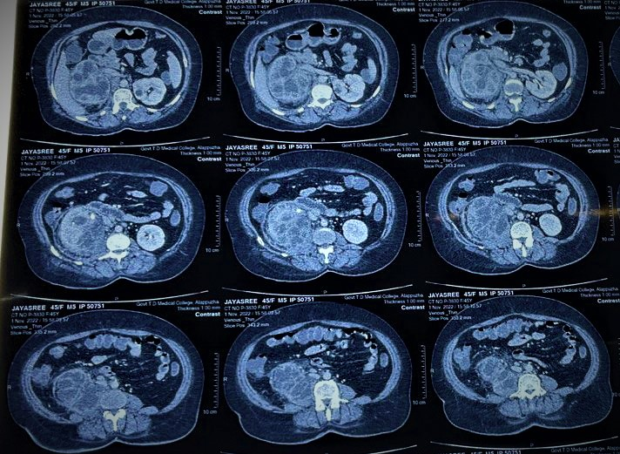

Slide 16
Owing to the characteristic CT findings- bear-paw sign- a diagnosis of Xanthogranulomatous pyelonephritis was made.

Slide 17
XANTHOGRANULOMATOUS PYELONEPHRITIS (XGP)
A rare & aggressive chronic pyelonephritis which can result in a non-functioning kidney.
aka Pseudotumor – ability for local invasion & destruction.
Destruction of renal/para renal tissue with granulomatous tissue containing lipid-laden macrophages.
D/D – RCC - differentiated by CT findings& biopsy.

Slide 18
ETIOLOGY
In patients with chronic urinary obstruction, nephrolithiasis & infection
E.coli, Proteus mirabilis, Pseudomonas , Enterococcus faecalis, Klebsiella
Staghorn calculi in 80%, in children-congenital anomalies of urinary tract.

Slide 19
Risk factors
Diabetes
Hypertension
Immunocompromised state
Dyslipidemia
Renal transplantation

Slide 20
Epidemiology
0.6 – 1% of all renal infections
Females > males ; 5th/6th decade
Usually unilateral

Slide 21
Pathophysiology
An inflammatory disorder – defect in degradation of bacteria by macrophages.
Destruction & replacement of renal tissue with lipid laden foamy macrophages.
Starts from renal pelvis& calyces –spreads to renal parenchyma & adjacent organs- liver, spleen, pancreas, duodenum, great vessels, psoas.

Slide 22
Typical history – a middle – aged female with recurrent UTI –most commonly with E.coli /Proteus.
Presents similar to renal tuberculosis/RCC

Slide 23
Diagnosis
CECT – replacement of normal renal tissue with multiple, hypoechoic areas of dilated collecting system surrounded by an enhanced rim of contrast medium – multiloculated appearance – Bear paw sign, Renal stones
Biopsy – lipid-laden foamy macrophages (difficult to differentiate from clear cell RCC)
IHC-XGP stains positive for PAS

Slide 24
Management
I .V. antibiotics & percutaneous drainage – if not resolving – partial/total nephrectomy.
B/L XGP –B/L nephrectomy & RRT

Slide 25
Patient Education & Follow-up
Evaluate the other kidney annually with imaging.
Relieve any obstructions & treat UTI episodes aggressively.

Slide 26
Course in hospital
Initially started on Iv Ceftriaxone & Metronidazole suspecting liver abscess.
She was not toxic/ febrile initially.
Urology consultation – R. percutaneous nephrostomy done under LA on 5/11/22 after anemia corretion with 2 pint PRC.
Drained pus -Pus C&S, TB PCR sent

Slide 27
Post procedure, patient became febrile.
Her counts & CRP –rising trend.
Changed over to Iv Piperacillin- Tazobactam on 5/11.
Pus C&S yielded E.coli resistant to Piptaz– started on Meropenem after discussion with Microbiologist.

Slide 28
She was shifted to Kottayam MCH at request citing personal convenience.
She was under Urology follow up there.
Clinically better.
PCN tube removed after 6 weeks.
Repeat USG showed heteroechoic collection right side, planned for nephrectomy in January 2023.

Slide 29
Thank You

