Slide 1
CLINICAL CLUB
The 2nd story :A Case of Frozen Joints
Dr Shifa C
JR3, M5

Slide 2
54/male, no comorbidities, H/o occasional alcohol use
Gave H/o insidious onset gradually progressive multiple large joints pain and stiffness(B/L shoulders, knee, hip, upper back) which almost coincided with a chikungunya infection 16 years back.
Around 15 years back he was evaluated for symptoms suggestive of lumbar radiculopathy.

Slide 3
He had a history RTA around the same time and left knee injury which was repaired surgically with a wire, and evaluation with MRI was not done citing this.
Now presented with worsening of pain and joint stiffness to an extent that he has difficulty moving and carrying out his daily activities for the past 3-4 months.

Slide 4
He was initially admitted under Neuromedicine for evaluation of hip girdle pain and difficulty walking.
He was taken over to M5 as a case of suspected post chikungunya arthritis.
The patient had pain and stiffness of upper back, B/L shoulder, knee , hip joints ; there was no morning stiffness or much small joint involvement.

Slide 5
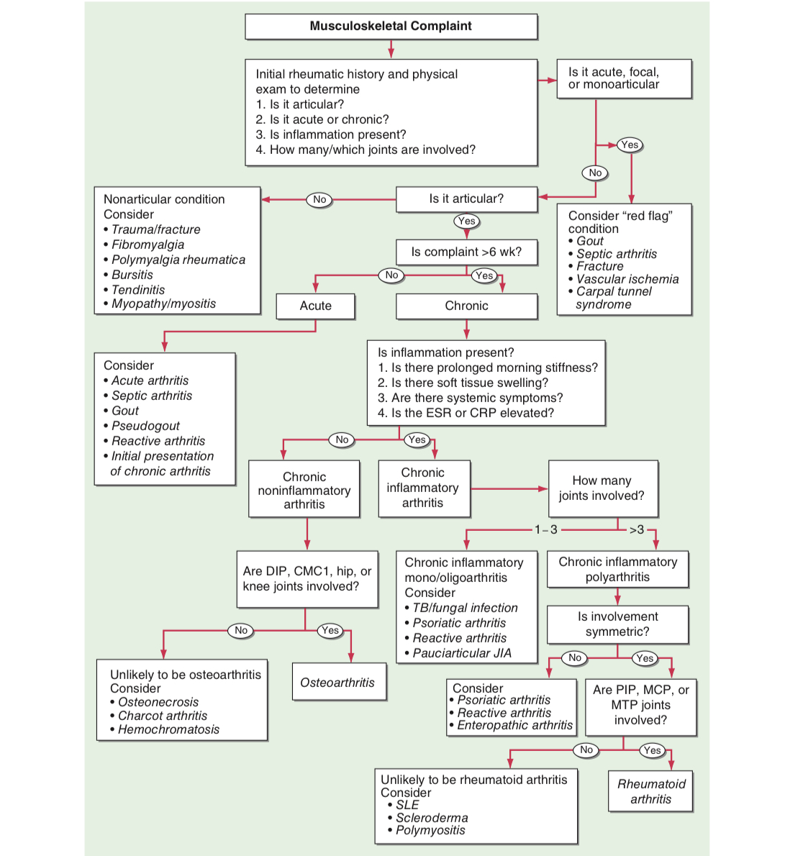

Slide 6
Differential diagnoses
Chikungunya arthritis- Resembles inflammatory arthritis- pattern similar to RA, peripheral spondyloarthritis, fibromyalgia.
Symmetrical polyarthritis affecting hands & feet, non- specific arthralgias, or asymmetric oligo/mono arthritis similar to seronegative spondylarthropathies.
Meta analysis of post- CHIKV infection- C/C inflammatory rheumatism in 25% and chronic arthritis in 14% cases.

Slide 7
But here, a non- inflammatory arthritis- not associated with morning stiffness, pain increasing with movements.

Slide 8
2. Osteoarthritis
Patient had a early onset disease, at less than 40 years of age.
Post- traumatic arthritis? - h/onRTA and trauma to Rightshoulder and left knee present,
But here other joints are also involved, symmetrical,including axial skeleton.

Slide 9
Was it something else?
Since the patient had joint stiffness, stiff back and restricted range of motion, PMR opinion was sought.
Something clicked for them after seeing the X-ray spine!

Slide 10
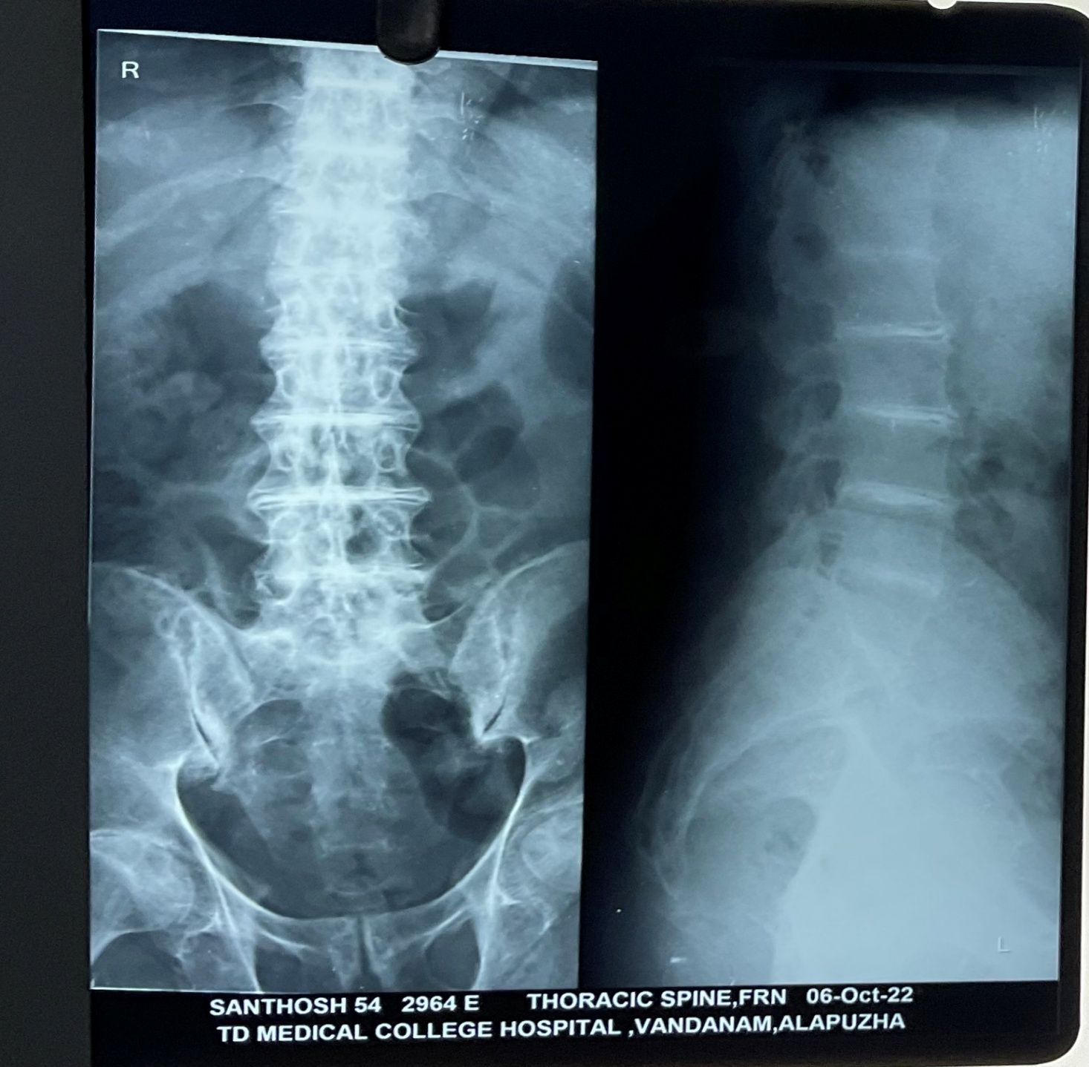
Your thoughts?

Slide 11
Differential diagnoses for intervertebral disc calicification
Degenerative
Post-op/ Traumatic
Ochronosis - very dense central ( nucleus pulposus) calcification with osteopenia, begins in lumbar spine & ascends.
Ankylosis spondylitis
Pseudogout - annulus fibrosus calcification
Hemochromatosis - annulus fibrosus calcification
Hypervitaminosis D- annulus fibrosus calcification, uncommon
Hyperparathyroidism
Amyloidosis
Poliomyelitis
Acromegaly

Slide 12
In this new light, suspecting something other than post-chicken gunya polyarthritis and post traumatic osteoarthritis,
when asked further, patient and bystanders gave a history of dark urine which would stain his undergarments when spilled, and which used to leave a blackish colour on his bathroom tiles and toilet seats, for as long as the patient could remember.
Was evaluated for this complaint in his childhood, records were not available, not followed up, not on any medications.
No similar complaints in his parents/siblings/children/cousins/nieces/nephews.

Slide 13
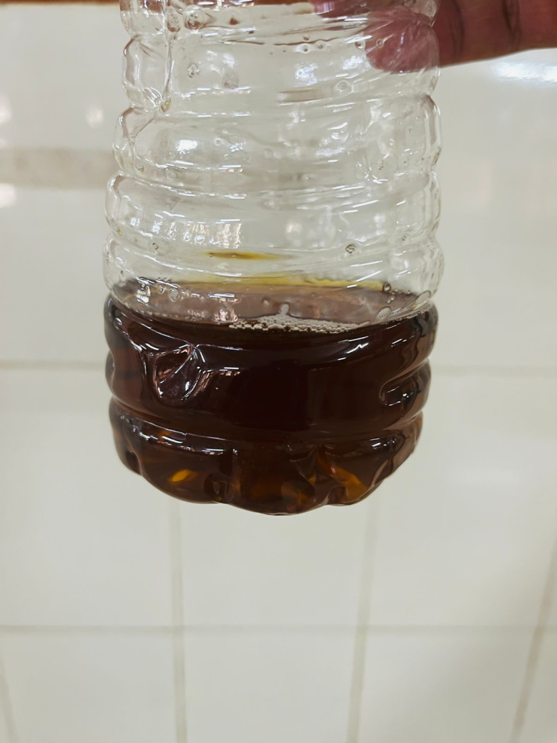
Not Coke!

Slide 14
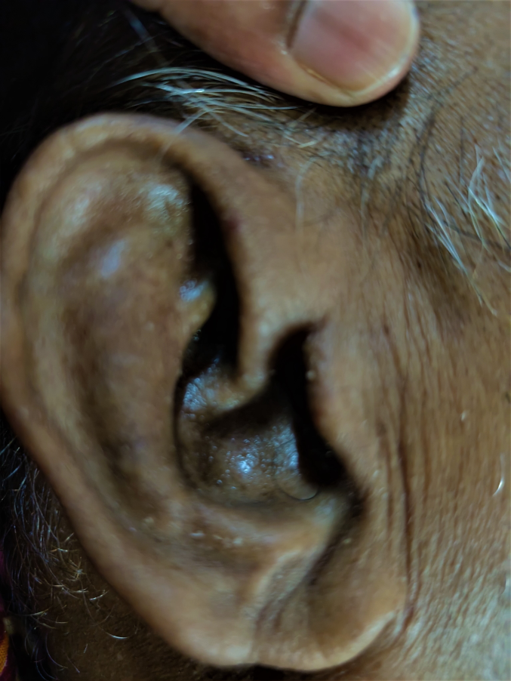
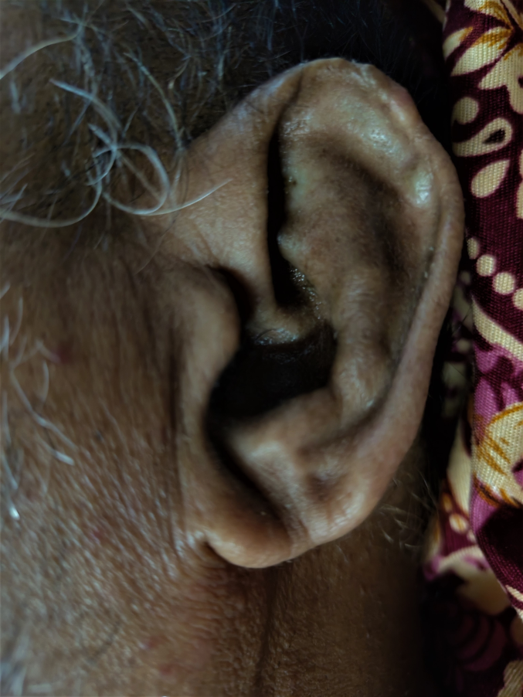

Slide 15
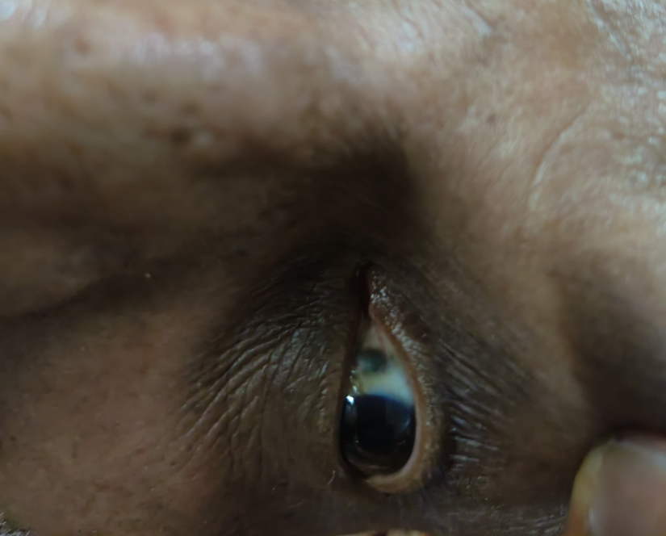
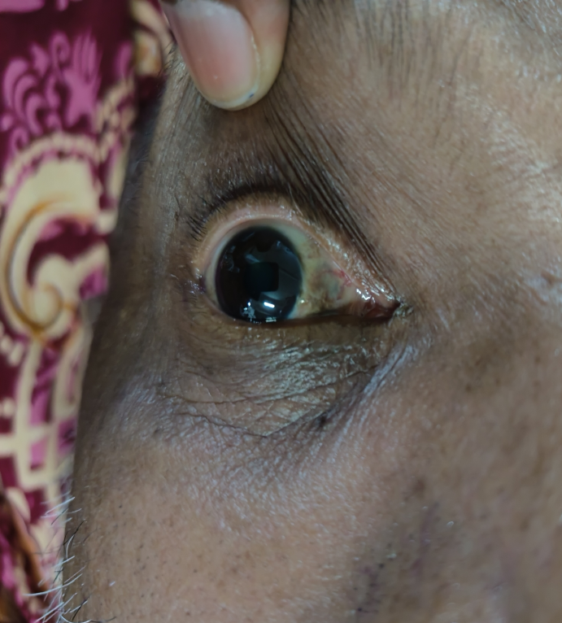
What do you see

Slide 16
Radiography findings
Severe osteoporosis
Multilevel intervertebral calcification- widespread & involves nucleus pulposus
Syndesmophyte formation
Multilevel vacuum phenomenon
Multilevel disc space narrowing

Slide 17
Spot diagnosis?
With the earlobe ,eye pigmentation , along with the dark urine and polyarthritis, a provisional diagnosis of ochronosis due to alkaptonuria was made.

Slide 18
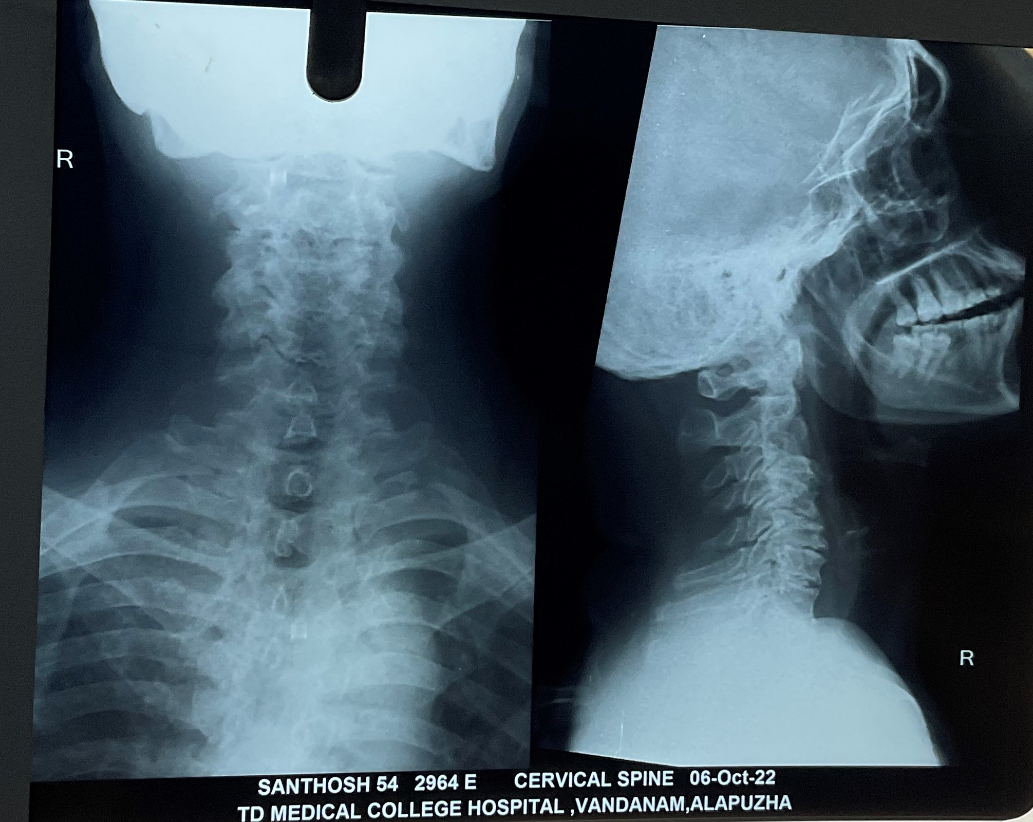

Slide 19
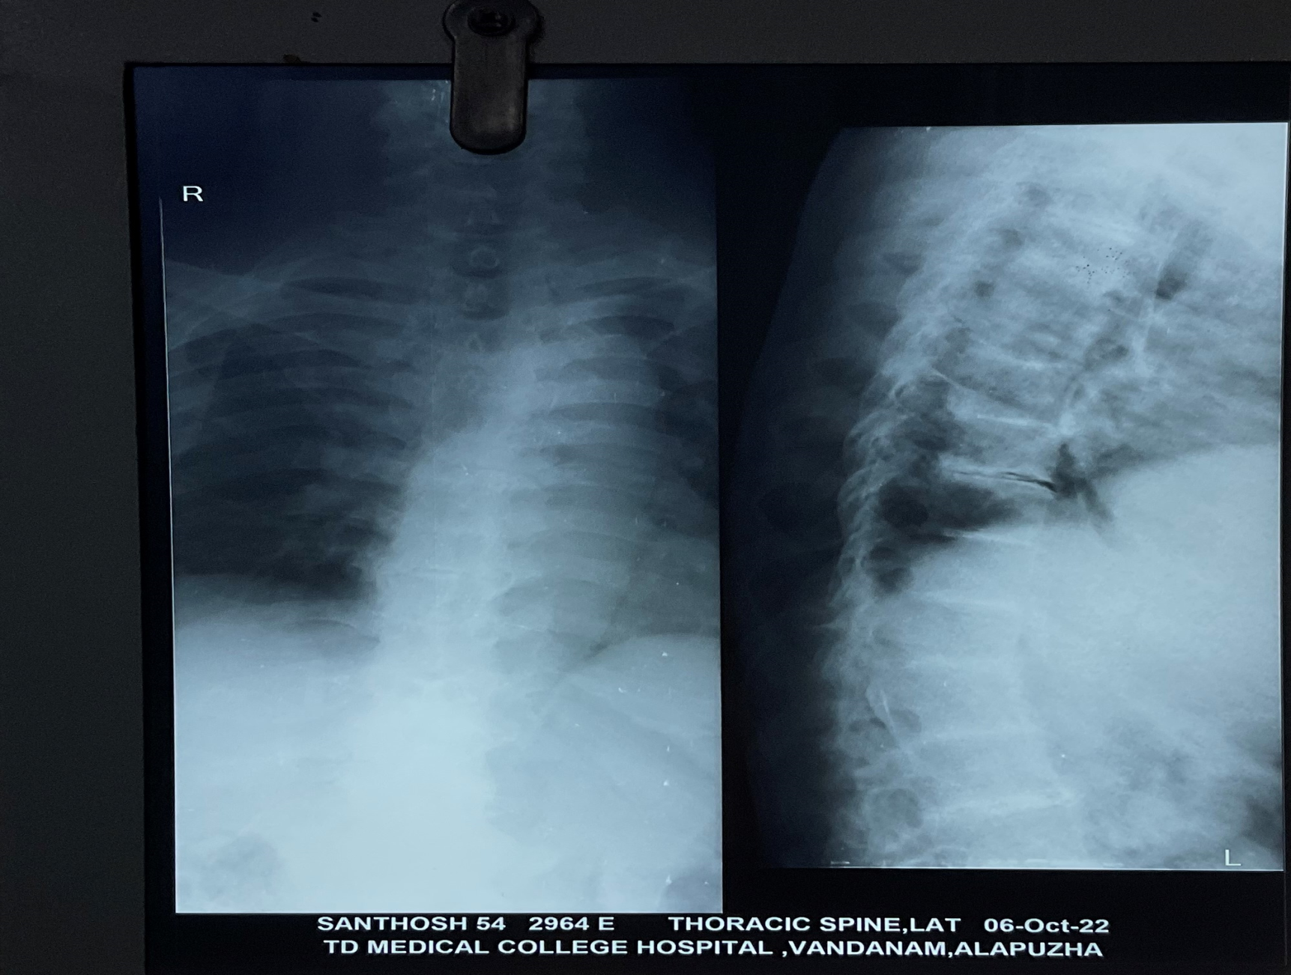

Slide 20
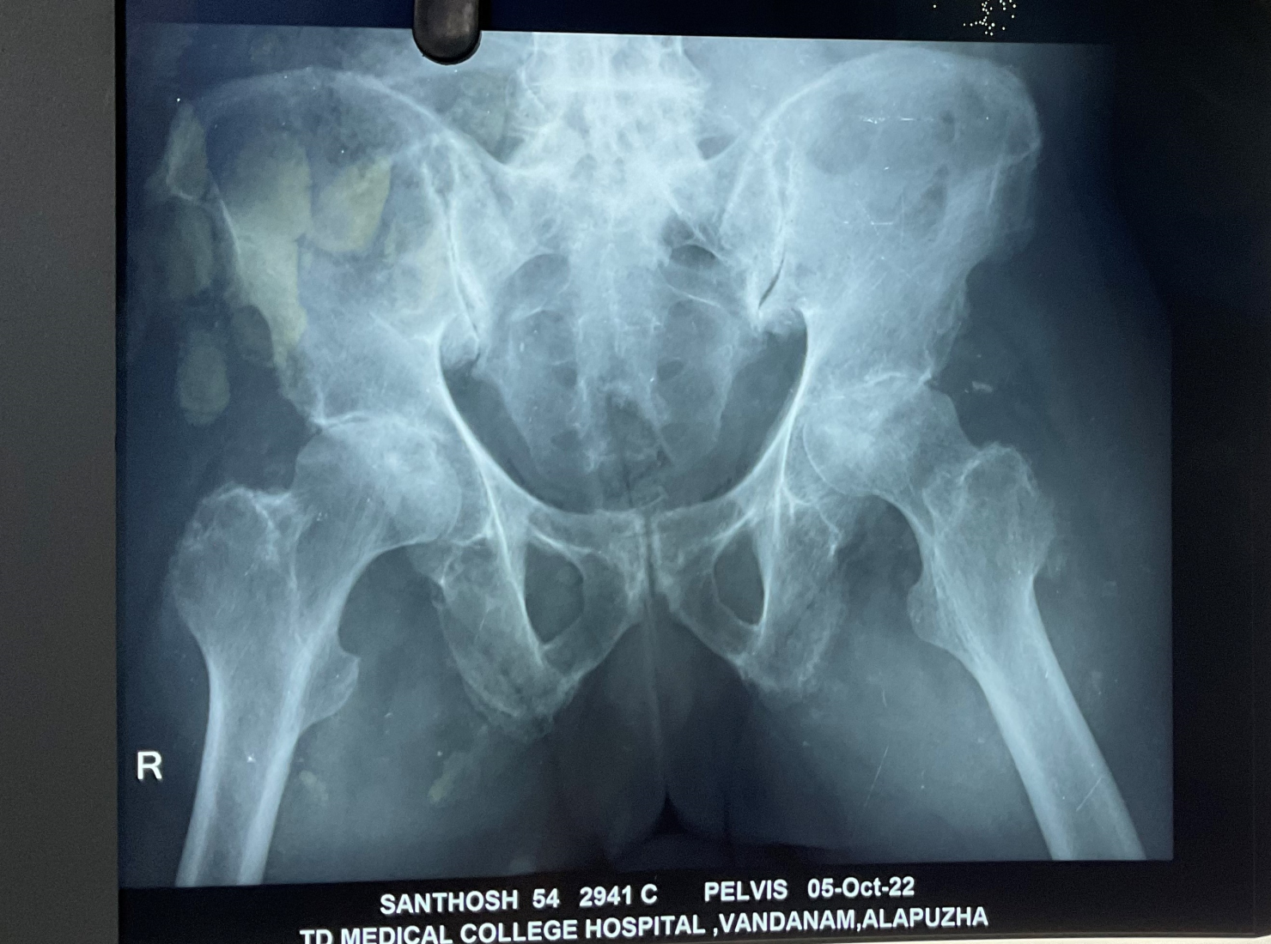

Slide 21
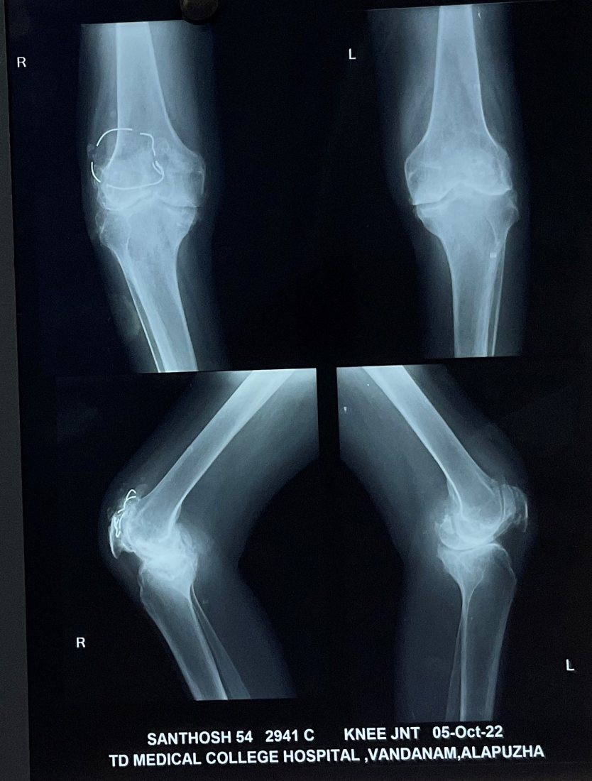

Slide 22
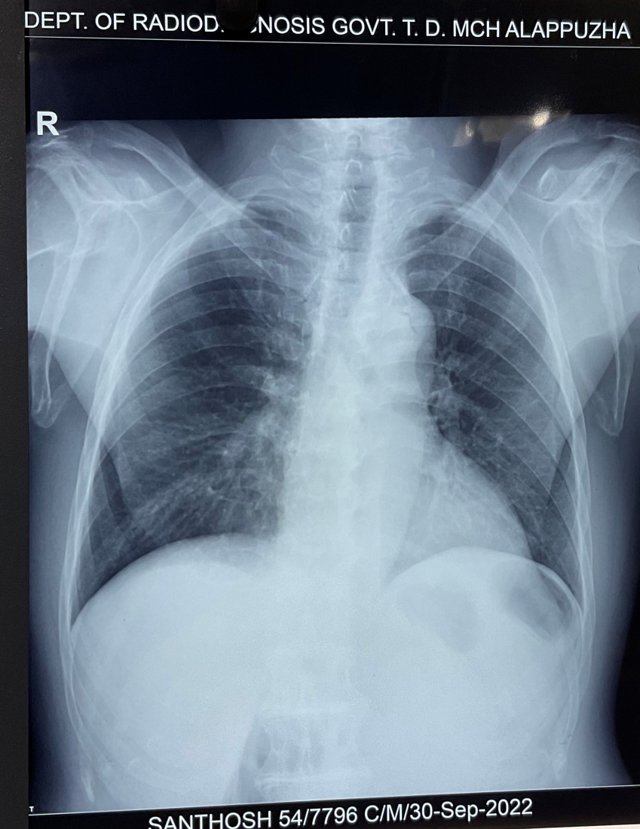

Slide 23
Alkaptonuria
Rare, AR
Endogeneous ochronosis – lack of renal & hepatic homogentisic acid oxidase –accumulation of homogentisic acid– a product of tyrosine and phenylalanine catabolism.
Excess HGA – excreted in urine & deposited in connective tissues, esp. cartilage.
Dark urine-blackens on standing.
Men : women 2:1

Slide 24
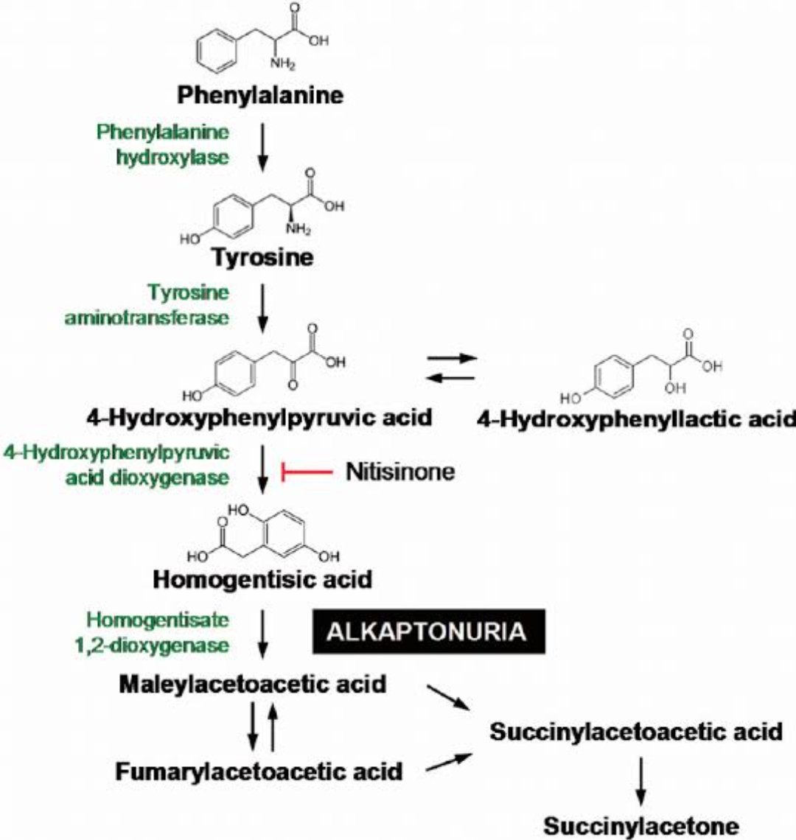

Slide 25
Pigmentation becomes apparent by 3rd decade.
Pigmentation of sclera (Osler sign) and ear cartilage- early signs.
Ochronotic arthropathy – axial spine, followed by knees, shoulder & hips.
Radiographs – early calcification of intervertebral disc- later narrowing of space and eventual disc collapse.
Tendon rupture
HGA deposition in aortic andmitral valves
Renal disease – HGA stones

Slide 26
Exogeneus ochronosis
From topically applied phenolic intermediates – hydroxyquinone, carbolic acid(phenol), picricacid , resorcinol.

Slide 27
Management
No effective treatment.
Dietary restriction of tyrosine and phenylalanine
Might need joint and cardiac valve replacement.
Nitisinone – inhibitor of 4-hydroxyphenylpyruvatedioxygenase – 10 mg daily- can reduce formation of HGA (SONIA-2 study)
Not useful once arthropathy sets in.
Adverse events- keratopathy due to tyrosine, increased infections.

Slide 28
Our patient – too late.
Was advised Cardiological evaluation, MRI spine.
PMR – physiotherapy.

Slide 29
2D ECHO – Aortic sclerosis
MRI could not be done
Urine Homogentisic acid awaited.

Slide 30
Thank you

