Slide 1
Are these Wellen’s Waves?
Clinical Club
Dr Shifa C
Jr3 ,M2

Slide 2
49 year old female, k/c/o CLD- NASH of more than 10 year duration presented in hepatic encephalopathy, on diuretics.
ECG was taken as a part of routine evalation

Slide 3
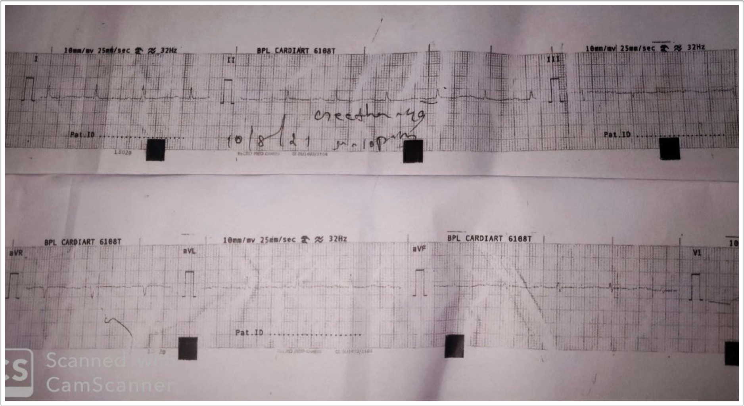

Slide 4
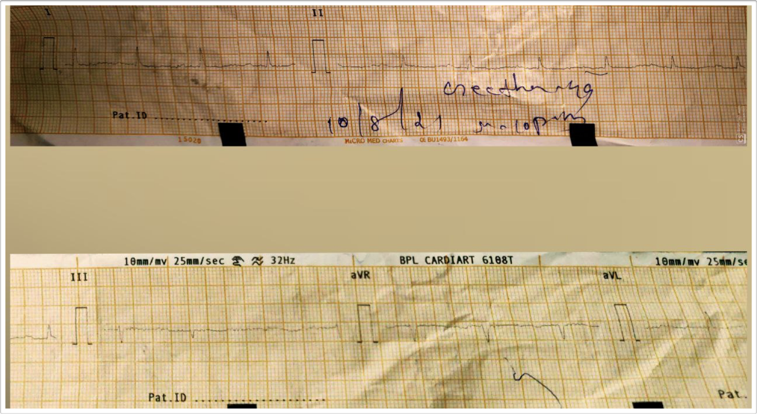

Slide 5
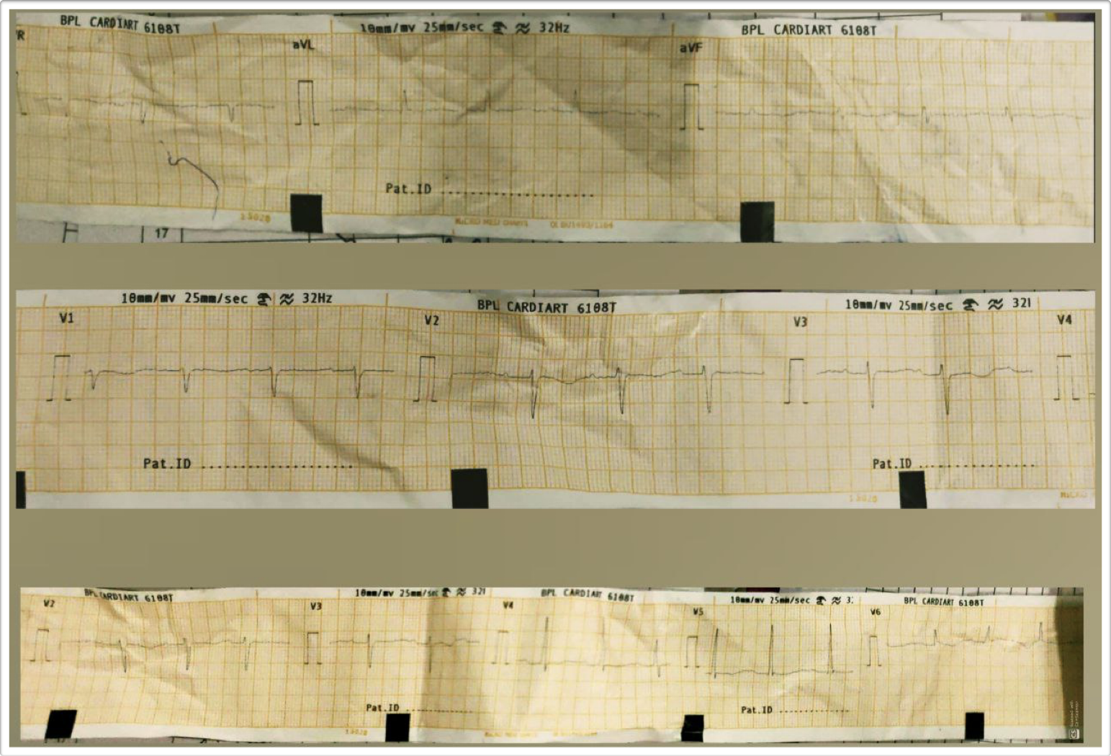

Slide 6
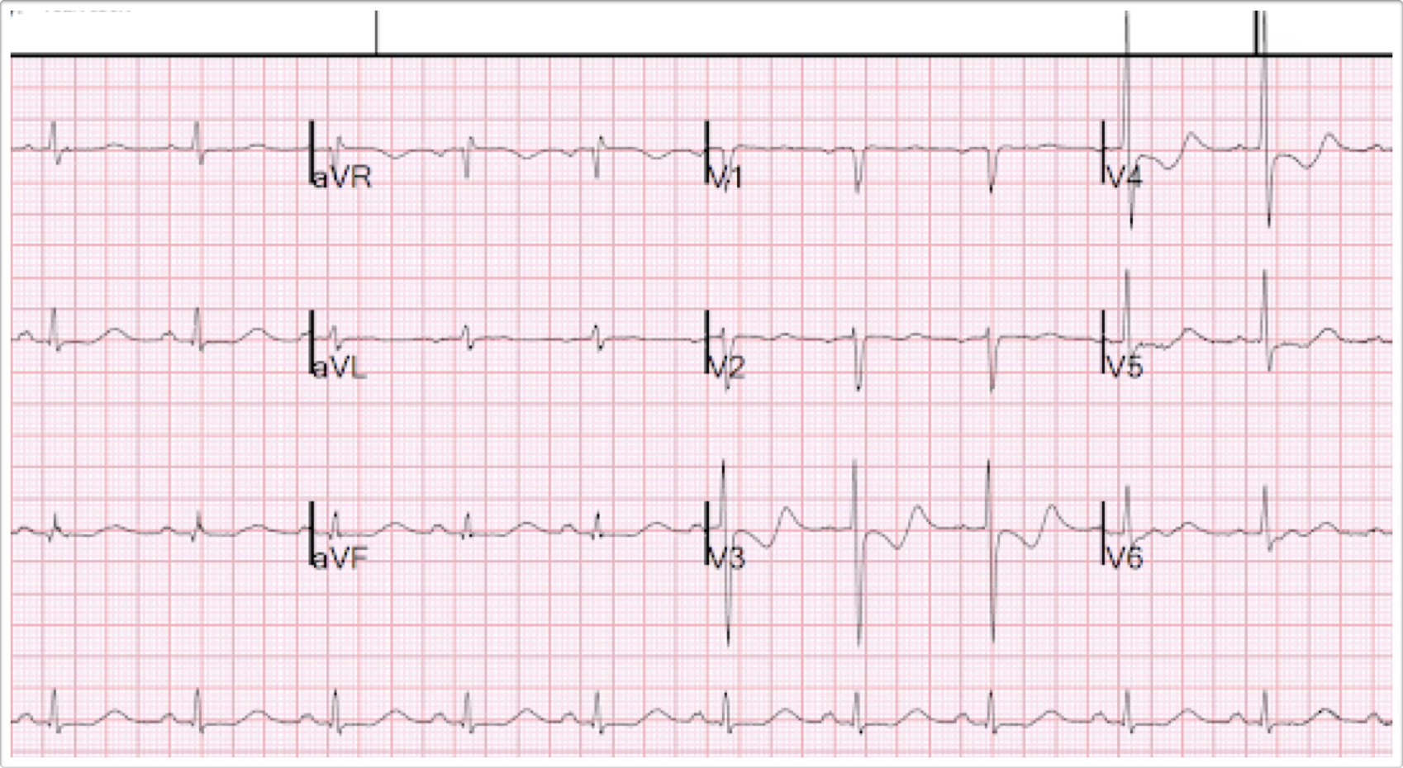

Slide 7
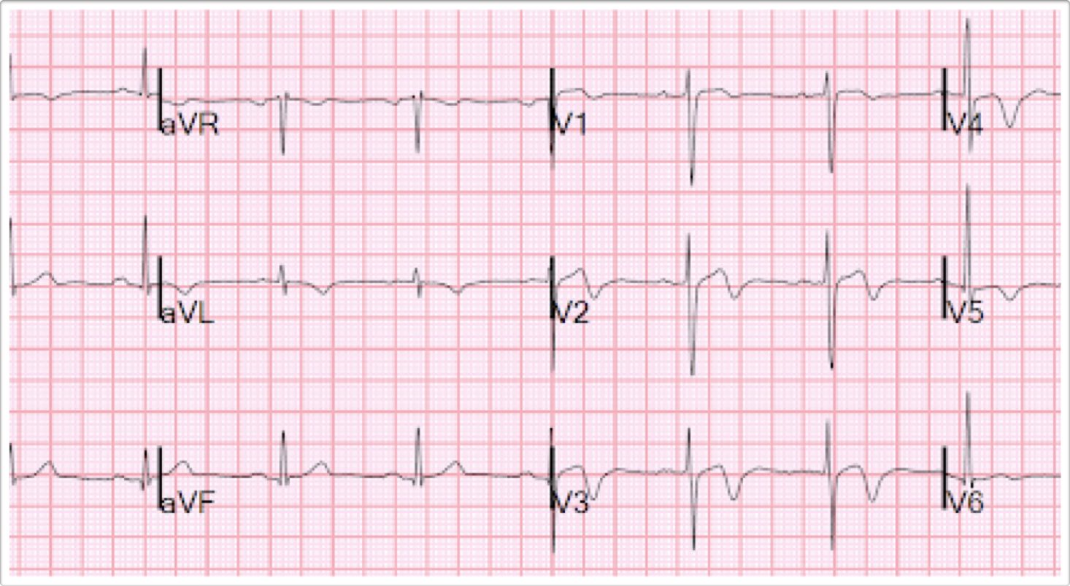
WELLEN’S PATTERN A

Slide 8
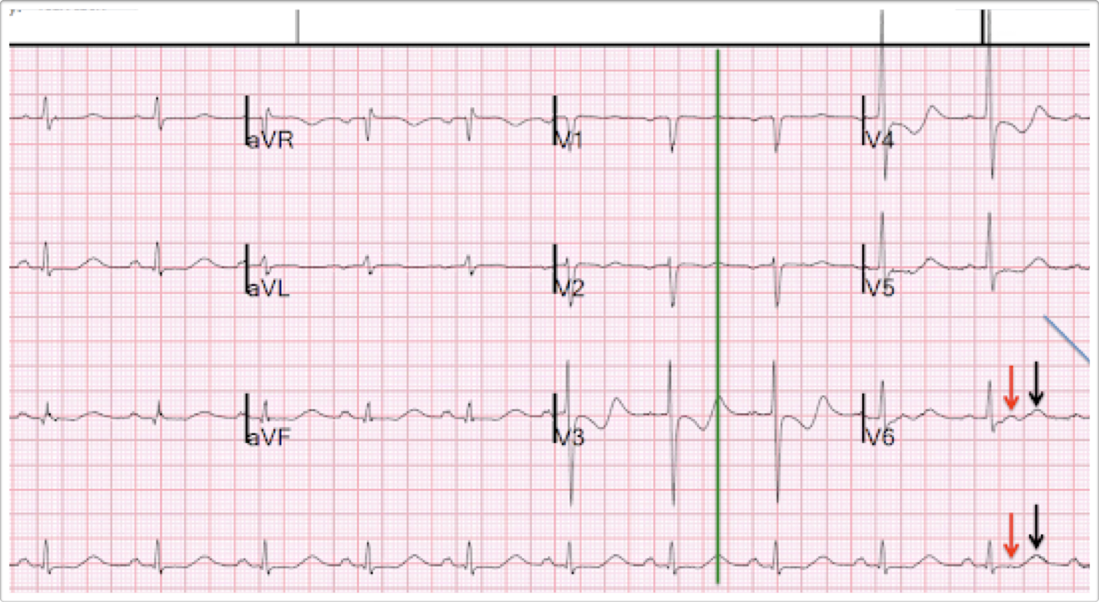

Slide 9
Hypokalemia
K + less than 3.5 mmoI/L
Most common causes - diarrhoea, diuretic therapy
In upto 20% of hospitalised patients, upto 40% of patients on diuretics

Slide 10
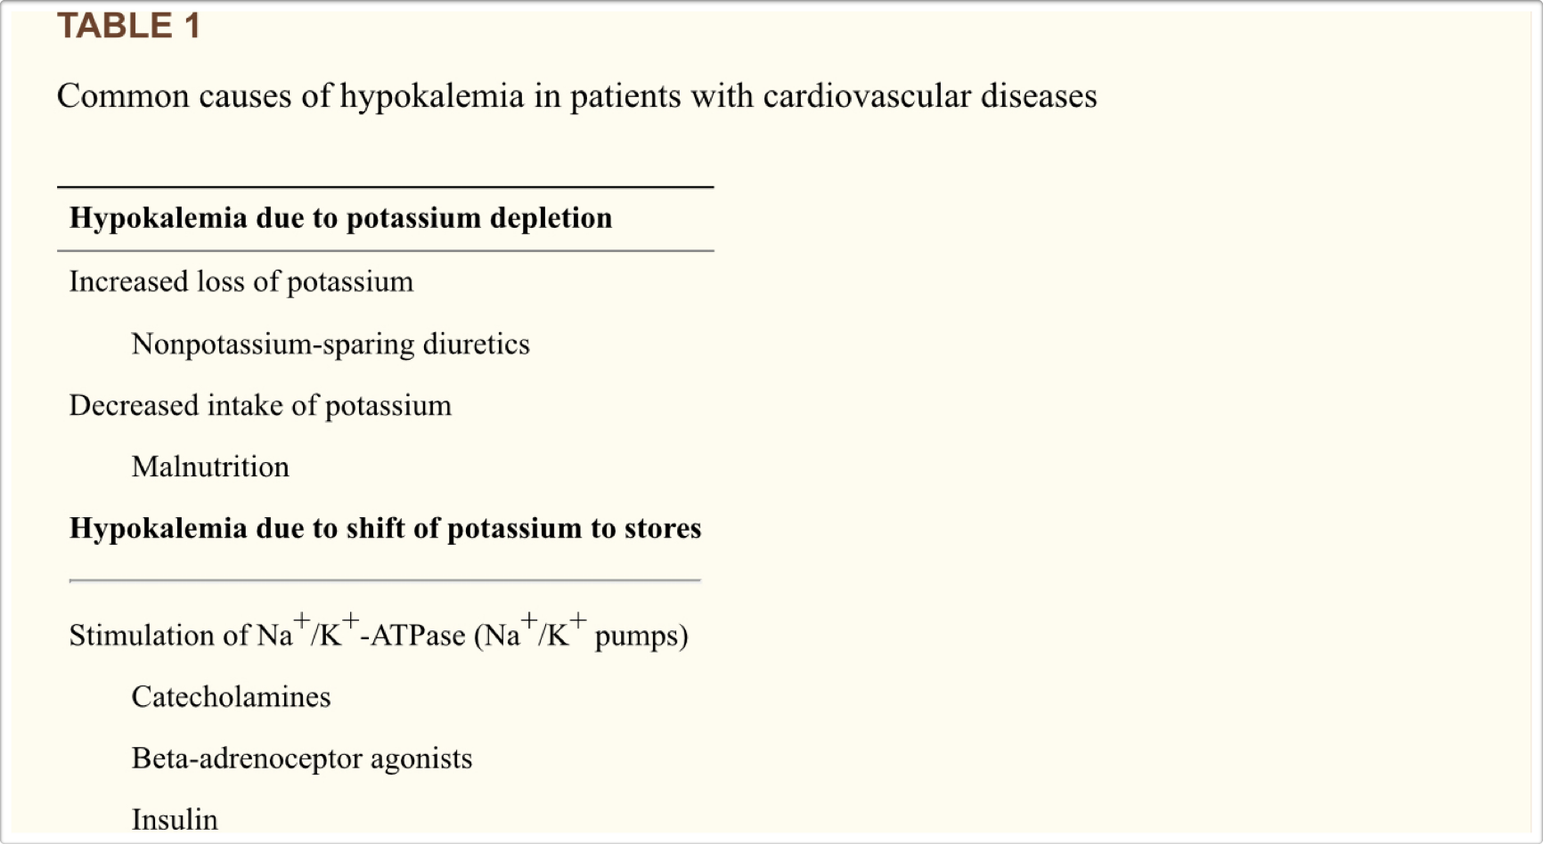

Slide 11
Hypokalemia- ECG changes
The earliest ECG change - decreased T wave amplitude
ST segment depression, PR prolongation, increase in P wave amplitude.
Appearance of U wave
U wave amplitude exceeding T wave - < 3 mEq/L
Severe hypokalemia - T and U wave fusion - pseudoprolonged QT interval

Slide 12
Severe hypokalemia- tachyarrhythmias - VT, VF, AV block
Torsades de pointes, Ventricular tachycardia, Ventricular fibrillation

Slide 13
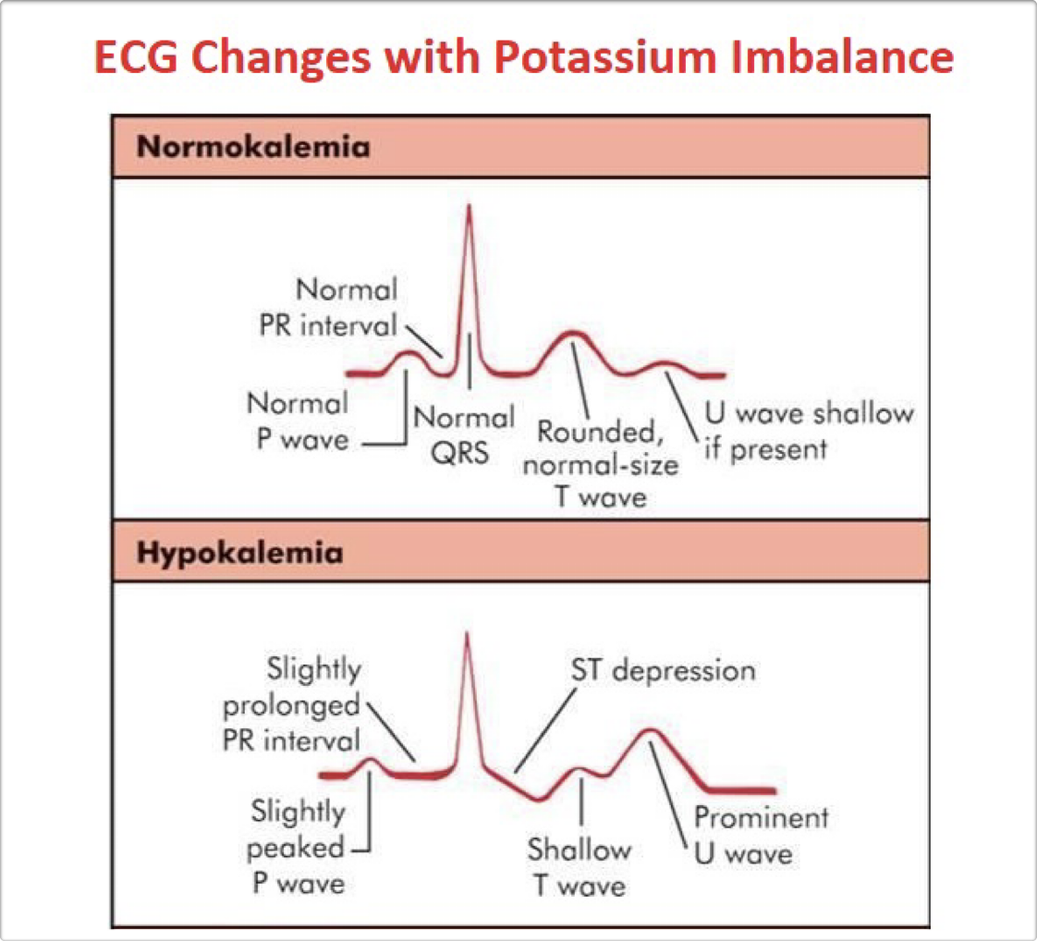

Slide 14
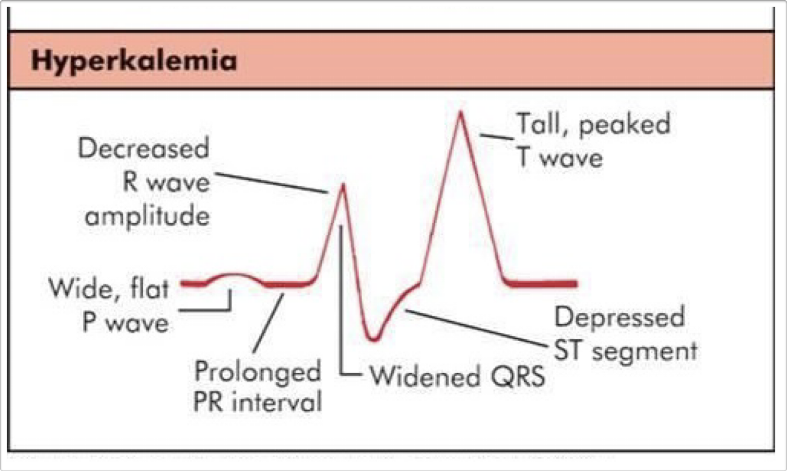

Slide 15
Electrophysiology of ECG Changes

Slide 16
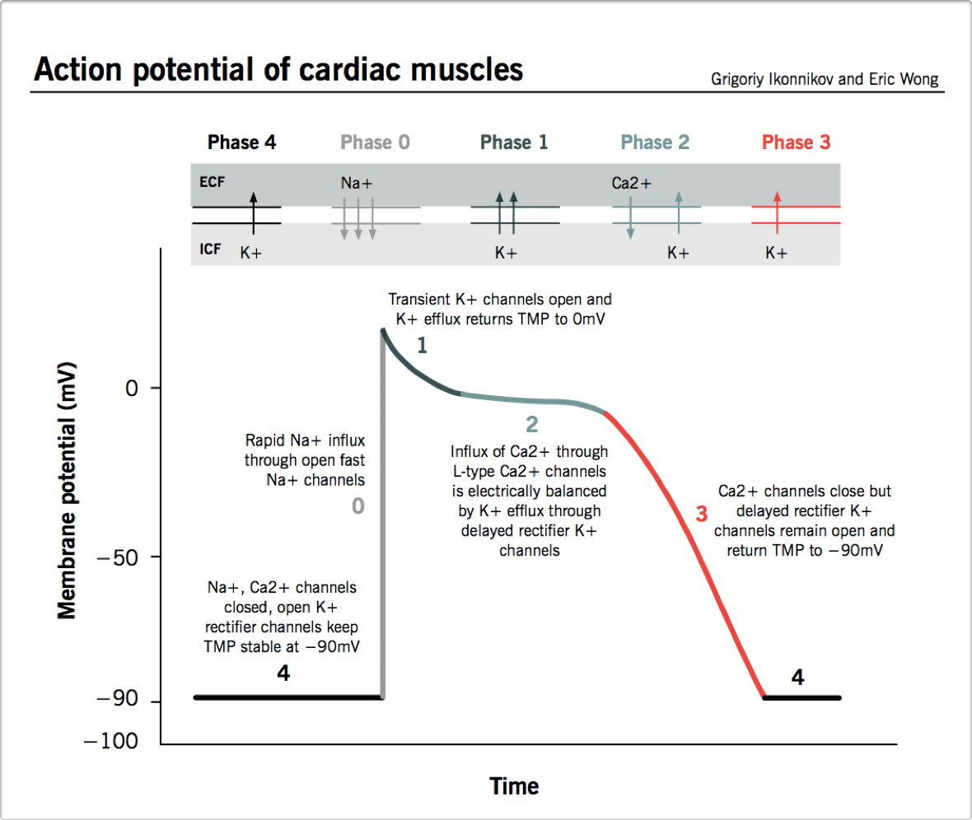

Slide 17
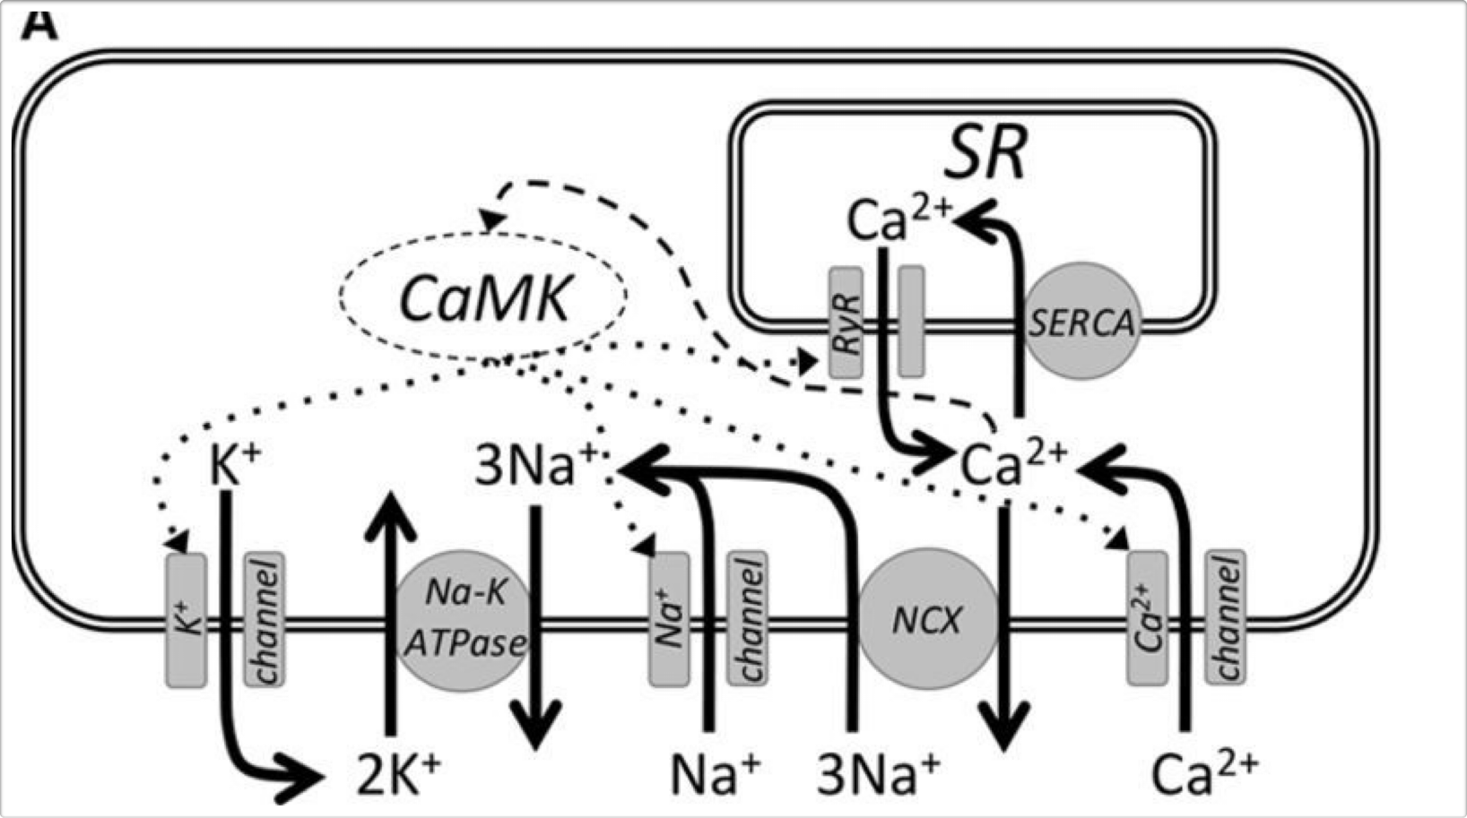

Slide 18
K + is mainly an intracellular cation
Determines the resting membrane potential (RMP)
RMP -90 mV - due to constant outward leak of K+ through inward rectifier channels.
Hypokalemia - more negative RMP -resting membrane hyperpolarization - widening between the threshold potential and RMP leads- slowed conduction.

Slide 19
Low extracellular K+ - a delayed rectifier current - increase in action potential duration and a delay in repolarization.
Extracellular K+ ions are required to open the delayed rectifier channel.
The action potential configuration changes- the slope of phase 2 first increases , then decreases; phase 3 duration increases with a decreased slope .
AP duration increases; room for ectopic during the terminal phase of AP , and RRP increases

Slide 20
Slowed conduction, delayed repolarization, shortened refractory period and increased automaticity.

Slide 21
Delayed phase 3 repolarization of the ventricular muscle fibre - phase3 slope is attenuated- small,opposing voltage gradientsthat cross over - T WAVE abnormalities
Reduction in the rate of phase 3 repolarization - increased action potential duration- BRADYCARDIA

Slide 22
U wave - a physiologic U wave is a small deflection following T wave, height is usually less than 1/4 of T wave
Genesis of U WAVE :
?delayed repolarization of Purkinje network
?EAD of the ventricular myocardium.

Slide 23
Large U wave in hypokalemia - genesis- complex !
Full repolarization of epicardium- the peak of pathological U, repolarization of endo and M cells - descending limb.
The apparent T- U complex - is a T wave with ascending limb interrupted.
The pathologicU wave is likely a second component of a bifid T wave.

Slide 24
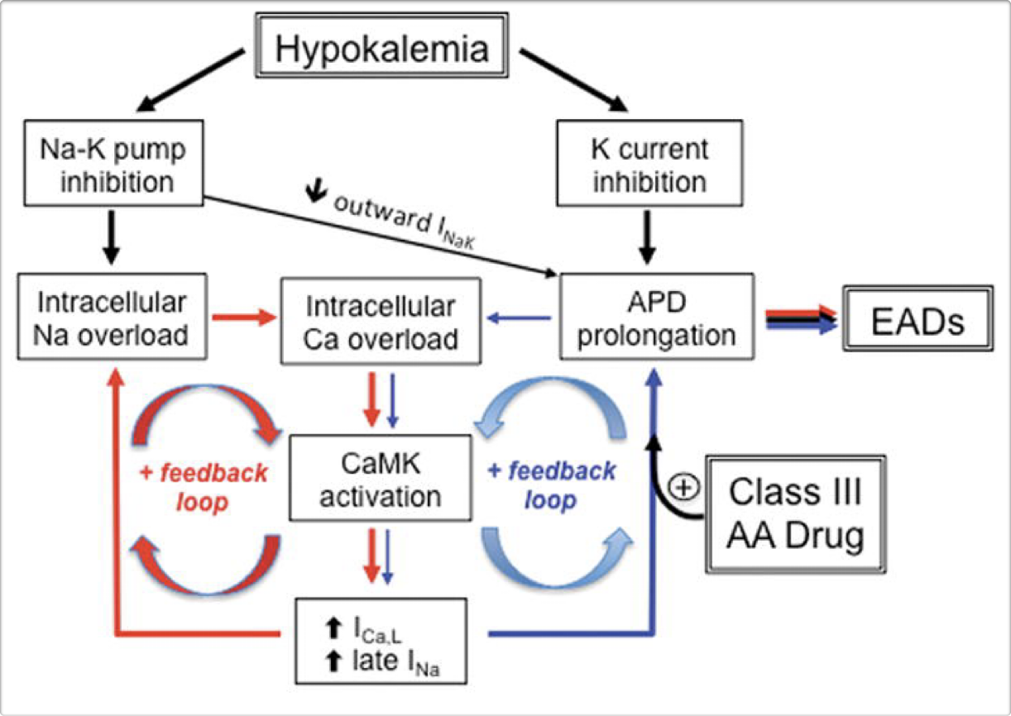

Slide 25
Mechanism of arrhythmias
Afterdepolarizations are abnormal depolarisations of cardiac myocytes that interrupt phase 2, phase 3 or phase 4 of the cardiac AP
Early AD and delayed AD
AfterDepolarisations can lead to arrhythmias
EAD- torsades de pointes, tachycardia
DAD - ventricular tachycardia

Slide 26
Cardiac repolarization reserve include the mechanisms that protect against arrhythmias
Suppression of K+ channel conductances, Na+- K+ ATPase inhibition - increased APduration , reduced repolarization reserve, EAD, DADs, and automaticity.
Hypokalemia potentiates the pro-arrhythmogenic effects of class III anti arrhythmic drugs.

