Slide 1
BIRDS OF THE SAME FEATHER : PART 2.
A case of recurrent seizures, syncopes
Dr. Ibrahim Ali Saleem
JR2, General Medicine

Slide 2
The case.
3.35pm, 12/10/2021.
63 year old, wary looking male walked into the casualty
C/o blacking out episodes
Vitals were checked, found to have severe bradycardia.PR - 30/min.
An ECG was ordered immediately.

Slide 3
Then the pt developed a sudden tonic posturing, followed by LOC.
He was immediately shifted to the RR,
Pulse was not felt anymore.

Slide 4

The ecg monitor.

Slide 5
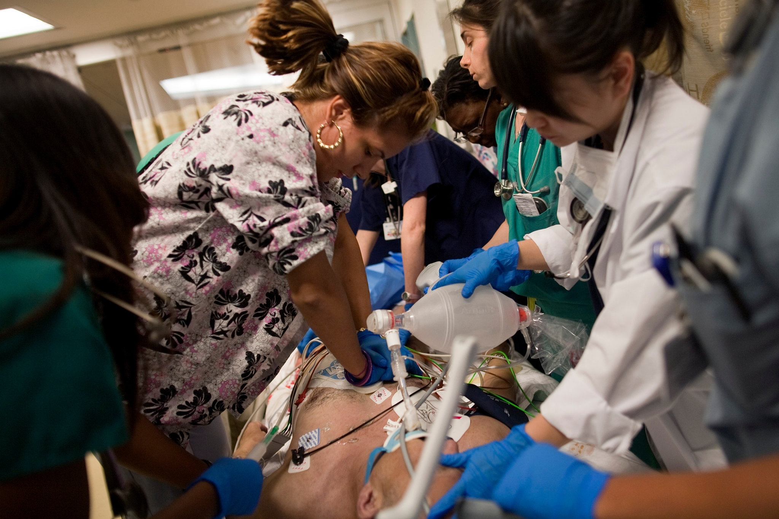
CPR and INTUBATION!

Slide 6
Pt was resuscitated.
PR - 120/'
BP - 140/70mmHg on inotropic supports.
ECG monitor - Sinus tachycardia.
Routine investigations and additional electrolytes were sent as emergency.
CT Brain taken - No IC bleed. No infarcts.

Slide 7
Tonic posturing again!
Pulse - 30/'
Bp could not be recorded.

Slide 8
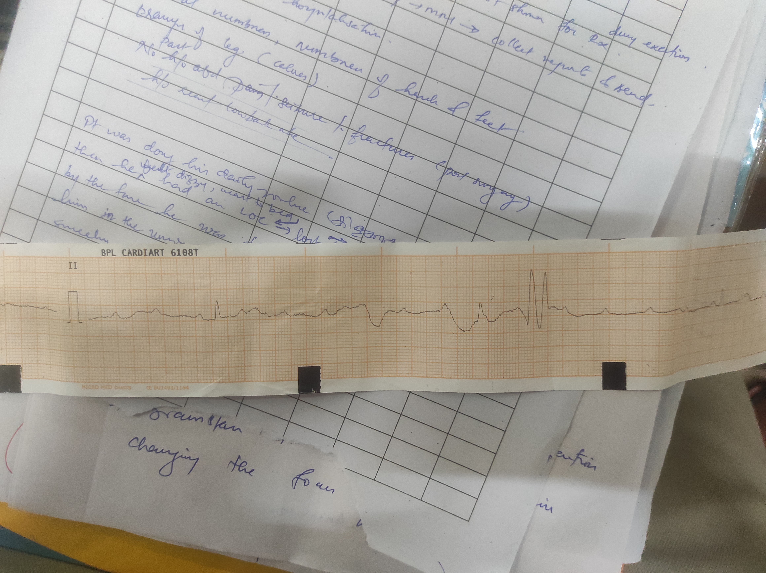
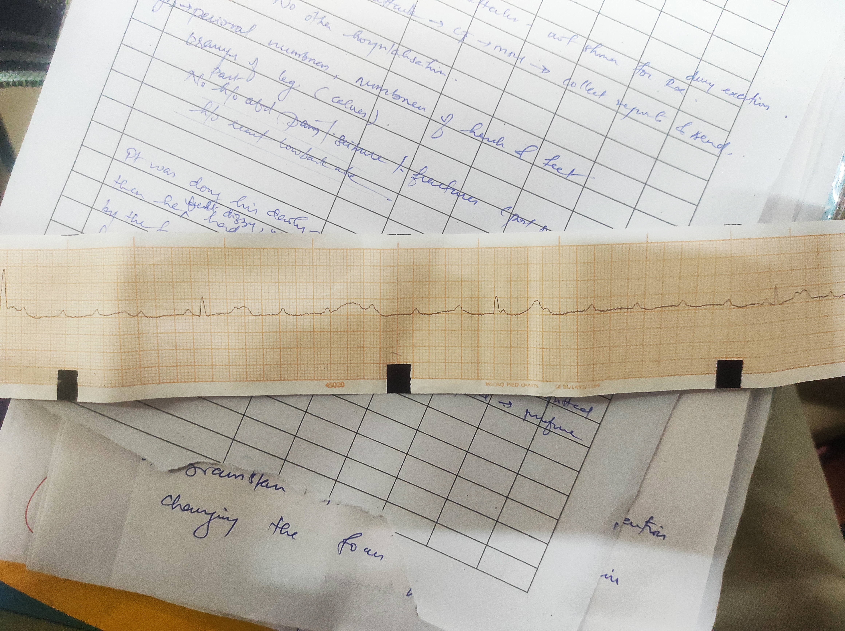
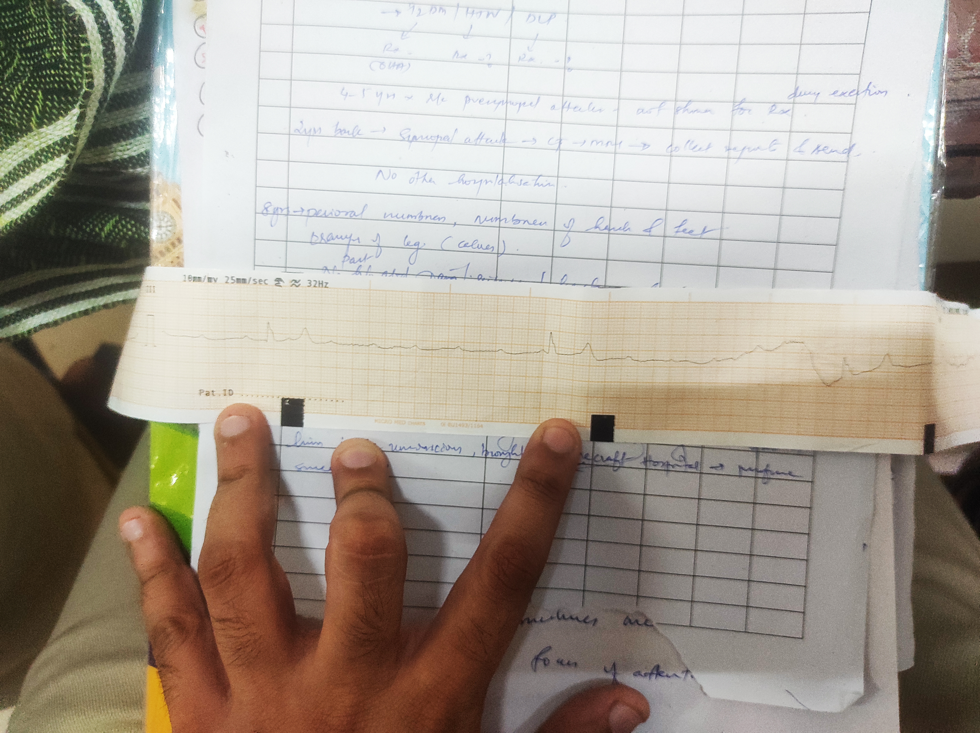
ECG taken.

Slide 9
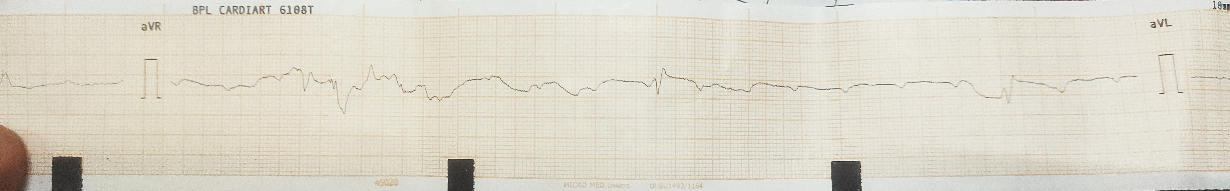
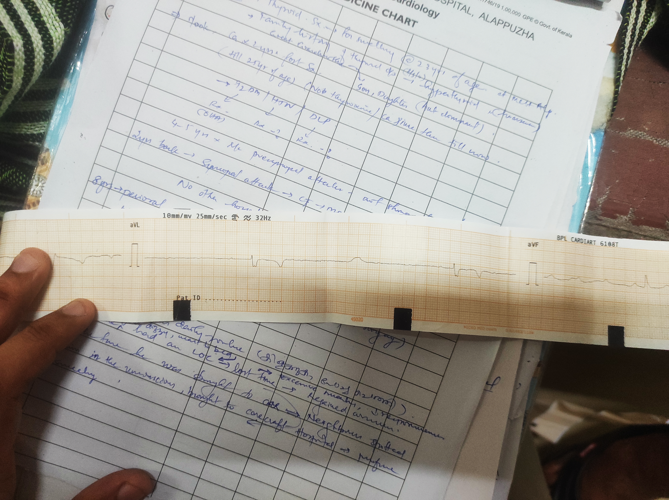
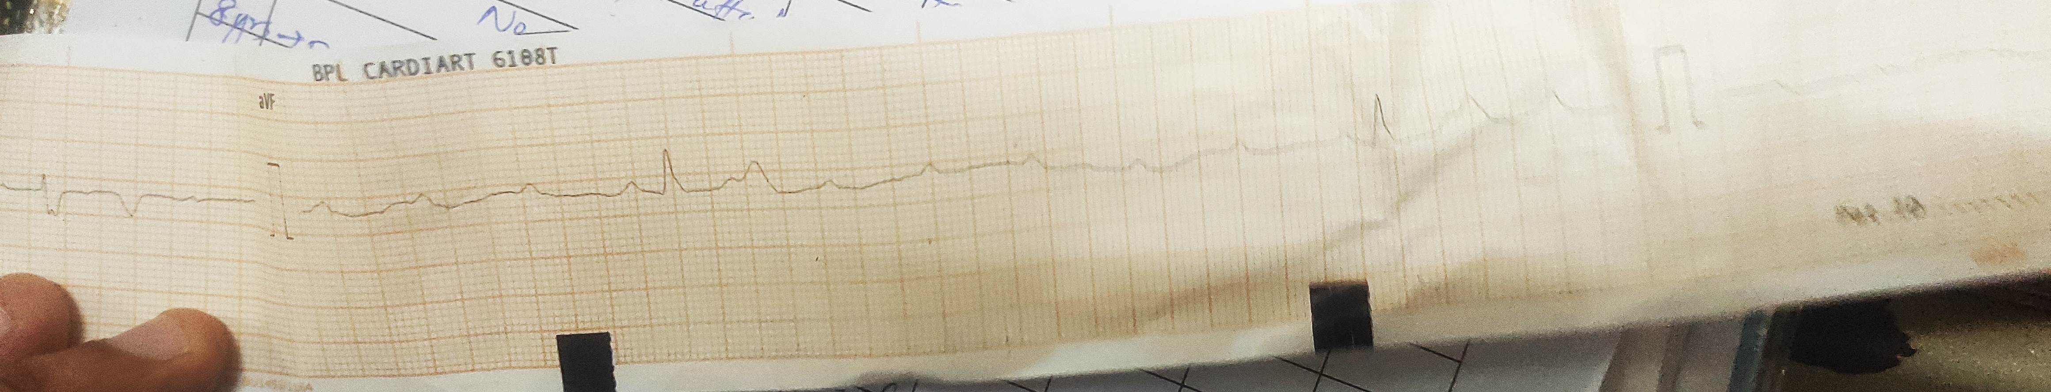

Slide 10
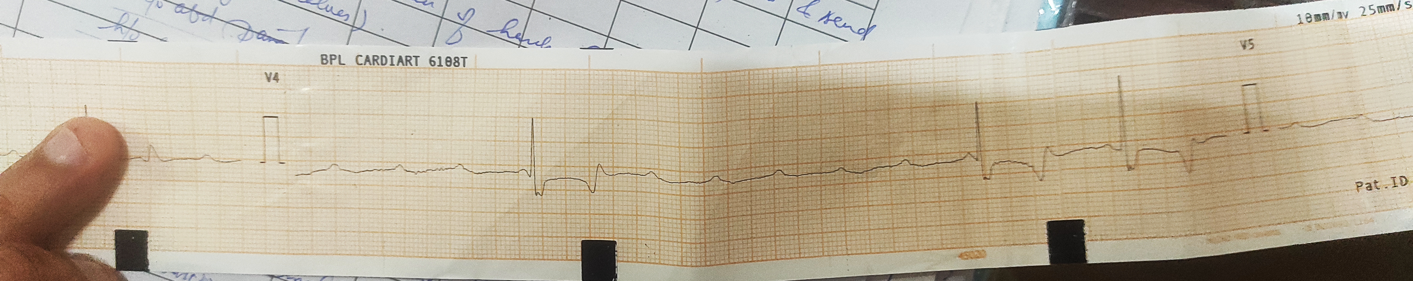
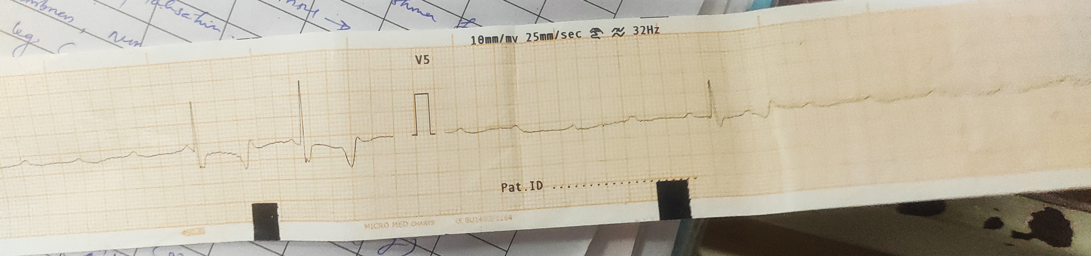

Slide 11
Atropine given, shifted the patient to icu.

Slide 12
Past history
History of thyroidectomy done at 23 years of age - goitre. Familial.
History of recurrent episodes of muscle spasms in the last few months.
S.HTN, chronic smoker, non alcoholic.

Slide 13
In the ICU, Day 1.
Time : 6.30 pm.
He was continued on inotropic support, heparin added.
Isoprenaline infusion.
BP - not recordable.

Slide 14
And the lab results came.
S. Calcium - 5.2 (corrected )
S. Magnesium - 1.4
Trop I - 0.14 (< 0.04)
Immediately iv calcium gluconate and iv magnesium sulfate were given.
Central venous access obtained.

Slide 15
Emergency cardiology cx done.
Further investigations sent.
Bedside ECHO - global LV hypokinesia.
At 8.20 pm - PR - 25/'

Slide 16
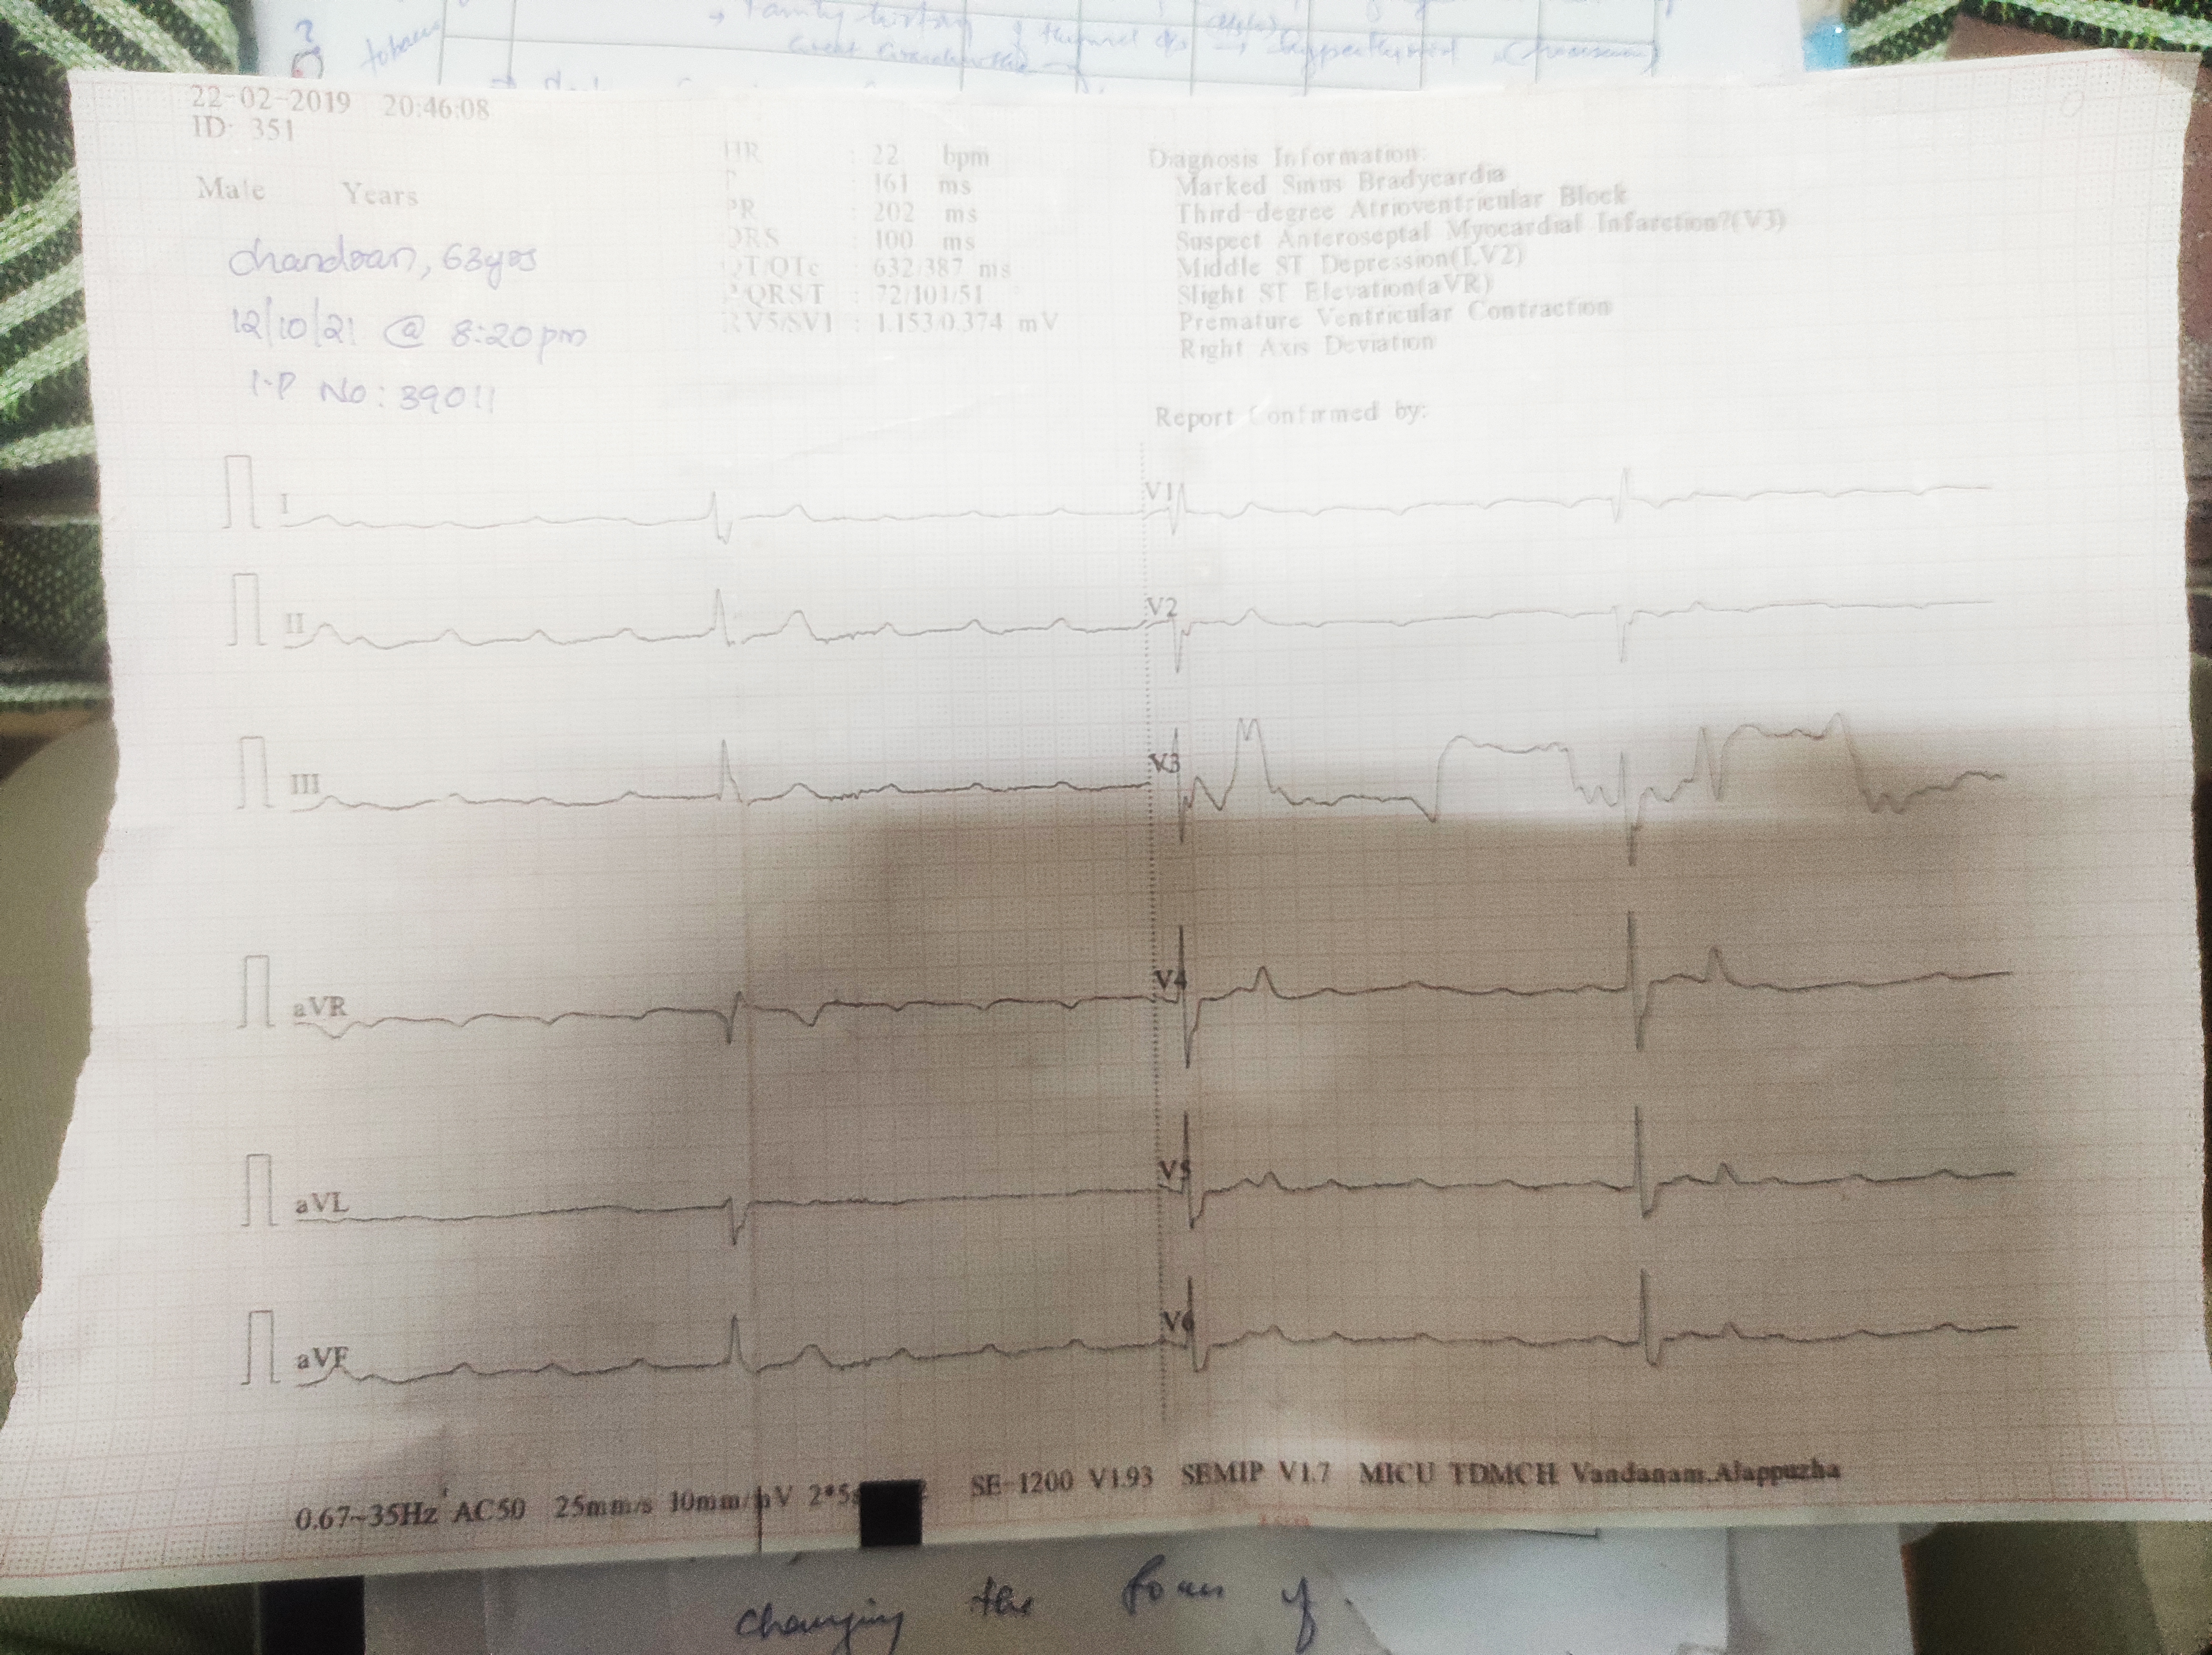

Slide 17
By midnight his heart rate started picking up.
BP - 50 mmg systolic.
Spo2 92 with CMV.
Oliguric AKI - Nephrology Cx done.

Slide 18
ICU : Day 2.
Another episode of tonic posturing followed by unresponsiveness ensued.
Vitals were not recordable but pt was resuscitated again.
He was continued on iv calcium and magnesium sulfate, inotropes.
Urine output improved.

Slide 19
General condition and vitals improved steadily in the next few days
Concurrent with improvement of calcium and magnesium levels.
S.PTH, TFT - WNL.

Slide 20
ICU : Day 5
Pt regained consciousness.
Delirium +
He ingested ten tablets of paracetamol (650 mg)believing he wanted to avoid covid.
He was started on IV NAC, RTA.

Slide 21
ICU : Days 6, 7, 8
Altered LFT, PT - INR.
Acute liver injury, managed conservatively.
Patient condition improved.
Psychiatric evaluation done.
Delirium subsided as pt shifted to ward.

Slide 22
Discharged on Day 10.
He was conscious,oriented.
Vitals stable.
Discharged.

Slide 23
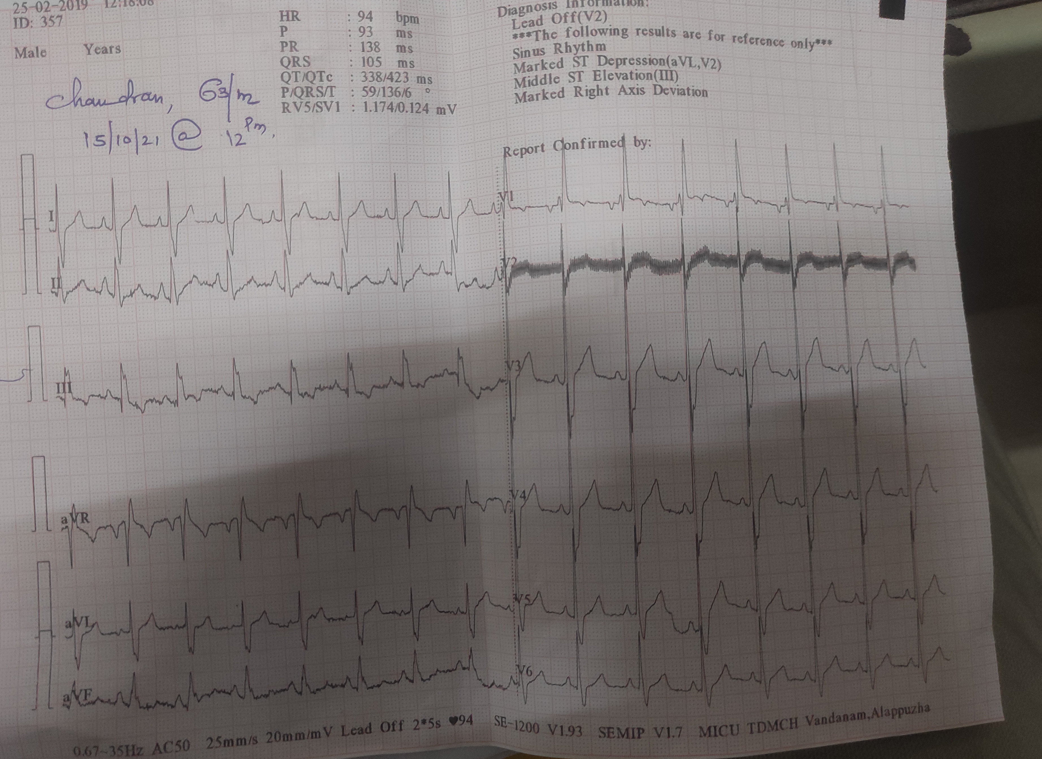

Slide 24
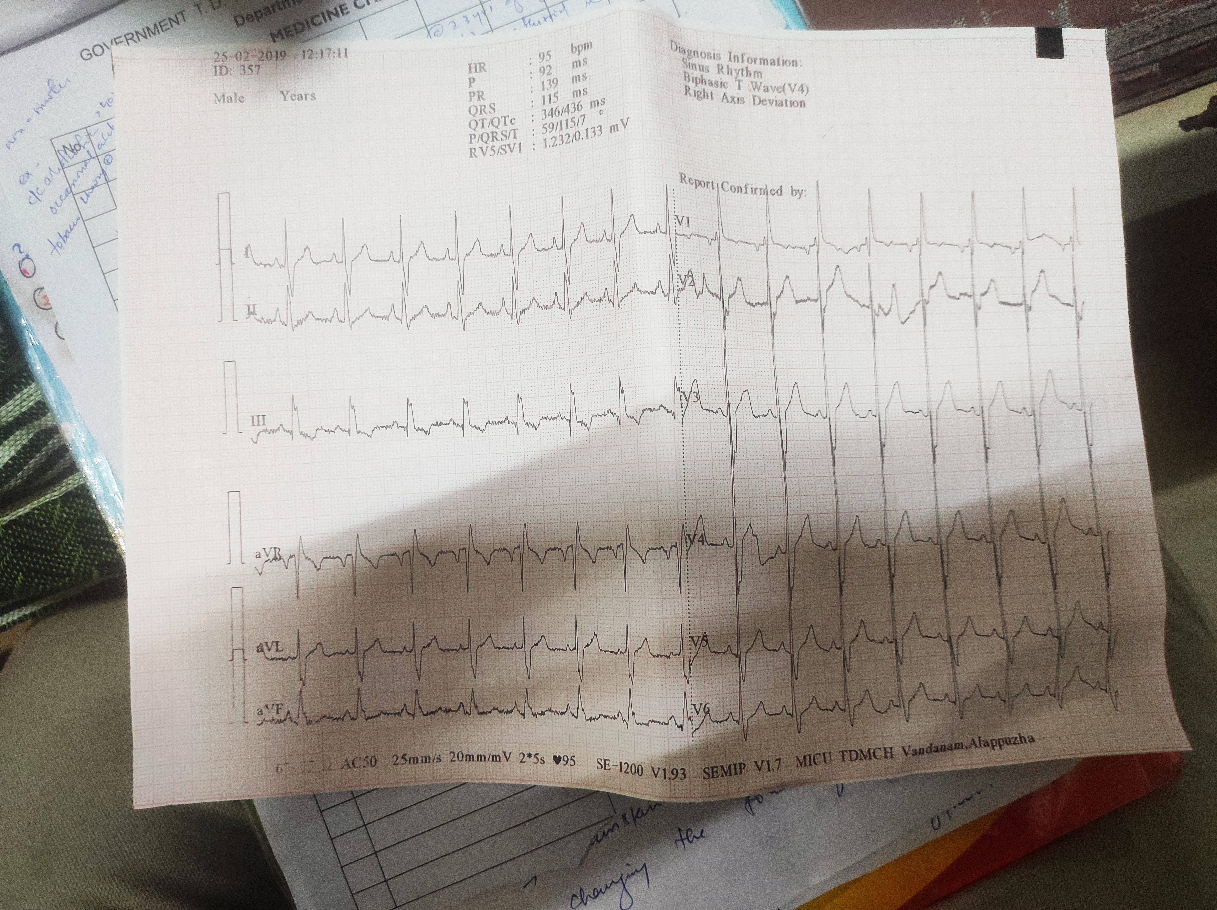

Slide 25
Syncope
Definition:
Syncope is a transient, self-limited loss of consciousness due to acute global impairment of cerebral blood flow.
Causes:
(1) neurally mediated syncope (also called reflex or vasovagal syncope),
(2) orthostatic hypotension,
(3) cardiac syncope

Slide 26
Neurally mediated syncope
A sudden, transient change in autonomic efferent activity
increased parasympathetic outflow, plus sympathoinhibition (the vasodepressor response)
result in bradycardia, vasodilation, and/or reduced vasoconstrictor tone.
The final pathway of a complex central and peripheral nervous system reflex arc.

Slide 27
Features:
Orthostatic intolerance such as dizziness, lightheadedness, fatigue
Autonomic activation – diaphoresis, pallor, palpitations, nausea, hyperventilation, yawning
Proximal and distal myoclonus
Eyes typically remain open and usually deviate upward
Roving eye movements may occur, grunting, moaning, snorting.

Slide 28
Urinary incontinence may occur.
Fecal incontinence, postictal confusion are very rare.
Sometimes, visual and auditory hallucinations and near death and out-of-body experiences.

Slide 29
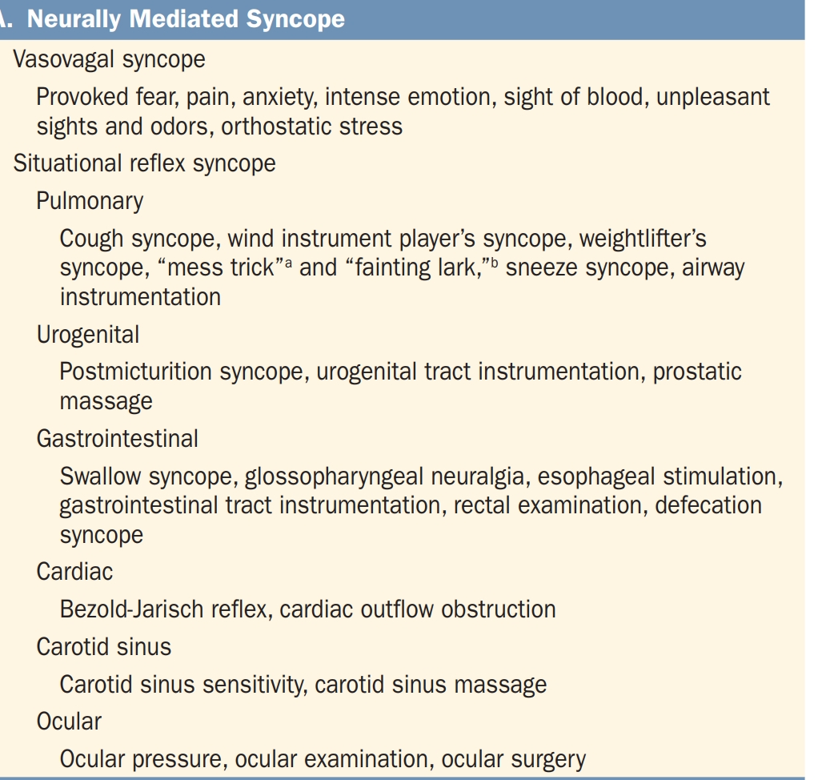

Slide 30
Orthostatic hypotension
Definition:
Reduction in systolic blood pressure of at least 20 mmHg or diastolic blood pressure of at least 10 mmHg within 3 min of standing or head-up tilt on a tilt table
manifestation of sympathetic vasoconstrictor (autonomic) failure.

Slide 31
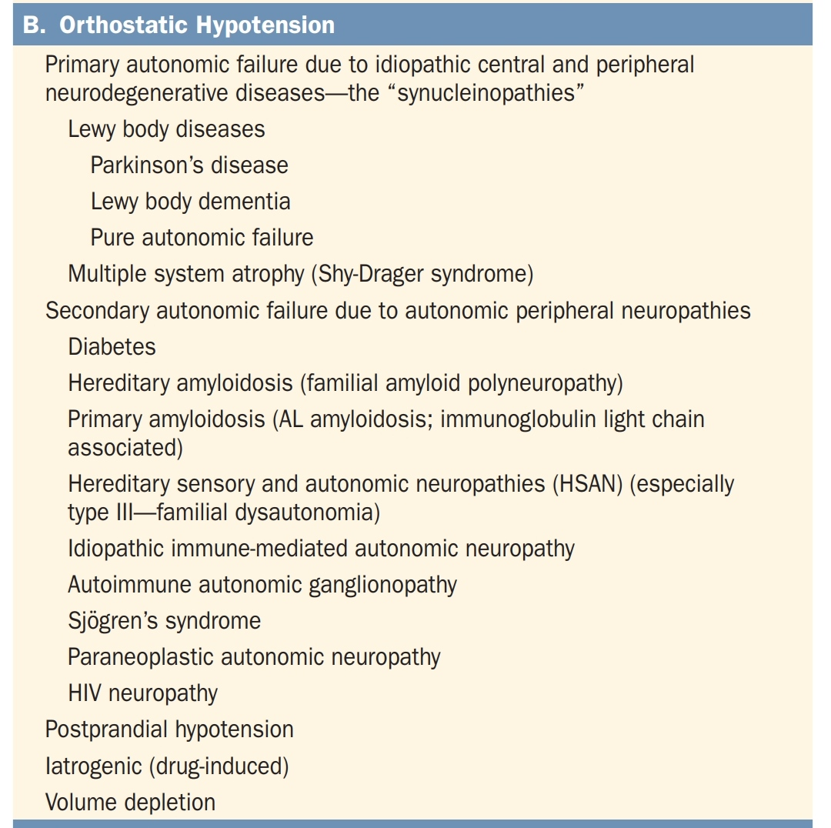

Slide 32
Cardiogenic syncope
caused by
arrhythmias and structural heart disease.
may occur in combination
Structural disease renders the heart more vulnerable to abnormal electrical activity

Slide 33
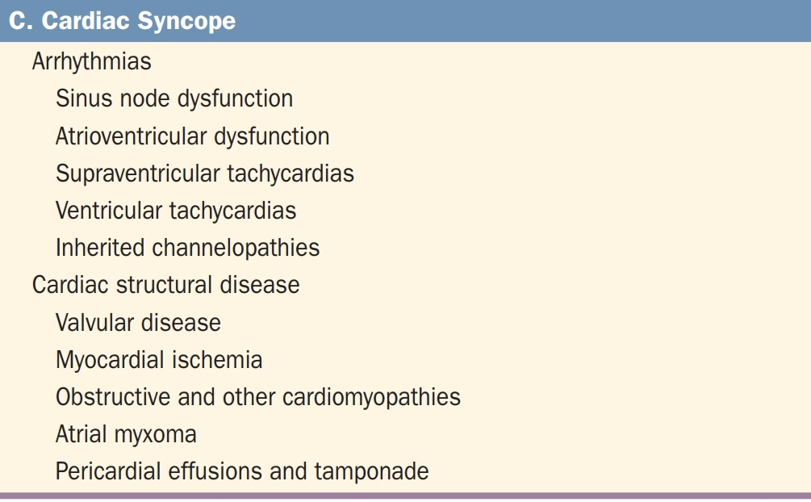

Slide 34
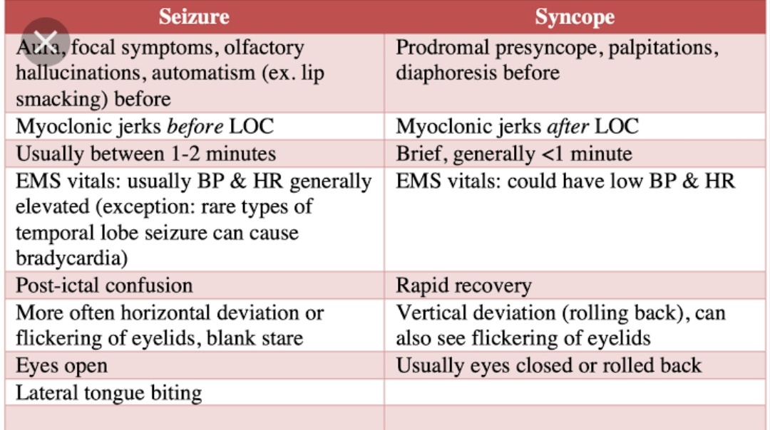
Syncope vs Seizure
Syncope
Seizure

Slide 35
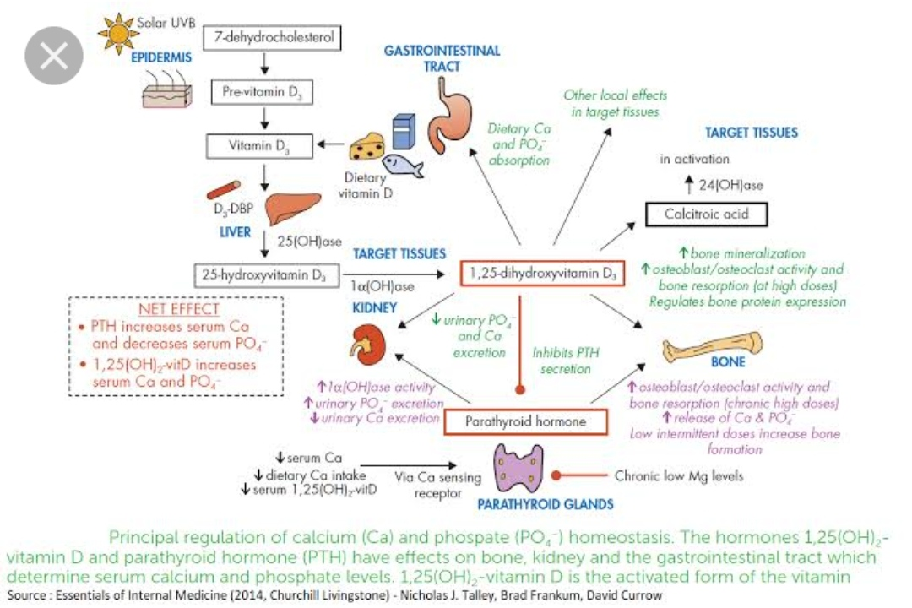
Calcium homeostasis.

Slide 36
Calcium and Nervous System
Ca2+ entry into a nerve terminal causes neurotransmitter release.
Hence in hypercalcaemia, exaggerated neurotransmitter release and neuronal hyperactivity?
No. In contrast, the effects are the opposite.
High Ca2+ levels (hypercalcemia) can block sodium movement through voltage-gated sodium channels, causing reduced depolarization and impaired action potential generation.

Slide 37
Hypocalcemia and nerve excitability.
Decrease in extracellular calcium.
Membrane potential on the outside of the nerve becomes less negative.
Depolarisation threshold Falls.
Easily excitable nerve.

Slide 38
Hypocalcemia can facilitate sodium transport, as the normal inhibition by Ca2+ of sodium movement through voltage-gated sodium channels is lost.
Thus, low Ca2+ levels result in hyper-excitability of excitable cells, such as neurons.
At plasma Ca2+ ion concentrations about 50 percent below normal, the peripheral nerve fibers begin to discharge spontaneously,

Slide 39
Trousseau's sign
A. Trousseau’s sign presents as carpopedal spasms following inflation of a sphygmomanometer cuff above systolic blood pressure.
Occluded brachial artery causes flexion of the wrist and metacarpophalangeal joints, hyper-extension of the fingers, and flexion of the thumb on the palm, producing a characteristic posture.

Slide 40
The proposed mechanism for Trousseau’s sign is increased excitability of the nerves in the arm and forearm by hypocalcemia, such that the nerves fire when subjected to Ischemia after inflating the cuff.

Slide 41
Chvostek's sign
elicited by tapping the cheek over the path of the facial nerve. In hypocalcemia patients, the facial muscles on the same side of the face will contract momentarily, as the tap will stimulate hyperexcitable motor axons.

Slide 42
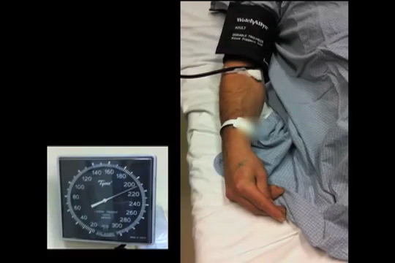

Slide 43
Magnesium and Nervous System
an essential role in nerve transmission and neuromuscular conduction.
a protective role against excessive excitation that can lead to neuronal cell death (excitotoxicity)

Slide 44
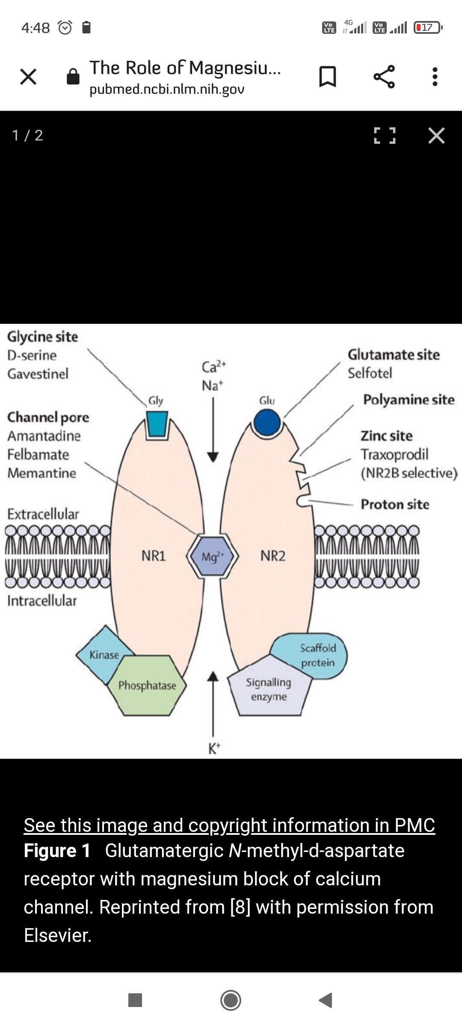

Slide 45
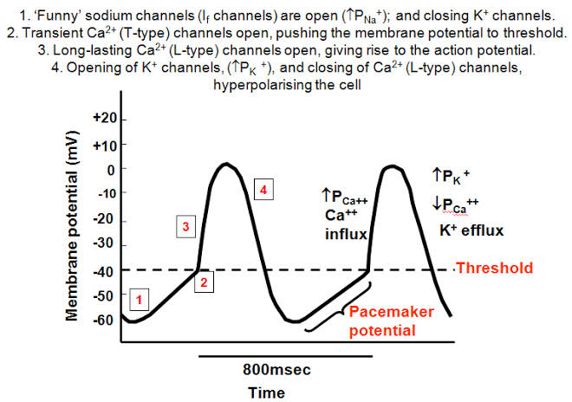
Calcium and CVS
Calcium in the pacemaker cells.

Slide 46
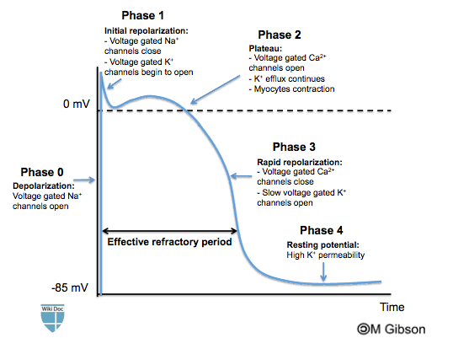

Slide 47
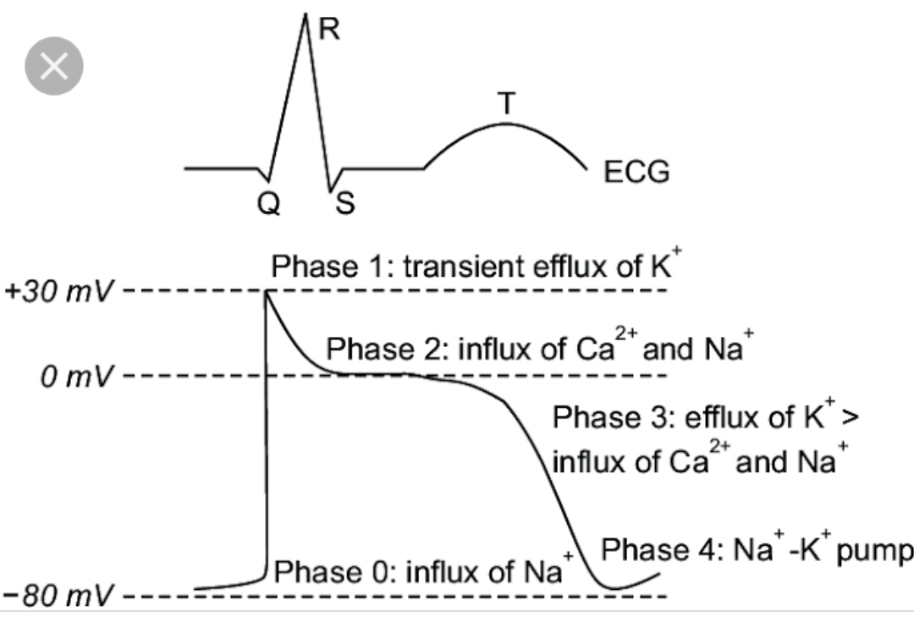
ECG and Cardiac Action potential.

Slide 48
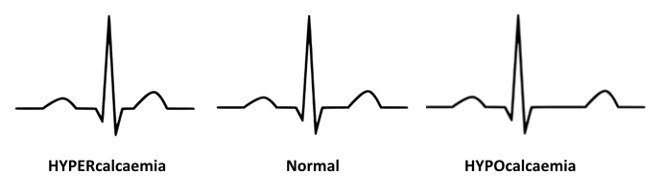
Hypocalcemia and ECG
Hypocalcaemia causes QTc prolongation primarily by prolonging the ST segment
The T wave is typically left unchanged
Dysrhythmias are uncommon, although atrial fibrillation has been reported
Torsades de pointes may occur, but is much less common than with hypokalaemia or hypomagnesaemia

Slide 49
Why TFT may be normal?
Some amount of residual thyroid tissue may be left in the patient
It can provide the necessary t3,t4 for functions.

Slide 50
Why PTH may be normal?
Serum I.PTH has to be sent, not serum.PTH.
Some residual parathyroid might be present.
The collection method may be improper.
Blood to be collected from 2 sites, and kept chilled at 20°C and sent for investigation immediately.

Slide 51
Final diagnosis.
The syncope - complete heart block.
Precipitated by acute myocardial ischemia, or high vagal tone which is rarely reported in hypocalcemia. Resolved after correction/heparinisation.
Seizures - due to hyperexcitable neurons
Hypocalcemia and hypomagnesemia.

Slide 52
Thank you.

