Slide 1
Presented by,
Bibymol Joseph
JOURNAL CLUB REVIEW ARTICLE

Slide 2
GLIFLOZINS IN THE MANAGEMENT OF CARDIOVASCULAR DISEASE

Slide 3
The reabsorption of glucose from the glomerular filtrate is an active process, which is linked to sodium and requires a carrier protein, referred to as a sodium– glucose cotransporter (SGLT).
Two isoforms of SGLT have been described:
  SGLT1
  SGLT2
SGLT1: Which is located primarily in the small intestine, with little effect on the renal tubule.
SGLT2: SGLT2 has low-affinity and high-capacity properties and is found almost exclusively in the epithelial cells of the proximal renal tubule, where it is responsible for more than 90% of glucose reabsorption and 65% of sodium reabsorption.
The SGLTs are coupled to accessory protein MAP17, which is required for glucose transport, and are encoded by genes in the SLC5A family.

Slide 4
HISTORY
Phlorizin was first isolated from the bark of the apple tree by Petersen in 1835.
Half century later that it was discovered by von Mering to have glucosuric properties.
In the 1980s, it was learned that the glucosuria resulted from phlorizin’s inhibition of glucose reabsorption by the renal tubules, which reduced blood glucose concentrations in rats with diabetes.
Phlorizin consists of glucose and two joined aromatic rings, is poorly absorbed, and requires parenteral administration to elicit a robust glucosuric response.

Slide 5
In the 1990s, Tsujihara et al., working at Tanabe Seiyaku, a Japanese pharmaceutical company, studied a variety of phlorizin derivatives.
The company developed an orally absorbed SGLT2 inhibitor, the first synthetic SGLT2 inhibitor that reduced hyperglycemia in rats with diabetes.
In 1999, Oku et al. suggested that this inhibitor could represent a new approach to the treatment of type 2 diabetes.
Several other pharmaceutical companies then began to develop SGLT2 inhibitors.

Slide 6
Clinical trials showed that this class of drugs, also referred to as gliflozins.
Reduced glycated hemoglobin levels by approximately 0.5 to 1.1%,
No hypoglycemia unless administered with other glucose-lowering agents.
Between 2012 and 2017, the Food and Drug Administration (FDA) and the European Medicines Agency approved canagliflozin, dapagliflozin, empagliflozin, and ertugliflozin for reducing hyperglycemia in patients with type 2 diabetes.

Slide 7
In 2008, as per the FDA Guidance “demonstrate that the therapy will not result in an unacceptable increase in cardiovascular risk”.
To satisfy this requirement, a number of large clinical outcome trials were conducted to evaluate such agents, including SGLT2 inhibitors, which had important actions on the heart and kidneys.
This article reviews the actions of SGLT2 inhibitors and their implications.

Slide 8
CARDIOVASCULAR OUTCOME TRIALS

Slide 9
EMPA- REG OUTCOME TRIAL
CANVAS PROGRAME
CREDENCE TRIAL
DECLARE-TIMI 58 TRIAL
VERTIS CV TRIAL
SOLOIST- WHF TRIAL

Slide 11
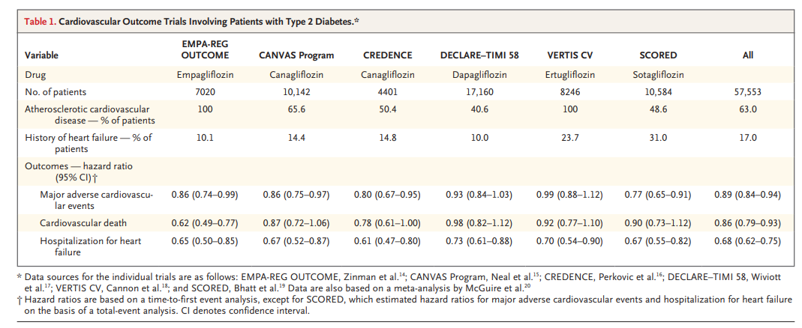

Slide 12
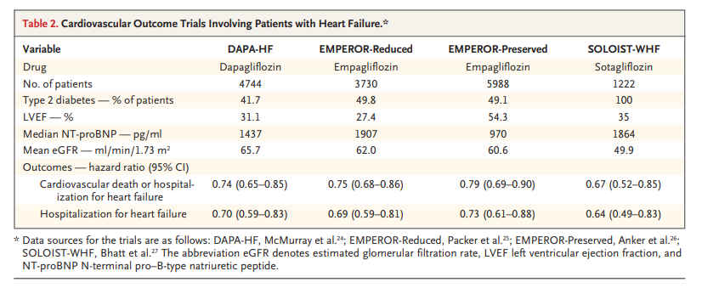

Slide 13
A meta-analysis involving the 8474 patients in the DAPA-HF and EMPEROR-Reduced trials showed that the primary end point, hospitalization for heart failure or cardiovascular death, was reduced significantly and almost identically among patients with and those without type 2 diabetes.
The improvements were similar in patients with and in those without type 2 diabetes, indicating that the cardiovascular benefits of the SGLT2 inhibitor were independent of its glucose-lowering properties.

Slide 14
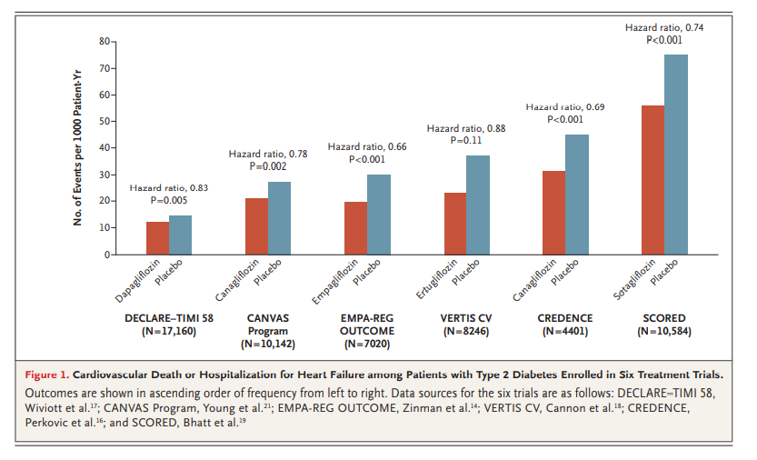

Slide 15
RENAL ACTION
In patients with type 2 diabetes, the hyperabsorption of glucose and sodium in the proximal renal tubules by SGLT2 causes afferent arteriolar vasodilatation which causes glomerular hyperfiltration, leading to glomerular inflammation, fibrosis, and ultimately, diabetic kidney disease.

Slide 16
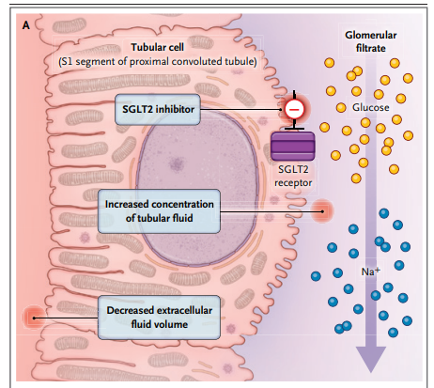
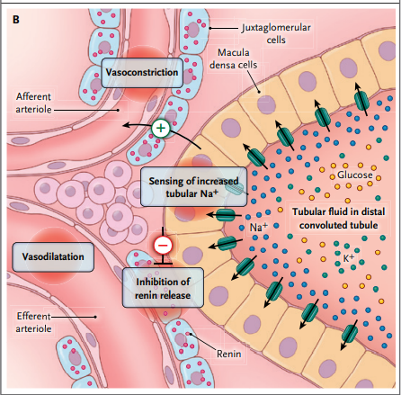
MECHANISM OF ACTION
Fig B
Fig A
Figure 2. Effects of Sodium–Glucose Cotransporter 2 (SGLT2) Inhibition.

Slide 17
Loss of sodium
Contraction of extracellular fluid volume
Vasoconstriction of afferent arterioles

Slide 18
Increased Na+ concentration in macula densa
Activation of TG feedback
Vasoconstriction of afferent arteriole
Efferent arteriolar dilatation
Inhibits release of renin from JG cells

Slide 19
The reduction of reabsorption of sodium increases the sodium concentration at the macula densa, specialized cells in the distal renal tubules adjacent to the glomeruli.
Tubuloglomerular feedback activates adenosine receptors, which constrict the afferent glomerular arterioles.
This constriction reduces glomerular hyperfiltration and thereby reduces further renal damage.
SGLT2 inhibitors block the renal sodium–hydrogen exchanger 3, which enhances diuresis of sodium and glucose.
SGLT2 inhibitors also reduce tubular work and oxygen requirements; they thereby reduce the damage associated with hypoxic tubular cells.
Enhance renal erythropoietin production.

Slide 20
CARDIAC ACTIONS
In many forms of heart failure, a reduction of cardiomyocyte ATP production is observed as a result of reduced mitochondrial glucose oxidation.
SGLT2 inhibition raises circulating ketone levels, an effect that appears to improve mitochondrial function, increase the production of ATP, and enhance ventricular contractile performance.

Slide 21
The sodium concentration in cardiomyocytes is increased in many forms of heart failure, and this increase may contribute to altered calcium handling, which in turn may lead to changes in contraction and arrhythmias.
SGLT2 inhibitors reduce the activity of the sarcolemmal sodium– hydrogen exchanger 1, the late inward sodium current, and calcium–calmodulin–dependent protein kinase II, which impairs cardiomyocyte contraction and relaxation.

Slide 22
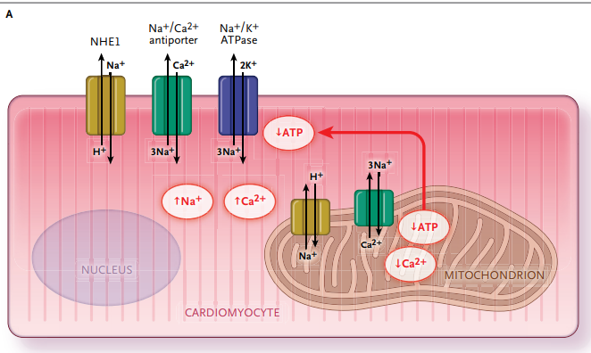
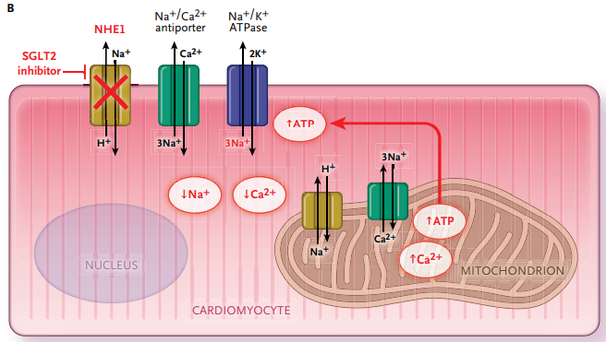
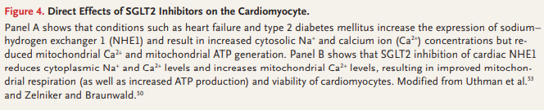

Slide 23
Inflammation is frequently present in heart failure and can cause cardiac fibrosis.
SGLT2 inhibitors can attenuate activation of the nucleotide-binding domain–like protein 3, which stimulates inflammatory responses in experimental models of heart failure.
Carotid-artery plaques obtained at atherectomy from patients treated with an SGLT2 inhibitor show reduced inflammation and an increased collagen content.
Oxidative stress may impair mitochondrial function in both cardiomyocytes and endothelial cells and can cause intracellular accumulation of sodium.
SGLT2 inhibitors reduce free radical formation of human cardiomyocytes, thereby enhancing systolic and diastolic function.

Slide 24
By inhibiting proinflammatory–oxidative pathways, SGLT2 inhibitors improve coronary endothelial function and enhance flow-mediated vasodilatation.
In many patients with type 2 diabetes, the aorta, coronary arteries, and ventricles are surrounded by excessive epicardial adipose tissue, which can release pro-inflammatory mediators that may impair ventricular function.
SGLT2 inhibitors reduce this adipose tissue, body weight, waist circumference, visceral and central adiposity, and extracellular volume, reducing aortic stiffness and myocardial fibrosis.

Slide 25
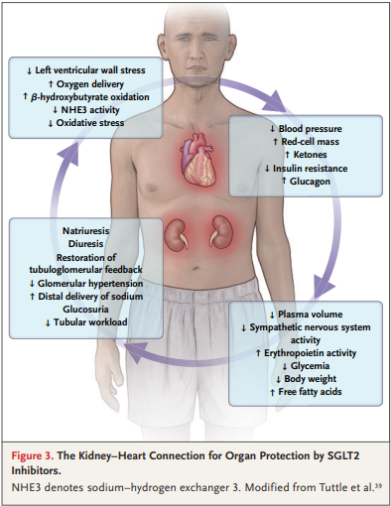

Slide 26
ADVERSE EVENTS
The most common adverse effects of SGLT2 inhibitors are mycotic genital infections, which are related to the glucosuric action of these agents and occur more frequently in women than in men.
Less common adverse effects are urinary tract infections and pyelonephritis.
Diabetic ketoacidosis, which is relatively uncommon, may occur, particularly in elderly patients with volume depletion.
The disorder may be precipitated by an acute illness or fasting and may be accompanied by serious hypotension.

Slide 27
Diabetic ketoacidosis is characterized by an accumulation of ketone bodies, principally hydroxybutyric acid.
A form of ketoacidosis in patients receiving SGLT2 inhibitors is euglycemic ketoacidosis, which is not accompanied by a markedly elevated blood glucose levels.
A doubling of the incidence of lower-limb amputations and an increase in bone fractures were noted with canagliflozin in the CANVAS Program.
However, these complications were not observed in the CREDENCE trial, which also studied canagliflozin, and they have not been reported with other SGLT2 inhibitors

Slide 28
OTHER CLINICAL OUTCOMES
In the DECLARE–TIMI 58 trial, dapagliflozin was associated with a reduction in atrial fibrillation or atrial flutter.
In the DAPA-HF trial, dapagliflozin was associated with a reduction in ventricular arrhythmias, resuscitated cardiac arrest, or sudden death.
Another reported benefit of SGLT2 inhibitors is the mitigation of anemia (presumably through stimulation of erythropoiesis), which improves oxygen delivery to the hear.
Empagliflozin has also been reported to reduce the risk of obstructive sleep apnea.

Slide 29
SGLT2 INHIBITORS COMBINED WITH OTHER DRUGS
The combination of an SGLT2 inhibitor and a glucagon like peptide receptor agonist appears to be safe and has an additive action in reducing glycated hemoglobin levels and possibly other end points as well.
However, the current cost of this drug combination may limit its use.

Slide 30
PRACTICE GUIDELINES
In 2022, for patients with type 2 diabetes and established arteriosclerotic cardiovascular disease, multiple risk factors, or diabetic kidney disease, the ADA recommended treatment with an SGLT2 inhibitor, a glucagon-like peptide 1 receptor agonist, or both to reduce the risk of a major adverse cardiovascular event.
The 2021 guidelines of the European Society of Cardiology and the 2022 guidelines of the American Heart Association for the treatment of heart failure made similar recommendations.

Slide 31
The FDA has approved empagliflozin to reduce the risk of cardiovascular death and hospitalization for heart failure in adults with heart failure, irrespective of the ejection fraction.
Canagliflozin has been approved to reduce the risk of major adverse cardiovascular events in adults with type 2 diabetes and established cardiovascular disease.
Dapagliflozin and canagliflozin have also been approved by the FDA for reducing the risk of end-stage kidney disease.

Slide 32
CONCLUSIONS
SGLT2 inhibitors are responsible for major paradigm shifts in the care of patients with or at high risk for heart failure, progression of chronic kidney disease or both.
SGLT2 inhibition improves cardiovascular outcomes in patients with heart failure over a wide range of ejection fractions, regardless of whether the patients have type 2 diabetes.
SGLT2 inhibiters also reduce the risk of end-stage kidney disease in patients with type 2 diabetes and chronic kidney disease.

Slide 33


