Slide 1
APPROACH TO HYPOKALEMIA
DR SANJU S
JUNIOR RESIDENT
GENERAL MEDICINE

Slide 2
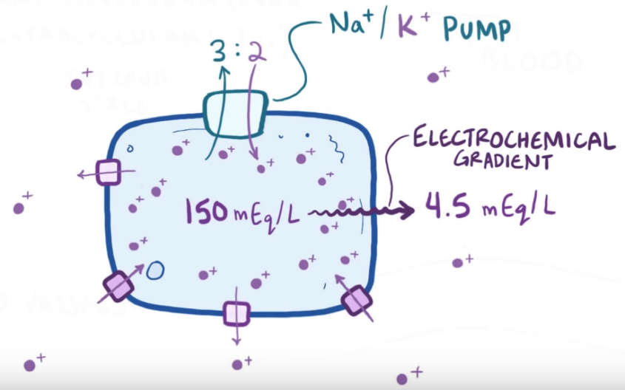
Potassium…
“Chief Intracellular Cation”
ECF : 3.5 – 5.5 mEq/L (1-2%)
ICF : 100-150 mEq/L (30x / 98%)
Chief regulator of ICF/ECF gradient : Na⁺/K⁺ ATPase Pump
Total Body Pool Of Potassium : 3000-3500 mEq

Slide 3
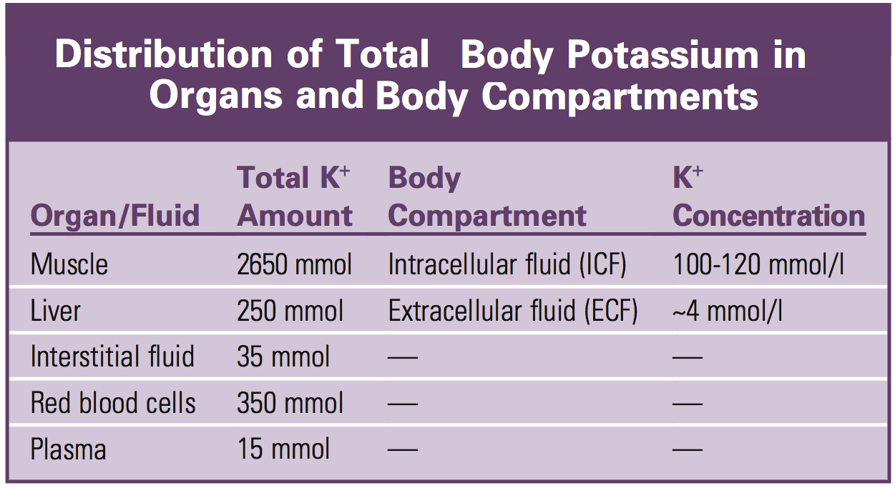

Slide 4
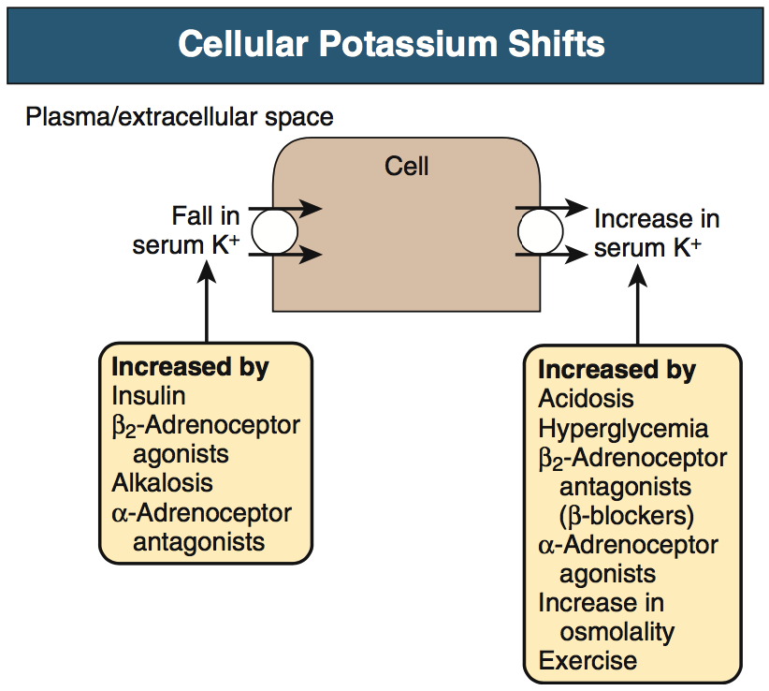
ICF/ECF Concentration
Maintained by Na⁺/K⁺ ATPase Pump
Cellular K⁺ uptake is rapid and it limits the rapid increase in serum potassium concentration
Shift from ICF to ECF also occurs when serum K⁺ is less

Slide 5
Potassium Excretion
In a healthy individual at steady state, the entire daily intake of potassium is excreted
Approx. 90% in the urine and 10% in the stool
Kidney plays a dominant role in potassium homeostasis
Serum Potassium almost completely ionised, not bound to any plasma proteins: Hence effectively filtered by glomerulus

Slide 6
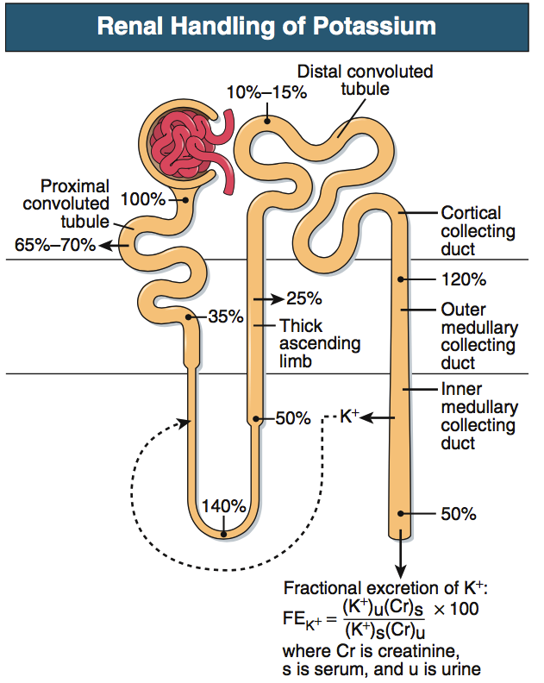
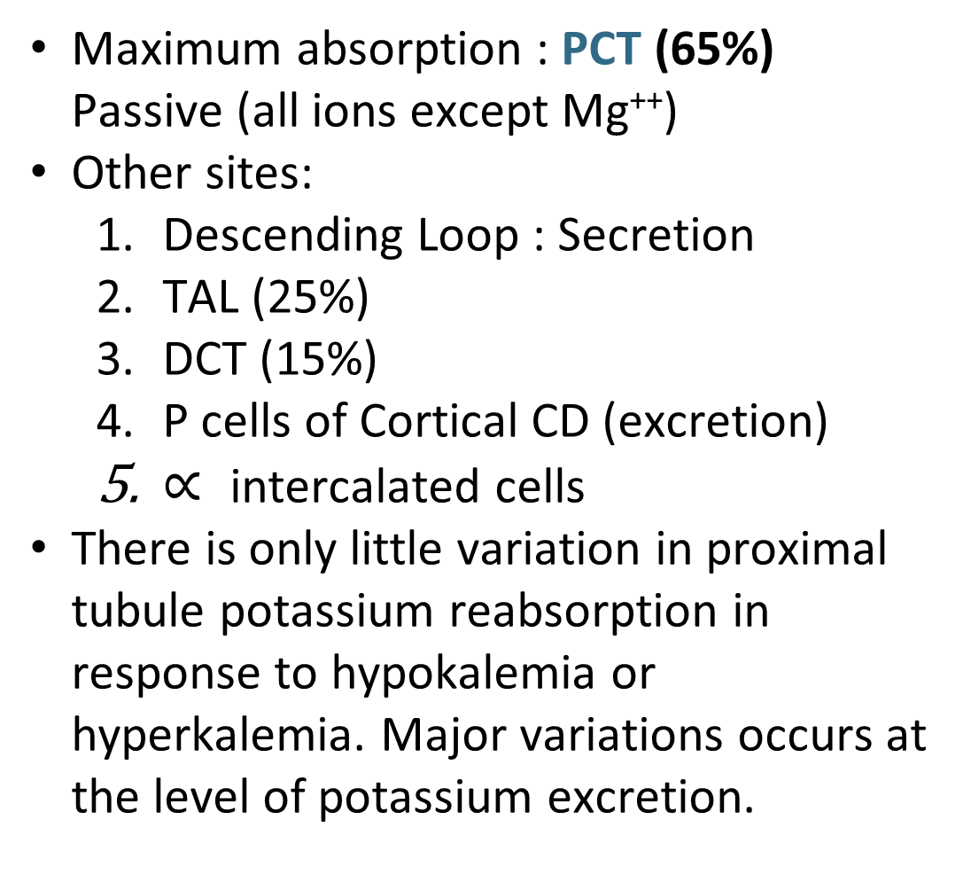
Maximum absorption : PCT (65%) Passive (all ions except Mg⁺⁺)
Other sites:
  Descending Loop : Secretion
  TAL (25%)
  DCT (15%)
  P cells of Cortical CD (excretion)
  $∝$intercalated cells
There is only little variation in proximal tubule potassium reabsorption in response to hypokalemia or hyperkalemia. Major variations occurs at the level of potassium excretion.

Slide 7
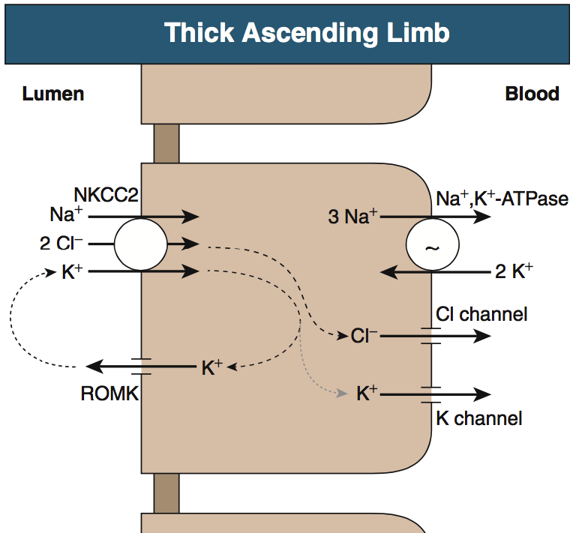
1. NKCC Channel
Active
2 Positive 2 negative ion inside
2. ROMK Channel
takes out K⁺ to lumen
positive charge in lumen
3. Paracellular Pathway
Absorption of Ca⁺⁺ Mg⁺⁺

Slide 8
Role of Collecting Duct
The collecting duct is the primary site at which the kidney regulates urinary K+ excretion.
The collecting duct has the ability both to secrete K+, enabling adaptation to K+ excess states, and to actively reabsorb K+, enabling adaptation to K+ depletion states.
The principal cell, particularly in the cortical collecting duct, secretes potassium, whereas intercalated cells throughout the entire collecting duct reabsorb potassium.

Slide 9
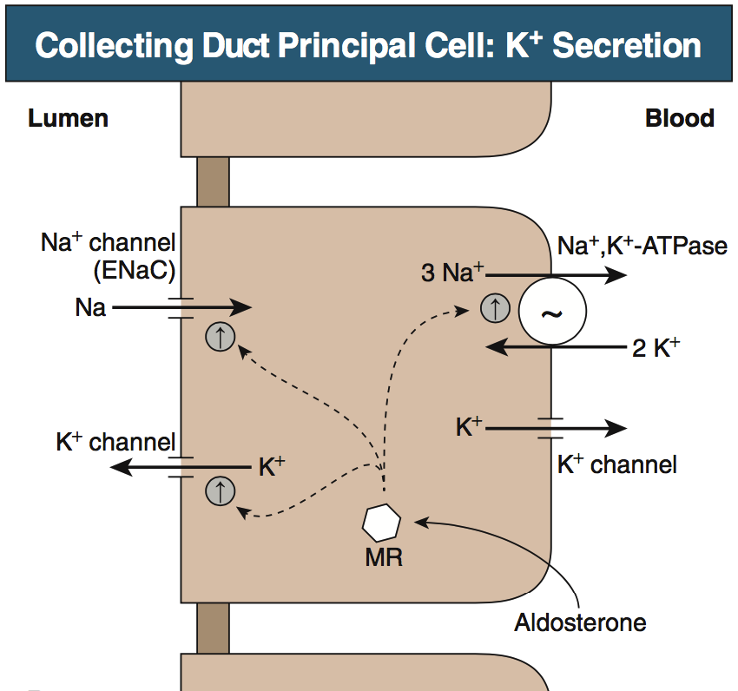
EnaC
  apical Na+ entry
  Amiloride sensitive
  generates a negative potential difference in lumen
  drives passive K+ exit through apical K+ channels
ROMK / KiR 1.1
  apical K+ channels
  the bulk of constitutive K+ secretion
Flow-sensitive big potassium (BK) or maxi-K K+ channel
  increases in distal flow rate
  genetic absence of ROMK

Slide 10
Factors influencing principal cell potassium secretion
Luminal flow rate (most Important)
Distal sodium delivery
Aldosterone
Extracellular pH

Slide 11
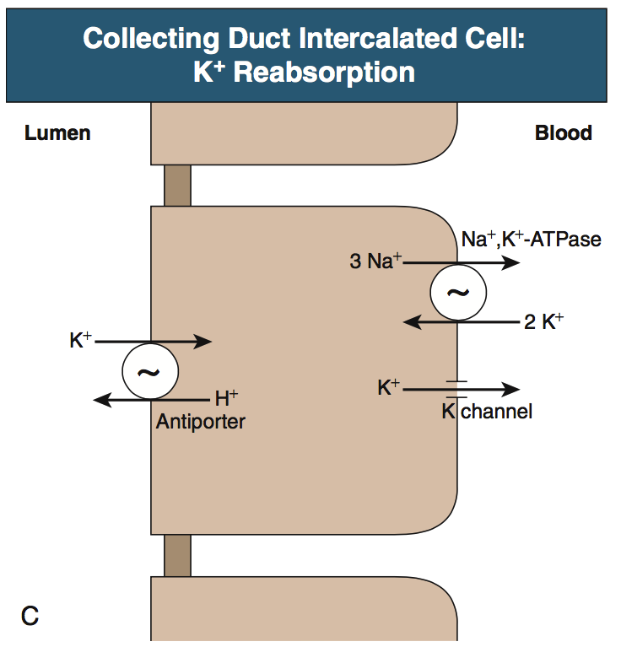
Apical H+-K+-ATPase
  Reabsorb K⁺ from Lumen
  Secretes H⁺
  Potassium depletion increases H+-K+-ATPase expression
  Aldosterone increases H+-K+-ATPase expression

Slide 12
The presence of two separate potassium transport processes, secretion by principal cells and reabsorption by intercalated cells, contributes to rapid and effective regulation of renal potassium excretion.

Slide 13


Slide 14
Definition
Serum potassium <3.5 mEq/L
occurs in up to 20% of hospitalized patients
10-fold increase in in-hospital mortality

Slide 15
Causes of Hypokalemia
Psuedohypokalemia
Reduced Intake
Increased translocation into cells
Increased Loss
    Renal
    GIT
    Sweat
    Dialysis
    Plasmapheresis

Slide 16
Pseudohypokalemia
artefactual decrease in serum potassium, after phlebotomy
in vitro cellular uptake of K+ after venipuncture
MCC : Acute Leukemia
Large numbers of abnormal leukocytes take up potassium when the blood is stored in a collection vial for prolonged periods at room temperature
Rapid separation of plasma
storage at 4° C

Slide 17
Reduced Intake
Average Person : 40 – 120 mEq/Day
Recommended : Close to 120 mEq/day
Mostly excreted : Urine
If Intake low : Kidney excretes Low K⁺ (conserves)
“decrease in intake rarely causes hypokalemia”
Decrease in intake can increase the severity of hypokalemia if there is already existing other causes of hypokalemia
Ex: Diuretic Therapy

Slide 18
Translocation into cells
Mechanism: Na⁺ K⁺ ATPase Action
Causes:
  Increased availability of insulin
  Increased Beta Agonist activity
  Alpha Antagonism
  Alkalosis
  Hypokalemic Periodic Paralysis

Slide 19
Increased β₂ Agonism
activation of β₂-adrenergic receptors stimulates Na⁺K⁺ ATPase , inducing cellular potassium uptake and decreasing serum K+
(Possibly also by increasing the release of insulin - UPTODATE)
(α₁-adrenergic receptor activation has the opposite effect)
UNEXPECTED HYPOKALEMIA
Β₂ agonist as bronchodilators in treatment of asthma
Dobutamine in treatment of heart failure
Tocolytics : Ritodrine
Pseudoephedrine and ephedrine in cough syrup or dieting agents
Theophylline intoxication/ Caffeine : xanthine- dependent activation of c-AMP dependent signaling (downstream to Β₂ receptor)

Slide 20
Β₂ agonist must be used with caution in
  Hypertensives on diuretic therapy
  Preterm labor on treatment with Ritodrine as tocolytic

Slide 21
Stress induced alterations in the activity of the endogenous sympathetic nervous system can cause hypokalemia sometimes :
  Alcohol withdrawal
  Hyperthyroidism
  Acute myocardial infarction
  Severe head injury

Slide 22
Hypokalemic Periodic Paralysis
FAMILIAL HYPOKALEMIC PERIODIC PARALYSIS
Genetic
Profound Hypokalemia
M>F
Never occurs after 25 yrs of age
THYROTOXIC PERIODIC PARALYSIS
a/w hyperthyroidsm
Profound hyperkalemia
F>M

Slide 23
FAMILIAL HYPOKALEMIC PERIODIC PARALYSIS
Missense mutations :
  α1 subunit of L-type calcium channels (type 1)
  skeletal Na+ channel (type 2)
Acute Attacks in which sudden movement of potassium occurs into cells
Profound Hypokalemia (1.5 – 2.5)
Precipitated often by rest following exercise stress and carbohydrate rich meals
Serum potassium normal in between the attacks
Low urinary potassium excretion

Slide 24
THYROTOXIC PERIODIC PARALYSIS
periodic attacks of hypokalemic paralysis
Asian or Hispanic origin
genetic variation in a thyroid hormone responsive K+ channel : Kir2.6, present in muscles
weakness of the extremities and limb girdles (frequently between 1 and 6 am)
Signs and symptoms of hyperthyroidism are not invariably present
Mechanisms
  activation of the Na+/ K+ ATPase
  β-adrenergic activity
High-dose propranolol (3 mg/kg) rapidly reverses the associated hypokalemia, hypophosphatemia, and paralysis

Slide 25
Other causes of transcellular shift
Potassium repletion associated “Paradoxical Hypokalemia”
Increased Blood cell production: due to uptake
  Vitamin B12/ Folate administration
  GM-CSF administration
Hypothermia
Barium intoxication
Cesium intoxication
Chloroquine intoxication
Antipsychotic drugs ( Risperidone, Quetiapine)

Slide 26
GI LOSS
Upper GI Loss
UGI secretion : 5-10 mEq/L
Vomiting
Alone cannot cause hypokalemia as such
Since K⁺ Conc is very low
Lower GI Loss
LGI Secretion : 20 – 50 mEq/L
Diarrhea
Laxatives
Tube drainage
Villous adenoma
VIPoma
Persistent Infective Diarrhea

Slide 27
Upper GI Loss
Vomiting : Acid Loss
Reduced pH : Metabolic Alkalosis
Compensation: HCO₃⁻ excretion
More HCO₃⁻Reaches Collecting duct
More electronegativity in lumen
Hypovolemia
Aldosterone Secretion
K+ Excretion
K+ Excretion

Slide 28
Lower GI Loss
Mechanism
  Bicarbonate Loss
  Hyperchloremic Metabolic Acidosis
Other Causes of LGI Loss:
Bowel Cleaning for colonoscopy : PEG, Sodium Phosphate
Ogilvies Syndrome
Geophagia

Slide 29
1.
2. Increase elecro Negativity in lumen
1.Increase Na/Water delivery
3. Increase Electronegativity in Lumen
3.
2. Increase Aldosterone Activity

Slide 30
Diuretics
“any diuretics acting proximal to potassium secreting site can cause hypokalemia”
CAi
Loop diuretics
Thiazides
Mechanism
Increased Na delivery to distal tubule
Volume depletion – RAS stimulation

Slide 31
Thiazide Produces more Hypokalemia than Loop diuretics
  Reason: Calcium Excretion
  Loop diuretics -> calcium excretion-> more calcium in lumen -> electronegativity in lumen is reduced -> Low K⁺ Excretion
  Thiazides -> less calcium excretion -> less calcium in lumen -> more electro negativity -> More K⁺ Excretion
Hypokalemia produced by diuretics is dose dependent
  Lower dose of thiazides 12.5/25 mg/day of chlorthalidone & hydrochlorthiazide are now widely used.
  Effectively control hypertension
  Less Hypokalemia

Slide 32
Diuretic induced fluid and electrolyte complications occurs only during first two weeks of therapy
  Steady state attained (if oral intake is adequate)
“Stable patient with Normal serum potassium at 3 weeks has no risk of developing late hypokalemia”
Potassium monitoring not required
  Adequate oral intake
  No increase in dosing
  No other loses (GI: Gastroenteritis)
  If any one present: consider temporary cessation of diuretics

Slide 33
Increased Mineralo corticoid activity
Conns Syndrome
Appareant Mineralo Corticoid Excess

Slide 34
Non Reabsorbable Anions in CD
Proximal RTA
BetaHydroxyButyrate in DKA
High dose penicillin
Toluene induced metabolic acidosis (Glue Sniffing): hippurate
Non reabsorbable Anions Increase Electronegativity in Lumen

Slide 35
What Happens in DKA ?
Glucose -Osmotic Diuretic : More Sodium and water to distal tubules
Dehydration – aldosterone stimulation
Ketones - BetaHydroxyButyrate – Non absorbable anion
Insulin infusion as treatment

Slide 36
Saltwasting Nephropathies
Bartter Syndrome
Gittleman Syndrome
Liddle Syndrome

Slide 37
HypoMagnesemia
Mechanism uncertain
Increase number of open ROMK channels
Magnesium known to inhibit ROMK channels
Also can coexist with hypokalemia in upto 40% cases
Concurrent Potassium loses
  Diuretic therapy
  Tubular toxins : iphosphamide, gentamycin

Slide 38
AMPHOTERICIN B: increase permeability of cell membrane collecting duct
LOW CALORIE DIETS: Atkins diet
Polyuria

Slide 39
Clinical Features
Muscular
  Weakness : hyperpolarization of skeletal muscle
  Rhabdomyolysis
Smooth Muscle
  Constipation
  Bladder Dysfunction
Endocrine
  Carbohydrate Intolerance
  Diabetes mellitus (Reduced insulin)

Slide 40
Renal
Prerenal AKI : reduced renal BF
Nephrogenic DI
Increased Ammoniagenesis
Tubular Vacuolization
Chronic : CKD
Hypokalemic polyuria: combination of central polydipsia and AVP-resistant renal concentrating defect

Slide 41
Cardiovascular changes
  ventricular and atrial arrhythmias
  predisposes to digoxin toxicity
  ECG Abnormalities

Slide 42
ECG Changes in Hypokalemia
1. | 3.0 – 3.5 | Reduced T wave Amplitude U waves
2. | 2.5 – 3.0 | Prolonged QT/QU interval Sagging of ST Segment
3. |  | T and U almost Coalesce
4. | <2.5 | QRS Widening PR prolongation

Slide 43
DIAGNOSTIC APPROACH TO HYPOKALEMIA

Slide 44
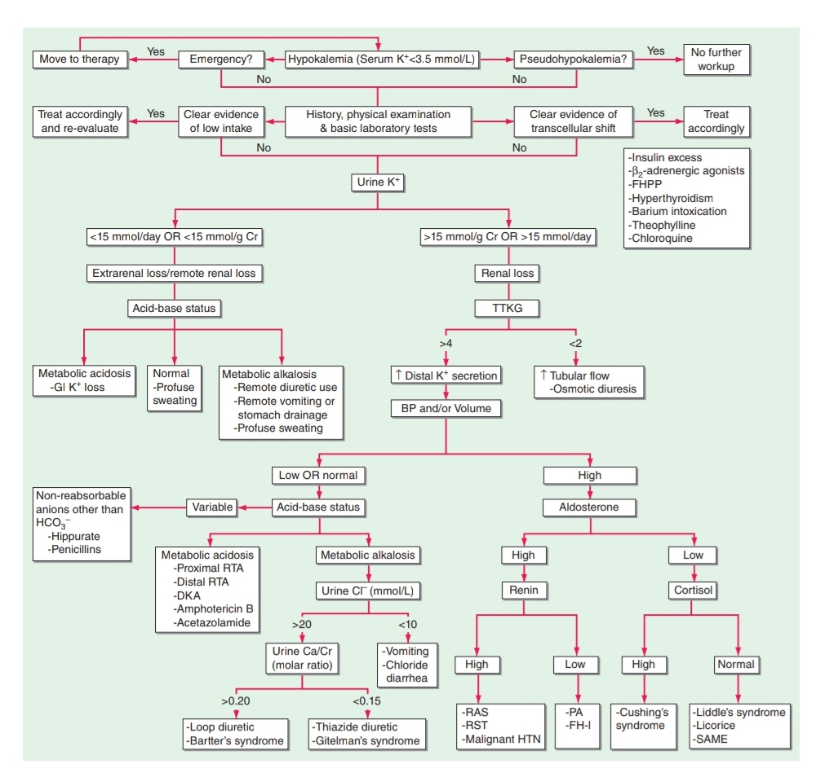

Slide 45
Goals Of Treatment
prevent life threatening complications
to replace the associated K⁺ deficit
to correct the underlying cause

Slide 46
Potassium Preparations
Potassium can be administered as
potassium chloride
potassium phosphate : hypokalemia and hypophosphatemia proximal (type 2) RTA
potassium bicarbonate : hypokalemia and metabolic acidosis (eg: renal tubular acidosis / diarrhea)

Slide 47
Oral replacement with KCl is the mainstay of therapy in hypokalemia.
Notably, hypomagnesemic patients are refractory to K⁺ replacement alone
Concomitant Mg²⁺ deficiency should always be corrected with oral or intravenous repletion.

Slide 48
IV KCL therapy
1 Amp KCL = 10 ml = 20 mEq
Approximatly 40 mEq of IV KCl raises Serum K⁺ by 0.5 mEq
Indication of IV KCl:
Severe symptomatic Hypokalemia
Unable to take oral medications
Saline is preferred over dextrose
Pain/ Phlebitis (Rates >10mEq/hr)

Slide 49
DKA + Hypokalemia
Insulin therapy should be delayed till S. potassium is above 3.3
Addition of potassium to NS will make it hypertonic solution. So 40-60 mEq of Potassium/Litre of Half NS is preffered

Slide 50
Redistributive hypokalemia
Potential complication is rebound hyperkalemia, as the initial process causing redistribution resolves or is corrected.
Such patients can develop fatal hyperkalemic arrhythmias

Slide 51
When excessive activity of the sympathetic nervous system is thought to play role in redistributive hypokalemia as in:
  Thyrotoxic Periodic Paralysis
  Theophylline overdose
  Acute head injury
  High dose propranolol (3 mg/kg) should be considered; this nonspecific beta blocker will correct hypokalemia without the risk of rebound hyperkalemia.

