Slide 1
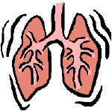
Approach to a case of dyspnea
ANAND T,
JUNIOR RESIDENT,
GENERAL MEDICINE

Slide 2
DYSPNEA.
“Subjective experience of breathing discomfort that consist of qualitatively distinct sensations that vary in intensity.The experience derives from interactions among multiple physiological psychological social and environmental factors and may induce secondary physiological and behavioral responses ”-American thoracic society .

Slide 3
These are activated in the setting Often increase workload from a disease state that produces an increase in the airway resistance that may be associated with symptoms of chest tightness eg.ASTHMA or COPD
Decreased chest wall compliance, Eg. PULMONARY FIBROSIS
The efferent signals are from the CNS, from the motor cortex and brainstem, to the respiratory muscles.

Slide 4
MECHANISMS UNDERLYINH DYSPNEA
Dyspnea can arise from a variety of pathways including generation of afferent signals from the respiratory system to the central nervous system and efferent signals from the CNS to the respiratory muscles and particularly when there is a mismatch in the integrative signalling between these two pathways termed efferent reafferent mismatch .
Afferent signals trigger the CNS and include primarily (1)peripheral chemoreceptors in the carotid body and aortic arch And central chemoreceptors in the medulla better activated by hypoxemia hypercapnia or academia and might produce a sense of air hunger and (2)mechanoreceptors In the upper Airways , lungs(inc stretch receptors,irritant receptors, and j receptors), and chest wall(inc muscle spindles as strech receptors, and tendon organ that monitor force generation)

Slide 5
Types of dyspnea
ORTHOPNEA- DYSPNEA ON LYING FLAT And this is a sign of advanced heart failure. lying flat increases venous return and in patients with left ventricular impairment may precipitate pulmonary edema.
PND- Sudden breathlessness waking the patient from sleep it is caused by accumulation of alveolar fluid . patients may choke or gasp for air, sit on the edge of the bed and open windows in an attempt to relieve the stress.
PLATYPNEA- breathlessness on sitting upright with relief on lying down, rare and is due to Right to left shunting through a patent foramen ovale, atrial septal defect or a large intrapulmonary shunt and it is much rarer than orthopnea and is usually associated with deoxygenation.
TREPOPNEA- while lying on one side. Causes can be unilateral lung disease , dilated cardiomyopathy. Or tumors compressing major vessels.

Slide 6
Causes of dyspnea
RESPIRATORY
CARDIOVASCULAR
NEUROMUSCULAR
METABOLIC
PSYCHOGENIC

Slide 7
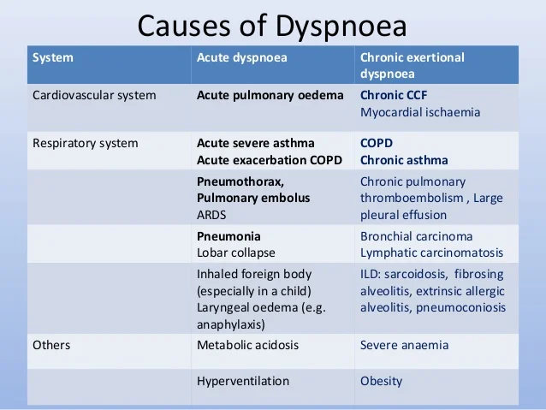

Slide 8
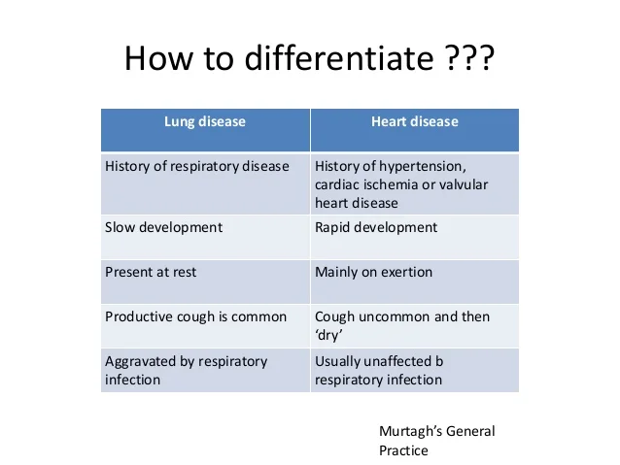

Slide 9
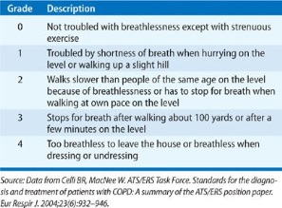
Gold criteria

Slide 10
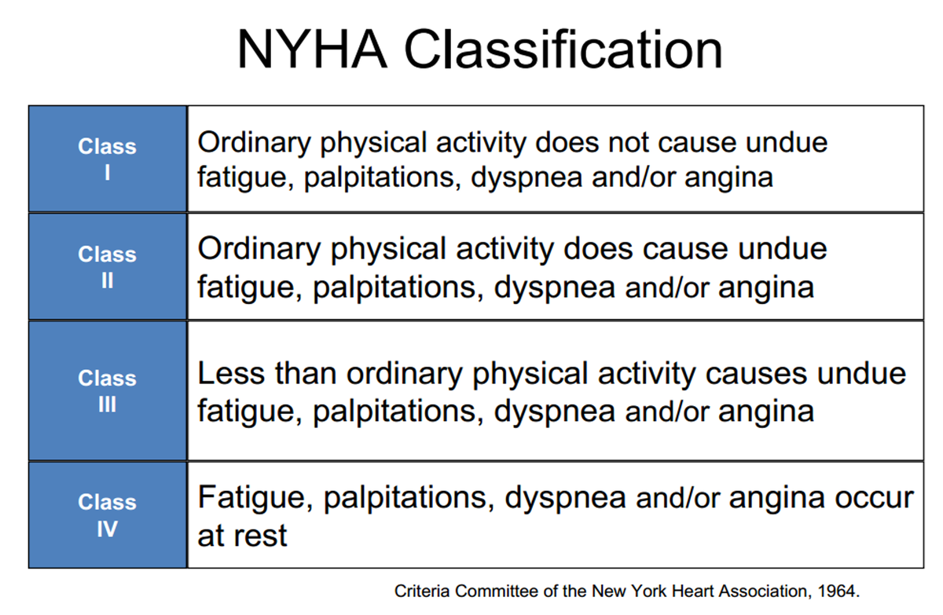
NYHa classification

Slide 11
DIAGNOSTIC APPROACH
HISTORY;
ONSET; Sudden onset as in acute pulmonary embolism ,acute coronary syndrome or spontaneous pneumothorax ,acute respiratory distress syndrome ,foreign body aspiration ,psychogenic causes
DURATION; Slowly progressing over hours or days include bronchial, asthma chronic obstructive pulmonary disease, pleural effusion, congestive heart failure, small pulmonary emboli .interstitial lung diseases or malignancy, psychogenic causes, and cardiac diseases ,coronary artery disease and congestive heart failure.

Slide 12
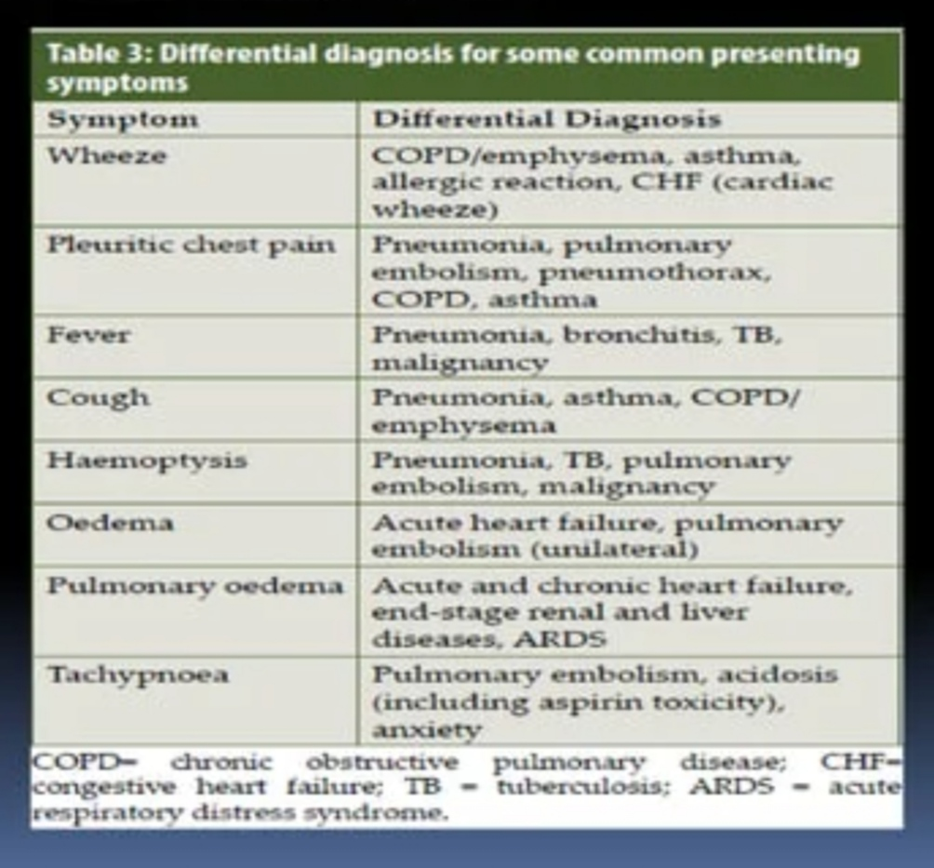

Slide 13
PHYSICAL EXAMINATION
We have to look for hemodynamic stability
Whether the patient is able to complete full sentences
Use of accessory muscles of respiration
Signs of pallor, cyanosis, clubbing and pedal edema’
Saturation in room air
The symmetry of the chest wall movements
Percussion [dull note in pleural effusion,hyperresonant in pneumothorax]
Auscultation[ wheeze,crepitations, decreased or hyperesonant sounds, bronchial breath sounds etc]
Signs of HF like elevated jvp, S3 gallop, peripheral edema

Slide 14
investigations
BLOOD ROUTINES
ECG
CHEST X RAY
LUNG USG with or without NTPROBNP Has high diagnostic accuracy for differentiating dyspnea due to HF from COPD
ABG to find the type of respiratory failure and also to know about the Acid-base state
Cardiac troponin I
D Dimer
Pulmonary function testing spirometry
Diffusion lung capacity of lung for carbon monoxide.

Slide 15
treatment
The first goal is to correct the underlying conditions driving dyspnea and address potentially reversible courses with appropriate treatment for the particular condition.
Dyspnea often arises from multifactorial causes so multiple interventions may be necessary
If relief of Dyspnea with treatment of the underlying condition is not fully possible an effort is made to lessen the intensity of the symptom and its effect on the patient’s quality of life
Supplemental oxygen should be administered if the resting oxygen saturation is less than 88% of if the patient saturation drops to these levels with activity or sleep
For patients with COPD the supplemental oxygen for those with hypoxemia has been shown to improve mortality and pulmonary rehabilitation programs have demonstrated positive effects on dyspnoea ,exercise capacity, and rates of hospitalisations.

Slide 16
Additional approaches are under study for dyspnea including inhaled frusemide that might alter afferent sensory information.

Slide 17
THANK YOU
☺

