Slide 1
Approach to Weakness

Slide 2
Case scenario 1
30y/F presented with acute onset weakness of both lower limbs one fine morning. She could not feel her clothes in the leg, and had a definite sensory level at torso. Urinary incontinence+ in the form of overflow incontinence.
O/E – Grade 2 power B/L LLs proximally
Gr.1 power – distally,B/L plantar extensor, Beevor’s sign +.

Slide 3
Case scenario 2
65/M, c/c smoker, diabetic, presented with weakness of B/L UL ( L>R) in the form of slipping if articles from hand, difficulty in buttoning shirt and drying hair for past 9 months. It was associated with wasting of hand muscles, cramps and fatigue. He also gave a history of inability to hold onto slippers and h/o buckling of knees on walking.
O/E – Wasting of thenar >>hypothenar ( Split hand sign+)
Wasting of shoulder girdle, quadriceps, calf muscles.
Fasciculations+
Tongue- wasting and fasciculations+
Power – UL – Gr 3
LL – Gr 3
B/L plantar extensor
Sensory, B& B – normal.

Slide 4
Case scenario 3
33/F presented with numess of B/L feet since 2 days followed by difficulty in gripping onto chappals, and within a span of 24 hours she developed buckling of both lowerlimbs and became bedbound.she had been treated for Ecoli UTI 3 weeks ago.
O/E
Conscious,
Cranial nerve –WNL
Motor- LL- B/L hypotonia
Power – LL – Gr2 prox, Gr 0 distally
UL – Gr 4+ both proximal.and distal

Slide 5
UL and LL – DTR absent
Plantar – B/L mute
Sensory, bowel and bladder normal

Slide 6
The 3 important questions:
True muscle weakness/not
Localizing the site of lesion
Finding the cause of the lesion

Slide 7
History
What does the patient mean by weakness?
What are the muscle groups involved?
Any associated findings?
Timing of onset?
Family history
Systemic signs and symptoms
Association with pain/other symptoms
Past history- drugs/toxins/infections.

Slide 8
Weakness?
Weakness is a reduction in the power that can be exerted by one or more muscles
DDs:
Fatigability
limitation in function due to pain or articular stiffness
severe proprioceptive sensory loss
Bradykinesia
apraxia

Slide 9
Ask if the patient’s movement is limited by shortness of breath,chest pain, joint pain, fatigue,paraesthesia, spascticity.
True muscle weakness- inability to perform specific tasks – like buttoning shirt, combing hair

Slide 10
MRC Grading of muscle weakness
Zero – No muscle contraction
One – Flicker or trace of muscle contraction
Two – Limb or joint movement with gravity eliminated
Three – movement against gravity only
Four – Power decreased but movement possible against resistance
Five – Normal power against resistance

Slide 11
Question 2
What is the spatial distribution of weakness?
Proximal/distal?
Proximal – myopathy
Distal – polyneuropathy
U/L or B/L?
In the distribution of a particular nerve or group of nerves?

Slide 12
Question 3
What are the associated symptoms?
Suggestive of systemic diseases- rheumatologic, endocrine, malignancy, infections.
Pain – plexopathy, inflammatory myopathy

Slide 13
Question 4
What is the onset and progression of weakness?
Clear timing of onset and rapid progression – vascular, infectious, inflammatory or traumatic disorders.
Insidious onset – degenerative , metabolic or hereditary diseases

Slide 14
Intermittent weakness –
Worsening with repeated activity – Myasthenia gravis
With certain movements or postures – mechanical problem- entrapment neuropathy, radiculopathy or localized vascular occlusion.
Diurnal variation or with meals – channelopathies
Random with rapid recovery -TIA

Slide 15
Question 5
Family history?
Hereditary neuropathies and myopathies.

Slide 16
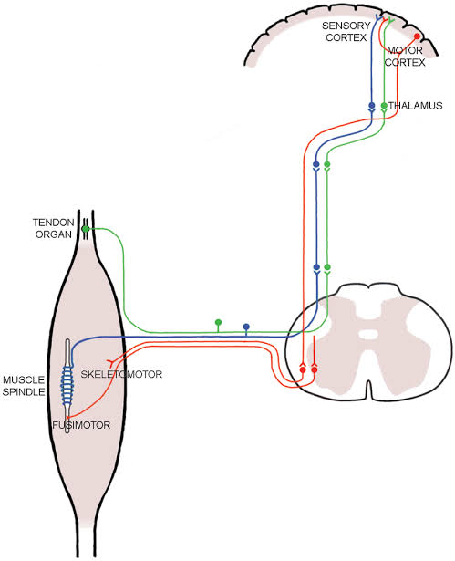
LOCALIZING THE SITE OF THE LESION
The Motor cortex > the corticospinal tracts >anterior horn cells > spinal nerve roots> peripheral nerves>neuromuscular junction> and finally muscle

Slide 17
Site of lesion
UMN/LMN?
NMJ?
Myopathy?

Slide 18
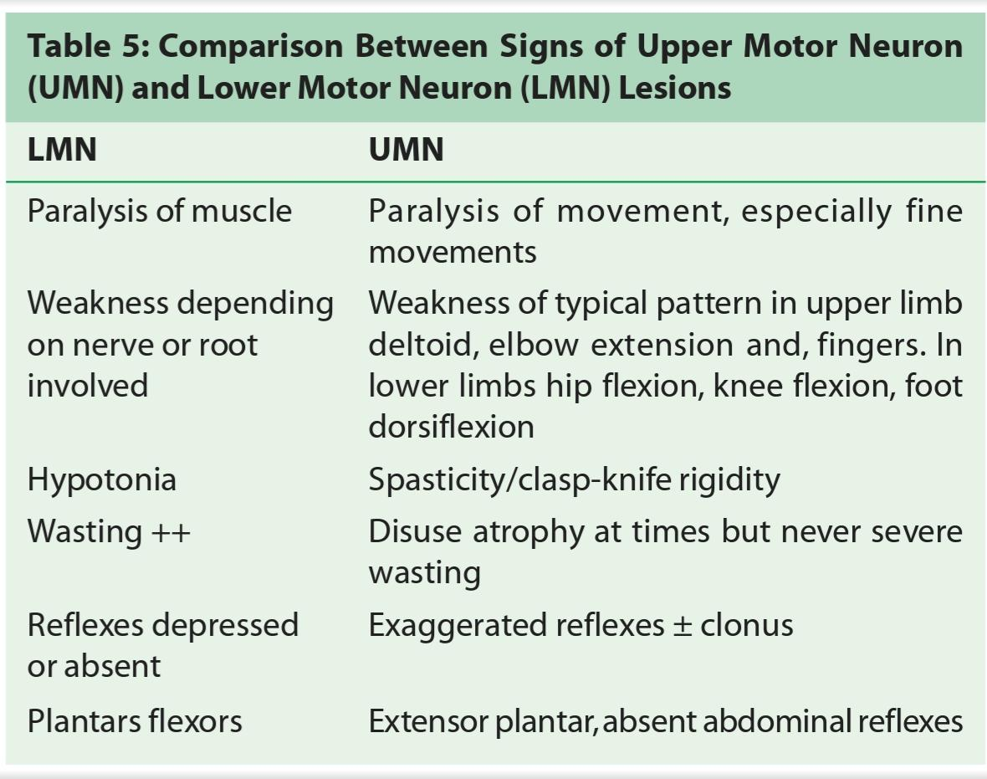

Slide 19
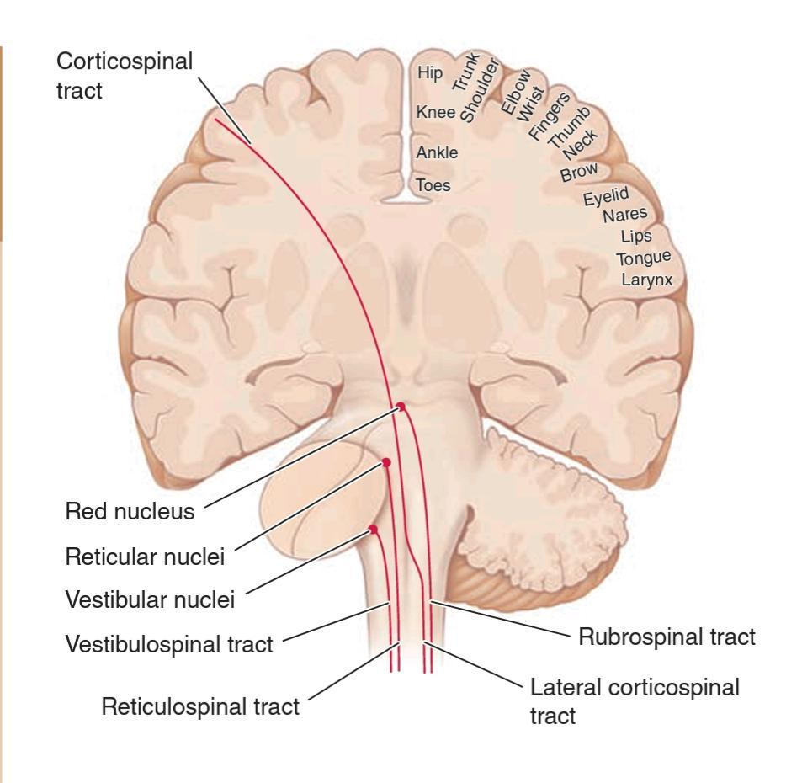
UMN pathways
The corticospinal(pyramidal) & bulbospinal (EP) tracts

Slide 20
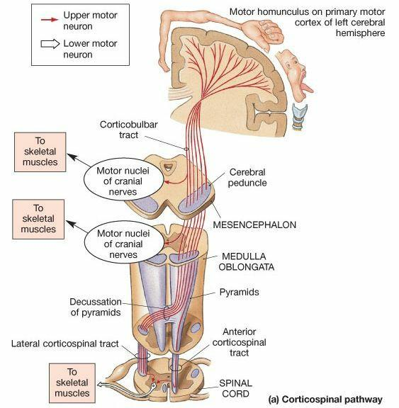
The Corticospinal tract
UMN cell bodies in the layer V of primary motor( precentral gyrus, BA4) & premotor and supplemental motor cortex(area6).

Slide 21
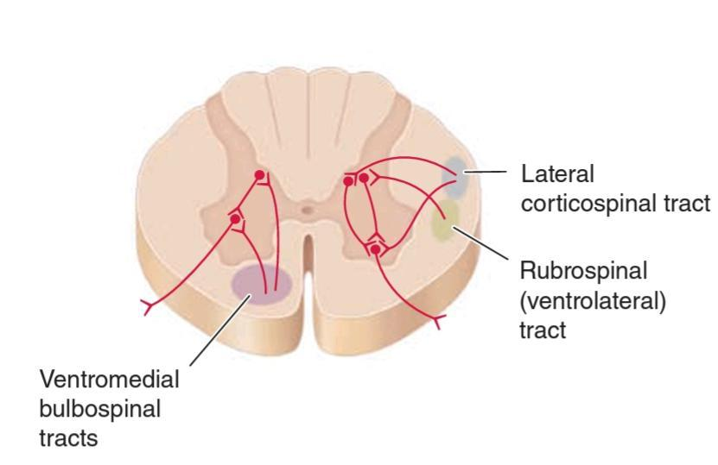
The bulbospinal pathways
Strength & tone
The ventromedian bulbospinal pathways : tectospinal, vestibulospinal & reticulospinal – axial & proximal muscles.
The ventrolateral bulbospinal pathway – rubrospinal – distal limb muscles.

Slide 22
UMN Weakness
Usually a graded weakness of movement(paresis) rather than palsy.
Paralysis in pyramidal distribution
Progravity muscles weaker than antigravity muscles. eg. UL extensors and LL flexors.
Distal > proximal weakness.
Axial movements are spared usually
Usually large groups of muscles
Corticobulbar involvement- lower face and tongue weakness; extraocular, upper facial, pharyngeal, and jaw muscles are typically spared.
B/L corticobulbar – Pseudobulbar palsy

Slide 23
Hypertonia, spasticity of paralysed muscles – d/t loss of descending inputs
Antigravity muscles > Progravity i.e. UL flexors and LL extensors.
In both UL and LL, adductor spasm> abductors.
3. Deep reflexes
Exaggerated DTR
pathological deep reflexes – finger reflex, patellar reflex, adductor reflex
Ankle clonus

Slide 24
4.Lost superficial reflexes.
5.Positive Babinski
6. Atrophy is rare – as Alpha motor neurons are intact.
7.No fasciculations and fibrillations.

Slide 25
UMN Type of Weakness
Above the level of AHC
Could be at
Cortex
Brainsten
Spinal cord

Slide 26
Cortical lesions
Higher mental functions – altered consciousness, language
Non-dense weakness
Vomiting, headache, seizure
Cortical sensory loss , apraxia ,behavioural changes, homonymous hemianopia –depending on site

Slide 27
Brainstem lesions
Crossed hemiplegia- I/L CN palsies + C/L weakness
eg. Midbrain - Weber’s
Pontine – Milliard Gubler and Foville

Slide 28
Spinal cord
Definite sensory level
Early B&B involvement
Dissociated sensory loss eg. Syrinx

Slide 29
LMN
The Anterior Horn Cell
α motor neurons- larger, numerous- to the extrafusal muscle fibers - loss of α motor neurons or disruption of their axons-LMN weakness.
γ motor neurons- intrafusal muscle fibers of the muscle spindle – normal tone and stretch reflexes.

Slide 30
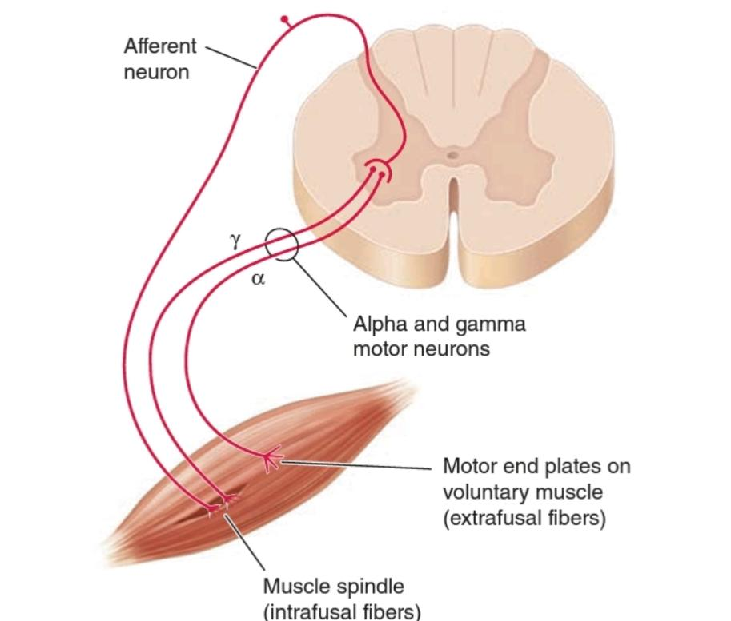
LMN type weakness

Slide 31
LMN type of Weakness
AHC
Radiculopathy
Peripheral nerve lesion
Neuromuscular junction disorder
Muscle disease

Slide 32
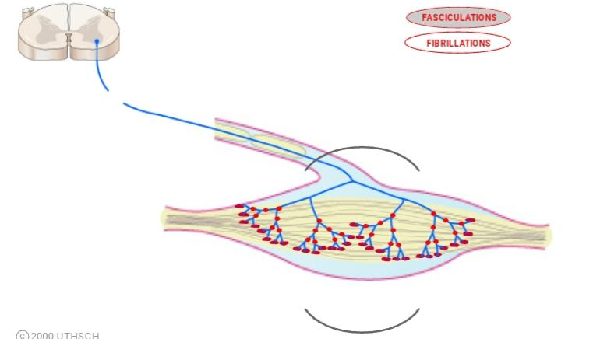
Limited to a small group of muscles
Muscle atrophy – due to deprivation of trophic factors.
Profound weakness, hypotonia, hyporeflexia
Fasciculations – damaged Alpha motor neurons can produce spontaneous APs – the muscle fibres of the motor unit fire – visible twitch.

Slide 33
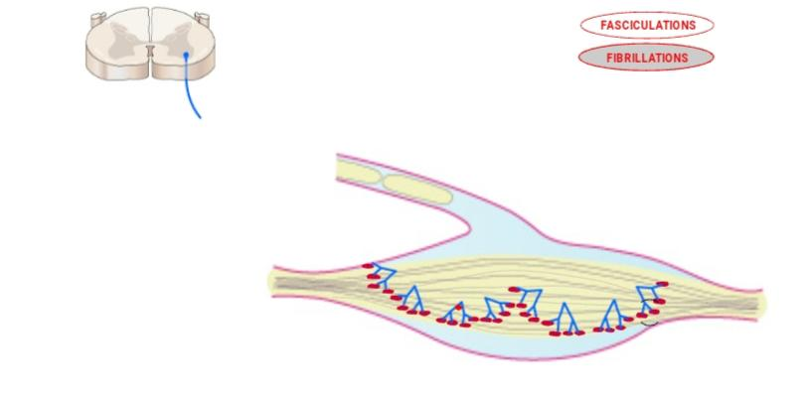
5. Fibrillations –
With further degeneration of the alpha motor neuron, only remnants of the axons near the muscle fibers remain- these individual axon fibres fire- individual muscle fibres contract.
Detected by an EMG

Slide 34
AHC lesion
Pure motor
Asymmetric
Predominantly Wasting > Weakness
Muscle groups with greater representation in the AHC will be affected more
No bowel and bladder involvement
Prototype - Poliomyelitis

Slide 35
Root
Characterised by Radicular pain
Sudden,brief, electric shock like/lancinating pain along the affected root.
The specific groups supplied by the radicle will be affected,sparing others.
Eg. L5S1 radiculopathy – hip extensors, dorsiflexion of ankle, EHL

Slide 36
Plexus
Sensorimotor symptoms
Asymmetric
LMN type weakness which is painful, may be U/L or B/L
Patchy sensory loss with patchy reflex loss.
Eg. Lumbosacral plexopathy – usually femoral nerve involved – buckling, sensory loss along antr thigh, loss of knee jerk, a/w pain.
Diabetes, infiltrative lesions, paraneoplastic

Slide 37
Peripheral Nerve
Individual muscle paralysis
Mononeuropathy – in leprosy, diabetes, entrapment neuropathy
Mononeuritis multiplex
Polyneuropathy

Slide 38
Peripheral neuropathy
May be due to axonal degeneration/ demyelination
B/L symmetrical
Distal > proximal
Length dependant

Slide 39
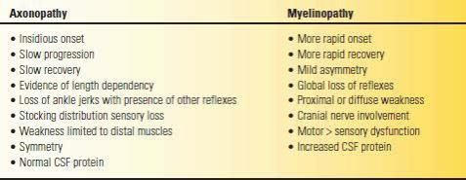

Slide 40
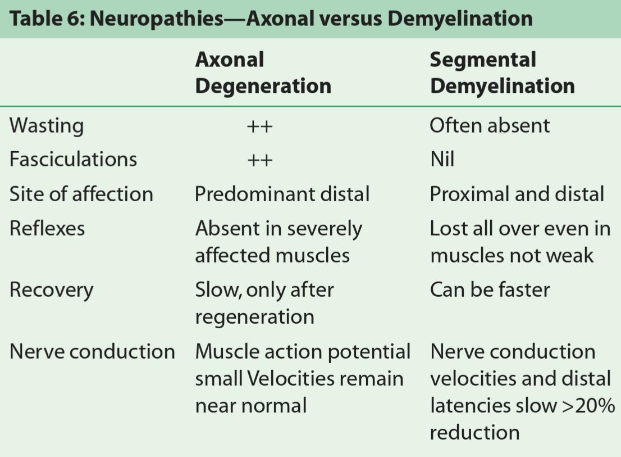

Slide 41
NMJ disorders
Post –synaptic – most common .eg.Myasthenia, OP poisoning, cobra bite
Pre-synaptic Lambert-Eaton, botulism
Mixed – Krait bite, antibiotic induced

Slide 42
Neuromuscular Junction
Fatigable weakness
Diurnal variation
Weakness >>> wasting
No sensory symptoms
Asymmetric
Prototype – Myasthenia gravis
Asymmetric fatiguable weakness usually with EOM weakness, bulbar and proximal muscles.

Slide 43
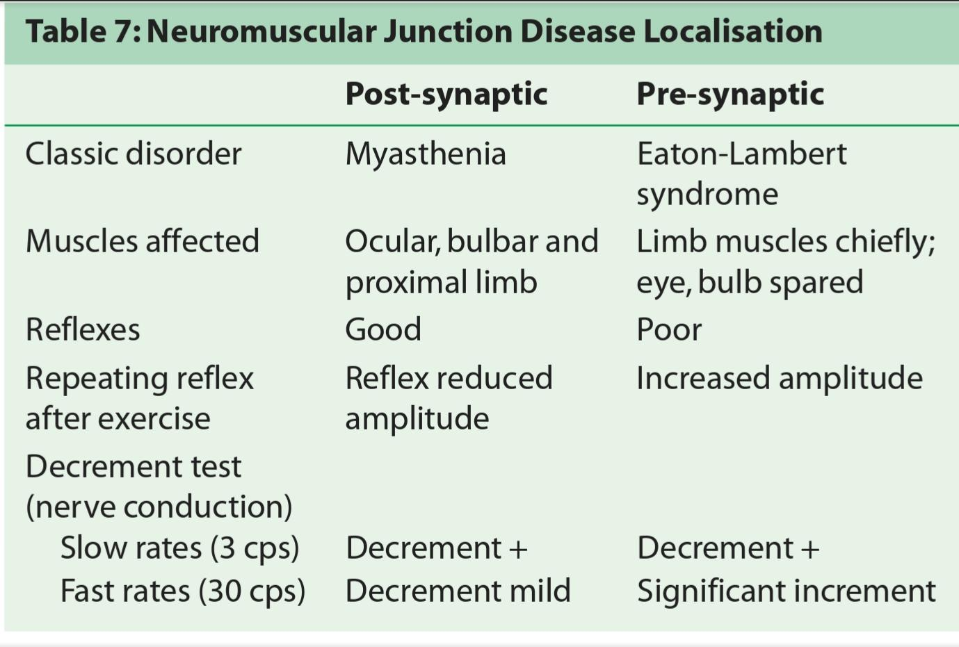

Slide 44
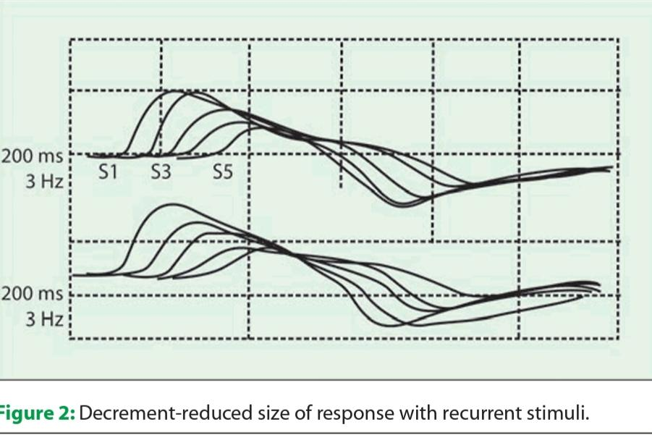
Repetitive Nerve Stimulation
Decrement – a fall of 20% in S4 amplitude (10% for smaller muscles like orbicularis oculi)

Slide 45
Muscle Disease
Weakness, hypotonia +
Sensations and reflexes preserved
Usually symmetric and proximal

Slide 46
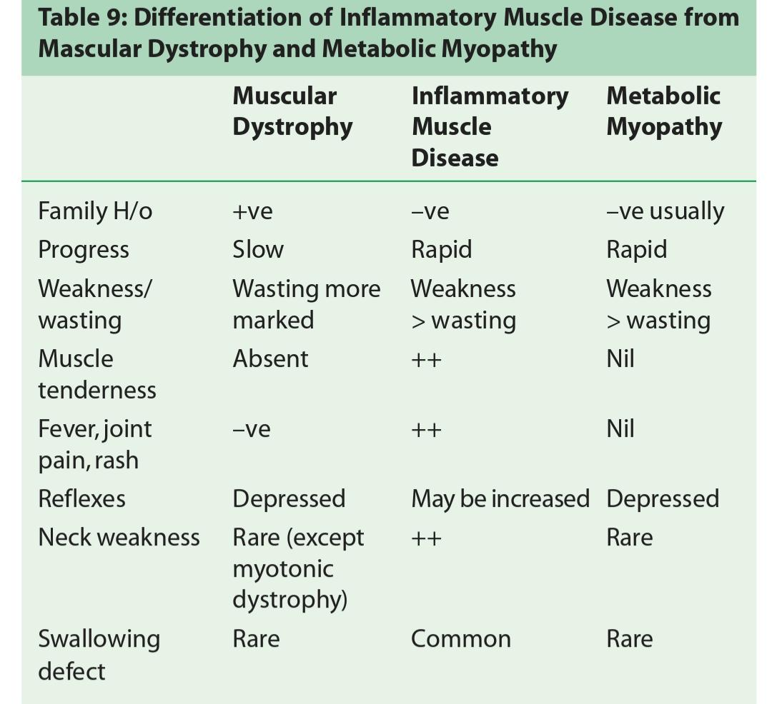

Slide 47
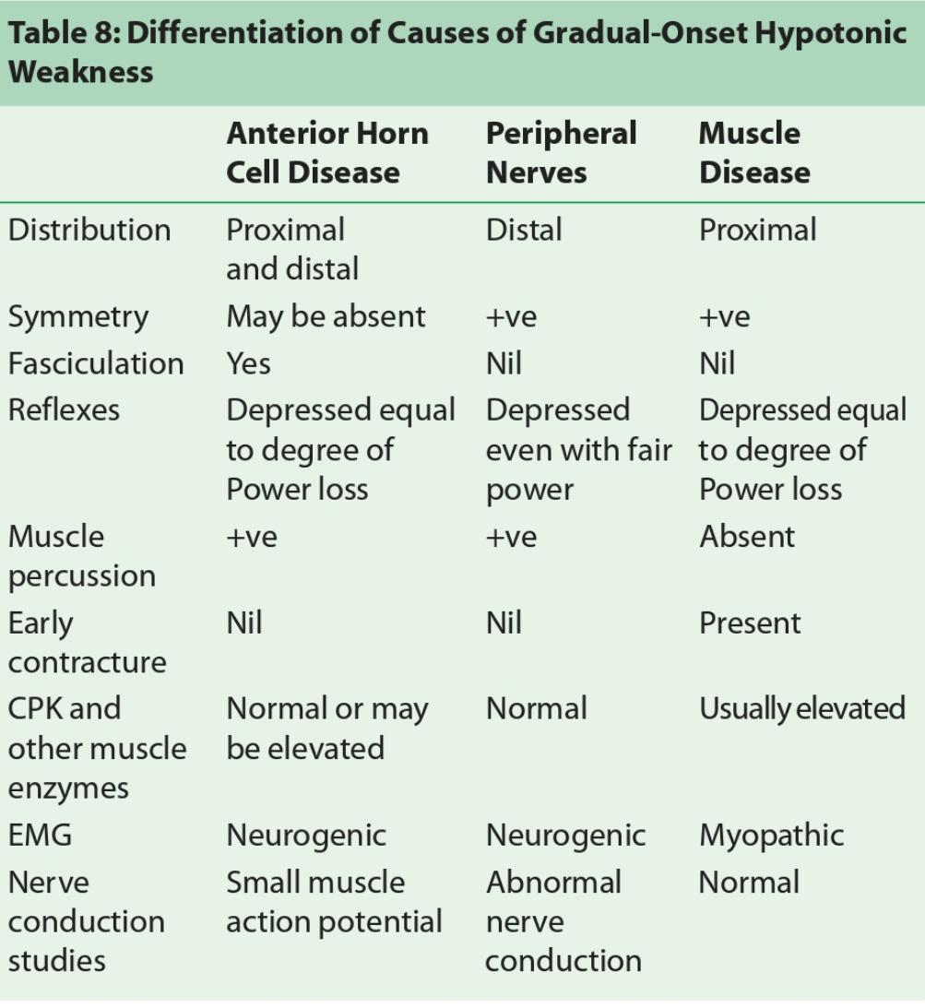

Slide 48
LMN Palsy
Brainstem motor nuclei / AHC of spinal cord or their axons.
Loss of Alpha motor neurons – weakness
Loss of gamma motor neurons – decreased tension of muscle spindle – decreased tone and attenuated stretch reflex.
Spontaneous discharge of motor units – Fasciculations
Single muscle fibre discharges – fibrillations – recorded via EMG.

Slide 49
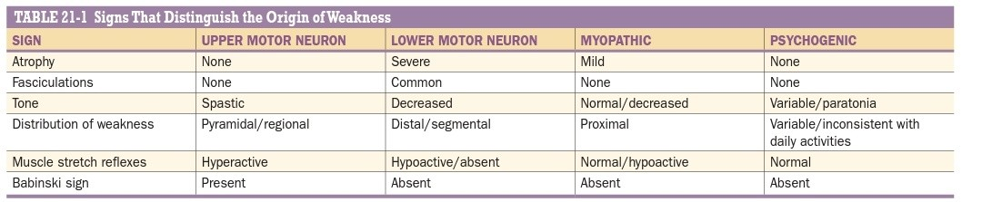

Slide 50
Distribution of weakness as a guide to localizing the lesion
Generalized weakness:
in some cases of myasthenia gravis
long-standing periodic paralysis
advanced disuse atrophy from prolonged bed rest
muscle wasting from malignancy, or longstanding motor neuron disease

Slide 51
Localized weakness- Symmetric/Asymmetric
Asymmetric Weakness - disease of the central or peripheral nervous system
Symmetric Weakness - distal, proximal, or specific distributions.

Slide 52
Distal Symmetric Weakness
decreased grip strength, weakness of wrist flexion or extension, decreased plantar flexion strength, and foot drop.
early motor neuron disease or peripheral neuropathy.

Slide 53
Proximal Weakness
involves the axial muscle groups, deltoids, and hip flexors.
myopathies, certain muscular dystrophies, and myasthenia gravis.

Slide 54
Specific distributions of weakness
are characteristic of certain neuropathies or muscular dystrophies.
Examples of localized disorders include facioscapulohumeral dystrophy, scapuloperoneal dystrophy, and scapulohumeral dystrophy.

Slide 55
DISTRIBUTION OF WEAKNESS
Hemiparesis – UMN lesions above the midcervical spinal cord; most such lesions are above the foramen magnum.
(pyramidal tract lesion at any point from its origin in the cerebral cortex to the C5 segment).
Broadly: 1. Above brainstem – Cortical or Subcortical ( internal capsule level).
2.Brainstem level
3.Spinal level (hemisection between C1-C5)

Slide 56
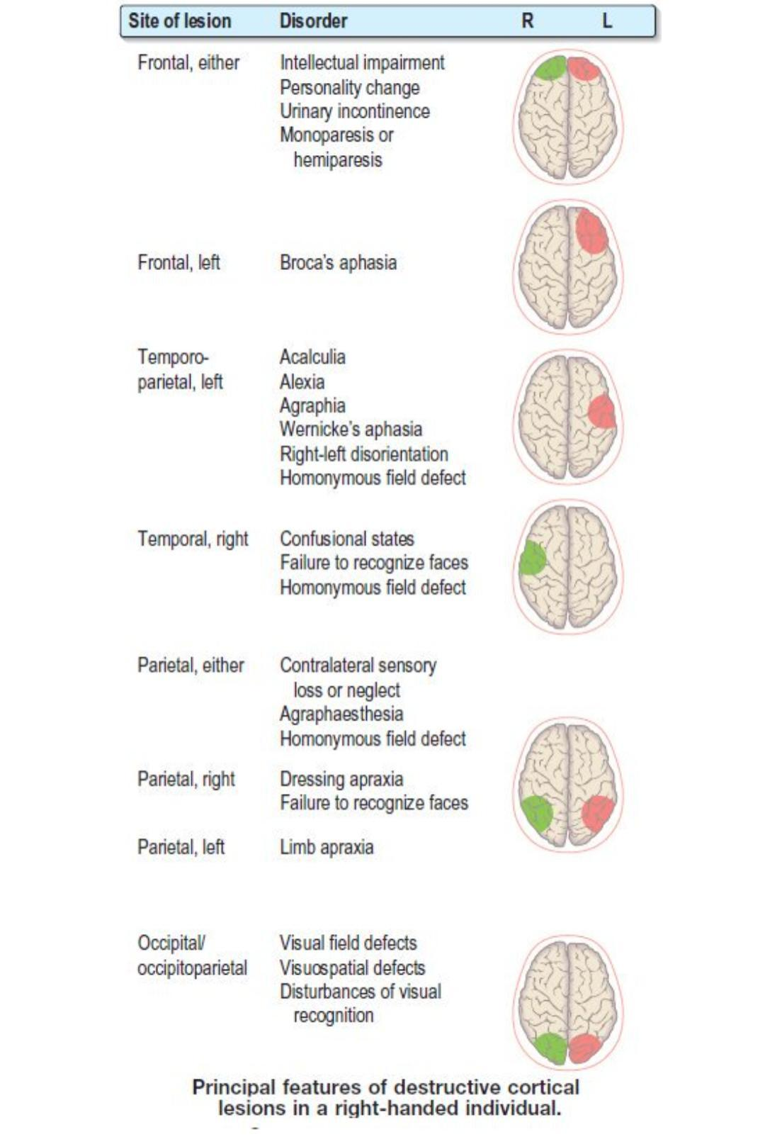

Slide 57
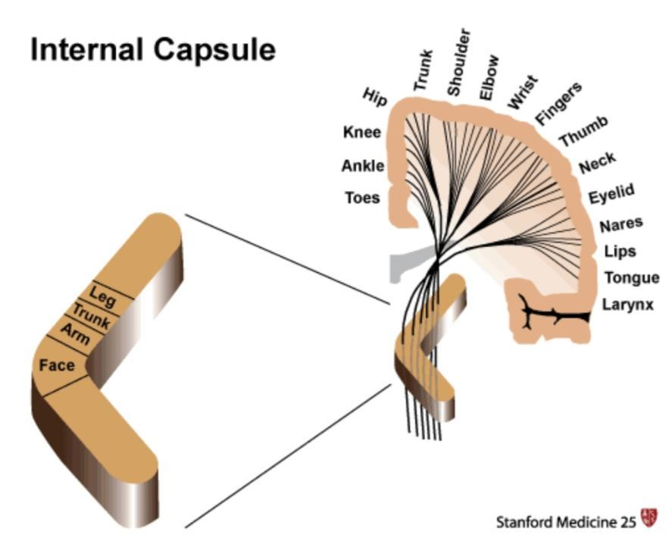
Internal Capsular lesions
Dense hemiplegia
No cortical signs/ seizures/ mental status changes
C/L hemisensory loss and hemianopia may occur

Slide 58
Paraparesis
Acute Paraparesis –
Spinal lesion
Cerebral hemisphere
- ACA ischemia
- Superior sagittal sinus thrombosis
- Cortical venous thrombosis
- Acute hydrocephalus
3. AHC disease, peripheral neuropathy, myopathy

Slide 59
Subacute or chronic spastic paraparesis
LL sensory loss & Sphincter involvement - Spinal cord disorder
Hemispheric signs – Parasagittal meningioma, c/c hydrocephalus
C/c non-spastic paraparesis
LMN or myopathic

Slide 60
Quadriparesis
CNS disorders – Consciousness/cognition affected, spascticity, hyperreflexia, sensory disturbances.
Neuromuscular causes – normal mental function,hypotonia, hypoactive muscle stretch reflexes.

Slide 61
Acute Quadriparesis
Onset over minutes
upper motor neurons (such as from anoxia, hypotension, brainstem or cervical cord ischemia, trauma, and systemic metabolic abnormalities) or
muscle (electrolyte disturbances, certain inborn errors of muscle energy metabolism, toxins, and periodic paralyses)
Over hours to weeks - AIDP

Slide 62
Subacute or chronic Quadriparesis
develop over weeks to years
UMN- chronic myelopathies, multiple sclerosis, brain or spinal tumors, chronic subdural hematomas, and various metabolic, toxic, and infectious disorder
LMN- chronic neuropathy ir myopathy.

Slide 63
Monoparesis
LMN disease- sensory involvement+/-
UMN- distal , non antigravity muscles
Acute monoparesis –
LMN type – peripheral nerve or plexus involovement
UMN type – focal cortical ischemia

Slide 64
Subacute or c/c Monoparesis – usually of LMN origin
If sensory symptoms+ : Nerve,root ir plexus
Pure motor – AHC disease

Slide 65
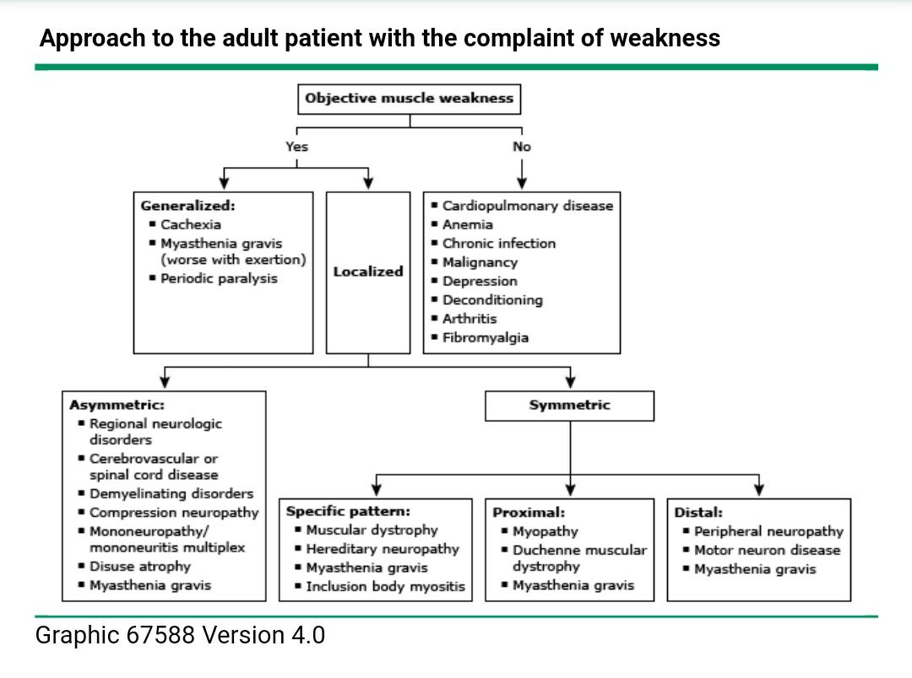

Slide 66
Case scenario 1
30y/F presented with acute onset weakness of both lower limbs one fine morning. She could not feel her clothes in the leg, and had a definite sensory level at torso. Urinary incontinence+ in the form of overflow incontinence.
O/E – Grade 2 power B/L LLs proximally
Gr.1 power – distally,B/L plantar extensor, Beevor’s sign +.

Slide 67
Case scenario 2
65/M, c/c smoker, diabetic, presented with weakness of B/L UL ( L>R) in the form of slipping if articles from hand, difficulty in buttoning shirt and drying hair for past 9 months. It was associated with wasting of hand muscles, cramps and fatigue. He also gave a history of inability to hold onto slippers and h/o buckling of knees on walking.
O/E – Wasting of thenar >>hypothenar ( Split hand sign+)
Wasting of shoulder girdle, quadriceps, calf muscles.
Fasciculations+
Tongue- wasting and fasciculations+
Power – UL – Gr 3
LL – Gr 3
B/L plantar extensor
Sensory, B& B – normal.

