Slide 1
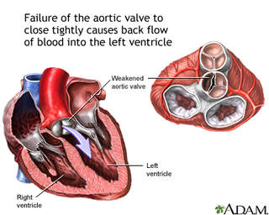
AORTIC REGURGITATION

Slide 2
CHRONIC AR
ETIOLOGY
PATHOPHYSIOLOGY
CLINICAL FEATURES
INVESTIGATIONS
TREATMENT
ACUTE AR

Slide 3
Etiology
Primary valve disease
Aortic root disease

Slide 4
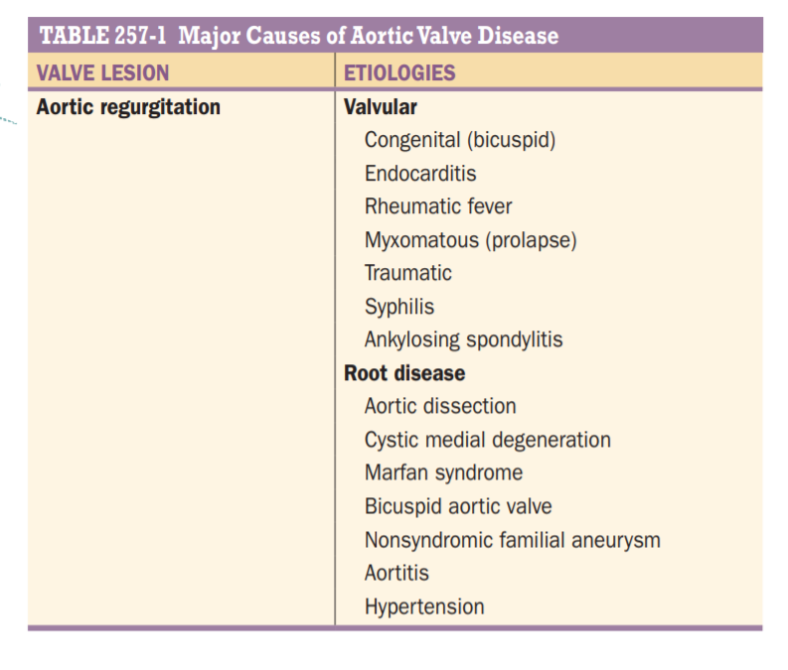

Slide 5
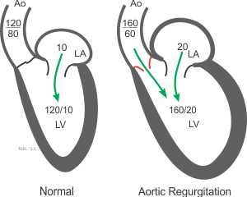
Pathophysiology

Slide 6
During diastole,
Blood from the left atrium + Blood from the aorta reaches the left ventricle
End diastolic volume
Increased force of contraction (Frank Starling Law) (systole)
Increased systolic blood pressure

Slide 7

Due to the regurgitation of blood from the aorta to LV during diastole, diastolic pressure decreases ( diastolic runoff) pulse pressure increases.
although there is increased LVEDV, LVEDP remains the same due to increased force of contraction all the blood is pumped into the aorta
When there is LV failure, LVEDP rises
Both Pre load and after load increases,
La Place law;
In AR, LV dilates, that is the radius increases, therefore to maintain the LVEDP, LV wall thickness increases leading to eccentric hypertrophy

Slide 8
As adaptive measures fail→ LV function deteriorates→ end-diastolic volume rises → forward SV & EF decline
LVEDP increases
LVEDP = LA pressure = pulmonary capillary wedge pressure
Therefore dyspnoea is a late manifestation in AR

Slide 9
Myocardial ischemia with AR
LV dilation, hypertrophy, & elevated LV systolic tension → elevate myocardial oxygen
coronary blood flow may be compromised.
This combination of increased oxygen demand and reduced supply may cause myocardial ischemia, particularly of the sub-endocardium, even in the absence of epicardial coronary artery disease (CAD).

Slide 10
HISTORY
pure or predominant valvular AR : men (75%)
primary valvular AR associated rheumatic mitral valve disease : women predominate

Slide 11
Long latent period: asymptomatic for as long as 10–15 years.
Palpitation ( due to increased force of contraction)
Fatigue
Asymptomatic → Palpitations → dyspnea → orthopnea & paroxysmal nocturnal dyspnea & excessive diaphoresis.

Slide 12
Anginal chest pain even in the absence of CAD may occur in patients with severe AR, even in younger patients.
Nocturnal angina → decreased sympathetic tone → bradycardia
The prolonged anginal episodes often do not respond satisfactorily to sublingual nitroglycerin.
Systemic fluid accumulation, including congestive hepatomegaly and ankle edema, may develop late in the course of the disease.

Slide 13
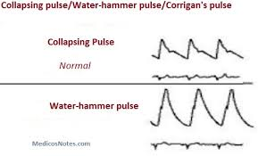
PHYSICAL EXAMINATION
Arterial pulse
“Water-hammer” pulse: A rapidly rising & collapses suddenly as arterial pressure falls rapidly during late systole and diastole (Corrigan’s pulse)

Slide 14
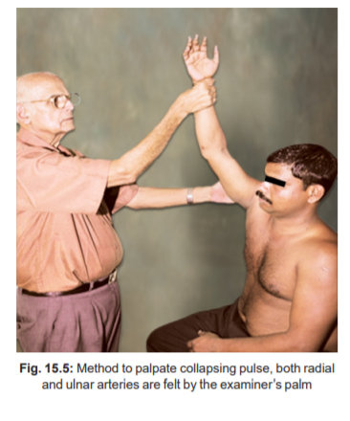
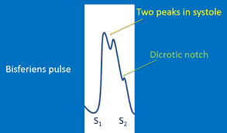
In some patients with AR or with combined AS and AR, the carotid arterial pulse may be bisferiens, i.E., With two systolic waves separated by a trough

Slide 15
Widened arterial pulse pressure : systolic hypertension and a lowering of the diastolic pressure.
The measurement of arterial diastolic pressure with a sphygmomanometer may be complicated by the fact that systolic sounds are frequently heard with the cuff completely deflated.
However, the level of cuff pressure at the time of muffling of the korotkoff sounds (phase IV) generally corresponds fairly closely to the true intraarterial diastolic pressure.
As the disease progresses and the LV end-diastolic pressure rises, the arterial diastolic pressure may actually rise as well, because the aortic diastolic pressure cannot fall below the LV end-diastolic pressure.

Slide 16
Hill sign
Popliteal cuff systolic BP exceeds brachial systolic BP by more than 20 mm HG
Mild AR | 20-40 mm Hg
Moderate AR | 40-60 mm Hg
Severe AR | > 60 mm Hg

Slide 17
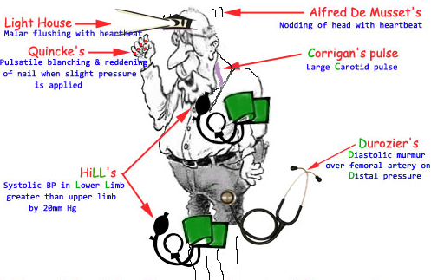

Slide 18
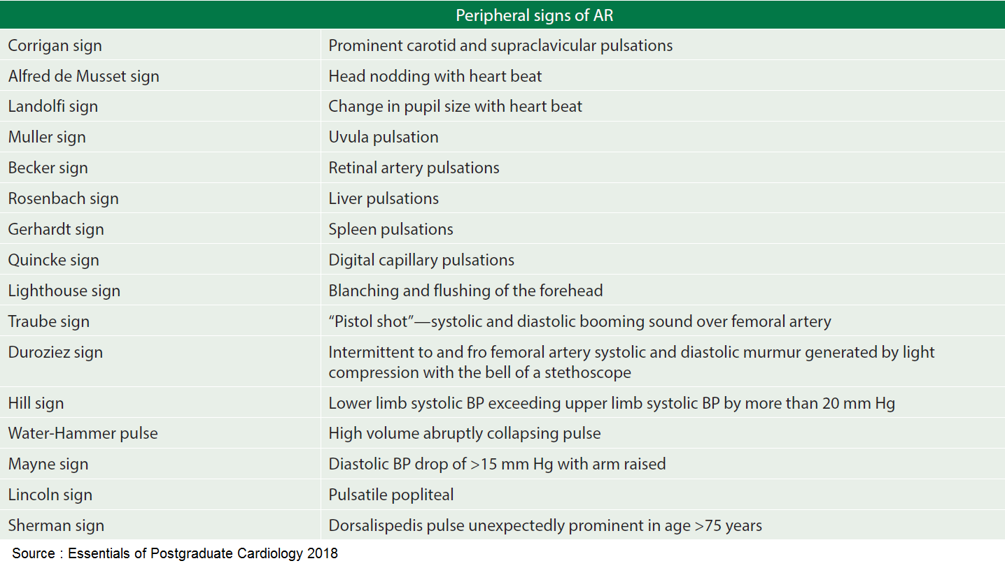

Slide 19
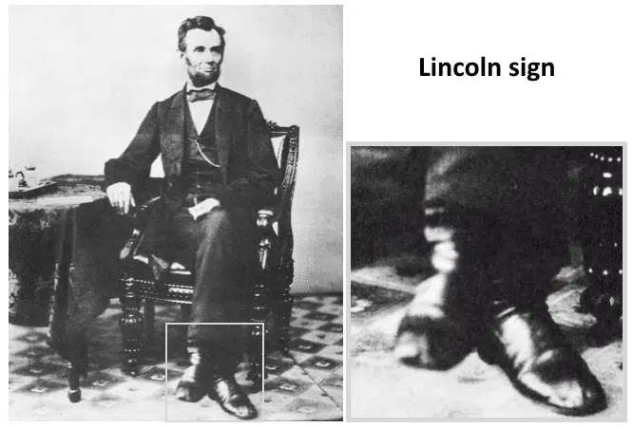
LINCOLN SIGN
Lincoln sign refers to forceful popliteal artery pulsation secondary to aortic regurgitation; exaggerated when the patient sits with legs crossed; and deemed positive if the elevated foot bobs up and down with each systolic contraction.

Slide 20
Palpation
chronic severe AR: LV impulse - heaving and displaced laterally and inferiorly.
The systolic expansion and diastolic retraction of the apex are prominent.
A diastolic thrill : palpable along the left sternal border in thin-chested individuals
a prominent systolic thrill : palpable in the suprasternal notch & transmitted upward along the carotid arteries.
This systolic thrill & the accompanying murmur do not necessarily signify the coexistence of aortic stenosis (AS).

Slide 21
Auscultation
S1 → normal
S2 → narrow split, A2→ soft in AR due to valvular etiology, loud in root disease
BAV disease: a systolic ejection sound

Slide 22
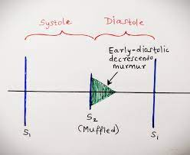
A high-pitched, soft-blowing, decrescendo diastolic murmur, heard best in the third intercostal space along the left sternal border, with the patient sitting up, leaning forward, breath held in expiration with the diaphragm of the stethoscope.
Duration of murmur is directly proportional to the severity
as the severity increases, it generally becomes louder and longer → holo diastolic

Slide 23
Primary valvular disease: → left sternal border
Aneurysmal dilation of the aortic root: → right sternal border.
“Cooing” or musical diastolic murmurs → eversion of an aortic cusp vibrating in the regurgitant stream.
Mid-systolic ejection murmur is frequently audible → best heard at the base of the heart and is transmitted along the carotid arteries.

Slide 24
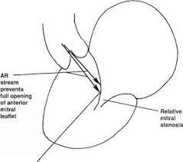
Austin flint murmur
a soft, low-pitched, rumbling mid-to-late diastolic murmur heard in the apex.
It is probably produced by the diastolic displacement of the anterior leaflet of the mitral valve by the AR stream and is not associated with hemodynamically significant mitral obstruction.
The auscultatory features of AR are intensified by strenuous and sustained handgrip, which augments systemic vascular resistance.

Slide 25
ECG
Chronic severe AR
LV hypertrophy - common
ST-segment depression and T-wave inversion in leads I, AVL, V5 , and V6 (“LV strain”).
Left-axis deviation and/or QRS prolongation → diffuse myocardial disease (associated with patchy fibrosis) : usually signify a poor prognosis.

Slide 26
ECHOCARDIOGRAM
CAUSE AND SEVERITY
LV size is increased in chronic AR
systolic function is normal / even supernormal until myocardial contractility decreases
A rapid, high-frequency diastolic fluttering of the AML produced by the impact of the regurgitant jet is a characteristic finding.

Slide 27
Doppler techniques are required for the specific diagnosis of AR
Pulse wave doppler, continuous wave doppler and color doppler are used
Highly sensitive and complementary in diagnosis.
Color flow imaging
Most commonly used method
Clinically evident AR → turbulence of the jet can be easily made out
Even Trivial /mild AR can be identified
Sensitivity : >95n %, specificity -100%

Slide 28
Severe AR
color flow doppler imaging : the central jet width assessed by color flow doppler imaging exceeds 65% of the LV outflow tract, the regurgitant volume is ≥60 ml/beat, the regurgitant fraction is ≥50%, and there is diastolic flow reversal in the proximal descending thoracic aorta.
.

Slide 29
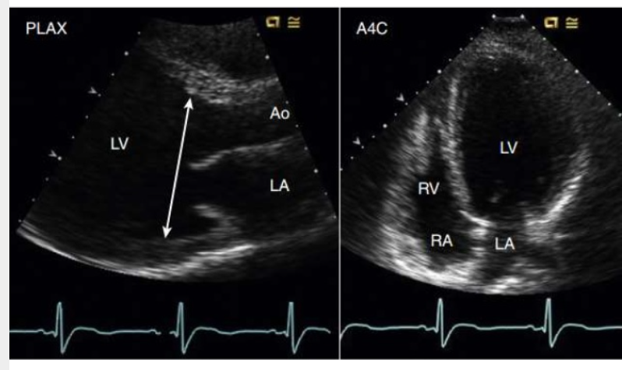
LV dimension and function in chronic severe ar
LVESD >50-55mm
LVEDD>70-75mm
Eccentric hypertrophy
LVEF<50%

Slide 30
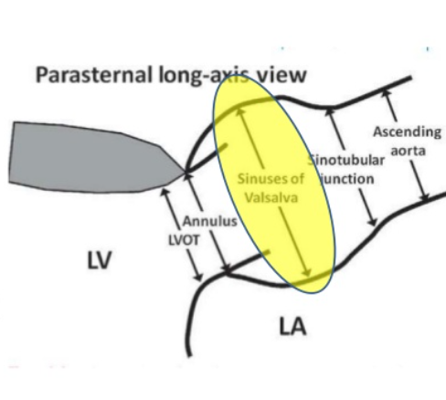
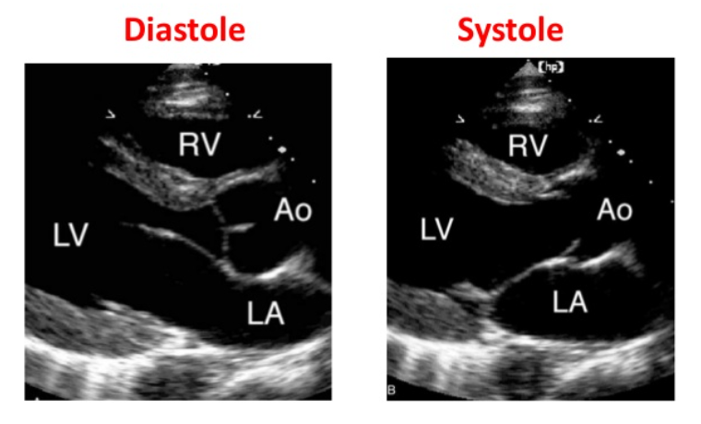
2 d echo in AR
permits evaluation of LV size and function as well as visualisation of valve structures and of the aorta.

Slide 31
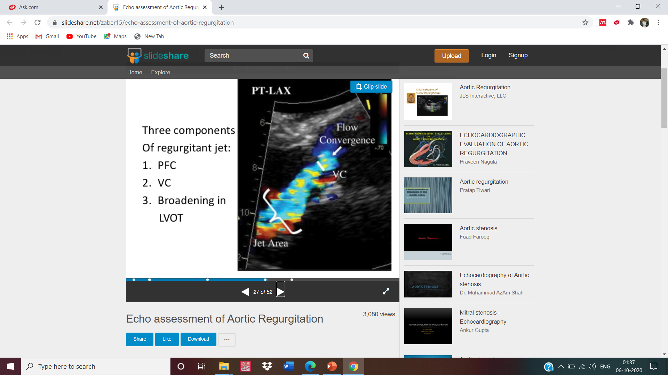
Qualitative assessment of AR : colour doppler width of the AR jet vs LVOT width in PLAX/PSAX view is used
Mild AR <25% Severe AR>/= 65%
VENA CONTACTA WIDTH
Orifice through which blood passes
Avoids the erroneous measurement of jet when it expand
in the LVOT
Mild AR < 0.3cm severe AR > 0.6 cm

Slide 32
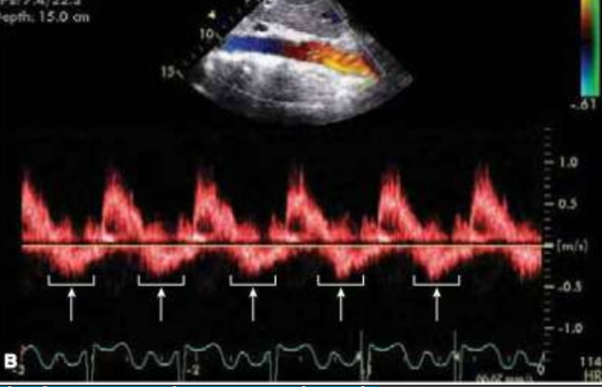
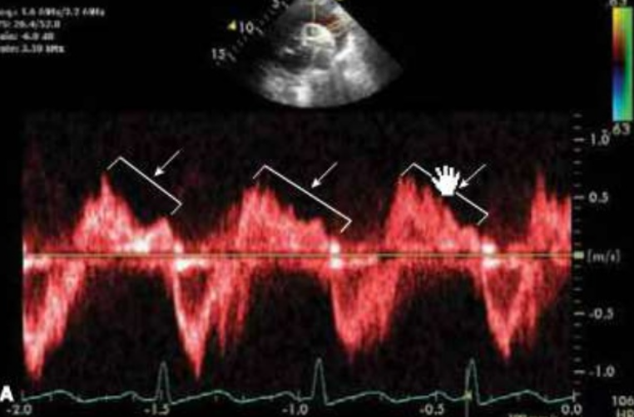
Diastolic flow reversal in aorta
PW doppler in suprasternal /subcostal view: ECG gated ECHO needed
Brief flow reversal may be normal
Holodiastolic flow reversal is abnormal.

Slide 33
Surveillance transthoracic echocardiography (TTE) : longitudinal follow-up and allows for the early detection of changes in LV size and/or function.
Transesophageal echocardiography (TEE) can also provide detailed anatomic assessment of the valve, root, and portions of the aorta.
There is increasing experience with the use of 3D echocardiography to measure LV volumes.

Slide 34
Chest x-ray
chronic severe AR : the apex is displaced downward and to the left in the frontal projection.
When AR is caused by primary disease of the aortic root, aneurysmal dilation of the aorta may be noted, and the aorta may fill the retrosternal space in the lateral view.
Echocardiography, cardiac MRI, and chest CT angiography are more sensitive than the chest x-ray for the detection of root and ascending aortic enlargement.
Cardiac catheterization & angiography
right and left heart catheterization with contrast aortography can provide confirmation of the magnitude of regurgitation and the status of LV function.
Coronary angiography is performed routinely in appropriate patients prior to surgery

Slide 35
TREATMENT
INDICATIONS FOR SURGERY:
Severe asymptomatic AR
Symptomatic AR

Slide 36
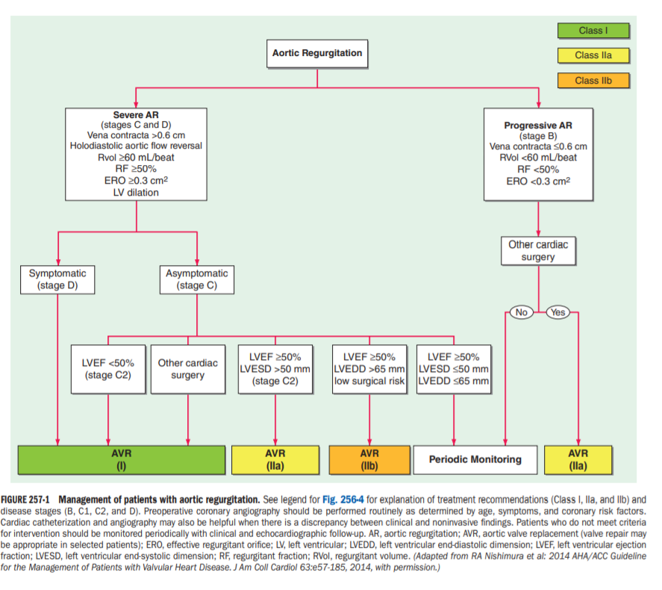

Slide 37
Early symptoms of dyspnea & effort intolerance respond to treatment with diuretics;
vasodilators (angiotensin converting enzyme [ACE] inhibitors, dihydropyridine calcium channel blockers, or hydralazine) may be useful as well.
The use of vasodilators to extend the compensated phase of chronic severe AR before the onset of symptoms or the development of LV dysfunction is more controversial and less well established.
Systolic blood pressure should be controlled (goal< 140 mmhg) in patients with chronic AR, and vasodilators are an excellent first choice as antihypertensive agents.
It is often difficult to achieve adequate control because of the increased stroke volume that accompanies severe AR

Slide 38
promptly and vigorous treatment of Cardiac arrhythmias & systemic infections
Although nitroglycerin and long-acting nitrates are not as helpful in relieving anginal pain as they are in patients with ischemic heart disease, they are worth a trial.
syphilitic aortitis - a full course of penicillin therapy
Beta blockers & ARB- losartan may be useful to retard the rate of aortic root enlargement in young patients with marfan syndrome and aortic root dilation.
Whether beta blockers or arbs is useful in retarding the rate of growth of aortic aneurysms in other patient subsets (e.G., BAV disease with aortopathy, takaysu’s disease) have not been demonstrated.

Slide 39
Beta blockers in patients with valvular AR were previously considered relatively contraindicated due to concerns that the resulting slowing of the heart rate would allow more time for diastolic regurgitation.
Observational reports, however, have suggested that beta blockers may provide functional benefit in some patients with chronic AR.
Beta blockers can sometimes provide incremental blood pressure lowering in patients with chronic AR and hypertension.
They can also lessen the sense of forceful heart action that many patients find uncomfortable.
Patients with severe AR, particularly those with an associated aortopathy, should avoid isometric exercises.

Slide 40
SURGICAL TREATMENT
AORTIC VALVE REPLACEMENT
chronic severe AR: clinical follow-up & noninvasive testing with echocardiography at ~6- to 12-month intervals are necessary if operation is to be undertaken at the optimal time, i.e. After the onset of LV dysfunction but prior to the development of severe symptoms.
Exercise testing may be helpful to assess effort tolerance more objectively.
Operation can be deferred as long as the patient both remains asymptomatic and retains normal LV function without severe or progressive chamber dilation.

Slide 41
Surgical management of aortic valve and root disease
When AR is due to aneurysmal dilation of the root or proximal ascending aorta rather than to primary valve involvement, it may be possible to reduce or eliminate the regurgitation by narrowing the annulus or by excising a portion of the aortic root without replacing the valve.
Elective, valve-sparing aortic root reconstruction generally involves reimplantation of the valve in a contoured graft with reattachment of the coronary artery buttons into the side of the graft and is best undertaken in specialized surgical centers .

Slide 42
AVR with a suitable mechanical or tissue prosthesis is generally necessary in patients with rheumatic AR and in many patients with other forms of regurgitation.
Rarely, when a leaflet has been perforated during IE or torn from its attachments to the aortic annulus by thoracic trauma, primary surgical repair may be possible.

Slide 43
Acute Aortic Regurgitation
ETIOLOGY:
Traumatic
Aortic dissection
Infective endocarditis

Slide 44
PATHOPHYSIOLOGY
LV is unprepared for the regurgitant volume load.
LV compliance is normal / reduced & LV diastolic pressures rise rapidly (even >40 mmhg.)
The LV pressure > LA pressure toward the end of the diastole→ reversed pressure gradient closes the mitral valve prematurely → protective mechanism to prevent pulmonary edema

Slide 45
SIGNS AND SYMPTOMS
Patient has tachycardia, hypotension, cardiogenic shock
Narrow pulse pressure
No peripheral signs of AR
Soft S1
Short EDM

Slide 46
TREATMENT
SURGCAL EMERGENCY
Inotrope + vasodilator ( Dopamine + sodium nitroprusside)
AORTIC VALVE REPLACEMENT
Treatment of underlying condition

Slide 47
Thank you

