Slide 1
Acute Inflammatory Demyelinating Polyneuropathy
Dr. Maria George
JR3

Slide 2
Guillain-Barre Syndrome
Acute, severe, and fulminant polyradiculoneuropathy that is autoimmune in nature.
Males are at higher risk for GBS than females
Adults are more frequently affected than children.

Slide 3
Variants
Acute inflammatory demyelinating polyneuropathy - most common variant
Acute motor axonal neuropathy
Acute motor sensory axonal neuropathy
Regional variants :
Miller Fischer syndrome
Pure sensory forms
Ophtalmoplegia with anti-GQ1b Ab as part of severe motor sensory GBS
GBS with severe bulbar and facial paralysis
Acute pandysautonomia

Slide 4
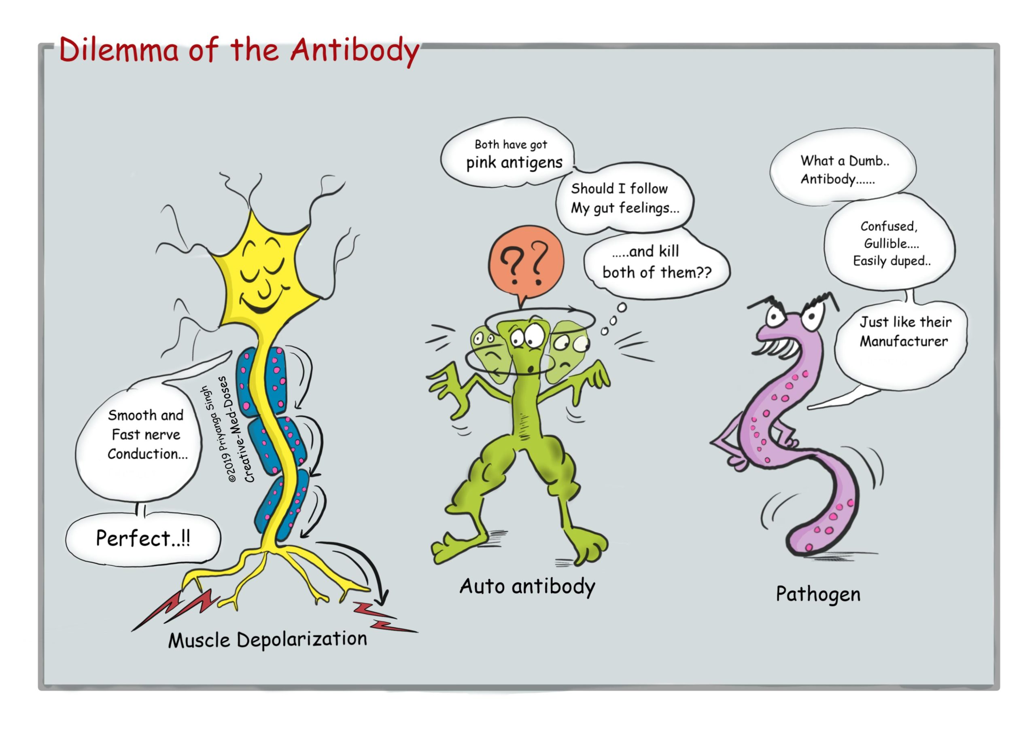
Pathogenesis
The acute polyneuropathy of GBS is often triggered when an immune response to an antecedent infection or other event cross-reacts with shared epitopes on peripheral nerve (molecular mimicry)

Slide 5
Neural targets are glycoconjugates, specifically gangliosides which are exposed on the plasma membrane of cells rendering them susceptible to an antibody mediated attack
Gangliosides are complex glycosphingolipids which contain one or more sialic acid residues
Both cellular and humoral immune mechanisms are implicated

Slide 6
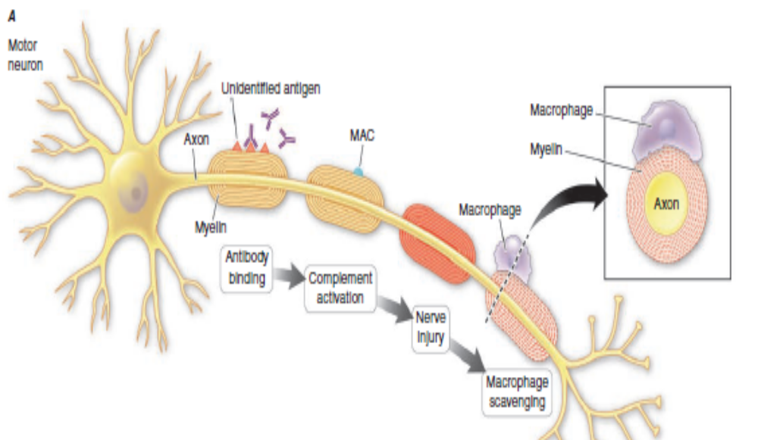
Immunopathogenesis of AIDP

Slide 7
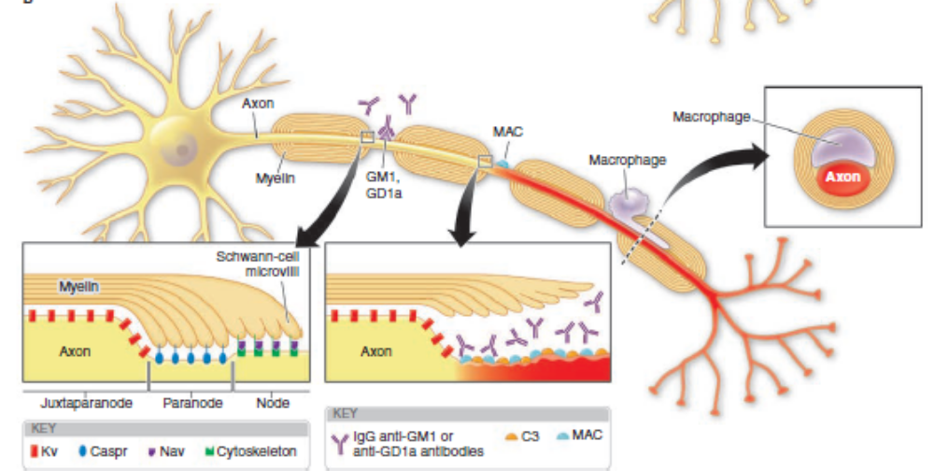
Immunopathogenesis of axonal variants

Slide 8
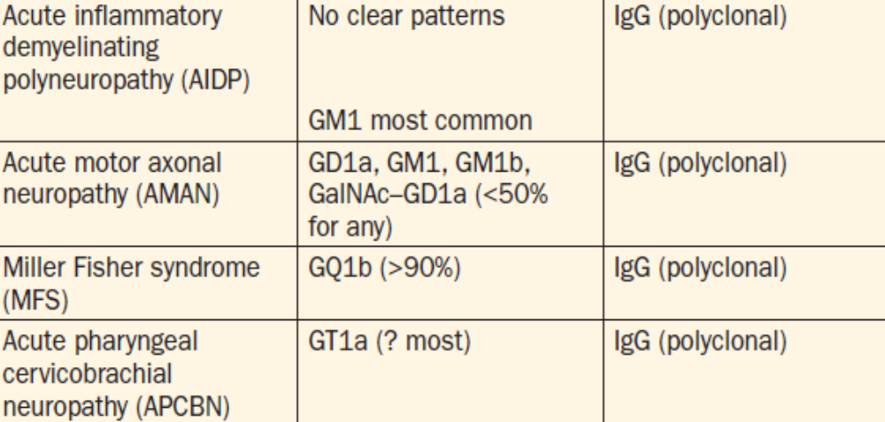
Antibodies

Slide 9
Pathophysiology
Demyelinating forms of GBS
The basis for flaccid paralysis and sensory disturbance is conduction block - implies that the axonal connections remain intact
Rapid recovery as remyelination occurs
Severe cases of demyelinating GBS, secondary axonal degeneration usually occurs; correlates with a slower rate of recovery and a greater degree of residual disability.
.

Slide 10
Severe primary axonal pattern - axons have degenerated and become disconnected from their targets, specifically the neuromuscular junctions, and must therefore regenerate for recovery to take place

Slide 11
Antecedent events
70% of cases of GBS occur 1–3 weeks after an acute infectious process, usually respiratory or gastrointestinal.
20–30% of all cases occurring in North America, Europe, and Australia are preceded by infection or reinfection with Campylobacter jejuni.
Other infections that are implicated include : human herpes virus infection, CMV or Epstein-Barr virus, HIV, hepatitis E, Zika, Mycoplasma pneumoniae.
Recent immunization : The swine influenza vaccine, administered widely in the United States in 1976, is the most notable example

Slide 12
Other triggers-surgery, trauma, bone marrow transplantation.
Hodgkin lymphoma, SLE, sarcoidosis
Medication - TNFalpha antagonist,tacrolimus isotretinonin,immune checkpoint inhibitors

Slide 13
Clinical features
Rapidly evolving areflexic symmetric ascending motor paralysis with or without sensory symptoms
Evolves over hours to few days
Cranial nerve involvement - 50% cases associated with facial diparesis
Sensory involvement :
pain over neck, shoulder, back, spine
Loss of pain and temperature – usually mild
Autonomic involvement : loss of vasomotor control, wide fluctuation in blood pressure, postural hypotension, cardiac arrhythmia
Once clinical worsening stops and the patient reaches a plateau (almost always within 4 weeks of onset), further progression is unlikely.

Slide 14
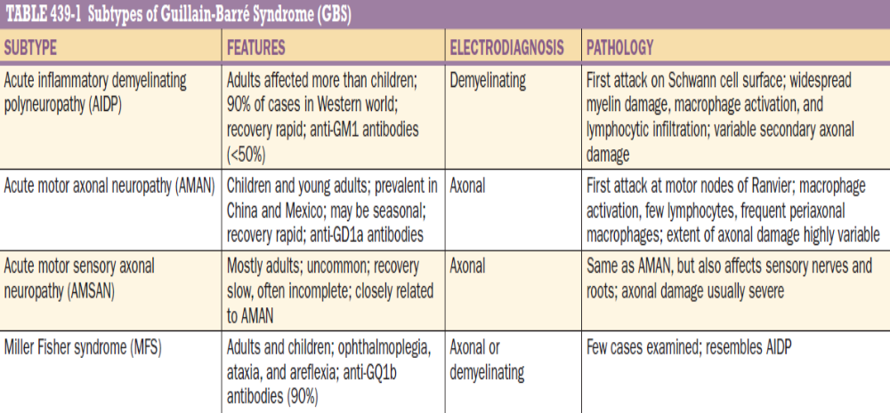

Slide 15
Laboratory features
CSF :
an elevated CSF protein level (1–10 g/L [100–1000 mg/dL]) without accompanying pleocytosis.
The CSF is often normal when symptoms have been present for ≤48 h; by the end of the first week, the level of protein is usually elevated.
A transient increase in the CSF white cell count (10–100/μL) occurs on occasion in otherwise typical GBS
sustained CSF pleocytosis suggests an alternative diagnosis (viral myelitis) or a concurrent diagnosis such as unrecognized HIV infection, leukemia or lymphoma with infiltration of nerves, or neurosarcoidosis.

Slide 16
Electrophysiological studies :
Mild or absent in the early stages of GBS and lag behind the clinical evolution.
In AIDP, the earliest features are prolonged F-wave latencies, prolonged distal latencies, and reduced amplitudes of compound muscle action potentials (CMAPs), probably owing to the predilection for involvement of nerve roots and distal motor nerve terminals early in the course.

Slide 17
Later, slowing of conduction velocity, conduction block, and temporal dispersion may be appreciated
Occasionally, sensory nerve action potentials (SNAPs) may be normal in the feet (e.g., sural nerve) when abnormal in the arms.
In cases with primary axonal pathology - reduced amplitude of CMAPs (and also SNAPS with AMSAN) without conduction slowing or prolongation of distal latencies

Slide 18
GBS doubtful
Weakness progresses in <24hrs or >4week
Sensory level
Asymmetric weakness
Bowl and bladder dysfunction
Pulmonary dysfunction wit no limb weakness
sensory sign –isolated or no weakness
Fever at onset
CSF->50/mm3

Slide 19
Differential diagnosis
Vit b12-symmetric distal motor and sensory
a/c myelopathies-c/c back pain and spincter disturbance
Diptheria -early oropharyngeal
Lyme -polyradiculopathy ,cranial nerve ,ataxia
Porphyria –abdominal pain,seizure,psychosis
Vasculitic neuropathy-esr
Poliomylities –fever meningisum
Cmv –immunocompromised

Slide 20
Critical illness neuropathy and myopathy
Neuromuscular junction abnormalities –Myasthenia gravis, botulism
Poisoning - Op, thallium, As(distal sensory predominant ), shellfish
hypophosphatemia

Slide 21
Diagnosis :
Brighton Criteria for diagnosis of GBS
LEVEL 1 of diagnostic certainty
Bilateral AND flaccid weakness of the limbs
Decreased or absent deep tendon reflexes in weak limbs
Monophasic illness pattern and interval between onset and nadir of weakness between 12 h and 28 days and subsequent clinical plateau
Electrophysiologic findings consistent with GBS
Cytoalbuminologic dissociation (i.e., elevation of CSF protein level above laboratory normal value AND CSF total white cell count <50 cells/μL)
Absence of an identified alternative diagnosis for weakness

Slide 22
LEVEL 2 :
Bilateral AND flaccid weakness of the limbs
Decreased or absent deep tendon reflexes in weak limbs
Monophasic illness pattern and interval between onset and nadir of weakness between 12 h and 28 days and subsequent clinical plateau
CSF total white cell count <50 cells/μL (with or without CSF protein elevation above laboratory normal value) OR If CSF not collected or results not available, electrophysiologic studies consistent with GBS
Absence of identified alternative diagnosis for weakness

Slide 23
LEVEL 3
Bilateral and flaccid weakness of the limbs
Decreased or absent deep tendon reflexes in weak limbs
Monophasic illness pattern and interval between onset and nadir of weakness between 12 h and 28 days and subsequent clinical plateau
Absence of identified alternative diagnosis for weakness

Slide 24
Diagnosis of miller fisher variant
LEVEL 1
Bilateral ophthalmoparesis and bilateral reduced or absent tendon reflexes, and ataxia
Absence of limb weakness
Monophasic illness pattern and interval between onset and nadir of weakness between 12 h and 28 days and subsequent clinical plateau
Cytoalbuminologic dissociation (i.e., elevation of cerebrospinal protein above the laboratory normal and total CSF white cell count <50 cells/μL)
Nerve conduction studies are normal, OR indicate involvement of sensory nerves only
No alterations in consciousness or corticospinal tract signs
Absence of identified alternative diagnosis

Slide 25
LEVEL 2
Bilateral ophthalmoparesis and bilateral reduced or absent tendon reflexes and ataxia
Absence of limb weakness
Monophasic illness pattern and interval between onset and nadir of weakness between 12 h and 28 days and subsequent clinical plateau
CSF with a total white cell count <50 cells/μL) (with or without CSF protein elevation above laboratory normal value) OR Nerve conduction studies are normal, OR indicate involvement of sensory nerves only
No alterations in consciousness or corticospinal tract signs
Absence of identified alternative diagnosis

Slide 26
LEVEL 3
Bilateral ophthalmoparesis and bilateral reduced or absent tendon reflexes and ataxia
Absence of limb weakness
Monophasic illness pattern and interval between onset and nadir of weakness between 12 h and 28 days and subsequent clinical plateau
No alterations in consciousness or corticospinal tract signs
Absence of identified alternative diagnosis

Slide 27
Treatment
Treatment should be initiated as soon as possible
More than 2 weeks of symptom onset – not known if treatment is effective
Once plateau is reached – treatment is no longer indicated unless patient has severe motor weakness and one cannot exclude the possibility of immune attack
IVIg or plasmapheresis

Slide 28
IVIg :
Preferred to plasmapheresis for AMAN and MFS variant
Dose : total dose of 2g/kg administered as 5 daily infusions
PLASMAPHERESIS :
40-50ml/kg PE 4-5 times over 7-10 days
Combination of both – not better
Glucocorticoids have no role
Treatment decreses need for mechanical ventilation and increases likelihood of full recovery by 1 yr

Slide 29
Prognosis
85%-full functional recovery
<5%-motality death from secondary lung complication
Worst-proximal and sensory axonal damage
Vaccination after GBS is not given for 12 month.

Slide 30
Thank you

