Slide 1
APPROACH TO DEMENTIA
Dr Gouri Krishnan M G

Slide 2
DEMENTIA
Acquired deterioration in cognitive abilities that impair the successful performance of activities of daily living.
Episodic memory, is the cognitive function most commonly involved.
In addition to memory, other components of cognition i.e language , visuospatial, praxis, calculation, problem solving abilities may be affected

Slide 3
CLINICAL DIAGNOSIS
According to DSM 5:
AMNESIA + 2 out of 4
1.Apraxia
2.Agnosia
3.Aphasia
4.loss of executive functions
Duration :6 months
Clear sensorium

Slide 4
THE NEURAL NETWORK
Left presylvian for language
Parieto frontal for spatial orientation
Occipitotemporal for face and object recognition
Limbic for memory
Prefrontal for executive functions

Slide 5
CAUSES OF DEMENTIA
Most common causes include:
Alzheimers disease
Vascular dementia:
Multi infarct
Diffuse white matter disease(Binswangers disease)
PDD/LBD spectrum
Alcoholism
Drug/medication intoxication

Slide 6
Other less common causes include:
Vitamin deficiencies:
Thiamine:Wernicke’s Encephalopathy
B12:subacute combined degeneration of spinal cord
Nicotinic acid:Pellagra
Endocrine causes:
Hypothyroidism
Hypo or Hyperparathyroidism
Renal failure
Liver failure
Chronic infections
HIV
Neurosyphilis

Slide 7
Head trauma
NPH
Intracranial neoplasms
Drugs and heavy metal intoxications
Psychiatric diseases like depression,schizophrenia
Degenerative disorders:
Huntington’s disease
MSA

Slide 8
APPROACH TO A PATIENT WITH DEMENTIA
Is it Reversible or not?
REVERSIBLE | IRREVERSIBLE OR DEGENERATIVE | PSYCHIATRIC DISORDERS
HYPOTHROIDISM | ALZHEIMERS | DEPRESSION
THIAMINE DEFICIENCY | FTD | SCHIZOPHRENIA
VIT.B12 DEFICIENCY | HUNTINGTON’S | CONVERSION REACTION
NPH | DLB
SUBDURAL HEMATOMA | VASCULAR
CHRONIC INFECTIONS | LEUCOENCEPHALOPATHIES
BRAIN TUMORS | PARKINSONS
DRUG INTOXICATION
AUTOIMMUNE ENCEPHALOPATHY

Slide 9
CLINICAL DIFFERENTITION OF MAJOR DEMENTIAS
DISEASE | HISTORY/ FIRST SYMPTOM | MENTAL STATUS | NEUROPSYCHIATRY | NEUROLOGY | IMAGING
1.AD | Memory loss | Episodic memory loss | Irritability, anxiety and depression | Spares motor system until later in the course. | Entorhinal cortex and hippocampal atrophy
2.FTD | Apathy,poor judgement,/insight, hyperorality | Frontal /executive and / or language ; spares drawing | Personality changes, apathy disinhibition, overeating | Vertical gaze palsy, axial rigidity,dystonia, MNDs. | Frontal, insular, and/ or temporal atrophy;usually spares posterior parietal lobe
3.DLB | Visual hallucination,REM sleep behavioral disorder,delirium,sensitivity to psychoactive medications | Drawing frontal and executives ;spares memory | Visual hallucinations,depression,sleep disorder,delusions | Parkinsonsim | Posterior parietal atrophy

Slide 10
DISEASE | HISTORY/ FIRST SYMPTOM | MENTAL STATUS | NEUROPSYCHIATRY | NEUROLOGY | IMAGING
4.CJD | Dementia, mood, anxiety, movt disorders | Variable; frontal/executive,focal cortical,memory | Depression ,anxiety ,psychosis | Rapid progression with myoclonus, rigidity, parkinsonism | Cortical ribboning,basal ganglia or thalamus hyperintensity on FLAIR/diffusion images
5.VASCULAR | History of stroke,with irregular stepwise progresion | Frontal,executive,cognitive slowing;can spare memory. | Apathy,delusions,anxiety | Motor slowing ,spasticity but can be normal | Cortical & or /subcortical infarcts,confluent white matter disease.

Slide 11
DISEASE | HISTORY /CLINICAL FEATURES
5.CNS INFECTIONS | High risk sexual behavior /IV drug abuse
6.CHRONIC SUBDURAL HEMATOMA,CHRONIC TRAUMATIC ENCEPHALOPATHY | Recurrent head trauma
7.CORTICOBASILAR SYNDROME | Assymetric akinesia,rigidity,dystonia,myoclonus,alien limb phenomenon,pyramidal signs and prefrontal deficits-non fluent aphasia with or without motor speech deficit,executive dysfunction ,apraxia or a behavioral disorder.
8.PROGRESSIVE SUPRANUCLEAR PALSY | Unexplained falls,axial rigidity,dysphagia and vertical gaze deficits.
9.CJD | Diffuse rigidity, akinetic mutism, startle sensitive myclonus
10.VITAMIN B12 DEFICIENCY | Veganism,h/o bowel irradiation,autoimmune diathesis,a remote history gastric surgery,chronic anti-histamine therapy for dyspepsia/GERD
11.NPH | Early ataxia,gait abnormalities,dementia and urinary incontinence

Slide 12
COGNITIVE AND NEUROPSYCHIATRIC EXAMINATION
Screening tools include:
MMSE
MOCA
CONGNISTAT

Slide 13
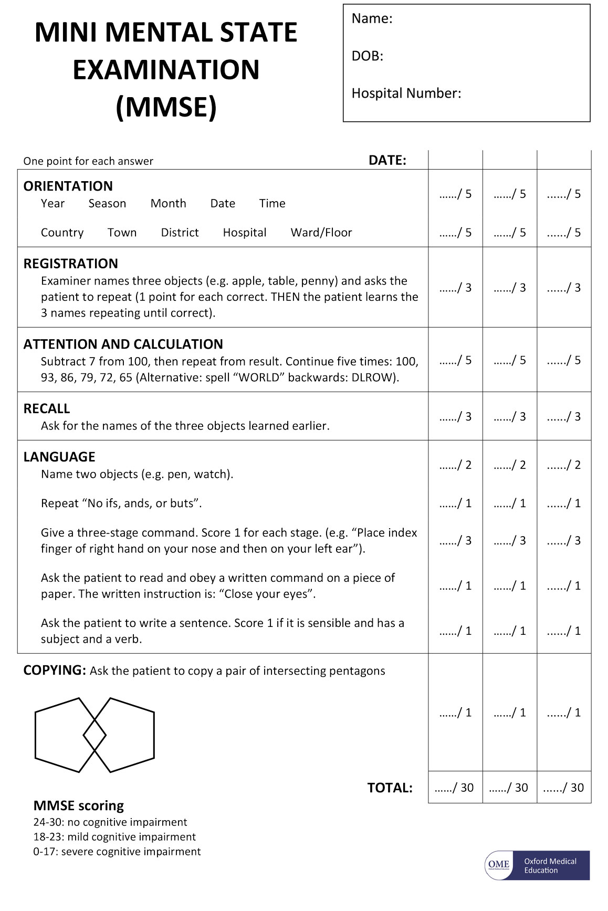

Slide 14
LABORATORY TESTS
Thyroid function tests
Vit B12 levels
CBC
Electrolytes
CT/MRI
Lumbar puncture
EEG

Slide 15
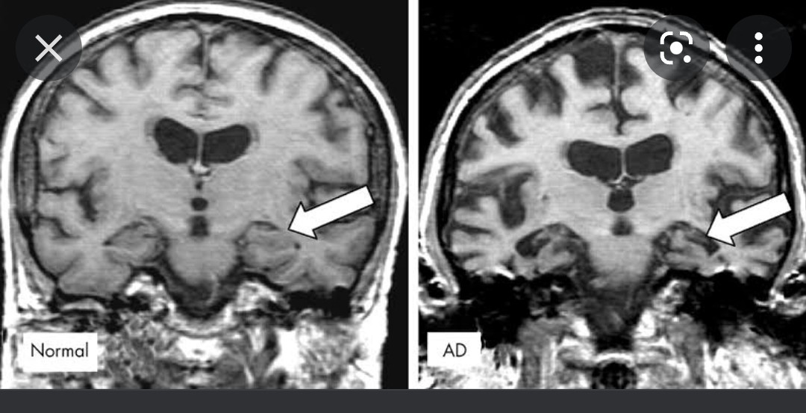

Slide 16
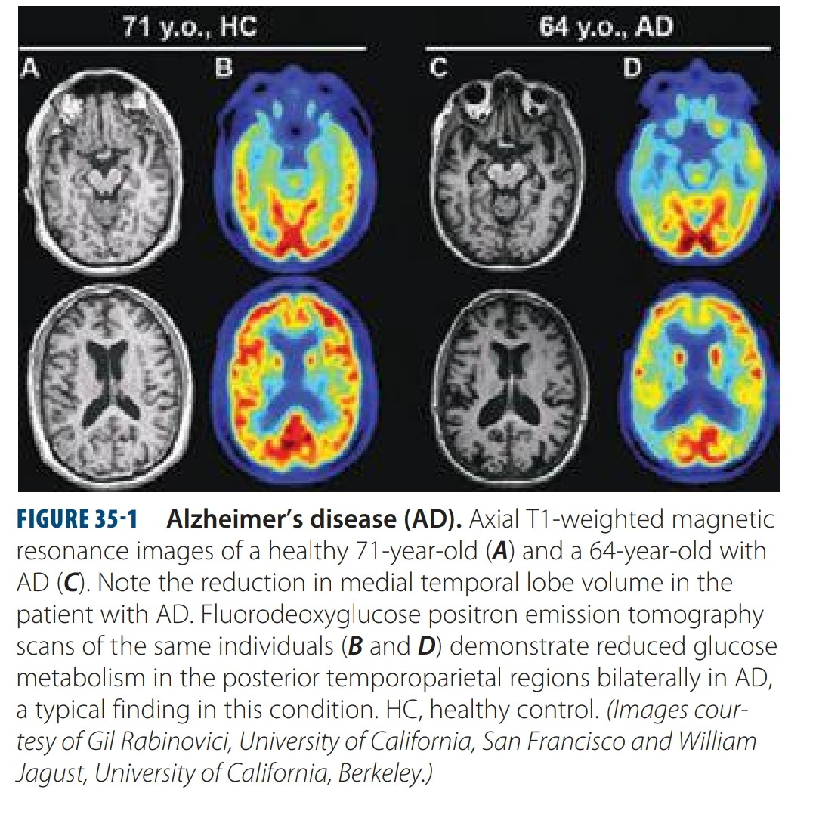

Slide 17
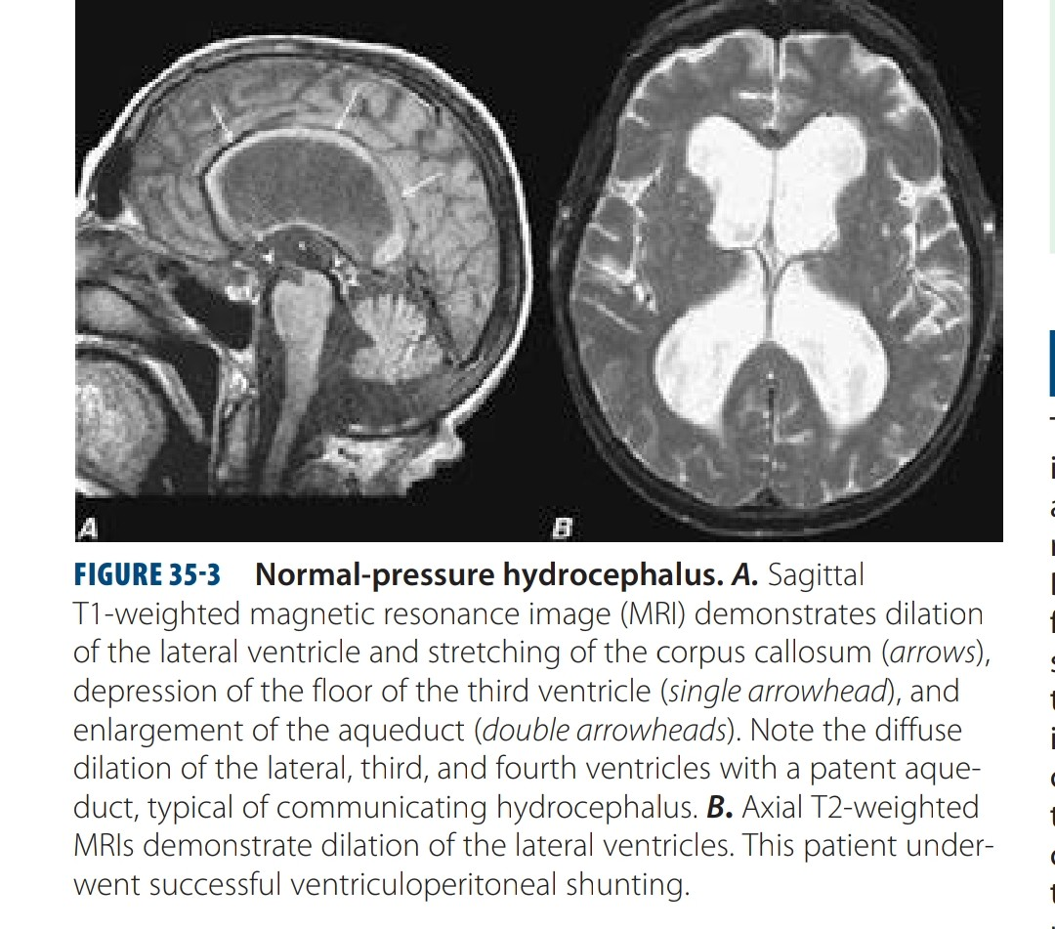

Slide 18
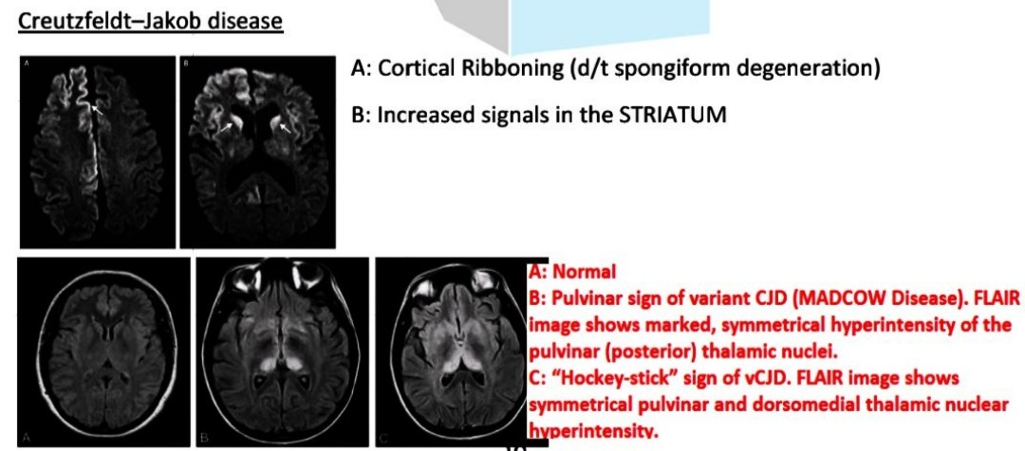

Slide 19
TREATMENT
Major goal –treatment of underlying causes.
Hypothyroidism : thyroid replacement
Thiamine/b12 deficiency: vitamin therapy
Opportunistic infections: antimicrobials
HIV :Antiretrovirals
NPH: ventricular shunting
CNS neoplasms: radiation and chemotherapy
Removal of cognition impairing drugs

Slide 20
Provide support and comfort to care givers and patients.
Patients with degenerative disorders may be depressed or anxious, SSRIs or SNRIs can be given
(low dose of ssri, eg:escitalopram starting dose 5mg daily,target dose 5-10 mg daily)
In patients with agitation or aggression or psychosis,second generation antipsychotics such as Quetiapine(12.5-25 mg daily) can be given.
Treatment of AD: Cholinesterase inhibitors-Donepezil, Rivastigmine, galantamine can be used.
NMDA Antagonists: Memantine

Slide 21
Non drug behavioral therapy-preparing lists,schedules,calenders and labels can be helpful in early stages
Stress on familiar routines ,walks and simple physical exercises.

Slide 22
THANK YOU..

