Slide 1
APPROACH TO VENTRICULAR ARRYTHMIAS
Harrison topic

Slide 2
Originate from
Myocardial cells
Purkinje cells
Reentry through areas of scar / diseased purkinje system
QRS > 0.12s

Slide 3
Types
Premature ventricular beats
Ventricular tachycardia – monomorphic :ventricular flutter; polymorphic VT
Ventricular fibrillation
Idiopathic ventricular arrythmias

Slide 4
Premature ventricular beats (PVC)
Single ventricular beats that fall earlier than next anticipated supraventricular beat
Unifocal – same focus , same morphology
Multifocal- different ventricular sites, different QRS morphology
Ventricular couplets

Slide 5
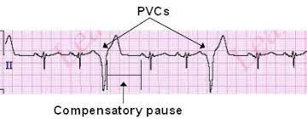
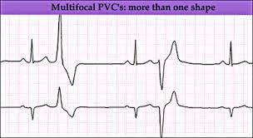

Slide 6
Ventricular tachycardia
3 or more consecutive beats at a rate faster than 100 beats/min
3 or more consecutive beats at slower rates – idioventricular rhythm
Non sustained- terminates spontaneously within 30 s
>30 s- active intervention

Slide 7
Monomorphic VT
Same QRS complex from beat to beat
QRS morphology – site of origin--- idiopathic / Associated with structural disease
Right ventricle or septum – LBBB like configuration
Free wall of left ventricle – RBBB like pattern
Cranial portion of ventricle – dominant R waves in lead II,III,aVF
Inferior wall- dominant s waves in II, III, aVF

Slide 8
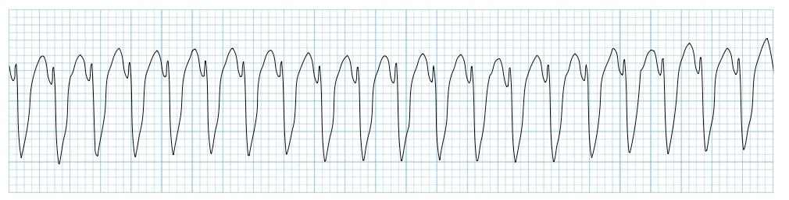

Slide 9
Ventricular flutter
Very rapid monomorphic VT – sinusoidal appearance
Hyperkalemia ,
drug toxicity that block sodium channels (flecainide, propafenone , TCA ) ,
Severe global myocardial ischemia

Slide 10
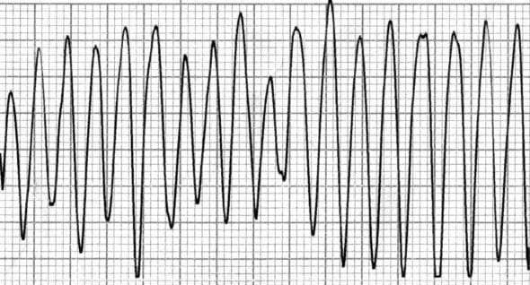

Slide 11
Polymorphic VT
Continually changing QRS morphology --- changing ventricular activation sequence
Occurs in context of congenital or aquired prolongation of QT interval=== waxing and waining== Torsade de Pointes

Slide 12
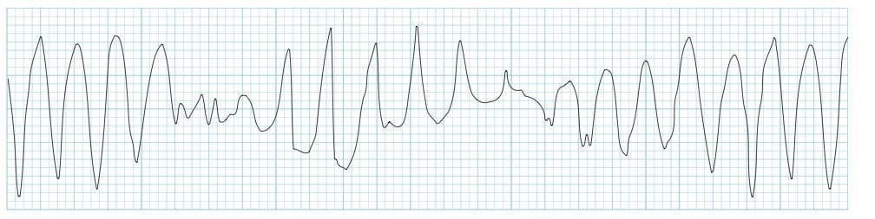

Slide 13
Ventricular fibrillation (VF)
Continous irregular activation with no discreate QRS complexes

Slide 14
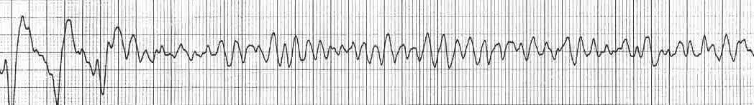

Slide 15
Clinical manifestations
Palpitations
Dizziness
Exercise intolerance
Episodes of light headedness
Syncope
Suddden cardiac arrest – sudden death
Asymptomatic – irregular pulse / heart sounds/ ecg

Slide 16
syncope
VT --- severe hypotension--- risk of cardiac arrest – sudden death
Most common causes – vasovagal / orthostatic hypotension

Slide 17
Evaluation of patients with documented or suspected ventricular arrythmias
1. establish cause of symptoms is due to ventricular arrythmias
2.association with cardiac disease and establish prognostic significance
3.likelihood of arrythmia recurrence – symptoms and risk

Slide 18
diagnosis
ECG
Pacemaker / ICD
Electrophysiological study

Slide 19
Evaluation of the patient with Arrhythmia symptoms
Intermittant symptoms – symptom severity,provocative factors,underlying heart disease
syncope – hypotension
Past history, medications- prolong QT interval,adrenergic stimulants
Family history – premature CAD, cardiomyopathy,arrythmia,sudden death

Slide 20
Physical examination – pulse ,JVP,lung fields,auscultation
NMD or dysmorphic features – genetic arrythmia syndrome
12 lead ECG – Q waves – MI; ventricular hypertrophy- HCM
Genetic arrythmia syndrome- long QT syndrome,brugada syndrome,short QT syndrome

Slide 21
TTE – depressed ventricular function- cause
- ventricular thickening- HCM,infiltrative disease
Cardiac MRI –Gd contrast image –ventricular scar (monomorphic VT)

Slide 22
Treatment options for ventricular arrythmias
Severity and frequency of symptoms
Reassurance and removal of aggravating factors
ICD implantation
Antiarrhythmic drug therapy
Catheter ablation

Slide 23
Antiarrhythmic drugs
Risks and potential benefits
Adverse events - mostly non cardiac and minor
Cardiac –pro-arrhythmia

Slide 24
Beta adrenergic blockers-first choice ;exercise induced arrythmias and idiopathic
Limited efficacy in most arrythmia associated with heart disease
Adverse effects- brady arrythmias and negative inotropic effects
Calcium channel blockers – diltiazem and verapamil –idiopathic VT
Adverse effects – negative inotropic and vasodilatory effect-- hypotension

Slide 25
Sodium channel blocking agents- mexiletine,quinidine,disopyramide,flecainide,propafenone-chronic oral therapy
Class 1 effect: fast inward sodium current blockade
IV formulation-lidocaine,quinidine,procainamide
Class 3 effect: potassium channel blocking-quinidine,disopyramide,procainamide

Slide 26
Potassium channel blocking agents: sotalol,dofetilide
Mechanism :Ikr(delayed rectifier potassium channel blocker)
Prolongation of action potential duration and cardiac refractory period
Class3 antiarrythmic effects
Sotalol – non selective beta adrenergic blocking activity
Avoided – Torsades de pointis , including QT prolongation , hypokalemia , bradycardia

Slide 27
Amiadarone and dronedarone
Amiodarone- the most effective antiarrythmic drug for suppressing ventricular arrythmias
Adverse effects – bradyarrhythmias
Hyper / hypothyroidism,pneumonitis,pulmonary fibrosis
Photosensitivity,neuropathy,ocular toxicity
Peripheral thrombophlebitis
Dronedarone- without iodine moiety ,efficacy poor
Increases mortality in patients with heart failure

Slide 28
Icd(implantable cardioverter defibrillators)
Detect sustained VT-terminate the arrythmia
VF terminated by shock applied between a lead in RV and ICD pulse generator
Anti tachycardia pacing (ATP) – monomorphic VT –Terminated by burst of rapid pacing faster than the VT
If ATP fails ,a shock is delivered (painful if patient is conscious)

Slide 29
Mc complication- delivery of unnecessary therapy in response to rapid SVT/electrical noise
Device infection-1%
Post traumatic stress disorder
ICD system-endocardial leads to R heart chambers+pulse generator(pre-pectoral area)
Disadvantage –vascular occlusion,endocarditis
Subcutaneous ICD,wearble ICD

Slide 30
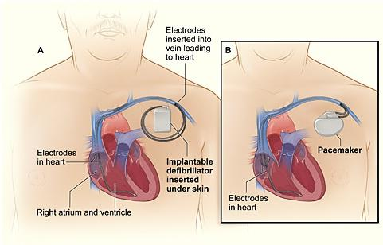

Slide 31
Catheter ablation for VT
Applying radio frequency current-cause thermal injury
Arrythmia substrate- an electrode catheter used to map local electrical activity to identify ventricular myocardium that is causing arrythmia.
Endocaridum- endovascular approach via femoral artery or vein
Subepicardium-percutaneous pericardial puncture.
Scar related VT – abnormal regions in the scar

Slide 32
Catheter ablation –recurrent ventricular arrythmias associated with poor cardiac function(0.5-3% mortality)
Outcomes better in patients with prior infarction
Lifesaving for patients with very frequent or incessant VT

Slide 33
ARRHYTHMIA SURGERY
Surgical cryoablation often combined with aneurysectomy-for recurrent VT due to prior MI

Slide 34
Approach to ventricular arrhythmias
Mechanism
Types
Clinical manifestations
Evaluation
Treatment – drugs ,ICD ,catheter ablation , arrythmia surgery

Slide 35
THANK YOU

