Slide 1
APPROACH TO PNEUMONIA
Dr Amrita Kurian

Slide 2
A 68 year old gentleman, diabetic for 8 years, COPD for 5 years (with latest exacerbation 3 months back), presented with high grade fever with chills and cough with purulent expectoration since 5 days. This has resulted in worsening of baseline breathlessness with complaints of orthopnea.
No history of angina, palpitations, vomiting, altered sensorium or seizures
History of loss of appetite for the past 1 week but no history of significant loss of weight.
Past history of pulmonary TB : completed ATT
Approach?

Slide 3
DEFINITIONS
Inflammation and consolidation of lung tissue due to an infectious agent (Fishman’s Pulmonary Diseases and Disorders)
Clinical definition : 2 or more of the following
New opacity on chest imaging
Productive cough
Purulent sputum
Dyspnea or tachypnea (rate>20/min)
Chills or rigors
Pleuritic chest pain

Slide 4
Hospital acquired pneumonia
Develops 72 hours or more after admission
Ventilator associated pneumonia
When a patient who has been mechanically ventilated for ≥48 hours develops a new or progressive lung infiltrate on imaging with the clinical evidence that the infiltrate is of infectious origin (fever, purulent sputum, leucocytosis and desaturation) together with a positive pathogen identified on a microbiologic respiratory sample.
(Infectious Diseases Society and American Thoracic Society)
Community acquired pneumonia
Infection of the lung parenchyma acquired outside the hospital

Slide 5
EPIDEMIOLOGY
The fourth most common cause of death is LRTI (WHO)
CAP in combination with influenza - most frequent cause of infection related death.
80% treated as outpatient and 20% as inpatient

Slide 6
Risk factors
Old age ( age > 65 in CURB 65 scoring and > 50 in pneumonia severity index scoring)
Underlying lung disease (COPD, Asthma, Bronchiectasis, cystic fibrosis)
Comorbidities : diabetes mellitus, Chronic liver/ kidney disease, immunocompromised
Post viral status (e.g : post COVID) : prone for bacterial (staph aureus) and fungal
Smoking, alcoholism (Klebsiella)
Malnutrition

Slide 7
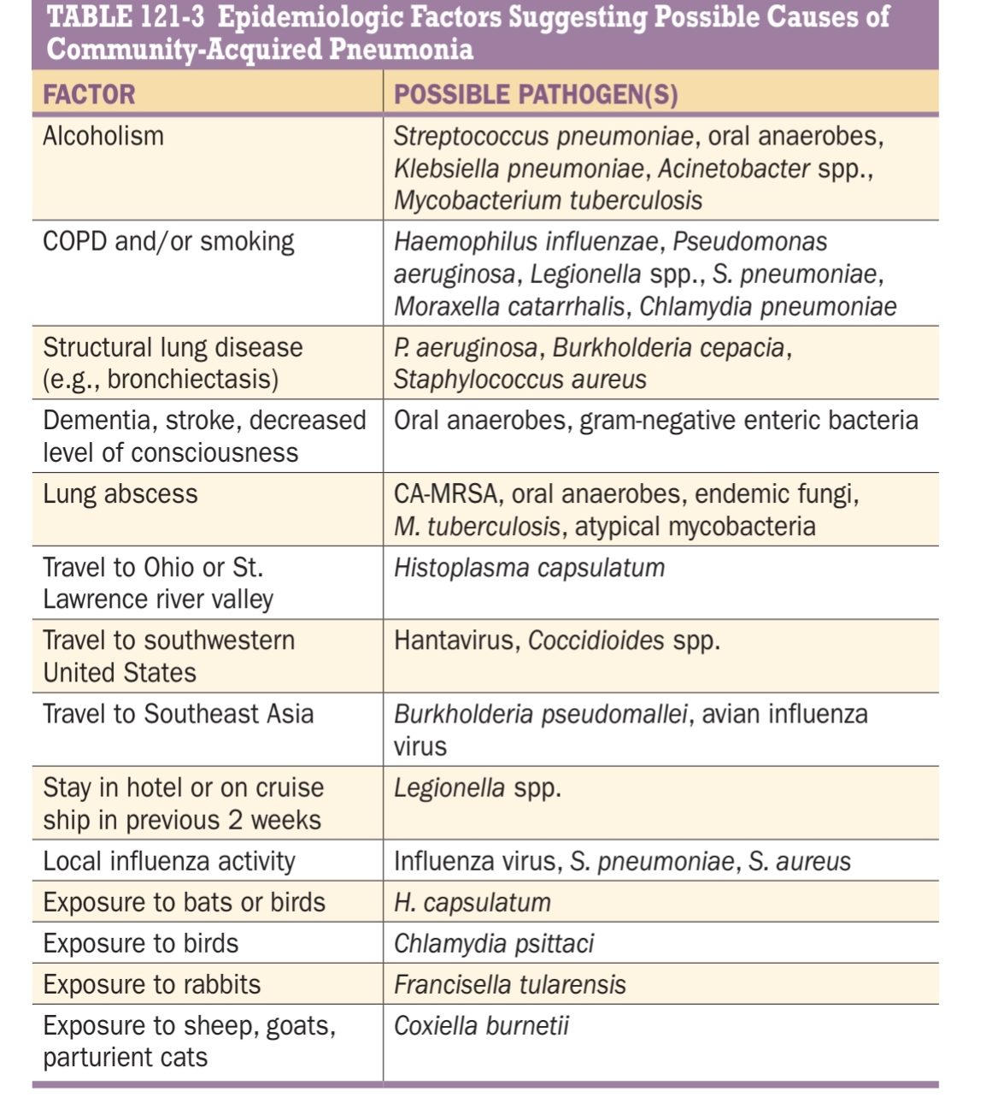

Slide 8
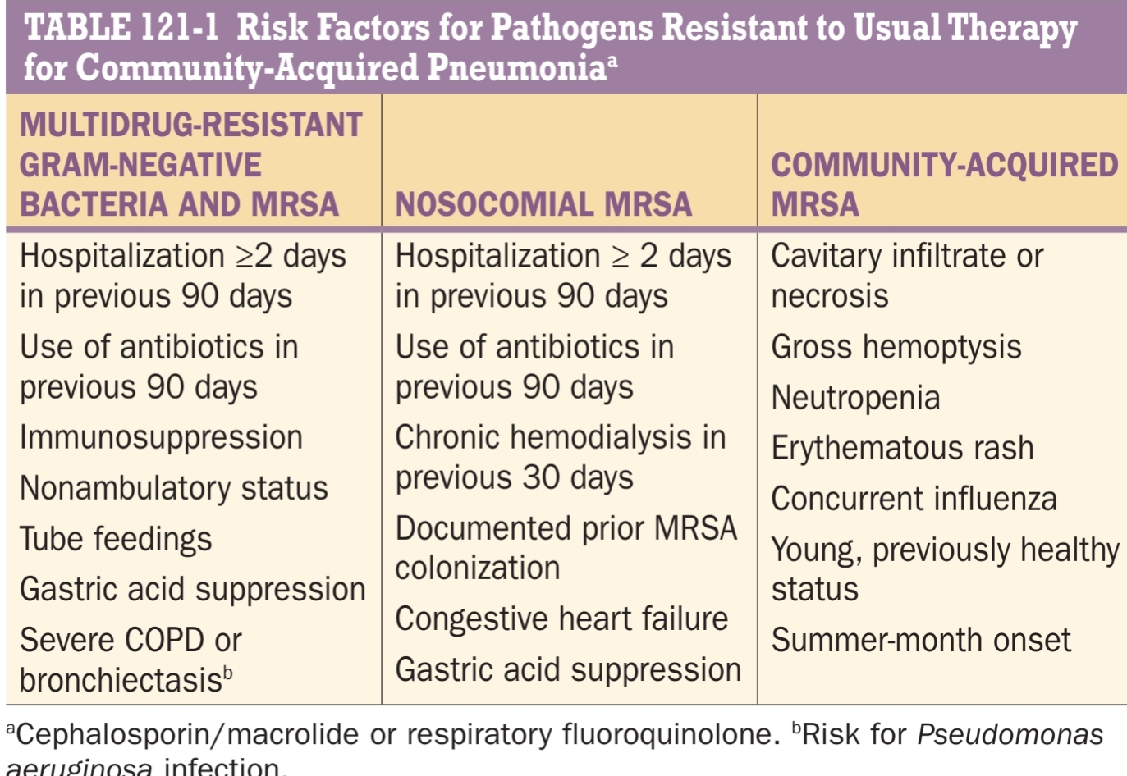

Slide 9
ETIOLOGY
TYPICAL CAUSES
Strep pneumoniae (most common bacterial cause)
Staph aureus (necrotising pneumonia)
ATYPICAL
Legionella
VIRAL
Influenza (H1N1, H5N1,H3N2)
Coronavirus
H influenzae
Moraxella catarrhalis
Group a streptococci
Mycoplasma
Chlamydia pneumoniae
Chlamydia psittaci
Coxiella burnetti
Rhinovirus
Parainfluenza
Adenovirus

Slide 10
Others:
Never forget TB even if the duration of illness is short
Fungal:
  if the patient isn’t responding to empirical treatment
  if imaging isn’t typical of bacterial
  Histoplasma capsulatum, Coccidioides, Blastomyces dermatitidis
  In immunosuppressed : aspergillus, pneumocystis jirovecii, cryptococcus

Slide 11
PATHOLOGY
Stages
Edema or Congestion
Red hepatization
Gray hepatization
Resolution

Slide 12
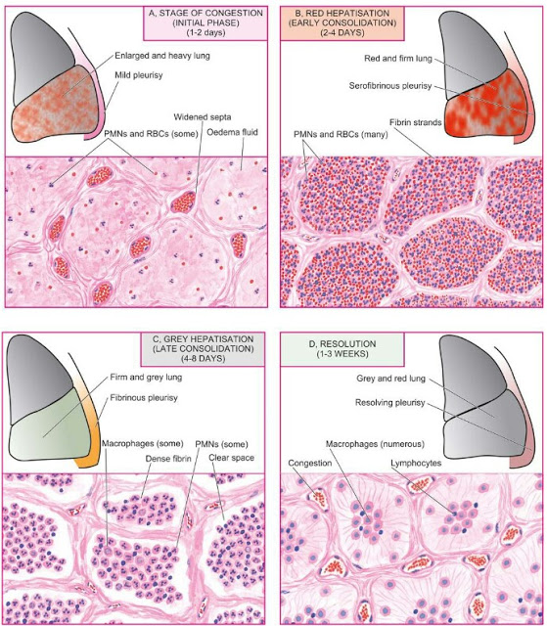
Best described for lobar pneumococcal pneumonia. Doesn’t apply to viral or pneumocystis pneumonia

Slide 13
CLINICAL MANIFESTATIONS
Indolent to fulminant in presentation.
HISTORY
Fever with chills, rigors and/or sweats seen in 80%.
Cough
  Productive with mucoid, purulent or blood tinged sputum
  Non productive (interstitial pneumonia)
  Bronchorrhoea: >100 ml/day : necrotising pneumonia (bronchiectasis, lung abscess, empyema, alveolar cell carcinoma)

Slide 14
Color of the sputum
green or yellow : bacterial.
Green color imparted by myeloperoxidase
rusty : pneumococcal pneumonia
Red currant jelly : Klebsiella
Hemoptysis : tuberculosis, staph aureus
white

Slide 15
Shortness of breath
Pleuritic chest pain if pleura is involved
GI symptoms – nausea, vomiting and /or diarrhoea in 20%
Fatigue, headache, myalgia, arthralgia.
Flu like prodrome : rhinopharyngitis with sore throat and hoarseness of voice
  Viral
  Mycoplasma
  chlamydia

Slide 16
EXTRAPULMONARY MANIFESTATIONS
Mycoplasma:
  CNS: Encephalitis, cerebellar ataxia, GBS
  Cold agglutinin induced hemolytic anemia, thrombocytopenia
  Heart: myocarditis, pericarditis
  Stevens Johnson Syndrome
  Arthritis

Slide 17
Legionella
  Diarrhoea
  Headache, altered mental status
  Investigations: hyponatremia, transaminitis

Slide 18
EXAMINATION
Tachypnea, use of accessory muscles of respiration
Palpation:
  Tenderness in case of pleurisy, empyema
  Increased vocal fremitus.
Percussion: impaired note, dull if synpneumonic effusion present

Slide 19
Auscultation :
  Bronchial breath sounds
  Crackles : inspiratory – fine, medium or coarse (during resolution)
  Pleural rub
  Aegophony and whispering pectoriloquy

Slide 20
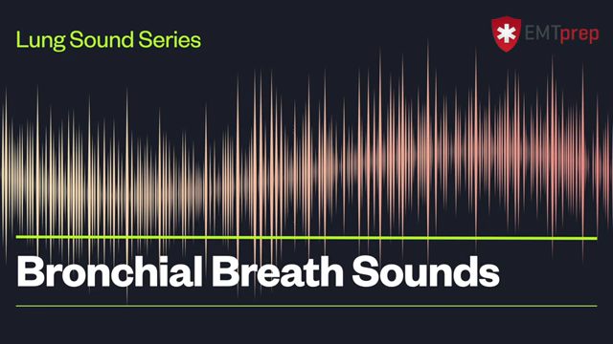
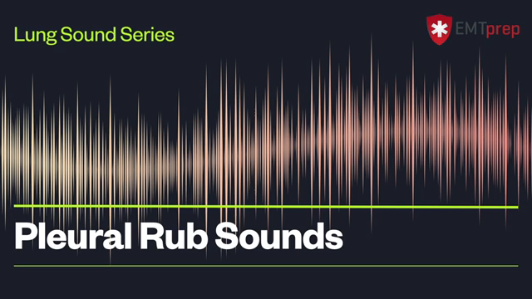


Slide 21
DIAGNOSIS
DIFFERENTIALS:
Acute bronchitis
Acute exacerbations of chronic bronchitis
Bronchiectasis
Heart failure
Pulmonary embolism
Hypersensitivity pneumonitis
Radiation pneumonitis

Slide 22
IMAGING : First line : CHEST X RAY
  Lobar or bronchopneumonia with air bronchogram
  Pre existing cavity / fibrosis / bronchiectactic changes
  Pleural effusion
  Cardiomegaly
  Features of pulmonary edema

Slide 23
X RAY PATTERNS
Common
Consolidation predominant pattern
Peribronchial nodules predominant pattern
uncommon
Ground glass opacity predominant pattern
Random nodules predominant pattern

Slide 24
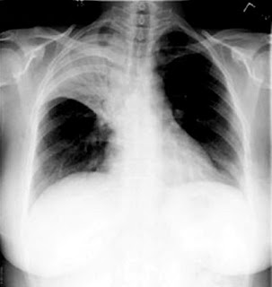
Consolidation predominant pattern
  aka alveolar/ lobar pneumonia
  Mechanism : spread of inflammation through pores of Kohn or canals of Lambert at the periphery of the lung
  Non segmental consolidation in the early stages
  Streptococcus, Klebsiella (bulging fissure sign)

Slide 25
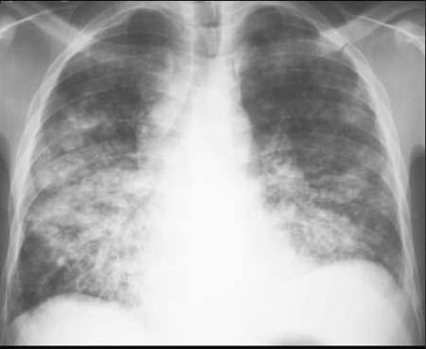
Peribronchial nodules predominant pattern
Bronchopneumonia : centrilobular nodules with or without peribronchial consolidation
Mechanism : enlargement and coalescence of the peribronchial nodules
Bacterial causes: H. influenzae, mycoplasma, Chlamydophila pneumonia, most cases of TB and atypical mycobacteriae

Slide 26
Viral pneumonias most commonly appear as bilateral patchy perihilar or subpleural infiltrates.
Staphylococcal pneumonia also appears in a bronchopneumonia pattern with pneumatoceles, lung abscess, cavity formation, effusion or empyema

Slide 27
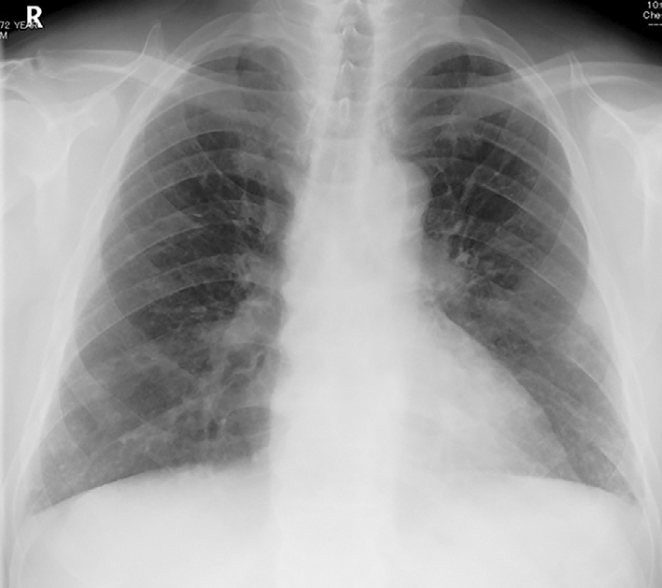
GGO predominant pattern
GGO correspond to
  Incomplete alveolar filling by inflammatory cells or exudate
  Pulmonary edema secondary to infection leaving air in the alveoli OR
  Interstitial infiltrates of inflammatory cells (interstitial pneumonia)
  Mycoplasma, pneumocystis jirovecii, viruses

Slide 28
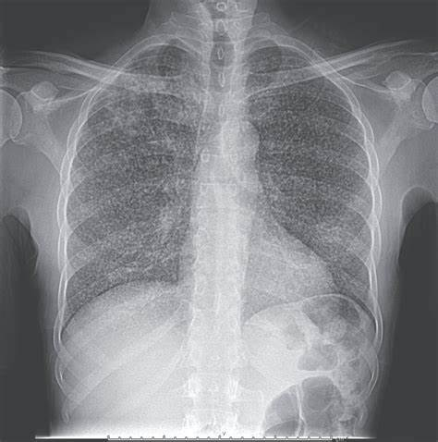
Random Nodules Predominant
Mechanism; hematogenous spread or granulomatous infection
Varicella pneumonia, miliary TB, fungal, septic emboli

Slide 29
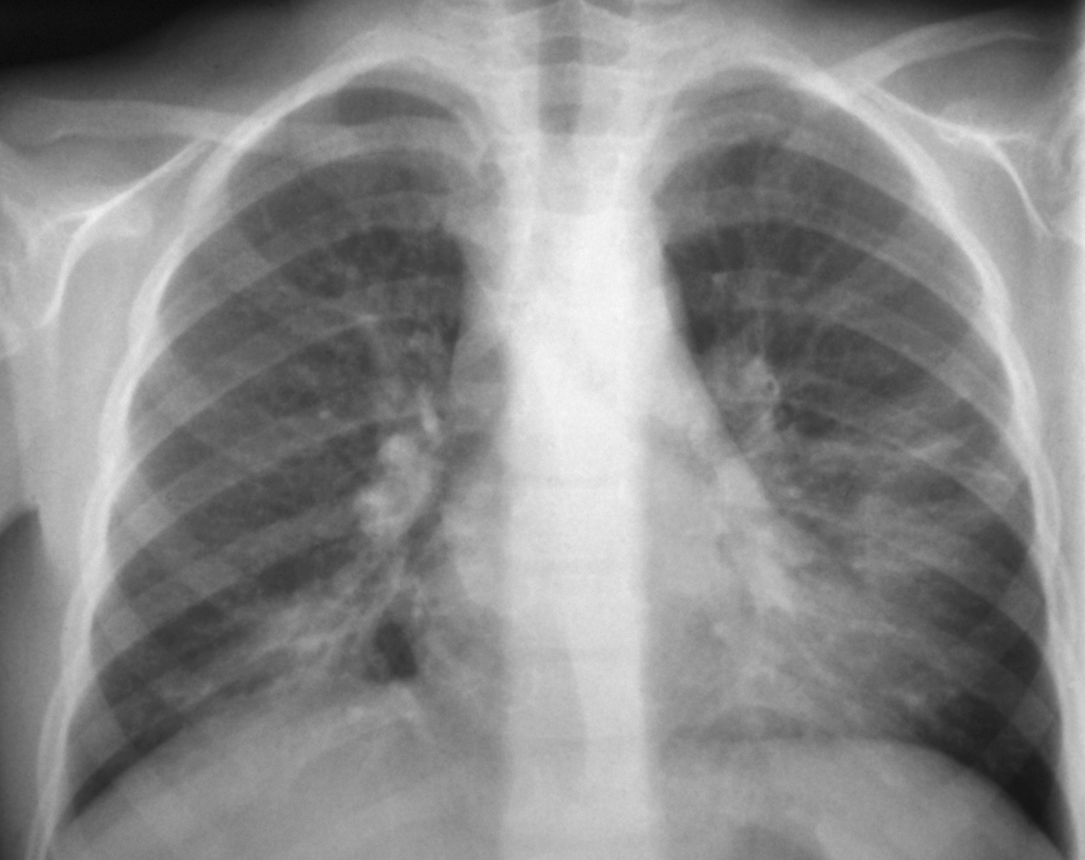
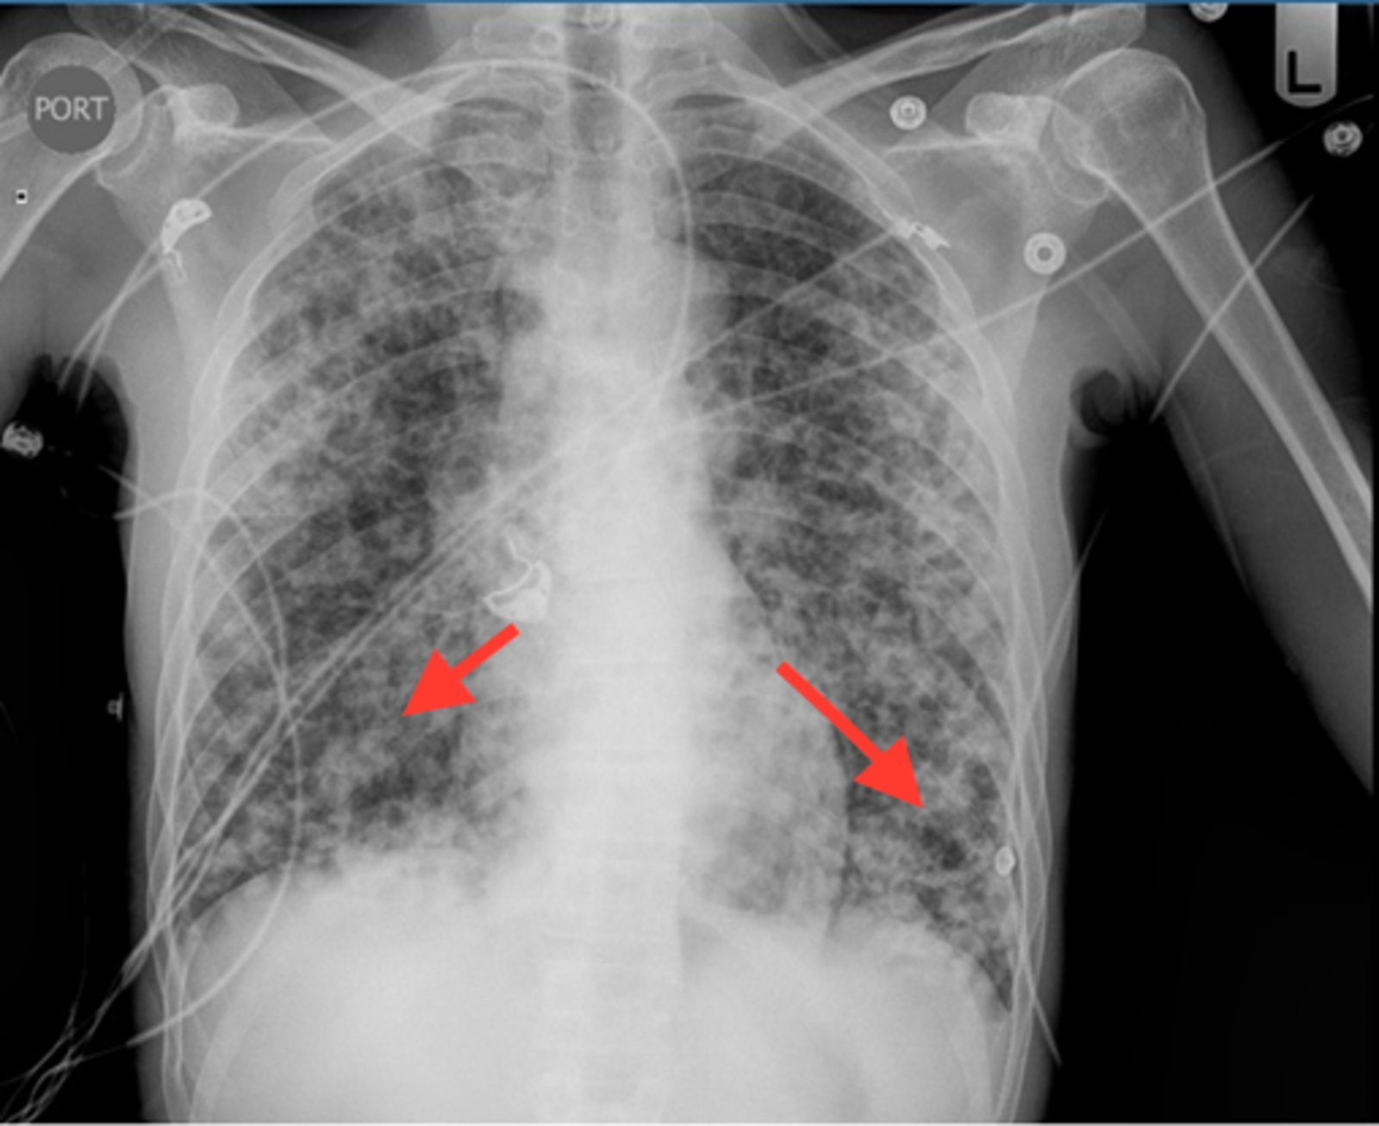
Mycoplasma pneumonia
PCP pneumonia

Slide 30
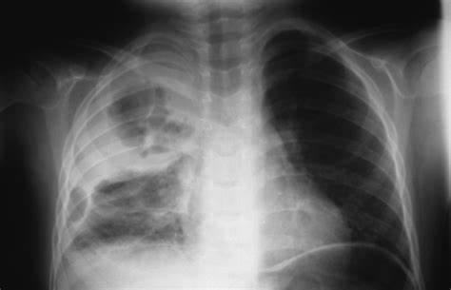
Staphylococcal pneumonia

Slide 31
USG : dynamic air bronchogram
HRCT Thorax :
  Symptoms not improving or Xray findings not correlating with clinical features.
  Suspecting beyond pneumonia.

Slide 32
CULTURES
Sputum/ nasopharyngeal suction aspirate/ ET aspirate/ BAL
Follow proper technique of sputum collection
  Gram stain, AFB stain
  bacterial culture, fungal culture
  viral PCRs and PCR for atypical agents
Blood culture: mostly unyielding in pneumonias
Urinary antigen tests for legionella and pneumococci

Slide 33
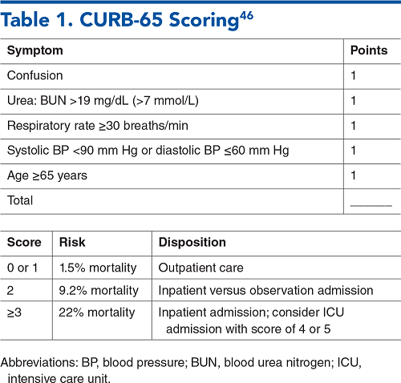
TRIAGING PATIENTS
CURB 65
PNEUMONIA SEVERITY INDEX

Slide 34
Our patient had a Respiratory rate of 36/ min, with a saturation of 90% in room air.
Respiratory system examination revealed bilateral inspiratory crepitations in infraclavicular, mammary, axillary and infrascapular areas with aegophony.
CXR showed a bronchopneumonia pattern with right upper lobe cavity
His RFT was 88/1.3

Slide 35
INDICATIONS FOR ADMISSION
PSI > II or CURB 65 ≥ 2
Rapid worsening course
O2 requirement
INDICATIONS FOR ICU CARE
Respiratory failure
Hemodynamically unstable
Organ dysfunction
Septic shock
CURB 65 score 4 or more

Slide 36
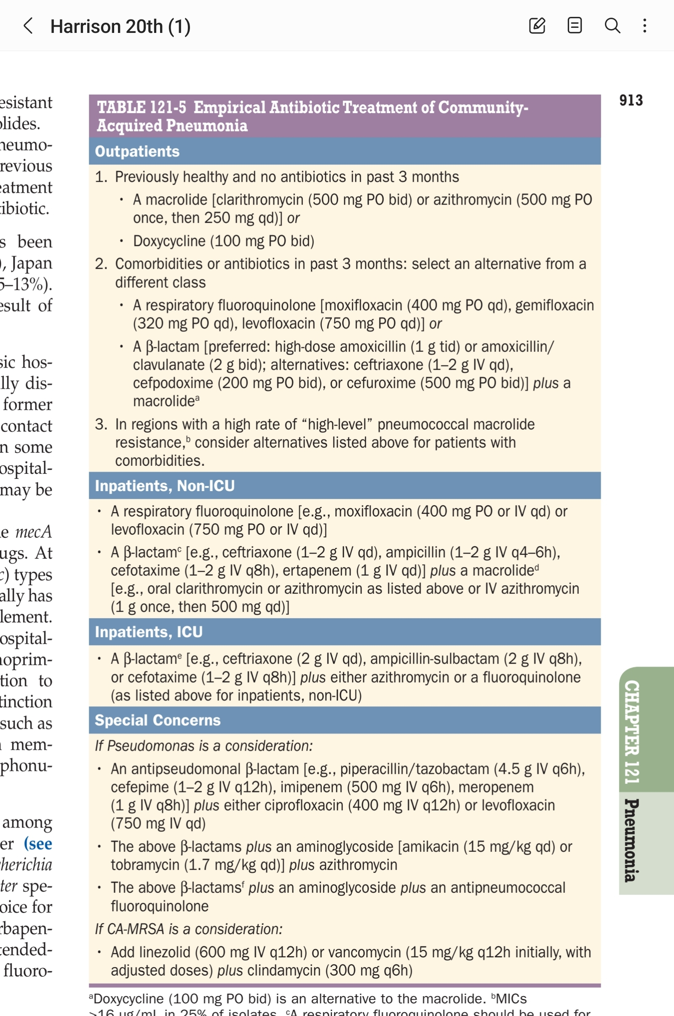
TREATMENT (Harrsion’s Principles of Internal Medicine)

Slide 37
Thank you

