Slide 1
APPROACH TO HEMOPTYSIS
DR MEGHANADH
JR1 MEDICINE

Slide 2
ANATOMY AND PHYSIOLOGY
IT CAN ARISE FROM ANYWHERE IN THE REESPIRATORY TRACT, FROM THE GLOTTIS TO ALVEOLUS
MOST COOMONLY ARISE FROM THE BRONCHI OR MEDIUM SIZED AIRWAYS
LUNG HAS DUAL BLOOD SUPPLY
1) LOW PRESSURE PULMONARY ARTERIES (GAS EXCHANGES)
2) HIGH PRESSURE BRONCHIAL ARTERIES (AIRWAY CIRCULATION)
(MOSTLY RUPTURES IN HEMOPTYSIS)
BRONCHIAL ARTERIES INVOLVES IN TUMOR METS,AIRWAY DILATATION IN BXIS,
AND CAVITARY LESIONS

Slide 3
ETIOLOGY
INFECTIONS
1)MOSTLY VIRAL BRONCHITIS USUALLY SMALL VOLUME
2)IN C/c BRONCHITIS SUPERADDED BACTERIAL INFECTION (S.Pneumoniae,
H.influenza, M.Cattarrhalis) - HR OF BLEEDING
3)MCC OF HEMOPTYSIS IS TB (BUT IN INDUSTIALISED COUNTRIES BRONCHITIS
&BXIS)

Slide 4
4)IN TB HEMOPTYSIS MOST COMMONLY DUE TO CAVITY FORMATION , RARELY BY
EROSION OF PULMO ARTERY ANEURYSM TO PRE EXISTING CAVITY
5)NOCARDIA , NTM, APERGILLUS- CAVITARY LUNG LESIONS
6)S.aureus,K.pneumonia,ORAL ANAEROBES – NECROTIC LESIONS, ABSCESS
7)PARAGONIMIASIS (h/o RAW CRAY FISH INGESTION) common SE ASIA & CHINA

Slide 5
VASCULAR
PULMONARY EDEMA PINK FROTHY SPUTUM USUALLY
PULMONARY EMBOLISM WITH INFARCTION
ECTATIC AIRWAY VESSELS, PULMONARY AV MALFORMATIONS
AORTOBRONCHIAL FISTULA RUPTURE( AORTIC ANEURYSM)
DAH UNCOMMONLY CAUSES HEMOPTYSIS
PULMO RENAL SYNDROMES - GPA , Anti GBM DISEASE USUALLY PRESENTS
WITH HEMOPTYSIS AND HEMATURIA

Slide 6
MALIGNANCY
BRONCHOGENIC CARCINOMA( BOTH MASSIVE AND NON MASSIVE)
SMALL CELL AND SQUAMOUS USUALLY CENTRAL AND ERODES MAIN
ARTERIES
CARCINOID TUMOUR
METS (MELANOMA,SARCOMA,BREAST CX, COLON CX)
KAPOSI SARCOMA

Slide 7
MECHANICAL AND OTHERS
PULMONARY ENDOMETRIOSIS CYCLICAL HEMOPTYSIS(CATAMENIAL HEMOPTYSIS)
FB ASPIRATION , BRONCHOSCOPY PROCEDURES,LA PROCEDURES,PA CATHETERS
TCP,ANTICOAGULANTS,COAGULOPATHY,ANTIPLATELETS

Slide 8
EVALUATION AND MANAGEMENT
HISTORY
AMOUNT OR SEVERITY OF BLEEDING
MASSIVE HEMOPTYSIS 400 ML IN 24 HR /100-150 AT A TIME
MCC DEATH MASSIVE HEMOPTYSIS IS CLOT ASPHYXIATION
H/O FEVER,CHILLS,COUGH- S/O INFECTION
H/O SMOKING/ WT LOSS – S/O CANCER
H/O INHALATIONAL EXPOSURES
PHYSICAL EXAMINATION
HYPOXIA,TACHYPNOEA,TACHYCARDIA
CLUBBING – S/O CANCER, CF
ECCHYMOSES AND PETECHIAE OR TELEANGECTASIAS

Slide 9
DIAGNOSTIC STUDIES
CBC – TO R/O INFECTION, ANAEMIA,THROMBOCYTOPENIA
COAGULATION STUDY
SE & RFT/ URE
CHEST X RAY
FOR AGE>40 & SMOKER
1)CT CHEST 2)FLEXIBLE BRONCHOSCOPY

Slide 10
INTERVENTIONS
FOR MASSIVE HEMOPTYSIS
A)PROTECT NON BLEEDING LUNG(MI STEP)
B)LOCATE THE SITE OF BLEEDING
C)CONTROL THE BLEEDING
PROTECT THE AIRWAY
IF THE SITE OF BLEEDING IS KNOWN, POSITION THE PATIENT WITH THE BLEEDING SITE DOWN, TO KEEP BLOOD OUT OF NON BLEEDING LUNG
AIRWAY INTUBATION SHOULD BE AVOIDED UNLESS TRULY NECESSARY
AIRWAY INTUBATION AND SUCTIONING IS LESS EFFECTIVE THAN COUGH REFLEX
IF INTUBATION IS ABSOLUTELY NECESSARY THE WE SHOULD PROTECT THE NON BLEEDING LUNG BY USING SELECTIVE LUNG INTUBATION OR DOUBLE LUMEN ET TUBE

Slide 11
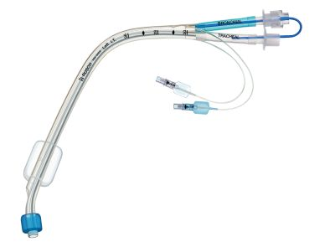
DOUBLE LUMEN ET TUBE

Slide 12
LOCATING THE SITE OF BLEED
A) CXR OPACITY
B) CT ANGIOGRAPHY CAN LOCALISE ACTIVE EXTRAVASATION
C) FLEXIBLE BRONCHOSCOPY
CONTROL THE BLEEDING
1)FROM AIRWAY 2) FROM INVOLVED VESSEL 3)SURGICAL RESECTION
FLEXIBLE BRONCHOSCPY AND CLOT SUCTIONING , INSERT BALOON CATHETER
RIGID BRONCHOSCOPY- PHOTOCOAGULATION, CAUTERY
BRONCHIAL ARTERY EMBOLIZATION
TREATMENT OF UNDERLYING CONDITION
SX RESECTION NOT PREFERED BECAUSE OF HIGH MORTALITY RATE

Slide 13
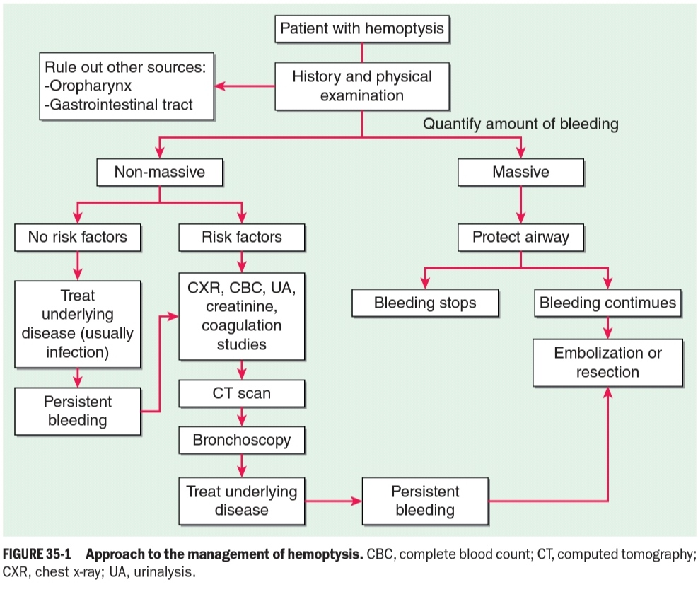

Slide 14
THANK YOU

