Slide 1
APPROACH TO EDEMA
Dr. Maria George

Slide 2
PATHOPHYSIOLOGY
Edema is an excess of interstitial fluid which has become evident clinically.
Normally, fluid volume in different compartments of the body is maintained by the starlings forces.

Slide 3
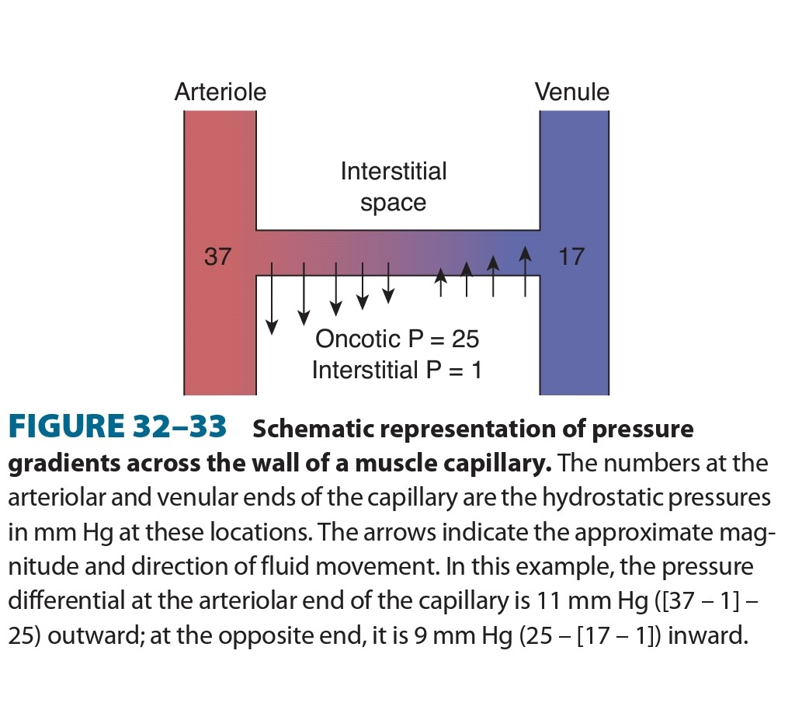

Slide 4
Edema is due to net movement of fluid from intravascular to interstitial spaces, which can occur under the following conditions:
An increase in intracapillary hydrostatic pressure
Inadequate lymphatic drainage
Reductions in oncotic pressure in the plasma
Damage to capillary endothelial barrier
Increase in oncotic pressure in the interstitial space.

Slide 5
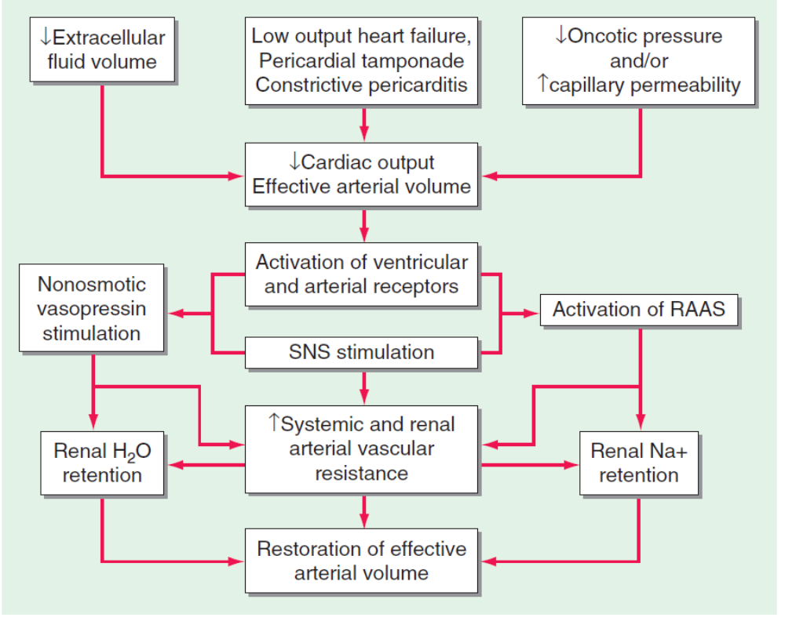

Slide 6
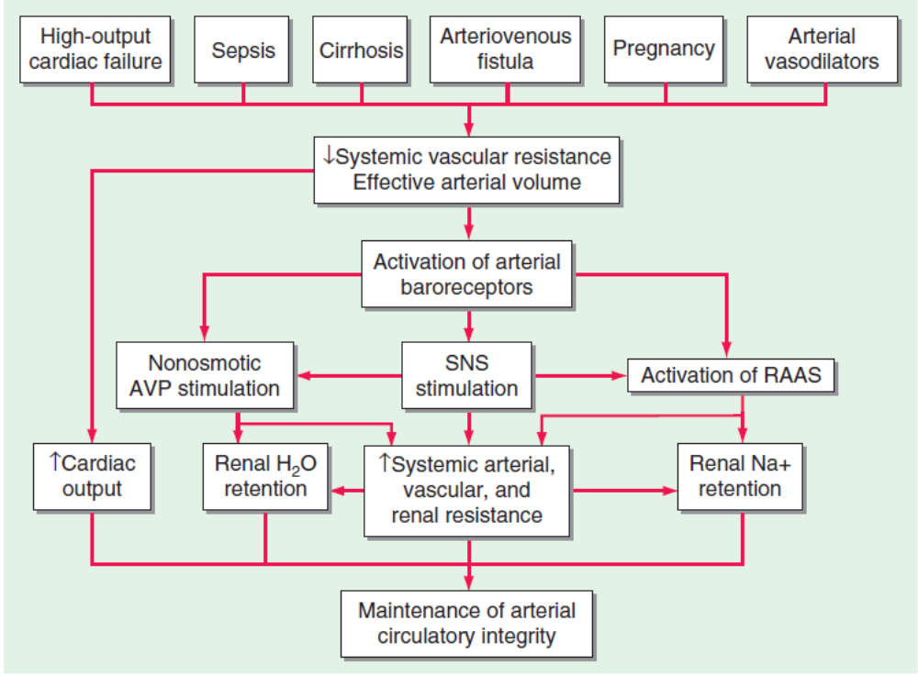

Slide 7
CLINICAL CAUSES OF EDEMA
1. GENERALAISED EDEMA
CARDIAC
HEPATIC
RENAL
DRUG INDUCED EDEMA
EDEMA OF NUTRITIONAL ORIGIN

Slide 8
2. LOCALISED EDEMA
VENOUS EDEMA:
Deep vein thrombosis
Varicose veins
SVC/IVC obstruction
LYMPHATIC EDEMA
Chronic lymphangitis
Resection of regional lymph nodes
Filariasis
Radiotherapy

Slide 9
5) Congenital ( milroy’s disease)
INFLAMMATORY CAUSES
cellulitis

Slide 10
Edema of cardiac origin
History:
Prominent dyspnoea on exertion
Orthopnea
PND
Physical examination:
Dependent edema found over the ankles in ambulant patient and sacrum in bedridden patient.
Elevated JVP
S3 gallop

Slide 11
Peripheral cyanosis
Cool extremities
Small pulse pressure
LABORATORY FINDINGS
Elevated urea nitrogen to creatinine ratio
Reduced S.Na
Elevated natriuretic peptides

Slide 12
Hepatic Cirrhosis
History:
Dyspnoea is uncommon, except if associated with significant degree of ascites
Physical Examination:
Ascites
JVP normal or low
BP lower than in renal or cardiac disease
Stigmata of chronic liver disease

Slide 13
Laboratory findings:
Decreased S. albumin, S. cholesterol, other hepatic proteins like transferrin, fibrinogen
Elevated liver enzymes
Tendency towards hypokalemia
Respiratory alkalosis
Macrocytosis from folate deficiency

Slide 14
EDEMA OF RENAL DISEASE
History:
Usually chronic
Associated with uremic signs and symptoms
Dyspnoea maybe present, less common than heart failure
Physical Examination :
Elevated BP
Hypertensive/Diabetic retinopathy
Nitrogenous fetor
Pericardial friction rub

Slide 15
Laboratory Findings:
Elevation of S. creatinine and cystatin C
Albuminuria
Hyperkalemia
Metabolic acidosis
Hyperphosphatemia
Hypocalcemia
anemia

Slide 16
NEPHROTIC SYNDROME AND OTHER HYPOALBUMINEMIC STATES
History:
Childhood diabetes mellitus, plasma cell dyscrasias
Physical Examination
Diffuse symmetric edema, more prominent in dependent areas, perirbital edema is more prominent in the morning.
Laboratory Investigations
proteinuria >3.5g/dl
Hypoalbuminemia
Hypercholesterolemia
Microscopic hematuria

Slide 17
DRUG INDUCED EDEMA
NSAIDs
ANTIHYPERTENSIVES:
Direct arterial/arteriolar dilators
Hydralazine
Clonidine
Methyldopa
Guanethidine
minoxidil

Slide 18
2. Calcium channel blockers
3. Alpha blockers
4. Thiazolidinediones
Steroid Hormones
Glucocorticoids, anabolic steroids, estrogens, progestins
Cyclosporins
Growth hormones
Immunotherapies: interleukin2, QK T3 monoclonal antibodies

Slide 19
APPROACH:
EDEMA
LOCALISED
GENERALISED

Slide 20
GENERALISED EDEMA
SERUM PROTEIN
LOW :
Nephrotic syndrome
Hepatic cirrhosis
Severe malnutrition
NORMAL:
Cardiac failure
Renal failure
Drug induced

Slide 21
LOCALISED EDEMA
LOWER LIMB EDEMA
BILATERAL
ACUTE/CHRONIC
UNILATERAL
ACUTE/CHRONIC

Slide 22
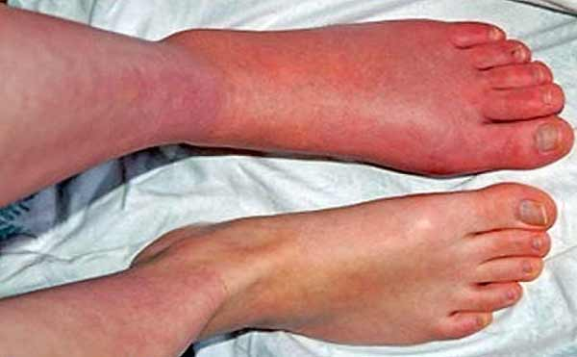
ACUTE ONSET UNILATERAL LOWER LIMB EDEMA
LOOK FOR EVIDENCE OF DVT
calf tenderness
pain or firmness along the course of a vein
unilateral warmth or erythema
a larger calf circumference in the affected leg is the most useful finding, whereas Homans’ sign (calf pain upon passive dorsiflexion of the foot) is not a reliable sign of DVT.

Slide 23
NO EVIDENCE OF DVT:
Calf muscle pull or tear – An inciting injury may be identified in the history, and there may be signs of bleeding (if ultrasonography is performed) or bruising at the ankle
Cellulitis – Bacterial cellulitis is a common condition of the leg, particularly in patients who have chronic leg swelling due to venous insufficiency or lymphedema.
In bacterial cellulitis, the warmth and redness often skip areas and may be associated with constitutional symptoms including fever.
Some patients with venous insufficiency develop a low-grade, nonbacterial cellulitis, which resembles infectious cellulitis, but without constitutional symptoms.
Although fever increases the suspicion for cellulitis, it can also be present in DVT

Slide 24
Superficial thrombophlebitis – Superficial vein thrombophlebitis classically presents with palpable, tender superficial veins.
Popliteal (Baker’s) cyst – The majority of popliteal cysts are due to either distention of a bursa by fluid originating from a knee joint or posterior herniation of the joint capsule due to increased intraarticular pressure. A popliteal cyst that causes calf symptoms is usually leaking or has ruptured. It is often distinguished from DVT by posterior knee pain, knee stiffness, swelling or a mass behind the knee (especially with the knee in extension), and bruising around the ankle. However, calf symptoms are common; in addition, compression of the popliteal vein may cause leg swelling or secondary DVT.
Inflammatory pathology of the knee – Pain, inflammation, and swelling can accompany any knee joint pathology and may be confused with a popliteal cyst or DVT.
May-Thurner syndrome – May-Thurner syndrome occurs in younger females (second or third decade) who present with acute pain and swelling of the entire left lower extremity, with or without venous thrombosis. The syndrome is most often caused by a compression of the left iliac vein between the overlying right common iliac artery and the fifth lumbar vertebrae.

Slide 25
APPROACH TO CHRONIC UNILATERAL LOWER LIMB EDEMA
The most common cause of chronic unilateral or asymmetric edema is lower extremity chronic venous disease.
Less common causes include primary or secondary lymphedema, a pelvic neoplasm compromising venous return, and complex regional pain syndrome.

Slide 26
If the history and examination are not consistent with venous insufficiency, lymphedema, or complex regional pain syndrome, compression ultrasonography (CUS) with Doppler should be obtained. CUS can provide the following information:
Confirmation of lower extremity chronic venous disease
Suggestion of pelvic outflow obstruction
A normal study is consistent with either lymphedema or complex regional pain syndrome.
A neoplasm should be suspected when CUS is suggestive of pelvic outflow obstruction
The most common etiologies include ovarian cancer, endometrial cancer, bladder cancer, lymphoma, and prostate cancer.
Rarely, benign lesions such as uterine fibroids or ovarian cysts can cause unilateral leg swelling.

Slide 27
BILATERAL LOWER LIMB EDEMA
ACUTE
Drug induced
Acute heart failure
Acute nephrotic syndrome
Bilateral DVT, which is often associated with malignancy.
CHRONIC
Chronic venous disease most common
heart failure
pulmonary hypertension (often related to sleep apnea)
renal disease, liver disease
a pelvic neoplasm
constrictive pericarditis
idiopathic edema, premenstrual edema, malnutrition

Slide 28
CHRONIC BILATERAL LOWER LIMB EDEMA
History & examination-
heart failure : Dyspnoea, orthopnoea, PND , fatigue , anorexia, abdominal distension with S3 , hepatomegaly, cardiomegaly, chest rales Elevated JVP
SLEEP APNOEA: Excessive day time sleepiness, snoring, breath interruption during sleeping
History suggestive of CLD/ CKD

Slide 29
INVESTIGATION :
Urine dipstick-for protein
serum creatinine
serum albumin
prothrombin time
liver function tests
thyroid-stimulating hormone
If these tests are unrevealing we obtain an echocardiogram to evaluate the possibility of heart failure or pulmonary hypertension.
If echo also unrevealing most probably chronic venous disease -pigmentary changes, induration, and ulceration
typical skin findings of chronic venous disease are absent, we obtain imaging of the pelvis to exclude a pelvic neoplasm or other lesion-causing venous outflow obstruction Eg TVS , CECT of pelvis

Slide 30
ARM EDEMA
ACUTE
Causes : trauma, infection, superficial thrombophlebitis, or inflammatory arthritis of the upper extremity
Upper extremity venous thrombosis should be suspected when none of the etiologies noted above are present, or if there are other significant risk factors such as the presence of a venous catheter.
Spontaneous thrombosis occurs most often in muscular male athletes engaging in strenuous activity with the involved arm and usually involves anatomic abnormalities of the thoracic outlet.
Acute bilateral upper extremity edema is rare but may be seen with bilateral spontaneous venous thrombosis or superior vena cava syndrome.
CUS with doppler – investigation of choice

Slide 31
LYMPHOEDEMA
Not a true edematous state.
The major causes of lymphedema in adults in developed countries are axillary lymph node dissection in patients with breast cancer and axillary or inguinal lymph node dissection in patients with melanoma.
Worldwide, the most common cause is filariasis.
The edema is typically limited to an arm or leg.
The clinical hallmark of lymphedema is the presence of cutaneous and subcutaneous thickening, as manifested by cutaneous fibrosis, peau d’orange, and a positive Stemmer sign, which refers to an inability to tent the skin at the base of the digits.

