Slide 1
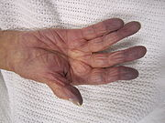
APPROACH TO CYANOSIS
This Photo by Unknown Author is licensed under CC BY-SA
DR CHAITHRA
JR1 MEDICINE

Slide 2
BLUISH DISCOLORATION OF SKIN AND MUCOUS MEMBRANE DUE TO INCREASED QUANTITY OF REDUCED HB OR HB DERIVATIVES IN CAPILLARY BLOODVESSELS
REDUCED HB>4 gm/dl

Slide 3
SITES
LIPS
NAILBEDS
EARS
MALAR EMINENCE
PALMS AND SOLE

Slide 4
CYANOSIS DEPENDS ON THE ABSOLUTE QUANTITY OF HB RATHER THAN RELATIVE
PATIENTS WITH SEVERE ANEMIA MAY NOT DISPLAY CYANOSIS WITH MARKED DESATURATION
MORE EVIDENT IN POLYCYTHEMIA

Slide 5
CENTRAL CYANOSIS
DECREASED ARTERIAL O2 SATURATION/ABNORMAL HB
SATURATION <85% /<75% IN DARK SKINNED INDIVIDUALS
MM AND SKIN BOTH AFFECTED

Slide 6
DECREASED ARTERIAL O2 SAT
DECREASED ATMOSPHERIC PRESSURE(PA02)--- HIGH ALTITUDE 13000 Ft
IMPAIRED PULMONARY FUNCTION
--PNEUMONIA / PULMONARY EDEMA/ COPD
ANATOMIC SHUNTS-
---CONGENITAL HEART DISEASES
----PULMONARY AV FISTULA

Slide 7
ABNORMAL HEMOGLOBIN
METH HB- >1.5% OF TOTAL HB
HEREDITARY-
AQUIRED- DRUGS, TOXINS,CHEMICAL SUBSTANCE EXPOSURE
NITRATES,NITRITES,SULPHONAMIDES
SULF HB –SULFER BINDING WITH HB
METOCLOPROMIDE,DAPSONE
CARBOXY HB

Slide 8
PERIPHERAL CYANOSIS
DUE TO SLOWING OF BLOOD FLOW AND ABNORMALLY GREAT EXTRACTION OF O2 FROM NORMALLY SATURATED BLOOD
VASOCONSTRICTION DUE TO COLD EXPOSURE
REDUCED CO – SHOCK , HEART FAILURE
REDISTRIBUTION OF BLOOD FLOW FROM EXTREMITIES
ARTERIAL OBSTRUCTION- EMBOLUS/ VASOSPASM
VENOUS OBSTRUCTION- THROMBOPHLEBITIS/DVT

Slide 9
DIFFERENTIAL CYANOSIS
IN LOWER LIMB- PDA WITH PULMONARY HTN WITH RIGHT TO LEFT SHUNT
IN UPPER LIMB-PDA WITH PULMONARY HTN WITH RIGHT TO LEFT SHUNT WITH TGA
BOTH LL AND LEFT UL-WITH PDA OPENS PROXIMAL TO ORIGIN OF LEFT SUBCLAVIAN ARTERY OR PDA WITH REVERSAL OF SHUNT WITH PREDUCATL COARCTAION OF AORTA

Slide 10
HISTORY
TIME OF ONSET –BIRTH/ INFANCY
DURATION
ACUTE/ CHRONIC
H/O EXPOSURE TO CHEMICALS
DRUG H/O
FAMILY H/O
EXPOSURE TO COLD

Slide 11
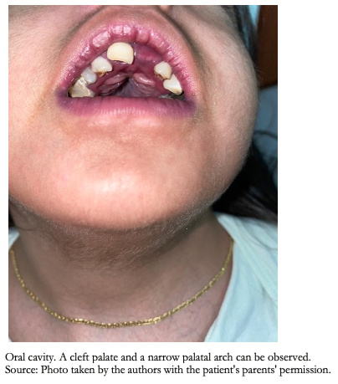

EXAMINATION
LOOK FOR SITES –CENTRAL /PERIPHERAL
This Photo by Unknown Author is licensed under CC BY-NC
This Photo by Unknown Author is licensed under CC BY-SA

Slide 12
CENTRAL
RIGHT TO LEFT SHUNT OR LUNG DISORDERS
WHOLE BODY ,MOUTH ,LIPS,MM
CLUBBING,POLYCYTHEMIA- CHD,
WARM EXTREMITIES
WARMING EXTREMITIES-NO CHANGE
PA02<85
O2 INHALATION- IMPROVEMENT

Slide 13
PERIPHERAL
DUE TO STASIS
NAIL BED, NOSE TIP,EAR LOBE, EXTREMITIES
ASS WITH REYNAUDS DISEASE ,COLD EXPOSURE
COLD EXTREMITIES
ON WARMING EXTREMITIES –IT DISAPPEARS
NO IMPROVEMENT ON O2
PAO2- NORMAL

Slide 14
SYSTEMIC EXAMINATION
LOOK FOR EVIDENCE OF PULMONARY DISEASE, PULMONARY EDEMA ,MURMERS OF CHD

Slide 15
INVESIGATIONS
BRE,ECG,CXR
V/Q SCAN PULMONARY ANGIOGRAHY
ECHO
DSA ,ARTERIALDOPPLER
ABG
SPECTROSCOPY FOR ABNORMAL HB

Slide 16
THANK YOU

