Slide 1
AZOTEMIA
Dr Akhil Suresh

Slide 2
Retention of nitrogenous waste products in blood is called azotemia
Results from reduced renal perfusion, intrinsic renal disease or post renal disease

Slide 3
ASSESSMENT OF GFR
primary metric for kidney function
Rate at which substances are filtered across the glomerular membrane

Slide 4
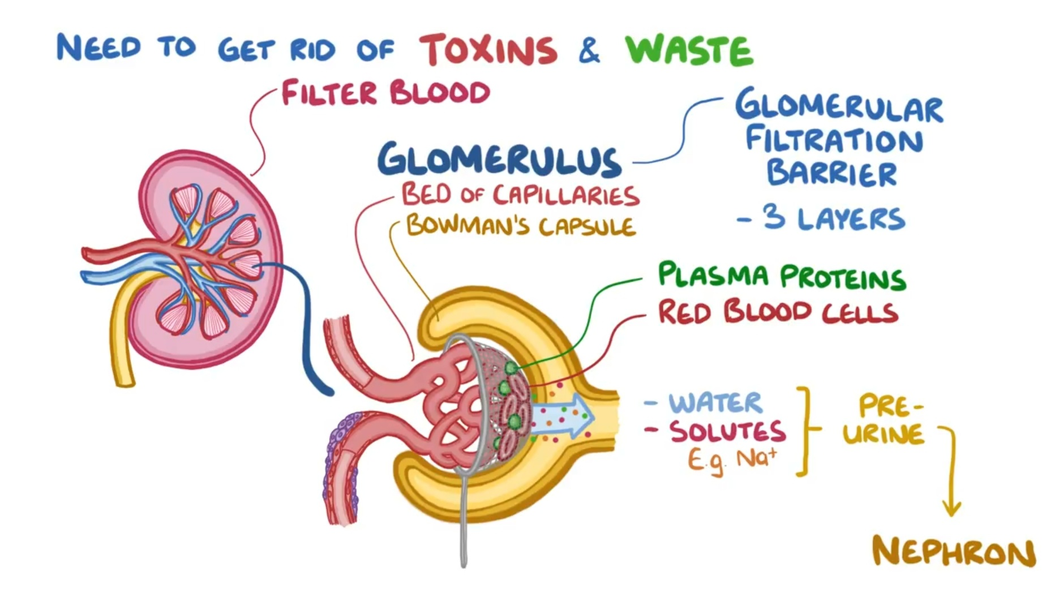

Slide 5
Measurement involves administration of a radioactive isotope such as inulin or iothalmate that is filtered at the glomerulus into the urinary space but is neither reabsorbed not secreted throughout the tubule.

Slide 6
GFR is the clearance of inulin and iothalmate in millilitres per minute
It is calculated from the rate of appearance of the isotope in the urine over several hours.

Slide 7
In most clinical circumstances direct GFR measurement is not feasible and the plasma creatinine level is used as a surrogate to estimate GFR.

Slide 8
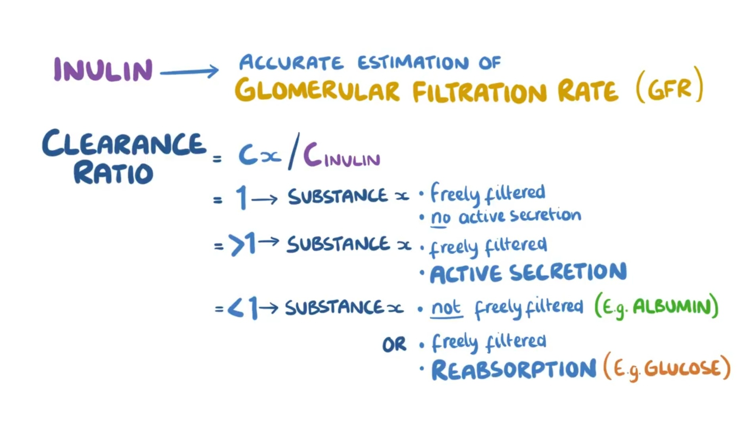

Slide 9
Plasma creatinine is the most widely used marker for GFR which is directly related to Ucr and inversely related to Pcr
Failure to account for GFR reductions in drug dosing can lead to significant morbidity and death from drug toxicities ( eg digoxin, imipenam )

Slide 10
Signs and symptoms of uremia develop at different levels of Pcr depending on the patient's characteristics
Generally they do not develop symptomatic uremia until GFR is less than 15 ml/min

Slide 11
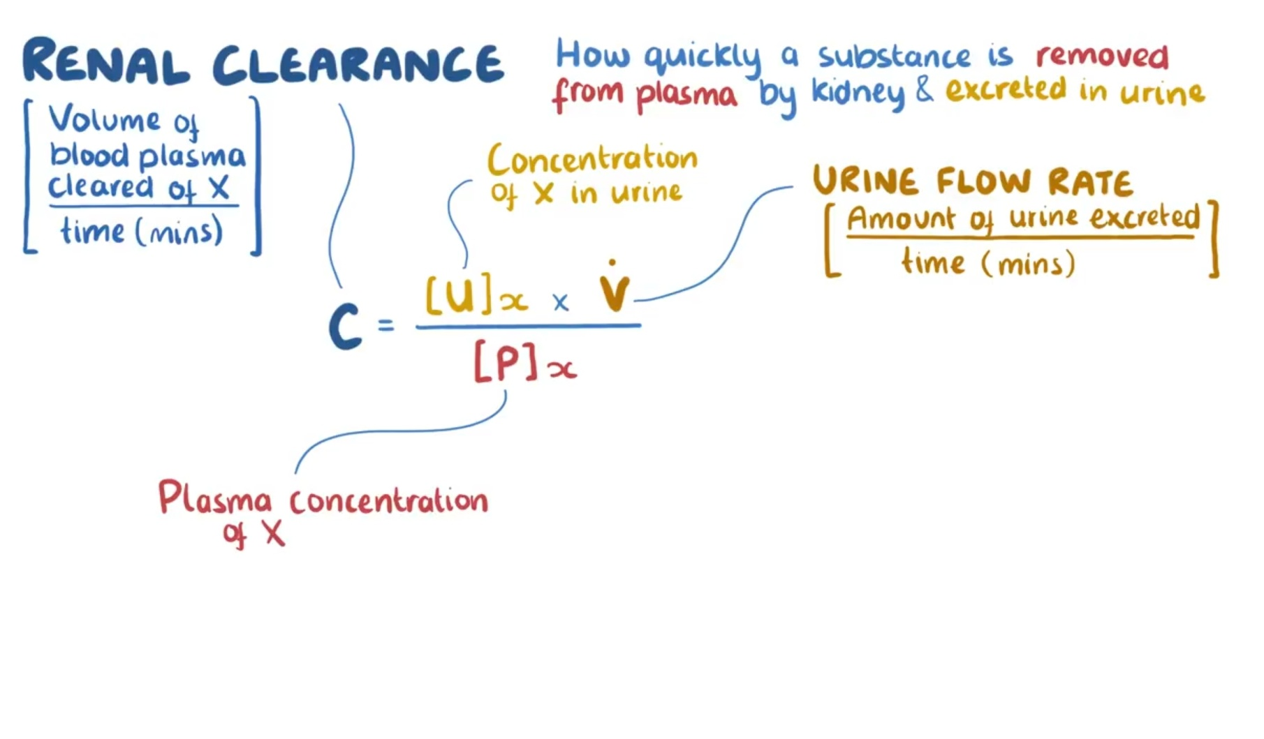

Slide 12
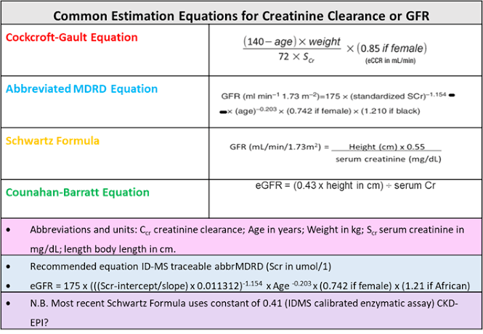

Slide 13
CYSTATIN C
Cysteine protease inhibitor
Produced at a constant rate from all nucleated cells
More sensitive marker for early GFR decline
Affected by patient characteristics, diabetes,etc

Slide 14
APPTOACH TO THE PATIENT
Acute vs Chronic kidney disease
Acute - pre renal , renal or post renal

Slide 15
PRERENAL FAILURE
Accounts for 40 to 80 % of cases of acute renal failure
Reversible

Slide 16
Causes of pre renal failure
Decreased circulating blood volume - GI hemorrhage,burns,diarrhoea, diuretics
Volume sequestration - pancreatitis,peritonitis, rhabdomyolysis
Decreased effective arterial volume - cardiogenic shock,sepsis

Slide 17
Peripheral vasodilation- sepsis , drugs
Profound renal vasoconstriction- severe heart failure, HRS, use of NSAIDs

Slide 18
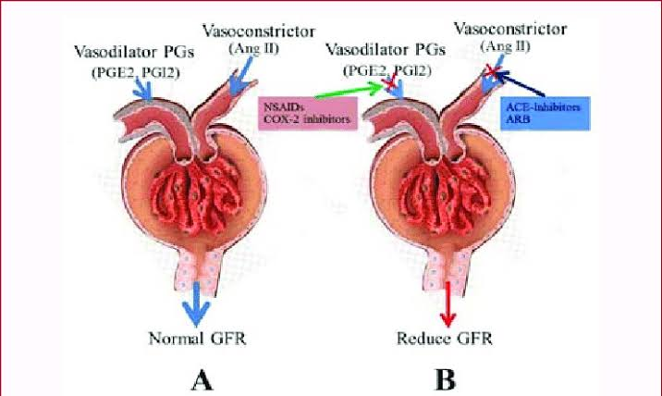

Slide 19
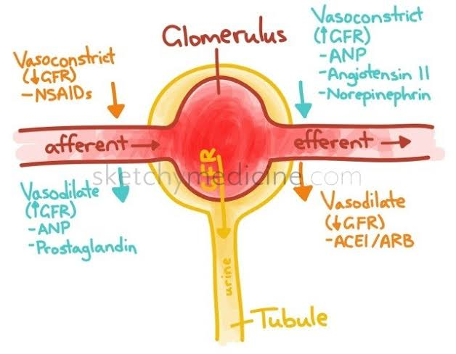

Slide 20
INTRINSIC RENAL DISEASE
Large renal vessels
Intra renal microvasculature
Glomeruli
Tubulointerstitium

Slide 21
ATN
Could be ischemic or toxic
Accounts for 90% of cases of acute intrinsic renal failure
Pre renal azotemia and ATN are part of a spectrum of renal hypoperfusion
Can be differentiated by urine analysis

Slide 22
ISCHEMIC ATN - major surgery, trauma, severe hypovolemia, sepsis, burns
NEPHROTOXIC ATN - intra renal vasoconstriction+ direct tubular injury+/- tubular obstruction

Slide 23
The kidneys are susceptible to such injury due to its rich blood supply and because of its ability to concentrate and metabolise toxins.

Slide 24
Tubular and interstitial disease can lead to acute kidney injury
Drug induced interstitial nephritis- antibiotics, NSAIDs and diuretics
Severe infections- bacterial and viral
Systemic diseases- SLE
Sjogrens , lymphoma, leukemia

Slide 25
Classic sediment finding in allergic interstitial nephritis is urine eosinophil more than 10%
Wrights stain or hansels stain

Slide 26
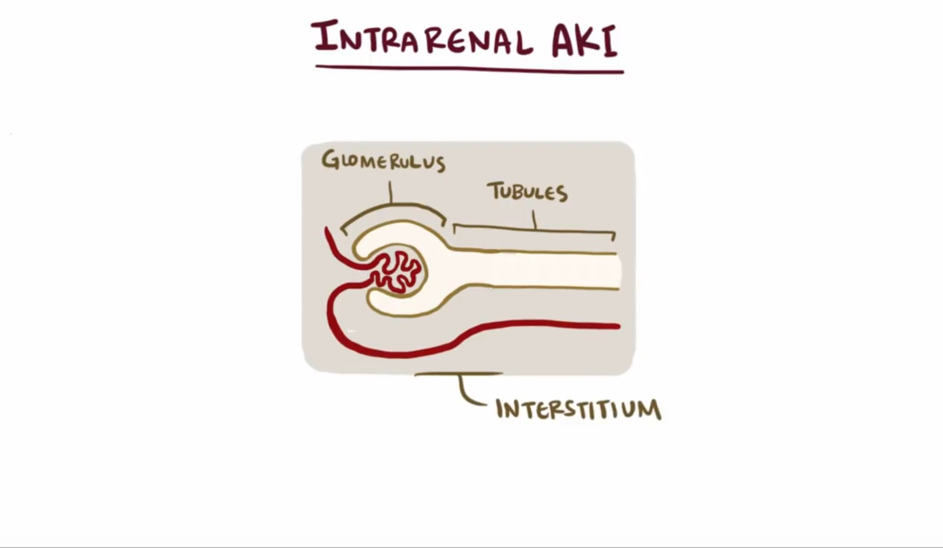

Slide 27
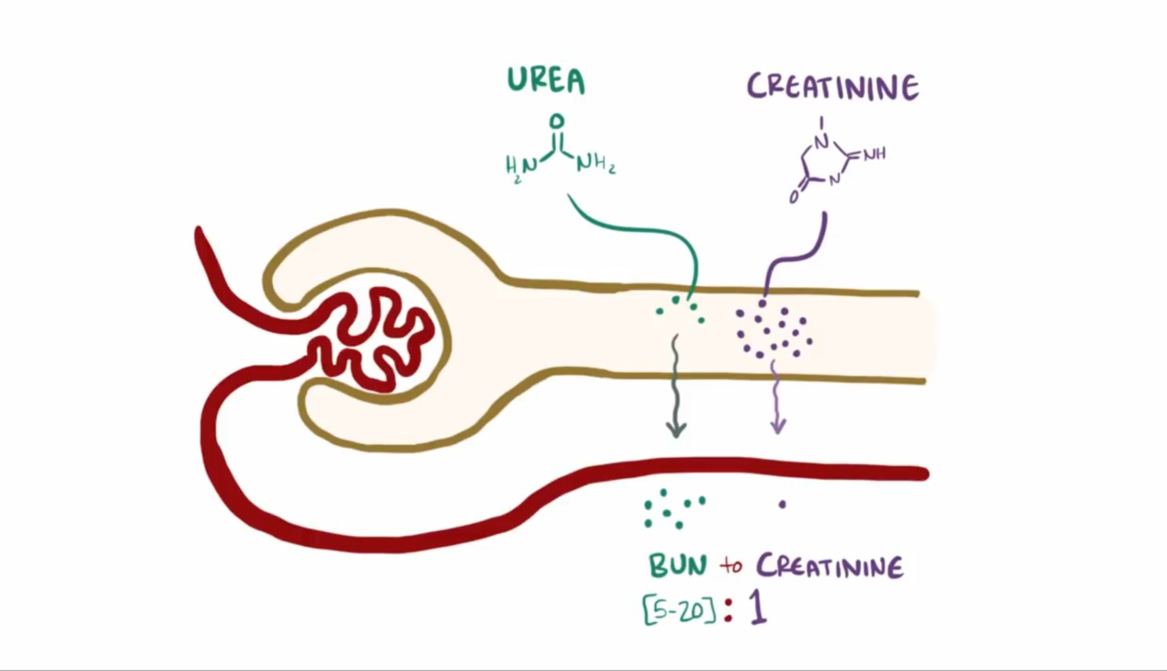

Slide 28
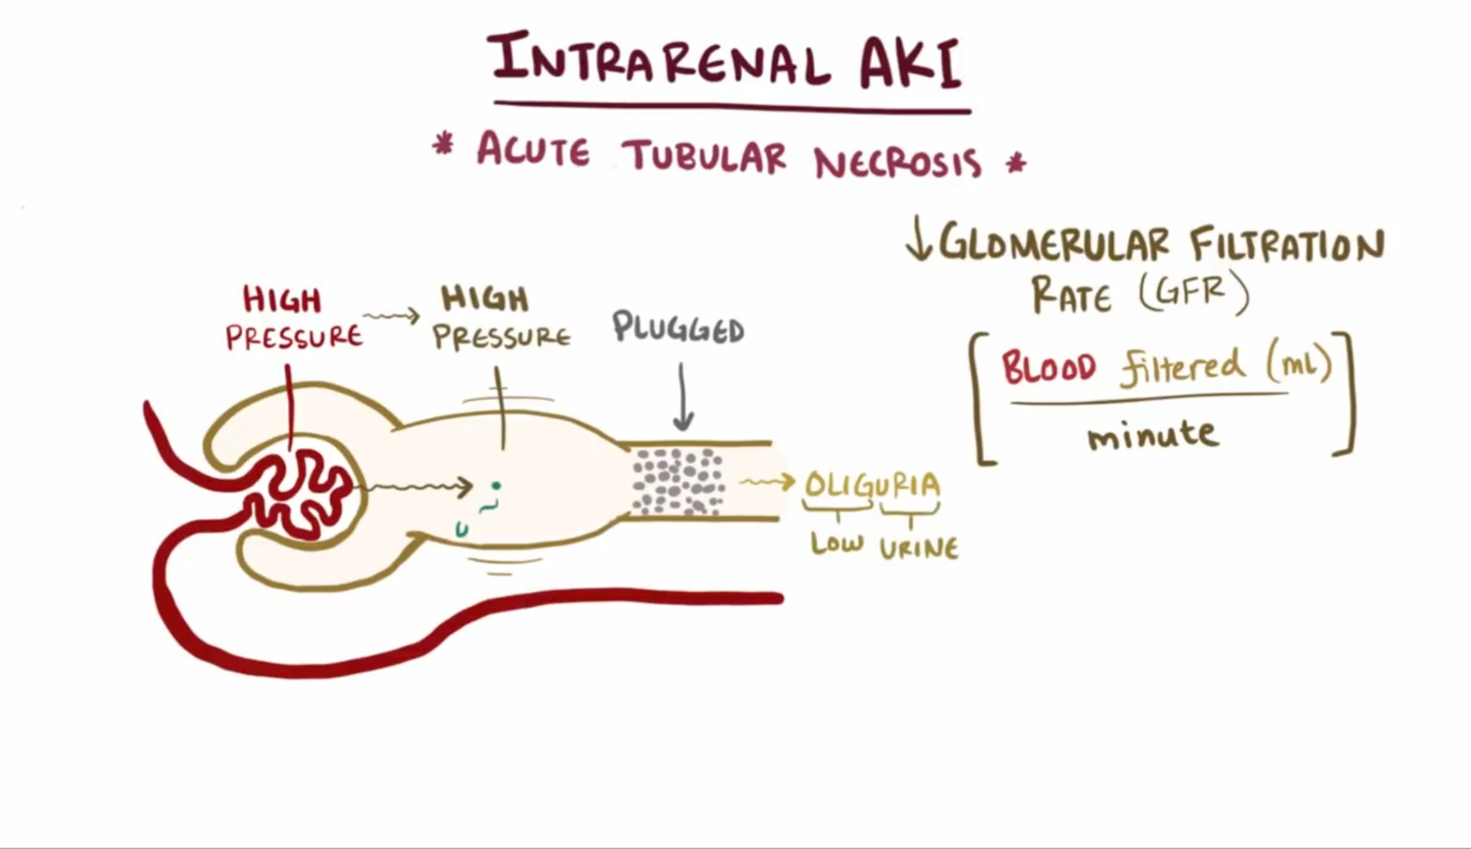

Slide 29
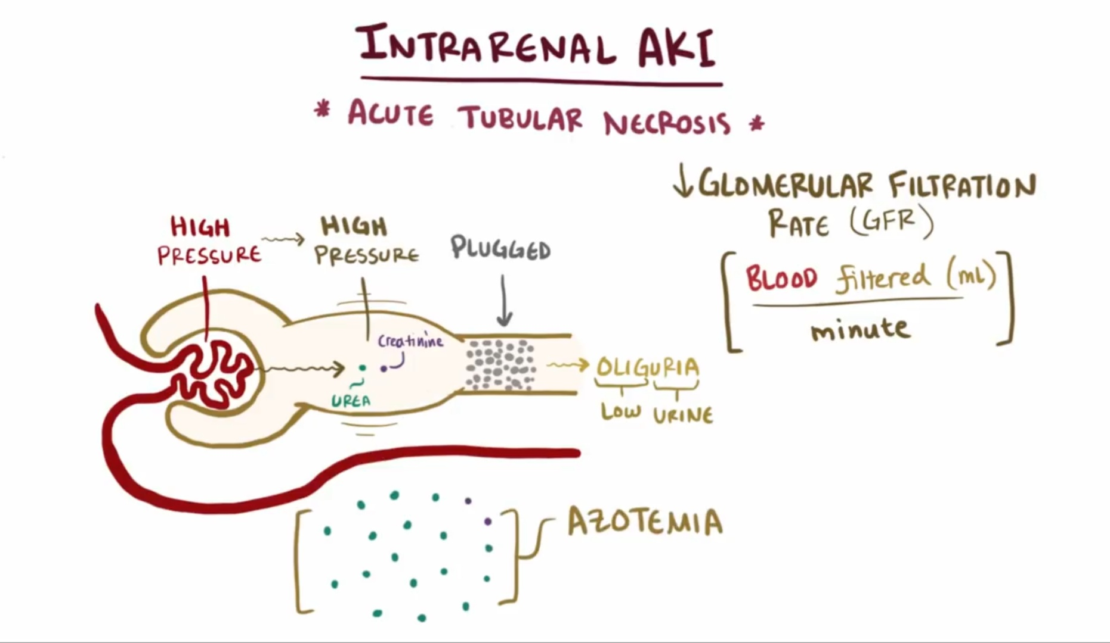

Slide 30
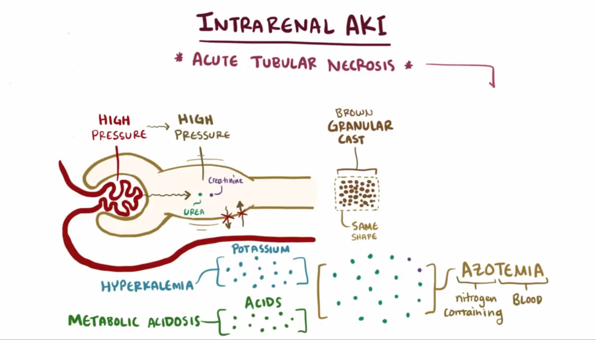

Slide 31
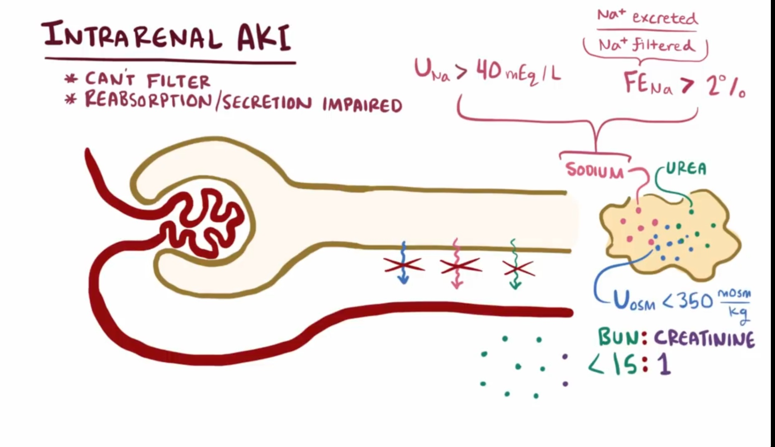

Slide 32
Large vessel occlusion
Renal artery stenosis
Atheroembolsim
In situ thrombosis
Vasculitis
Aortic dissection
Renal vein thrombosis

Slide 33
Emboli are cholesterol rich and Lodge in medium and small vessel arteries with a consequent eosinophil rich inflammatory reaction
Urine contains eosinophils and casts

Slide 34
Glomeruli- glomerulonephritis, vasculitis
Renal microvasculature- HUS, TTP, malignant hypertension

Slide 35
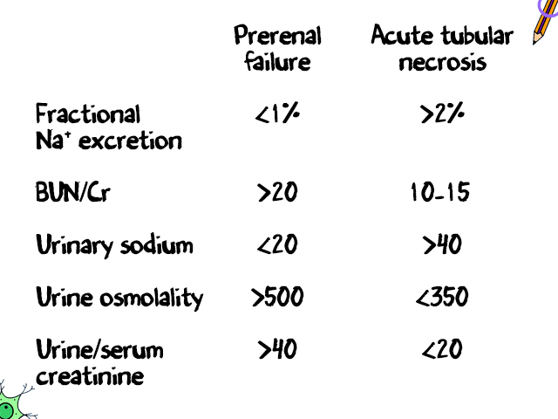

Slide 36
POST RENAL AZOTEMIA
Less than 5% of cases
Urethra, bladder outlet obstruction,bilateral ureteral obstruction
Diagnosed on USG
Ureteral obstruction- encasement by pelvic or periureteral tumors or retroperitoneal fibrosis

Slide 37
Oliguria and Anuria
24 hour urine output less than 400 ml
Anuria is the complete absence of urine formation ( less than 100 ml )
Causes - bl urinary tract obstruction,vascular catastrophe, renal vein thrombosis,acute cast nephropathy in myeloma,renal cortical necrosis,severe ATN,septic shock, hypovolemic or cardiogenic shock

Slide 38
