Slide 1
APPROACH TO APHASIA
Dr MONET PHILIPOSE

Slide 2
Aphasia is the loss or impairment of the production and / or comprehension of spoken or written language due to a lesion in brain.

Slide 3
The production and comprehension of words and sentences is dependent on the integrity of a distributed network located along the perisylvian region of the language dominant, usually the left cerebral hemisphere.

Slide 4
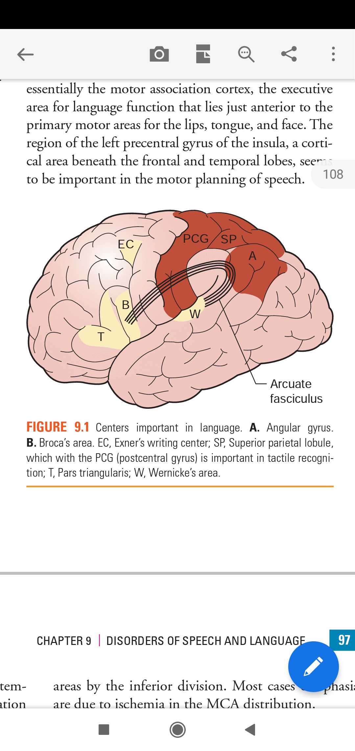

Slide 5
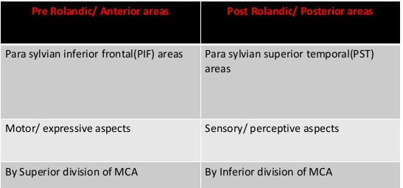
The central sulcus intersects the sylvian fissure near its posterior ramus.
The PIF language areas lie in front of the central sulcus in the frontal lobe
The PST areas lies posterior to central sulcus

Slide 6
BROADMANN AREAS FOR SPEECH
Broca’s area - situated in the inferior frontal gyrus ,
- needed for the fluency of verbal outputs and
grammatical structure of sentences.
Wernicke’s area - located at the superior temporal gyrus
- needed for the word and
sentence comprehension.
left precentral gyrus of insula – motor planning of speech

Slide 7
Arcuate fasciculus -
deep white matter tracts that arches from Wernicke’s area around the posterior end of the sylvian fissure to broca’s area.
Angular gyrus - part of inferior parietal lobule
- connects wernickes area and the visual cortex
- for reading and other non verbal language functions

Slide 8
Supramarginal gyrus - lies between visual cortex and the PST,
- involved in visual language functions
Exner’s center - lies in the middle frontal gyrus
- cortical area concerned with writing functions.

Slide 9
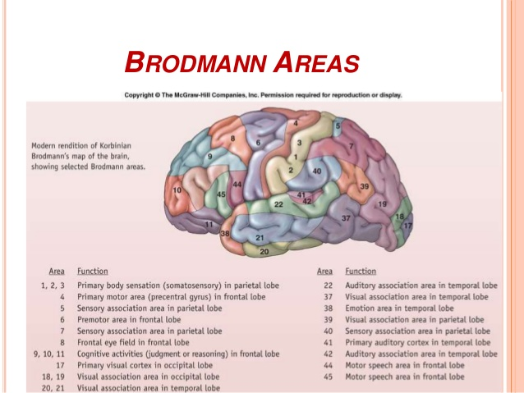

Slide 10
CLINICAL EXAMINATION
The clinical examination of language is done by the assessment of
naming
comprehension
repetition
reading
Writing
fluency of speech.

Slide 11
NAMING
Ask the patient to identify and name colors like red green blue
Check the ability to name body parts
The ability to name common objects in ward

Slide 12
COMPREHENSION
Comprehension can be examined by assessing the patient’s
ability to follow conversation ,giving sequence of commands
one step command like close your eyes
multistep command like close your eyes and point to the window ,
asking yes-no questions like is it a hospital or hotel
asking the patient to point approppriate objects or
by asking for verbal definitions of single words.

Slide 13
REPETITION
Repetition is assessed by asking the patient to repeat single words , short sentences or strings of words , with phrases in increasing complexity.
The testing of repetition with tongue twisters provides a better assessment of dysarthria and palilalia than of aphasia.

Slide 14
READING
Reading can be assessed for deficits in reading aloud as well as comprehension.
Patients are asked to read aloud from newspaper or from a list of words
Reading comprehension may be tested with written commands eg. Fold this paper into half and put it on the table
Confirm whether the patient is literate and check whether she/he
1) can read words /sentences/paragraphs
2)can comprehend what she/he is reading

Slide 15
WRITING
Assessed by
1) writing the letters and numbers to dictation
2) writing short sentences describing about his/her disease
3) copying a sentence

Slide 16
FLUENCY
Spontaneous speech is described as fluent if it maintains
The output volume
Phrase length
Melody of speech

Slide 17
Nonfluent speech has the following characteristics
Sparse output with a decreased number of words per minute,
usually utterance length below four words
Shortened phrases
Agrammatism characterized by omission or substitution of function words
-telegraphic speech
Effortfulness with hesitations and disruption of normal melodic rhythm
Breakdown of speech praxis - the ability to coordinate the articulatory movements required for comprehensible speech
tested by asking the patient to repeatedly pronounce the syllables ma/pa/ta and then to link the three together into a sequence

Slide 18
APHASIA SYNDROMES

Slide 19
ANOMIA
Anomia is the deficit in naming
When asked to name a common object ,the patient may fail to come up with the appropriate word
In one- way/retrieval based naming deficit - the patient cannot retrieve the appropriate object when shown an object but can point to the appropriate object when the name is provided by the examiner.
In two- way deficit /comprehension based /semantic naming deficit -the patient cannot provide or recognize the correct name.

Slide 20
BROCA’S APHASIA
Speech is nonfluent with sparse word output
Abnormal word order leads to agrammatism
Comprehension preserved
Naming impaired
Repetition impaired
Associated right facial weakness , hemiparesis/hemiplegia may be present
Cause is infarction of Broca’s area due to occlusion of the superior division of MCA

Slide 21
WERNICKE’S APHASIA
Fluent aphasia
Comprehension impaired
Speech is voluminous, but meaningless, contains paraphasic errors and neologisms often described as word salad
Naming impaired
Repetition impaired
Patient lost insight about his illness and can became agitated
Most commonly related to the lesion in inferior division of MCA.
Coexistent right hemianopia/superior quadrantopia may be present.

Slide 22
CONDUCTION APHASIA
Fluent aphasia
Comprehension preserved
Naming impaired
Repetition impaired
Lesion is in the arcuate fasciculus interconnecting the Brocas and Wernickes area

Slide 23
GLOBAL APHASIA
Deficits in all language functions
Comprehension ,Fluency ,Naming , Repetition will be lost
Associated with extensive peri sylvian injury affecting both Broca’s and Wernicke’s areas due to strokes affecting entire MCA distribution.
Patients are often mute or produce only nonword utterances
Patients generally have a right hemiparesis/hemisensory loss and right visual field deficit.

Slide 24
TRANSCORTICAL MOTOR APHASIA
Aphasia similar to Broca’s except that here the repetition is intact.
Nonfluent speech
Naming impaired
Comprehension preserved
Repetition preserved
The lesion site disconnects intact language network from prefrontal areas of brain and usually involves the anterior watershed zone between ACA and MCA

Slide 25
TRANSCORTICAL SENSORY APHASIA
Aphasia similar to Wernicke’s except that, here the repetition is intact
Fluent aphasia
Comprehension impaired with paraphasic errors
Naming impaired
Repetition is preserved
Patients can read aloud but without comprehension
Lesions can be in the posterior watershed zone or temporoparietal cortex posterior to the Wernicke’s area

Slide 26
TRANSCORTICAL MIXED APHASIA
Combination of two transcortical aphasias
Nonfluent aphasia
Comprehension lost
Naming lost
Repetition preserved
Seen in lesions to the frontal,parietal,temporal cortex ,associated with anoxia,carbon monoxide poisoning,complete watershed zone infarctions.

Slide 27
ANOMIC APHASIA
Patients with anomic aphasia cannot name or write the word for a particular item/object
Sentence comprehension ,fluency , repetition is intact
Seen in head trauma ,metabolic encephalopathy , Alzheimer’s disease.

Slide 28
APHASIA RELATED DISORDERS

Slide 29
PURE WORD DEAFNESS
There is interruption of flow of information from auditory association area to language network
Patients can comprehend written language, but not spoken language.
Spontaneous speech is preserved
Patient cannot repeat spoken language
The most common cause are either bilateral or left sided MCA strokes affecting the superior temporal gyrus

Slide 30
PURE WORD MUTISM
Deficits in the production of oral speech with retention of auditory comprehension as well as the ability to write and read

Slide 31
ALEXIA WITHOUT AGRAPHIA
Visual equivalent of pure word deafness
Interruption in the flow of visual input to language network
Patient can understand and produce spoken language,name objects,repeat and write, but cannot read
Lesion in left occipital cortex,angular gyrus, and splenium of corpus callosum

Slide 32
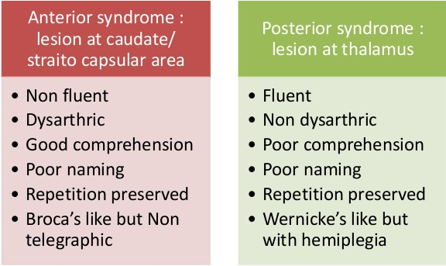
SUBCORTICAL APHASIA
Damage to subcortical components of language network like thalamus,striatum,periventricular white matter or internal capsule of the language dominant hemisphere - also can lead to aphasia.

Slide 33
PRIMARY PROGRESSIVE APHASIA (PPA) can be caused by FTLD,Alzheimers disease and rarely in Creutzfeldt Jacob disease (CJD)
Aphasia caused by neurodegenerative diseases have an insidious onset and relentless progression.

Slide 34
AGRAMMATIC PPA
The language impairments in agrammatic PPA includes
Low fluency
Impaired grammar with intact word comprehension
Resembles Broca’s aphasia but usually lacks hemiparesis.
The neuropathology is FTLD with taupathy with neuronal loss in the inferior frontal gyrus.

Slide 35
SEMANTIC PPA
The semantic variant is characterized by
Preserved fluency and syntax
Impaired single word comprehension
Anomia
Comprehension of sentences is relatively preserved.
Differs from Wernicke’s aphasia because speech is usually informative and the repetition is intact.
The neuropathology is FTLD with neuronal losses in anterior temporal lobe

Slide 36
LOGOPENIC PPA
The logopenic variant is characterized by
Preserved syntax and word comprehension
Anomia ,word finding pauses ,circumlocutions , impaired repetition
Interruption of fluency is variable
Resembles anomic aphasia ,but with frequent word finding pauses.
Most commonly associated with AD.

Slide 37
THANK YOU

