Slide 1
CLINICAL CLUB M2
SKIN TO BONE !
DR AMRITA KURIAN
JUNIOR RESIDENT

Slide 2
TABLE OF CONTENTS
01
04
02
05
03
HISTORY
INVESTIGATIONS AND FINAL DIAGNOSIS
EXAMINATION
MANAGEMENT
06
CLINICAL DIAGNOSIS
DISCUSSION

Slide 3
HISTORY
PRESENTING COMPLAINTS
55/M
DOA : 31/01/23
Slurring of speech x 7 days
Weakness of all 4 limbs x 3 days

Slide 4
HISTORY OF PRESENT ILLNESS
Admitted at a private hospital 8 days ago (23/01/23) with right lower limb cellulitis
H/o slurring of speech during the course of admission
Nasal intonation and a breathy quality to voice but the speech was comprehensible
No h/o dysphagia or nasal regurgitation
No h/o deviation of angle of mouth or drooling of saliva from the corner of mouth
Managed with IV antibiotics and discharged on Day 5.

Slide 5
AT HOME….
The following night he developed acute onset symmetrical weakness of both upper limbs.
Started distally in each limb, progressed rapidly (over minutes) to involve the proximal limb
Overnight, the weakness extended to both lower limbs in the same manner
Needs support to get up from bed and to walk.
Unable to hold a glass of water or wipe his own face
c/o pins and needles sensation over both upper limbs till shoulders and over lower limbs till thighs – circumferential pattern
Difficulty in rolling over on his bed
Day 1 of weakness
Day 1 of weakness
Day 2 of weakness

Slide 6
HISTORY OF PRESENT ILLNESS
Progressive worsening of slurring of speech over the next 3 days
Constant hawking sensation in throat with difficulty in swallowing his saliva but able to take solid feeds.
No odynophagia
c/o breathlessness with wife mentioning effortful breathing.
Breathlessness not relieved on making him sit upright.
Neck pain – aching type – extending to the occiput and upper back. Severe, poorly localised pain aggravated by neck movements. No throbbing/thunderclap quality.
Difficulty in lifting his limbs off the bed : BED BOUND Electric shock like sensation travelling down both upper limbs
Day 2 of weakness
Day 3 of weakness

Slide 7
Negative history
No h/o burning paresthesias or inability to appreciate warmth /cold
No h/s/o Lhermittes sign or girdle like sensation
No h/o paresthesias over face.
No h/o drooping of eyelids/diplopia.
No h/o vertigo, tinnitus or oscillopsia.

Slide 8
Negative history
No h/o fluctuation in the level of weakness over the day
No h/o vomiting, altered sensorium or seizures
No bowel or bladder symptoms
No h/o fever

Slide 9
PAST HISTORY
Diabetic x 4 years on OHA, poorly controlled
Ethanol related non decompensated CLD – cirrhosis x 4 years
Lumbar spondylosis x 2 years
Right knee septic arthritis in September 2022 S/P arthroscopy, using a walking stick thereafter
No history suggestive of rheumatoid arthritis

Slide 10
Family history
Personal history
Addictions
None significant
Mixed diet
Decreased sleep and appetite
Normal bowel and bladder habits
Reformed smoker and alcoholic x 4 years

Slide 11
SUMMARY
55/M with poorly controlled diabetes, alcohol related cirrhosis and lumbar spondylosis, a reformed smoker and alcoholic…..
Admitted with flaccid dysarthria, minimal dysphagia and acute onset rapidly progressive quadriparesis with paresthesias of the involved limbs with no bowel or bladder involvement

Slide 12
Continued….
Associated with neck pain extending to occiput and upper back
No h/o altered sensorium or symptoms of raised ICT
Associated breathlessness x 3 days
In the background of an acute infection (cellulitis)

Slide 13
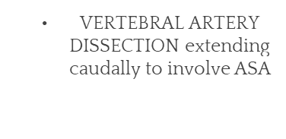
DIFFERENTIALS
HIGH CERVICAL (prob compressive) MYELOPATHY with involvement of LOWER CRANIAL NERVES
ACUTE DISSEMINATED ENCEPHALOMYELITIS
BRAINSTEM ENCEPHALITIS

Slide 14
DIFFERENTIALS
Less likely differentials
SUDDEN DECOMPENSATION OF A PRE EXISTING CVJ ANOMALY
B/L ACA and MCA TERRITORY WATERSHED INFARCT
Large medial medullary stroke compressing the contralateral pyramidal tract
HEMORRHAGE INTO A MEDULLARY TUMOR

Slide 15
GENERAL EXAMINATION
No pallor or cyanosis
Muddy sclera, icterus +
Parotid enlargement
Conscious , oriented
No neck swelling/cervical lymphadenopathy
Moderately built and moderately nourished
White nails, no clubbing
BMI :26.8 kg/m²
Mild tenderness over the posterior aspect of neck , no swelling
Painless gynaecomastia
Pulse rate : 80/mt
Distended abdomen
Bp: 150/90 mm hg
No axillary/ inguinal lymphadenopathy
Respiratory rate : 24/mt SBC :12
Right leg edema (upto knee) with redness and warmth
Temp : 98.8 f
Vital signs
Edema left ankle with hyperpigmentation and hyperkeratosis of the whole foot

Slide 16
SYSTEMIC EXAMINATION
NERVOUS SYSTEM
HIGHER MENTAL FUNCTIONS
Memory : normal
Speech : flaccid dysarthria
Right handed
No hallucinations
Conscious ,oriented
Appears unwell, normal behaviour
Normal attention and concentration

Slide 17
NERVOUS SYSTEM
CRANIAL NERVES
CN I to VII : normal
Jaw jerk : absent
CN XII:
No fasciculations
Deviation to left on protrusion
Slightly deviated to right within the mouth
CN IX and X
Palatal movements decreased on right
Absent gag reflex (R)
CN XI couldn’t be tested

Slide 18
MOTOR SYSTEM
 | RIGHT | LEFT
UPPER LIMB | 2+ | 2+
LOWER LIMB | 3- | 3-
Bulk : normal except for wasting of 1st dorsal interossei bilaterally
Tone :normal
Power:
Deep tendon reflexes : 3+ in all four limbs with positive pectoral and trapezius reflex

Slide 19
MOTOR SYSTEM
Superficial reflexes:
  Conjunctival reflex :present, corneal reflex : absent
  Superficial abdominal reflex: absent in all quadrants
  Plantar reflex : mute bilaterally
Tests for coordination: couldn’t be assessed
No involuntary movements
Gait : couldn’t be assessed

Slide 20
SENSORY SYSTEM
Superficial sensations:
  Light touch :
    Lower limbs : impaired upto L1 bilaterally
    Upper limbs : impaired upto the base of neck (C 3) but preserved over the thoracic dermatomes
  Vibration: impaired upto ASIS and acromion b/l, appreciated over sternum
  Joint sense: impaired over toes, preserved elsewhere
  Pain and temperature: normal
Cortical sensations: not tested

Slide 21
SKULL AND SPINE
Tenderness over the whole of back of neck including C spine
No obvious deformity of the spine, no gibbus.
No thoracic spine tenderness
Mild lower lumbar spine tenderness
Signs of meningeal irritation not tested in view of the severe neck pain Kerning’s sign : absent

Slide 22


OTHER SYSTEMS
Apex beat in 5th left ICS, normal character.
S1 and S2 heard normally , no S3/S4/Murmurs/ clicks/ pericardial rub
SBC: 12
No visible deformity of chest
Air entry present in all areas, normal breath sounds, no ALS
Abdomen distended,
Soft and non tender
No hepatosplenomegaly
Shifting dullness not done, no fluid thrill

Slide 23
Musculoskeletal system
C- spine and paraspinal tenderness
No signs pointing to rheumatoid arthritis
R knee tenderness with positive patellar tap
Painful restriction of neck movements Height to neck length < 13.5
Erythema, warmth, tenderness and swelling of right leg Right knee semiflexed

Slide 24
DIFFERENTIALS
HIGH CERVICAL COMPRESSIVE MYELOPATHY
  Reflex level : above C4
  Sensory level : above C3
  Since corneal reflex absent : above C2
ADEM (less likely)

Slide 25
COURSE IN HOSPITAL

Slide 26
INVESTIGATIONS
31/1/23 | TC | DC | Hb | platelets | ESR | RBS
 | 14000 | N 77 L 13.6 | 13.5 | 1.43 L | 95 | 163
 | RFT | Na/K | Bil | TP/albumin | SGOT,SGPT/ALP | PT/ INR
 | 34/0.9 | 132/4.4 | 3.6 | 6.8/2.6 | 77/42/104 | 16/1.24
OUTSIDE INVESTIGATIONS (24/1/23)
BLOOD CULTURE: GROUP B BETA HEMOLYTIC STREPTOCOCCI
CRP: 245 ( <8)

Slide 27
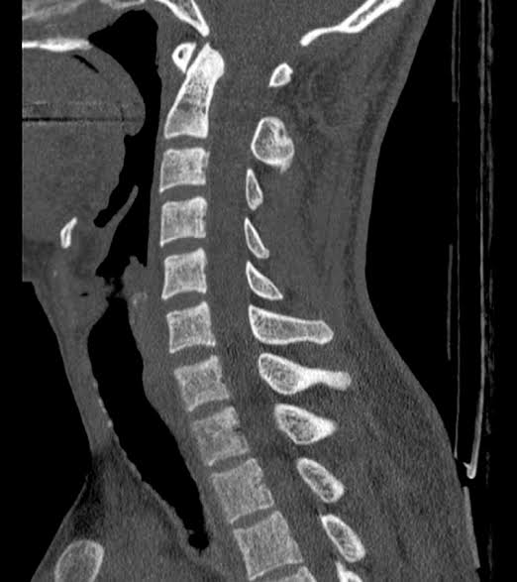
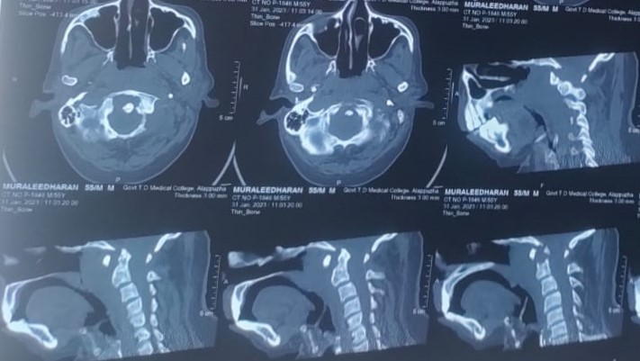
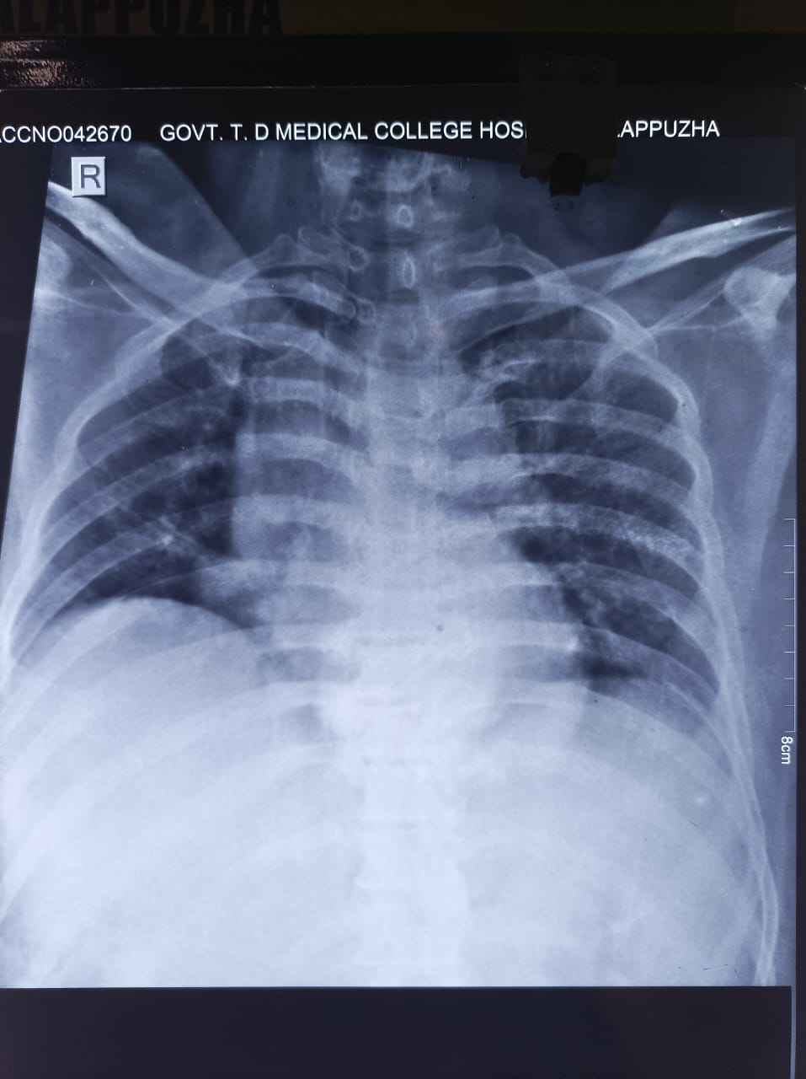
IMAGING
CT cervical spine
Normal
Case

Slide 28
Admission day
Cervical spine stabilisation with hard collar
NCCT Brain with C spine : soft tissue density around odontoid process extending into prevertebral and retropharyngeal area with lytic lesion and cortical defect of odontoid process
Initiated on antibiotics (Ceftriaxone)
Features of cervical cord compression - pulse dose of methylprednisolone administered after discussion with senior faculty
Low single breath count : shifted to ICU

Slide 29
Post admission day
Emergency MRI Brain + C spine + WSS :
Marrow edema with increased post contrast enhancement in C1 and C2 vertebrae with osteolytic changes within.
Joint effusion atlantoaxial and atlanto occipital joints
Prevertebral and paravertebral soft tissue edema with increased enhancement at C1/C2 level
Prevertebral soft tissue collection extending from C1 to C5 with max thickness of 15mm at C2 level compromising the nasopharyngeal airway

Slide 30
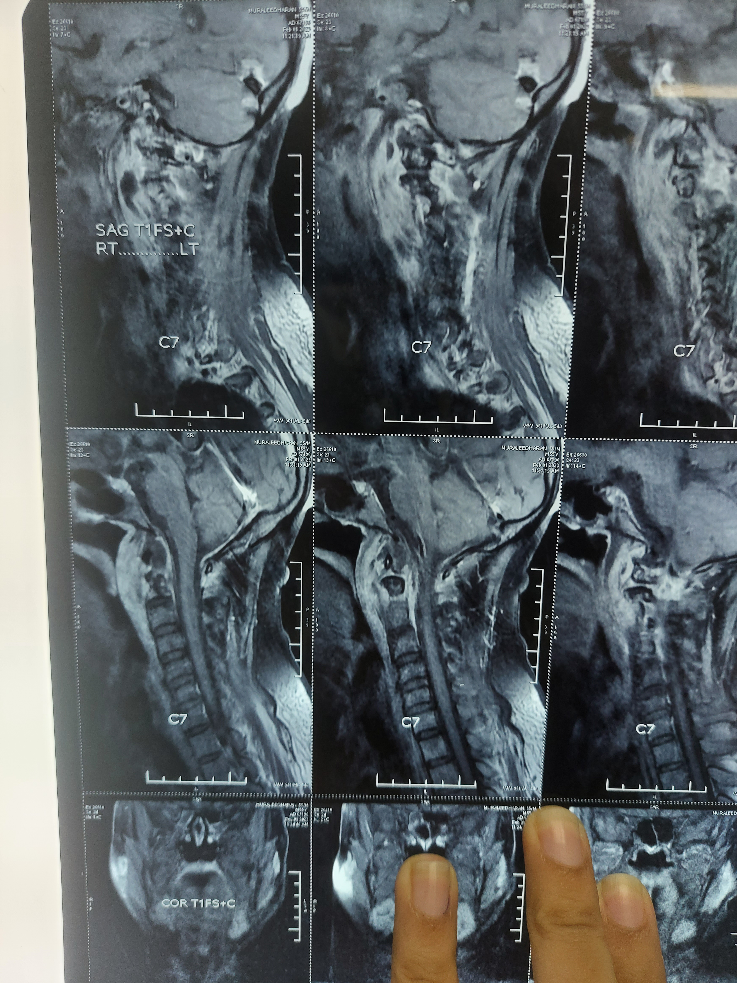
MRI CERVICAL SPINE

Slide 31
COURSE IN THE ICU
Cardiology consult : ECHO revealed normal valves, no evidence of infective endocarditis
Antibiotics hiked to CEFTAZIDIME and TEICOPLANIN
Neurosurgery opinion :
Conservative management since no imaging evidence of spinal canal narrowing
Orthopedics consult to rule out septic arthritis : USG knee showed joint effusion
ENT consult to look for evidence of otitis externa /media : NAD

Slide 32
INVESTIGATIONS (Day 3 to 7)
CRP : 30 (nl <6)
Viral markers : negative
Tumor markers (CEA, AFP, CA 19-9, PSA, calcitonin) : negative
Repeat blood culture : sterile
Right knee effusion : aspiration attempted – failed due to minimal collection

Slide 33
Course In Ward
Shifted to ward after 7 days of ICU stay with a plan to continue antibiotics for 6 weeks
Mantoux test : negative
RA factor, Anti CCP : negative
CECT Thorax + Abdomen :
  Right mild pleural effusion, eventeration of right hemidiaphragm
  Chronic liver disease with portal hypertension and moderate ascites (managed with diuretics , IV albumin)
Repeat CRP : 17.

Slide 34
status
Patient improving
Power grade 4+ in all 4 limbs
DVT prophylaxis
Rehabilitation in consult with PMR

Slide 35
Pancytopenia !
Until …
Possibilities?
Sepsis
CLD
Drug induced
HLH
Other side effects of Teicoplanin
Altered liver and renal function
Skin : rashes,pruritus
Thrombophlebitis
Drug fever
TEICOPLANIN STOPPED on Day 38
CYTOPENIA IMPROVED

Slide 36
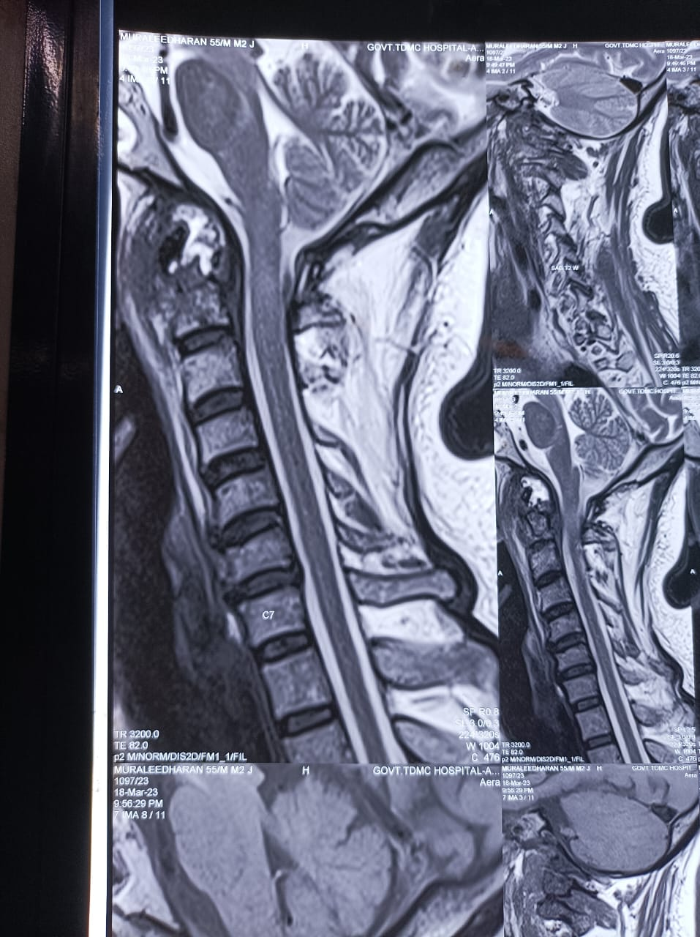
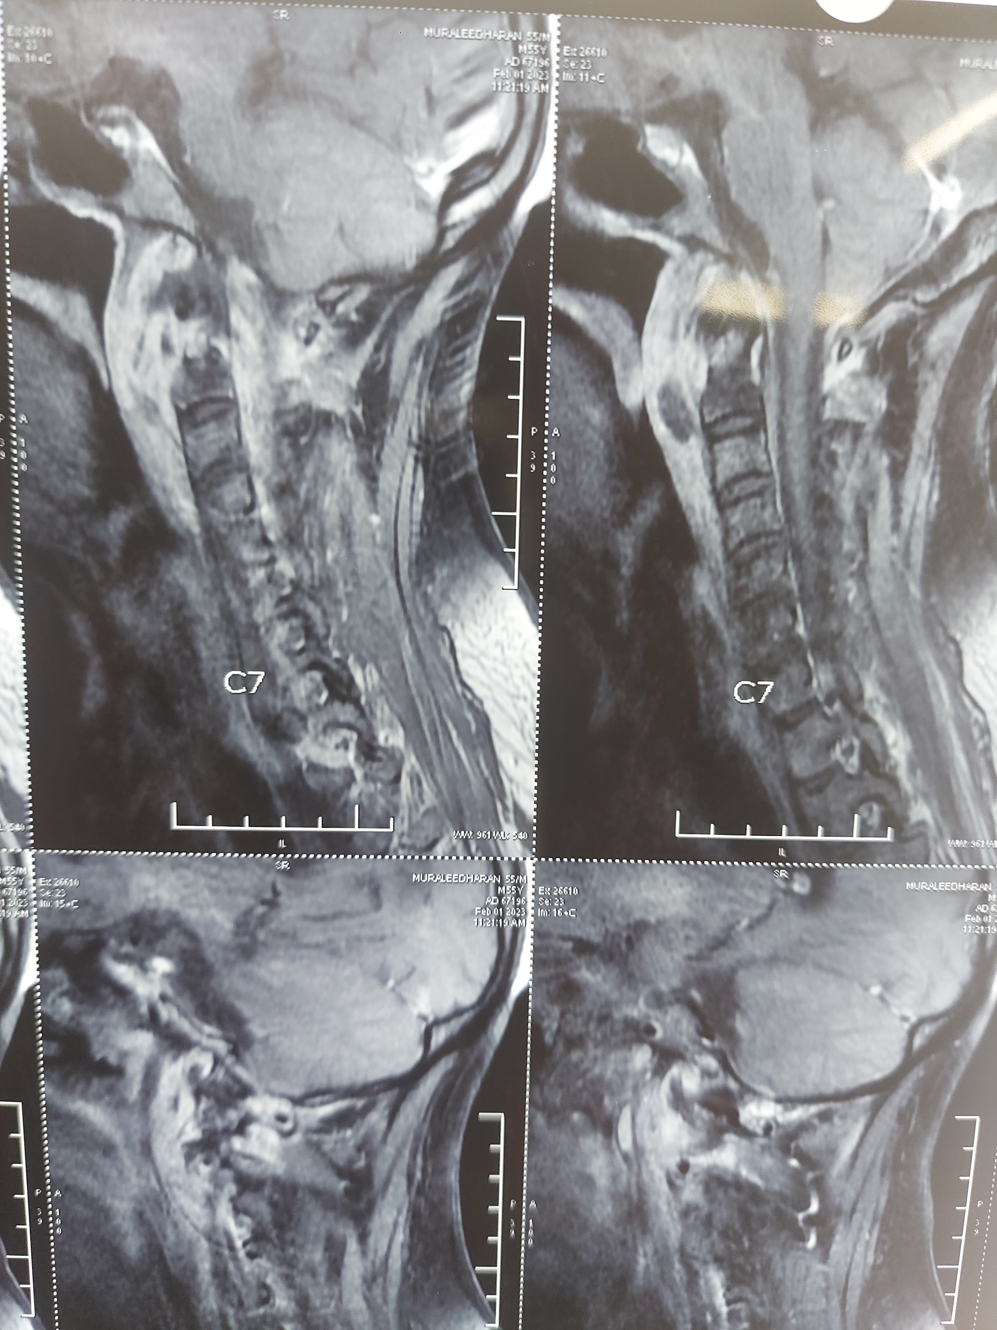
REPEAT MRI on Day 45 – decrease in thickness of collection to 3.3 mm
BEFORE
AFTER

Slide 37
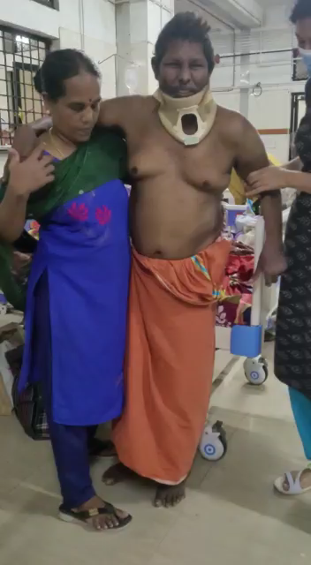
And….

Slide 38
CONCLUSIONS
FINAL DIAGNOSIS
DISABILITY:
Acute spastic quadriparesis with right palatal palsy and left hypoglossal palsy
ANATOMY AND PATHOLOGY:
High cervical extramedullary extradural compressive myelopathy with involvement of lower cranial nerves
ETIOLOGY:
Prevertebral abscess extending from C1-C5 with C1-C2 osteomyelitis secondary to bacterial sepsis
Primary focus of infection – Right Lower Limb Cellulitis
RISK FACTORS : Immunocompromised state ( poorly controlled Diabetes and CLD)

Slide 39
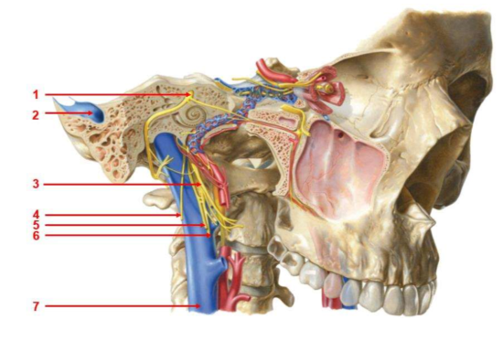

Slide 40
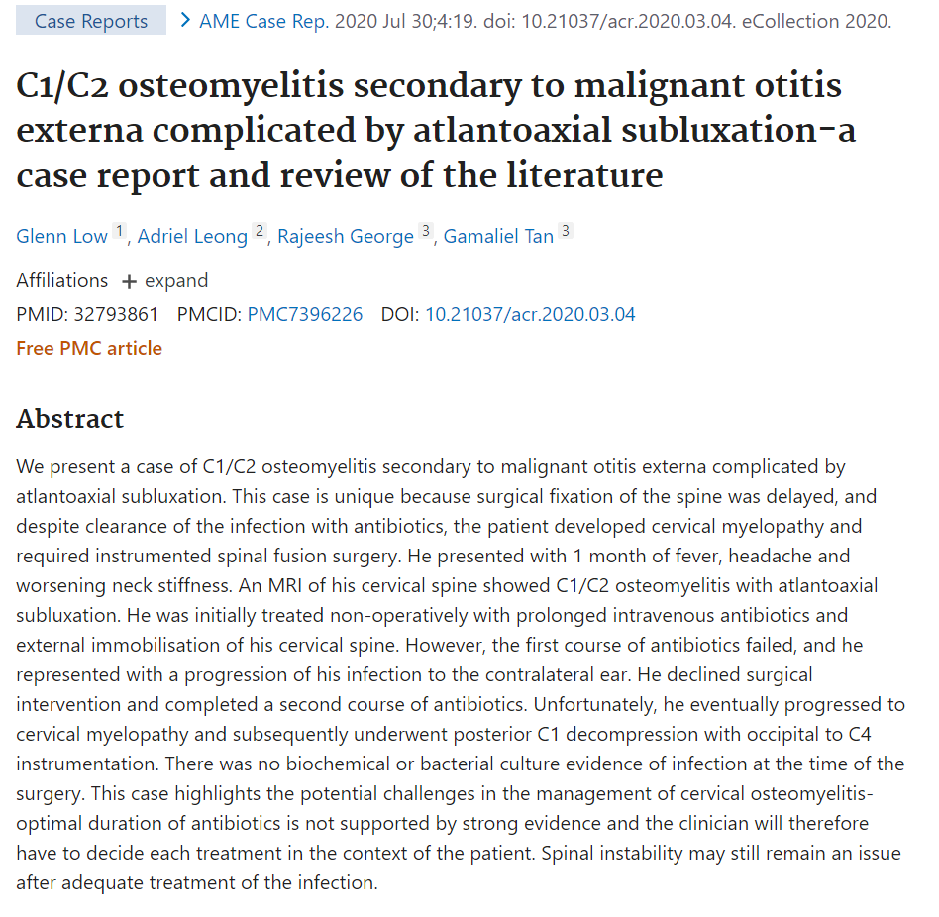
OVER THE GLOBE

Slide 41
THANK YOU

