Slide 1

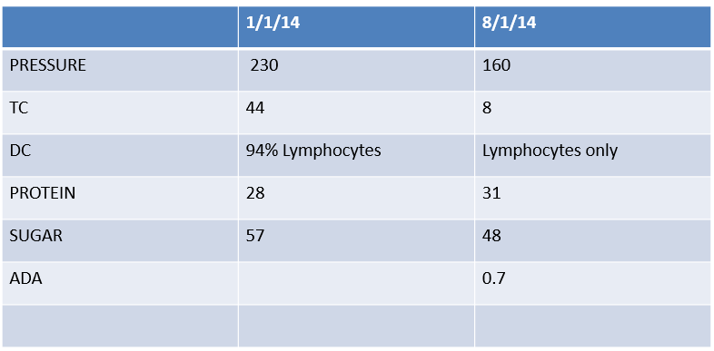
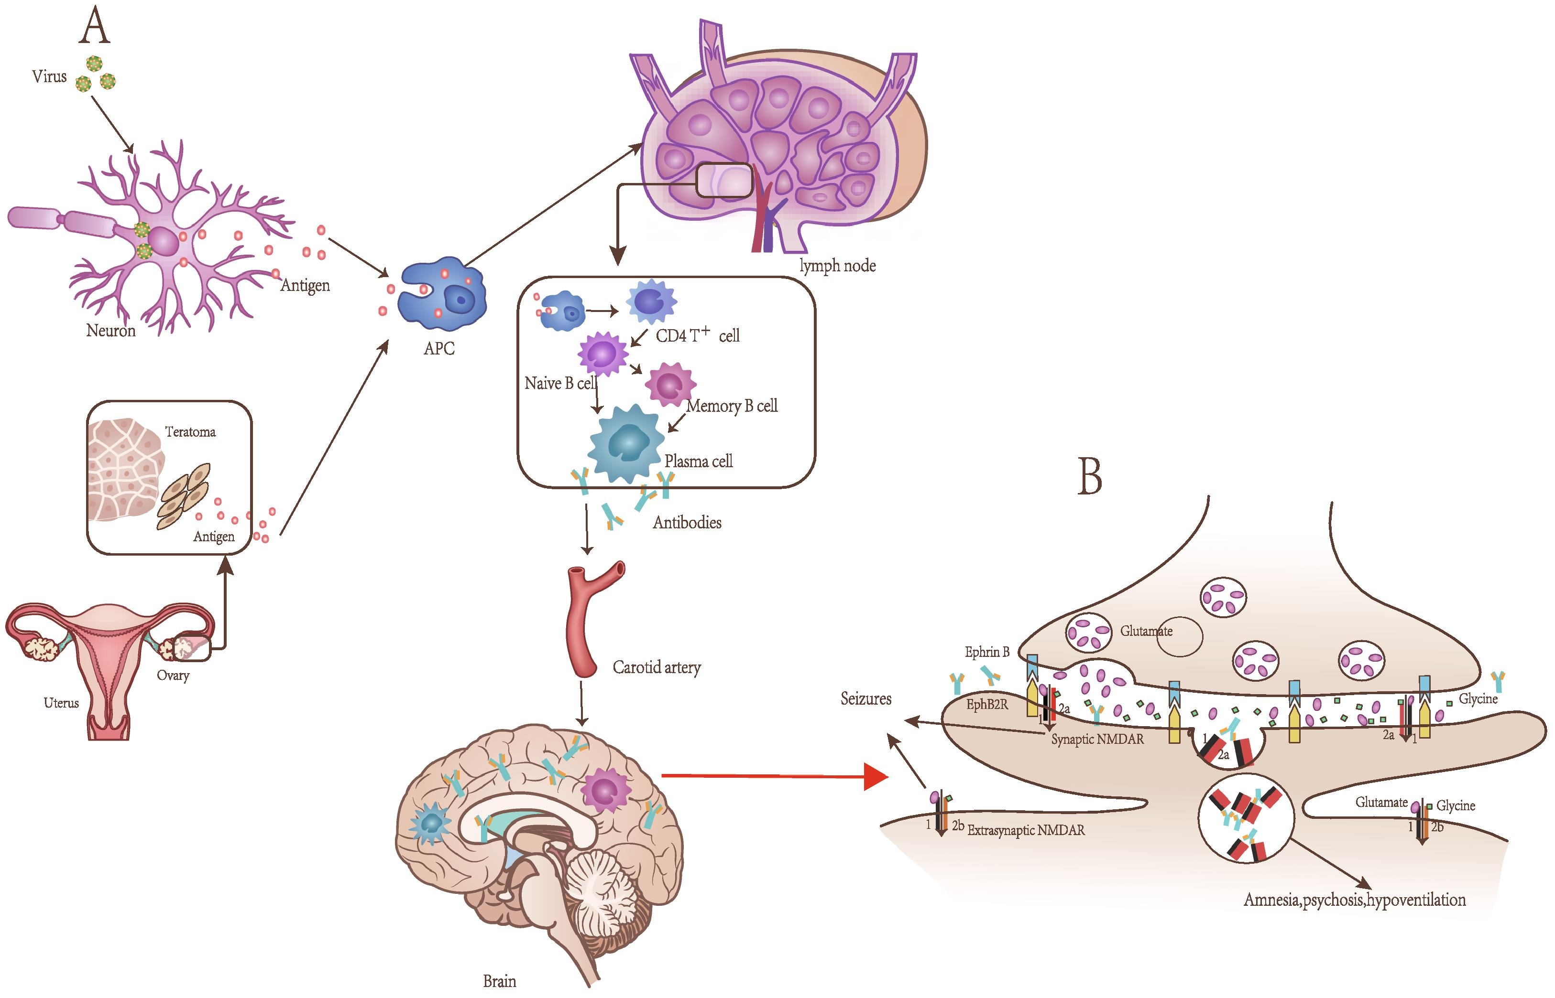
INTERNAL MEDICINE UPDATE 2022
A Brain on Fire:
Autoimmune Encephalitis
Aishwarya Ramesh, House Surgeon, Calicut Medical College
ABSTRACT
By day 5 , she became conscious and oriented . Her orofacial dyskinesias reduced but did not completely disappear . She was evaluated for any ovarian tumors but none was detected .
a viral-like process, followed by a multistage progression of symptoms that include prominent psychiatric manifestations (anxiety, agitation, bizarre behaviour, hallucinations, delusions, disorganised thinking, psychosis), sleep disorders, memory deficits, seizures, decreased levels of consciousness, dyskinesias (orofacial, choreoathetoid movements, dystonia, etc), autonomic instability and language dysfunction). Diagnosis is challenging given the overlap of symptoms with various neuroinfections and pschiatric disorders .
Our patient’s presentation and progression was consistent with that of an autoimmune encephalitis. However, hindsight is always 20/20. Being a relatively rare condition, it may not be included in the list of differentials. Failure of clinical improvement after initiation of antibiotics , promptly allowed us to discard an infective etiology. Imaging and EEG did not prove useful in our case .
Early identification, immunotherapy, and malignancy workup are the mainstays of management . Delay in managemtent is dangerous as approximately 1 in 4 patients end up with debilitating neuropsychiatric dysfunction or death . Clinicians, at the very least, should entertain this diagnosis in patients with acute neuropsychiatric deterioration , CSF with lymphocytic pleiocytosis, and an otherwise unrevealing cranial imaging and metabolic testing .
Autoimmune encephalitis refers to a wide clinical spectrum of immune mediated encephalitis syndromes ranging from typical limbic encephalitis to syndromes with complex neuropsychiatric symptoms . These are associated with antibodies to neuronal cell surface proteins . Due to its varied clinical presentation , diagnosis remains rather challenging and often requires a high degree of clinical suspicion. We report the case of a 13 year old female with no significant past history who presented to our centre with clinical features of encephalitis. Imaging and immunological studies were consistent with autoimmune encephalitis , after which we saw clinical improvement with immune-modulating therapy. It is essential to highlight the importance of considering the possibility of autoimmune etiology in the differential diagnosis of patients presenting with clinical and imaging results suggestive of encephalitis with predominant neuropsychiatric features . It is fatal if not treated early . It responds dramatically to immune mediated therapies .
INVESTIGATIONS & MANAGEMENT
Intravenous immunoglobulin for 5 days
Anti epileptic agents
Anti pyretic agents for fever
CASE REPORT
A 13 year old female presented to our centre with high grade fever, persistent vomiting , an episode of generalised tonic clonic seizure and altered behaviour . Her vital signs were within normal limits . She was drowsy . Neurological examination revealed abnormal orofacial movements . CSF study revealed lymphocytic pleocytosis with normal protein and sugar . Her blood routines were normal . A diagnosis of encephalitis was considered which was confirmed by brain imaging .She was started on intravenous acyclovir and doxycycline . Despite treatment , her sensorium did not improve and she developed status epilepticus . Lack of clinical improvement prompted the search for an alternate cause for encephalitis. EEG was inconclusive . CSF viral panel and cultures were negative . Possibility of an autoimmune aetiology was finally raised . CSF was repeated and sent for IgG antibodies to the NR1 subunit of the NMDA receptor which tested positive . She was immediately started on intravenous immunoglobulin . She experienced improvement on day 2 of treatment with IVIg . She had no further seizures .
REFERENCES
1. Bhat, P., Ahmed, A., Jolepalem, P., & Sittambalam, C. (2018). A case report: anti-NMDA receptor encephalitis. Journal of community hospital internal medicine perspectives, 8(3), 158–160.
2. Barry H, Byrne S, Barrett E, et al. Anti-N-methyl-d-aspartate receptor encephalitis: review of clinical presentation, diagnosis and treatment. BJPsych Bull. 2015;39(1):19–23.
3.www.uptodate.com
DISCUSSION
Anti-NMDAR encephalitis was first reported in 2005 and was named for the first time in 2007. It is an increasingly recognized, potentially lethal syndrome of psychiatric and neuromotor dysfunction in patients, often younger in age, who have an underlying neoplasm. Most cases follow a typical prodrome of headache, fever, or
Notes:
1

