Slide 1
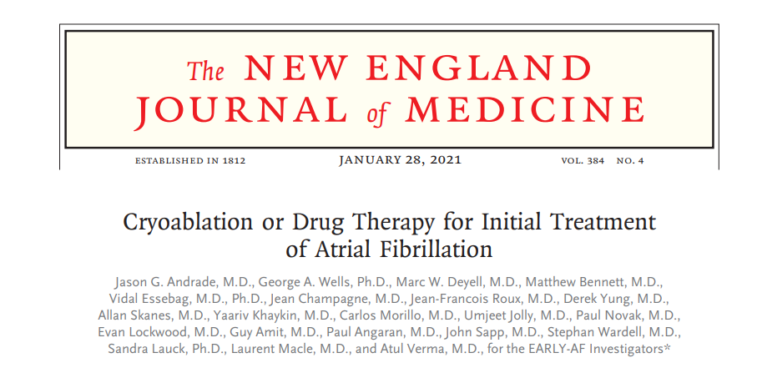
DR KRISHNANUNNI G
JR1

Slide 2
DESIGN: In a follow-up analysis of the multicenter, randomized EARLY-AF trial involving patients with paroxysmal atrial fibrillation, the proportion of patients with progression to persistent atrial fibrillation after cryoablation was compared with that after the receipt of antiarrhythmic drug therapy.
INTERVENTION: 303 patients who had undergone ablation or received antiarrhythmic drug therapy were followed for at least 3 years; an implantable continuous cardiac rhythm monitor was used to detect atrial fibrillation events. Data regarding the first episode of persistent atrial fibrillation and recurrent atrial tachyarrhythmia were collected

Slide 3
EFFICACY: During 3 years of follow-up, the incidence of persistent atrial fibrillation or recurrent atrial tachyarrhythmias was lower in the ablation group than in the antiarrhythmic drug group
SAFETY: During follow-up, adverse events, including cardiac events and stroke, were less common in the ablation group than in the antiarrhythmic drug group
CONCLUSIONS: Patients with paroxysmal atrial fibrillation treated with cryoablation had a lower incidence of persistent atrial fibrillation or recurrent atrial tachyarrhythmias during 3 years of follow-up than those who had been treated with antiarrhythmic drugs.

Slide 4
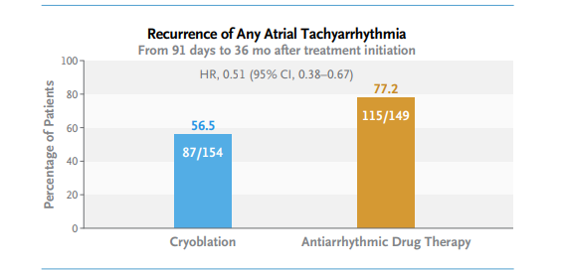
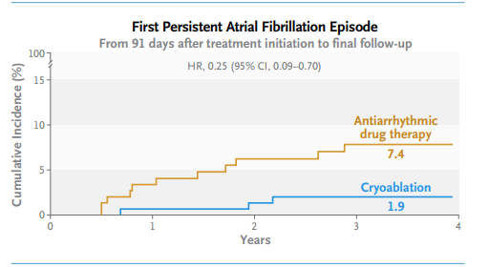

Slide 5
ATRIAL FIBRILLATION
MOST COMMON SUSTAINED CARDIAC ARRYTHMIA AFTER SINUS TACHY
CHAOTIC,DISORGANISED ,INEFFECTIVE CONTRACTION
STASIS OF BLOOD-EMBOLISM-STROKE RISK HIGH
NARROW QRS TACHY, HR>100, IRREGULAR RR, NO IDENTIFIABLE MORPHOLOGICALLY NORMAL P WAVE
ATRIAL RATE 300-600,IMPULSE ORGINATE SOMEWHERE NEAR PULMONARY VEINS

Slide 6
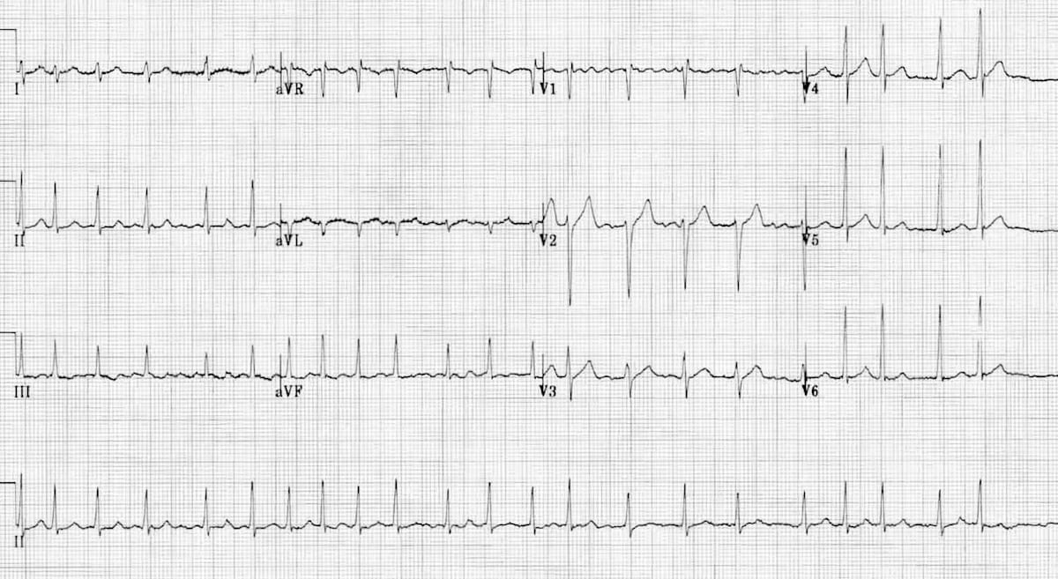

Slide 7
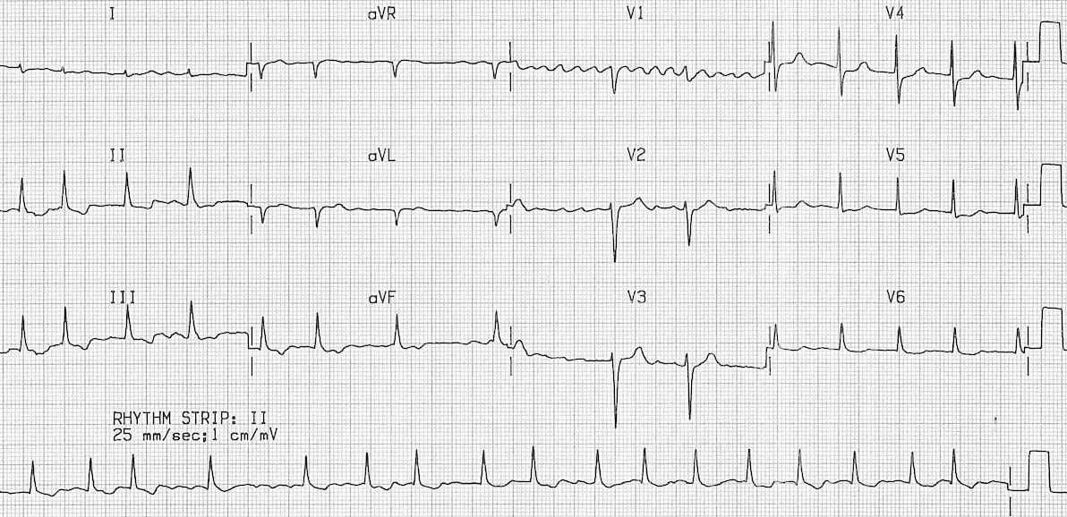

Slide 8
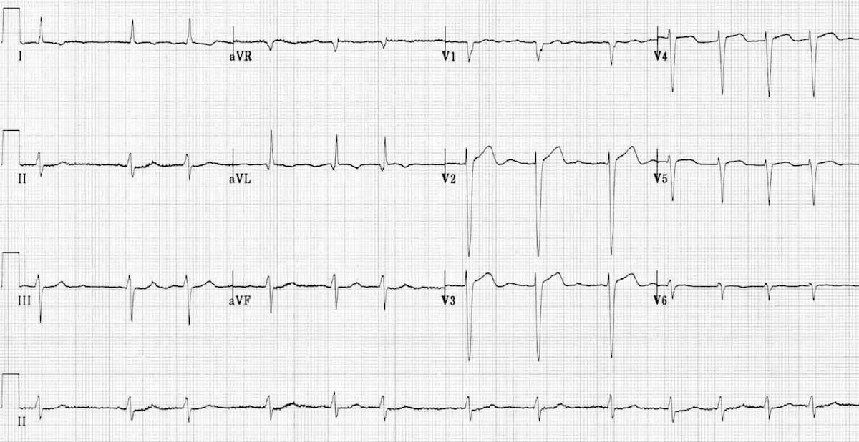

Slide 9
PERMANENT AF-
LA DIALATED >4 CM ,STRUCTURALLY ABNORMAL HEART
NOT BASED ON ANY DURATION
RATE CONTROL ONLY
PAROXYSMAL AF
TERMINATE WITH IN 48 HRS USUALLY-SELF TERMINATION OR VIA
CARDIOVERSION
LESS THAN 7 DAYS
PERSISTANT AF
GREATER THAN 7 DAYS
LONG STANDIND PERSISTENT >1 YEAR

Slide 10
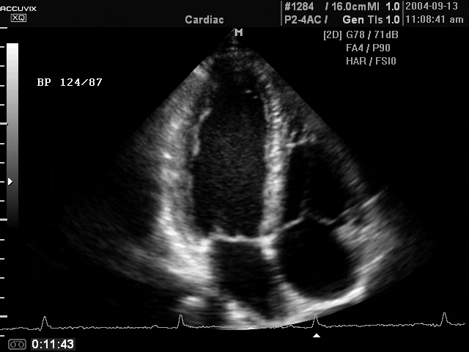

Slide 11
VALULAR AF
MS
PROSTHETIC MITRAL VALVE
NON VALVUALR AF

Slide 12
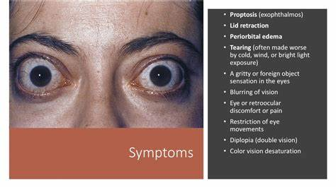
ETIOLOGY AND RISK FACTORS
ANY CARDIAC DISEASE
ANY FAST HR
THYROTOXICOSIS
STRUCTURAL LUNG AND HEART DISEASE
OSA
CKD
PSORIASIS
HYPOMAGNESEMIA,HYPOKALEMIA
ALCOHOL-HOLIDAY HEART SYNDROME

Slide 13
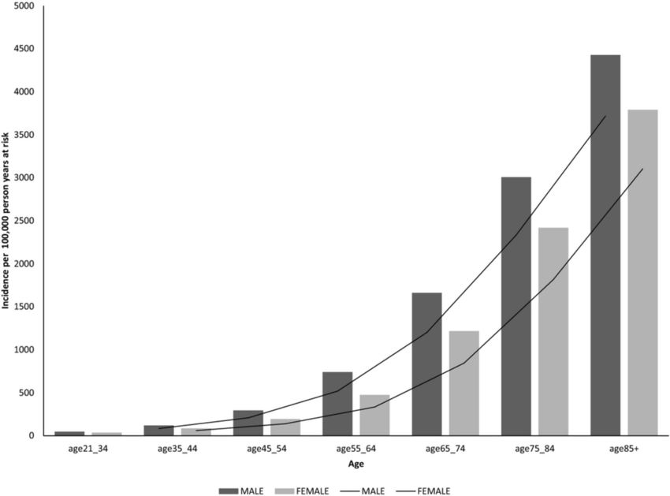
AGE
SYSTEMIC HTN

Slide 14

COMPLICATIONS
STROKE
AF INCREASES RISK OF STROKE
USUALLY WHEN PT REVERT BACK INTO SINUS RHYTHM
USUALLY FROM LA APPENDAGE
DEMENTIA
HEART FAILURE
TACHYCARDIOMYOPATHY

Slide 15
MANGEMENT OF AF
RATE CONTROL OR RHYTHM CONTROL
WHICH DRUG TO USE
ANTICOAGULATE OR NOT

Slide 16
ACTE AF-RHYTHM CONTROL FIRST
IN CHRONIC AF-RATE CONTROL=RHYTHM CONTROL
IN HEMODYNAMICALLY STABLE –WE GO FOR PHARMACOLOGICAL CARDIOVERSION AFTER CONSIDERATION OF THROMBOEMBOLIC RISK
POST CARDIOVERSION ALWAYS START ANTICOAGULATION FOR 3 WEEK ATLEAST,LONG TERM ANTICOAGULATION BASED ON CHADVASC SCORE

Slide 17
PHARMACOLOGICAL CARDIOVERSION
FLECANIDE –ORAL/IV
PROPAFENONE-ORAL/IV
VERNAKALANT-IV FASTEST ONSET OF ACTION ,MOST EFFICACIOUS,LEAST SIDE EFFECT,NON AVAILABILITY,CLASS 3-NA +K BLOCKER,ATRIAL SPECIFIC,WORKS AT HIGHER HEART RATE
IBUTILIDE-IV FAST ,EFFECTIVE
AMIODARONE –IV IN CASE OF STRUCTURAL HEART DISEASE,LEAST EFFECTIVE IN ACUTE AF

Slide 18
PALPITATIONS
CHESTPAIN
FATIGUE
DYSPNOEA
AF
HEMODYNAMICALLY UNSTABLE
WPW
HEMODYNAMICALLY STABLE
LESS THAN 48 HRS
MORE THAN 48 HRS/DURATION UNCERTAIN
DC CARDIOVERSION
ASSUME NO CLOT ,GO FOR CARDIOVERSION
TEE TO R/O LA CLOT
NO CLOT
CLOT
CV
ANTICOAGULATE FOR 3W AND REPEAT TEE
AFTER ANTICOAGULATION ANTICOAGULATE FOR 3-4 WEEKS AND THEN LOOK FOR CHADVASC

Slide 19
ANTICOAGULATION
VKA-ACENOCOUMARIN,WARFARIN
NOAC-DABIGATRAN/APIXABAN/EDOXABAN/RIVAROXABAN
NOAC>VKA
VALVULAR AF-VKA
UFH,LMWH-IN HOSPITAL SETTING
NOAC-RAPIDLY ACTING 1.5 TO 2 HRS
CHADS2VASc SCORE-0 NO ANTICOAGULATION,>/= 2 ANTICOAGULATE
HASBLED SCORE FOR BLEEDING RISK AFTER ANTICOAGULATION

Slide 20
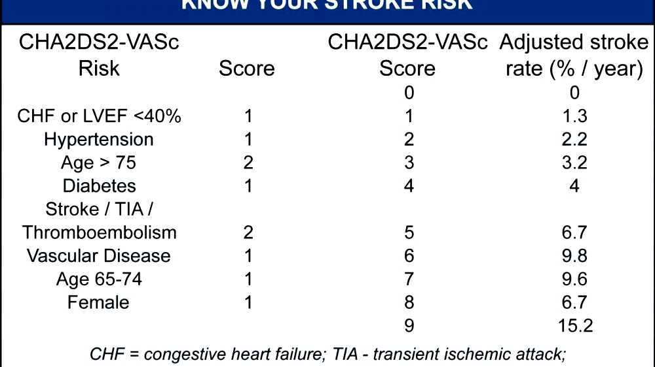
CHADS2 VASc SCORE

Slide 21
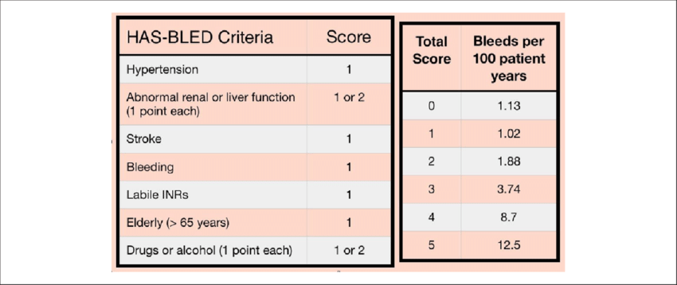

Slide 22
PILL IN THE POCKET STRATEGY
ACUTE,INFREQUENT SYMPTOMATIC AF ,NON VALVULAR AF,HEMODYNAMICALLY STABLE PT,WALKING IN THE OPD,NO STRUCTURAL OR ELECTRICAL HEART DISEASE
ORAL B BLOCKER F/B ORAL FLECAINIDE OR PROPAFENONE (AF CAN ORGANISE BACK INTO ATRIALFLUTTER)
FIRST EPISODE SHOULD BE TREATED IN HOSPITAL

Slide 23
PHARMACOLOGICAL CARDIOVERSION
ELECTRICAL CARDIOVERSION
NO NEED FOR ANESTHESIA
PILL IN THE POCKET APPROACH ALSO AVAILABLE
NEGATIVE INOTROPIC EFFECT
PROARRYTHMIA
TIME CONSUMING
ONLY EFFECTIOVE IF AF OF SHORT DURATION
THROMBOEMBOLISM RISK
IMMEDIATE EFFECT
HIGHLY EFFECTIVE EVEN IN LONG LASTING AF
SAFE IN HEMODYNAMICALLY UNSTABLE PT
THROMOEMBOLISM RISK

Slide 24
TREATMENT FOR PREEXCITED AF
AVRT,WPW
NO ROLE FOR CCB,B BLOCKER,DIGOXIN
HEMODYNAMICALLY UNSTABLE-DC CARDIOVERSION
HEMODYNAMICALLY STABLE-PROCAINAMIDE>IBUTILIDE
IA IC 3
CATHETER ABLATION

Slide 25
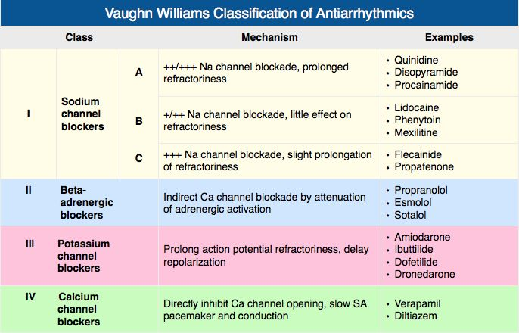

Slide 26
RATE CONTROL
<110 TARGET
CHRONIC AF RATE CONTROL= RHYTHM CONTROL
LA DIALATION >4 CM
BASED ON EACH INDIVIDUAL,CAN ALWAYS TRY ONE ATTEMPT OF RHYTHM CONTROL
B BLOCKER DOC
NDHP-CCB-VERAPAMIL,DILTIAZEM
DIGOXIN
AMIODARONE

Slide 27
NON PHARMACOLOGICAL MX OF AF
ATRIAL PACING
CATHETER ABLATION
AV NODAL ABLATION
SURGERY

Slide 28
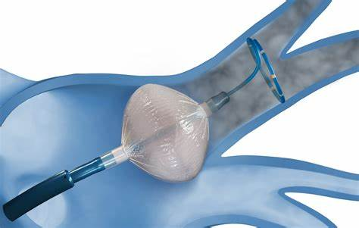
CRYOABLATION
ABLATE NEAR THE PULMONARY VEINS
ELECTRICAL ISOLATION OF PULMONARY VEINS
BODY OF ATRIUM GOES BACK INTO SINUS RHYTHM
RFA=CRYO
NITROUS OXIDE BALOON AT -40 DEGREE CELSIUS
PAROXYSMAL AF RESPONDS BETTER THAN PERSISTENT AF
REDUCTION OF ARRYTHMIA RELATED SYMPTOMS

Slide 29
INDICATIONS
SYMPTOMATIC AF PATIENTS –FIRST LINE THERAPY
SYMPTOMATIC AF PT-FAILURE OF AAD
AF-MEDIATED TACHYCARDIA INDUCED CARDIOMYOPATHY
SINUS NODE DYSFUNCTION +AF

Slide 30
COMPLICATIONS
PV STENOSIS
TAMPONADE
THROMBOEMBOLISM
ATRIO ESOPHAGEAL FISTULA
PHRENIC NERVE INJURY

Slide 31
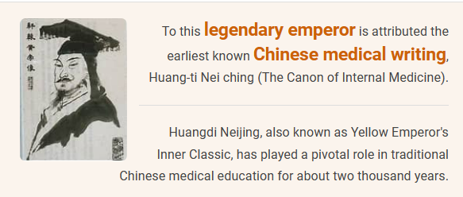
“When the pulse is irregular and tremulous and the beats occur at intervals,then the impulse of life fades”
Huang ti nei ching su wen-2600 BC
THANK YOU

