Slide 1
AF-PART1
Dr.Anjos

Slide 2
Topics covered
Definition
Classification
Statistics
Risk factors
Mechanism
Clinical features

Slide 3
Definition
A supraventricular tachyarrhythmia with uncoordinated atrial electrical activation and consequently ineffective atrial contraction. Electrocardiographic characteristics of AF include:
• Irregularly irregular R-R intervals (when atrioventricular conduction is not impaired),
• Absence of distinct repeating P waves
• Irregular atrial activations(f waves).
in standard 12-lead ECG recording or a single-lead ECG tracing of >_30 s

Slide 4
Statistics
The worldwide age-adjusted prevalence of AF is estimated at 0.596% in men and 0.373% in women.
Each year more than 5 million people develop AF worldwide.
Prevalence of AF in the general population - 0.5% to 2%.
AF progresses from paroxysmal to persistent (despite antiarrhythmic therapy) in approximately 10% at 1 year, in 25% to 30% at 5 years, and in more than 50% beyond 10 years

Slide 5
Classification of AF
First diagnosed AF- not diagnosed before, irrespective of its duration or the presence/severity of AF-related symptoms.
Paroxysmal AF - terminates spontaneously or with intervention within 7 days of onset.
Persistent AF - is continuously sustained beyond 7 days, including episodes terminated by cardioversion (drugs or electrical cardioversion) after >_7 days
Long-standing persistent -Continuous AF of >12 months’ duration when decided to adopt a rhythm control strategy

Slide 6
Classification of AF
Permanent-AF
accepted by the patient and physician, and
no further attempts to restore/maintain sinus rhythm will be undertaken.
represents a therapeutic attitude of the patient and physician rather than an inherent pathophysiological attribute of AF, and the term
should not be used in the context of a rhythm control strategy with antiarrhythmic drug therapy or AF ablation.

Slide 7
Special Terminology
Lone AF –AF in the absence of structural heart diseases.
Valvular/nonvalvular AF- Differentiates patients with moderate/severe mitral stenosis and those with mechanical prosthetic heart valve(s) from other patients with AF

Slide 8
Risk factors for AF
TRANSCIENT REVERSIBLE CAUSES | NONMODIFIABLE RF | MODIFIABLE RF
THYROTOXICOSIS | AGE | DM,HTN,MI,HEART FAILURE
ACUTE MI,PERICARDITIS | RACE | VALVULAR HEART DISEASES,CHD
CARDIAC SURGERY | SEX | OBESITY
ACUTE PULMONARY EMBOLISM | GENETICS | EXERCISE,OSA
ALCOHOL,ELECTROCUTION |  | RECREATIONAL DRUG

Slide 9
Clinical Risk Factors
.
The most frequent causes of acute AF are MI and cardiothoracic surgery.
The most common clinical risk factors for chronic AF are hypertension and ischemic heart disease.

Slide 10
Unmodifiable Risk Factors
Age
increases with advancing age.
Prevalence- <1% -< 60 years, 6% ->65 years, >10% of those older than 80 years.
Median age of patients with AF is approximately 75 years.
In adults 55 years of age and older, the lifetime risk of the development of AF is approximately 24% in men and 22% in women

Slide 11
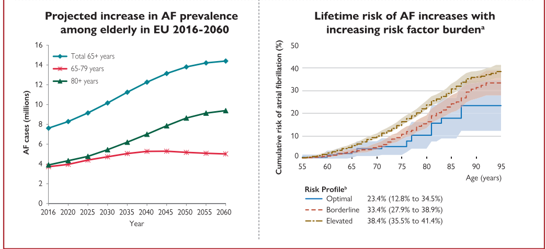
EPIDEMOLOGY

Slide 12
Unmodifiable Risk Factors
Gender
higher in men compared with women (3.8 vs. 1.6 per 1000 person-years)
(10.3% vs. 7.4% in adults aged greater than or equal to 65 years)
Race
higher in whites as compared to blacks, Asians, and Hispanics

Slide 13
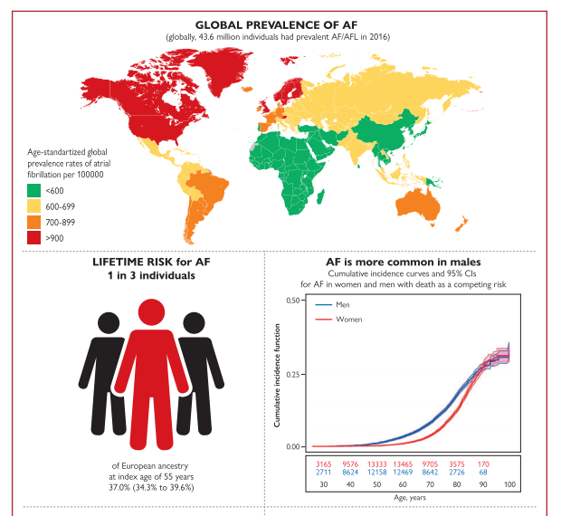
EPIDEMOLOGY

Slide 14
Unmodifiable Risk Factors
Genetics
In 5% of all patients with AF and 15% to 20% of those with AF in the absence of known causal conditions had a positive family history.
Offspring of AF parent-two- to threefold greater risk of developing AF.

Slide 15
Modifiable Risk Factors
Hypertension
most common underlying chronic disorder in patients with AF.
Affect 49% to 90% of the participants in major AF clinical trials
increase the risk of stroke, heart failure, hospitalization, and overall mortality by twofold as compared to AF patients without hypertension.

Slide 16
Modifiable Risk Factors
Heart failure
Heart failure was prevalent in 33% of paroxysmal, 44% of persistent, and 55% of permanent AF patients.
In the Framingham study (AF and heart failure ) 41% of patients with developed heart failure first, 38% developed AF first, and in the remaining 21% AF and heart failure occurred at the same time.
prevalence of AF increases with heart failure severity, ranging from 5% in functional class I patients compared with approximately 50% in class IV patients.

Slide 17
Modifiable Risk Factors
AF can be both a cause and a consequence of heart failure
HF has sixfold increase in the risk of developing AF, while AF is associated with a threefold increased risk of incident heart failure.

Slide 18
Modifiable Risk Factors
Valvular heart disease
1% -aortic valvular disease, 16% -mitral regurgitation, 29% -mitral stenosis, 52% -mitral stenosis and regurgitation.
LA size
the incidence of AF rises from 3% when the LA diameter is less than 40 mm to 54% if the LA diameter exceeds 40 mm.
“nonvalvular” AF -mitral regurgitation (61%), aortic regurgitation (24%), and aortic stenosis (32%)

Slide 19
Modifiable Risk Factors
Coronary artery disease
. Coronary artery disease is present in more than 20% of patients with AF.
AF occurs transiently in 6% to 22% of patients with acute coronary syndrome
Mechanism of MI in AF
1.AF-induced prothrombotic state caused by increased systemic platelet activation, thrombin generation, and endothelial dysfunction;
(2) AF-mediated inflammation that can potentially promote plaque rupture and MI;
(3) direct coronary thromboembolism from LAA clots;
(4) demand ischemia related to fast ventricular rates during AF
(5) presence of common risk factors that predispose to the development of both AF and coronary artery disease (e.g., diabetes, hypertension, advanced age).

Slide 20
Congenital heart disease
AF develops in more than one-third of patients with congenital heart disease.
congenital aortic stenosis,
mitral valve disease,
palliated single ventricles, common causes
unrepaired heart defects,
end-stage heart disease

Slide 21
Modifiable Risk Factors
Obstructive sleep apnea
AF occurs in 5% of individuals with severe sleep apnea
prevalence of at least moderate sleep apnea was reported in up to 32% of patients with AF and structurally normal hearts.
use of CPAP therapy is associated with more than 40% relative risk reduction in AF recurrence in patients with obstructive sleep apnea

Slide 22
Modifiable Risk Factors
Obesity
Overweight populations have higher incidence, prevalence, severity, and progression of AF compared with their normal weight counterparts.
every 5 kg/m2 increase in BMI, there were 10% to 29% greater risks of incident AF

Slide 23
Modifiable Risk Factors
Diabetes.
40% higher risk of AF in men and 60% higher risk in women after 38 years of follow-up.
AF was more prevalent in subjects with pre-diabetes compared to controls and correlated positively with hemoglobin A1c

Slide 24
Modifiable Risk Factors
Hyperthyroidism
The prevalence of AF in patients with overt hyperthyroidism ranges between 10% and 15%
The risk is approximately sixfold that of the euthyroid population.
Subclinical hyperthyroidism -threefold increase
2/3 rd of the patients with AF due to hyperthyroidism revert spontaneously to NSR after treatment of the thyrotoxic state, typically within 3 to 6 months of becoming euthyroid.

Slide 25
Modifiable Risk Factors
AF persists or recurs in up to 30% to 40% of patients after restoring a euthyroid status.
Older age (greater than 55 years),
long duration of hyperthyroidism (greater than 5 years),
long duration of pretreatment AF, Predictors
severe LV dysfunction,
LA enlargement are independent

Slide 26
Modifiable Risk Factors
Chronic kidney disease
the prevalence of AF is two- to threefold higher than reported in the general population.
1.0% among adults without CKD, and 2.8%, 2.7%, and 4.2% among adults with stage 1 to 2, stage 3, and stage 4 t–5 CKD,

Slide 27
Modifiable Risk Factors
Exercise and fitness
Sedentary lifestyle significantly increases the risk of AF, while moderate-intensity exercise is protective against future AF in both men and women.
Men who exercised at a vigorous intensity had a threefold sk of incident AF.
In contrast, women exercising at vigorous intensities actually had a lower incidence of AF

Slide 28
Modifiable Risk Factors
Alcohol
AF is the most common arrhythmia associated with alcohol consumption.
8% increase in AF risk for each 1 standard drink per day (or 12 g pure alcohol per day) increase of alcohol consumption.
association exists between binge-pattern drinking (greater than 5 drinks on a single occasion) and increased AF risk, independent of the number of drinks consumed per week-HOLIDAY HEART syndrome
60% of binge drinkers

Slide 29
Modifiable Risk Factors
Smoking,illicit drug use, Caffeine
Smoking-2x risk
Illicit drugs-amphetamine, heroin, or LSD abuse, annabis, cocaine, ecstasy, and anabolic androgenic steroids .
Cannabis, the most commonly used recreational drug, has been associated with several cases of AF (starting within minutes to 3 hours of cannabis use) in young people without comorbidities.

Slide 30
Drug-Induced AF
paroxysmal, spontaneously terminating in a few minutes or hours
Adenosine,Dobutamine,Milrinone.
cisplatin (12% to 32%), cyclophosphamide (2%), anthracyclines (1% to 10%), IL-2 (4% to 8%), melphalan (6% to 12%), 5-fluorouracil (1%), and paclitaxel (1% to 1.7%).
nonsteroidal antiinflammatory agents, highdose corticosteroids, ondansetron, aminophylline, theophylline, antipsychotic agents (e.g., clozapine, olanzapine), antidepressants (e.g., fluoxetine), bisphosphonates (e.g., alendronate), and ivabradine

Slide 31
MECHANISM OF AF
initiation and maintenance of AF can be linked to the interaction between a trigger and the substrate.
‘trigger’ - rapidly firing focus that can act as an initiator for the arrhythmia.
substrate’ - electrophysiological, mechanical and anatomical characteristics of the atria that sustain AF.

Slide 32
MECHANISM OF AF
Development of this substrate usually includes both electrical and structural elements of atrial remodelling.
Electrical remodelling -changes in the properties of ion channels affecting atrial myocardial activation and conduction
structural remodelling - alterations in the tissue architecture, both microscopic (eg, fibrosis) and macroscopic (eg, atrial dilatation

Slide 33
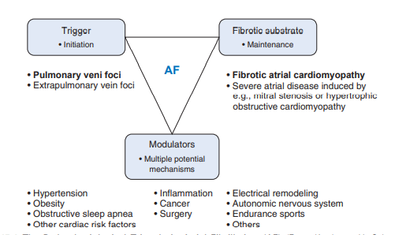

Slide 34
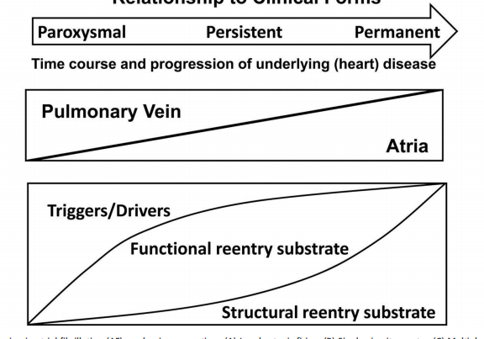
Progression of atrial fibrillation

Slide 35
Triggers for AF
Pulmonary vein foci- myocardial sleeves within PVs
Non Pulmonary vein triggers-the superior vena cava, coronary sinus, left atrial appendage, crista terminalis and left atrial posterior free wall, potentially due to the presence of myocardial sleeves or regional atrial fibrosis at these sites.

Slide 36
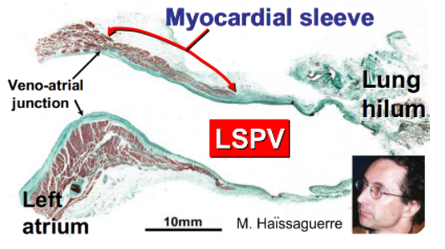

Slide 37
Triggering factors for AF
PACs- the most common cause
atrial stretch
ischaemia
autonomic imbalance
sympathetic or parasympathetic stimulation,
Bradycardia
atrial flutter
supraventricular tachycardias
.

Slide 38
Arrhythmic mechanisms that sustain AF
‘rotors’ or spiral waves –
special form of functional re-entry
In a rotor, the wavefront has a curved or spiral form, with the velocity of any specific portion of the wavefront depending on its degree of curvature.
Stable rotors can also anchor at certain sites (often around the PVs and in areas of heterogeneous atrial tissue)—wavefronts spreading away from the centre of the rotor then fragment, inducing chaotic and fibrillatory activity within the rest of the atrium.

Slide 39
PROPOSED THEORIES
LEADING CIRCLE REENRTY
SPIRAL WAVE REENTRY

Slide 40
VENTRICULAR RESPONSE
In AF,excitation & recovery of atria are chaotic and bizzaire.
The numerous excitatory wavelets reach av node at frequent but irregular intervals.(rate-400-600/min)
AV node can conduct only some of impulses due to the refractory period.
In untreated cases ,ventricular rate is usually 120-150/min
Intraventricular conduction of impulses from fibrillating atria may at times be associated with phasic abberant ventricular conduction

Slide 41

VENTRICULAR RESPONSE
Abberant ventricular conduction-defined as abnormal intraventricular conduction of a supraventricular impulse.

Slide 42
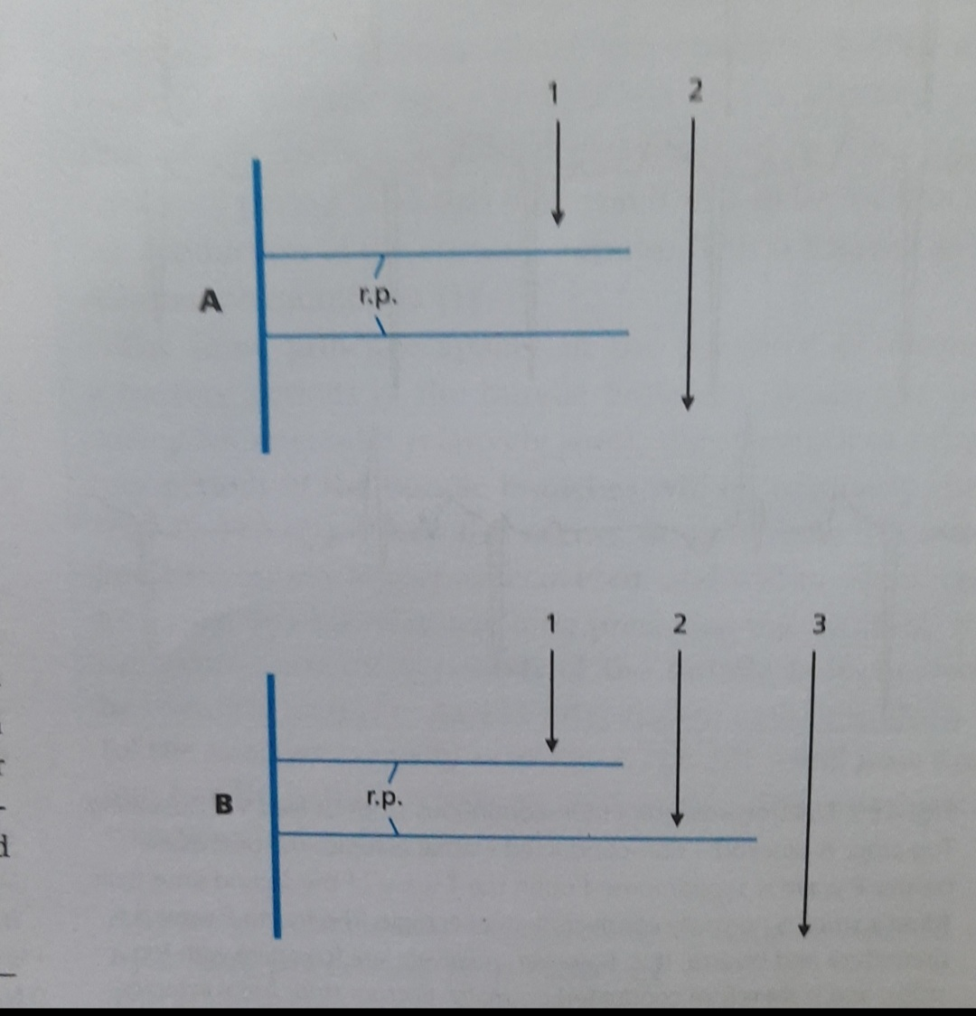

Slide 43
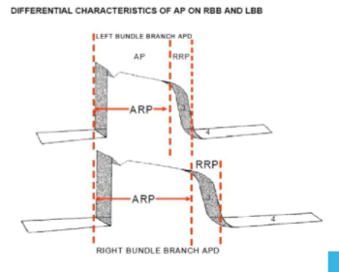
Mechanism of abberant ventricular conduction

Slide 44
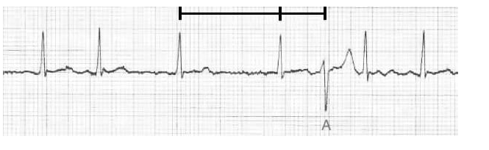
ASHMAN PHENOMENON
As the refractory period of the right bundle is slightly longer than the left, the aberrantly-conducted beat typically demonstrates a right bundle branch (RBBB) morphology.

Slide 45
CLINICAL FEATURES
ASYMPTOMATIC | SYMPTOMATIC-STABLE | SYMPTOMATIC-UNSTABLE
Usually elderly,persistent | PALPITATION | SYNCOPE
25% | DYSPNOEA | ACUTE HF,PULM EDEMA
Fatigue ,effort intolerance “diagnostic cardioversion” | SYNCOPE,DIZZINESS,FATIGUE | ONGOING CHESTPain
 | CHEST PAIN, | SHOCK

Slide 46
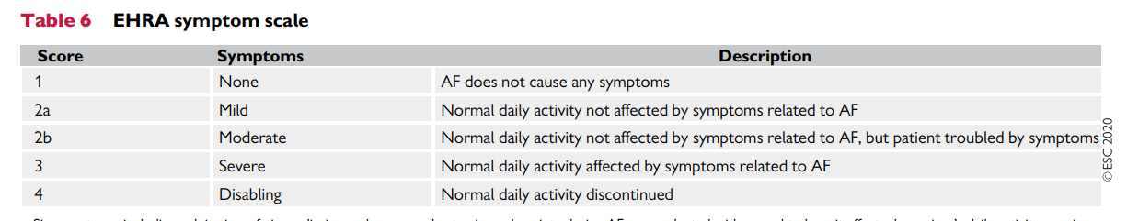
EHRA symptom scale

Slide 47
Silent Atrial Fibrillation
approximately onethird of patients with AF
65% of AF episodes have been shown to be asymptomatic.
Up to 30% of patients presenting with cryptogenic strokes are found to have AF that was not previously recognized.
clinically silent AF is similar to symptomatic AF in terms of overall risks of death, cardiovascular death, or thromboembolic events.

Slide 48
Device-Detected Atrial Fibrillation
Implanted pacemakers or defibrillators with atrial leads are capable of continuously monitoring the heart rhythm and detection of high atrial rates.
In patients without prior history of AF, silent AF (as indicated by device-detected atrial high-rate episodes) is observed in nearly 30% of dual-chamber pacemaker recipients and 25% of cardiac resynchronization device recipients.

Slide 49
Device-Detected Atrial Fibrillation
Atrial high-rate episodes (AHRE)have been used as a surrogate for AF, and several studies have documented positive correlation between device identified atrial high-rate episodes and ECG-documented episodes of AF or AFL with a high degree of sensitivity and specificity.\
Atrial rate cut-off of at least 220 beats/min sustained for durations exceeding 5 minutes provides good sensitivity and specificity for clinically confirmed AF (approaching 98% sensitivity and 100% specificity)

Slide 50
Clinical Implications of Device-Detected Atrial Fibrillation
Several studies have clearly demonstrated that device-detected silent AFs are associated with increased risk of ischemic stroke and systemic embolism.
The risk of thromboembolism appears to be related to the duration of atrial high-rate episode as well as the patients’ risk factor profile (CHA2DS2-VASc score).
Based on current evidence, it seems appropriate to consider long-term oral anticoagulation for stroke prevention in high-risk patients with atrial high-rate episodes lasting longer than 5 to 6 minutes, when falsepositive AF detections are excluded.

Slide 51
AF & MORBIDITY& MORTALITY
5x-stroke, 2x- dementia, 3x-heart failure, 2x-MI.
The mortality rate of patients with AF is approximately double that of patients in NSR
Cause of Death
Cardiac causes (sudden cardiac death [SCD], heart failure, and MI) account for almost one-half of deaths
stroke and bleeding only account for approximately 6% of all deaths each as the principal cause.

