Slide 1
ACUTE TRANSVERSE MYELOPATHY
DR NITHYA RAMANUJAN
JR3 GENERAL MEDICINE

Slide 2
Complete spinal cord transection
All ascending tracts from below the level of the lesion
All descending tracts from above the level of the lesion interrupted
Impairment of all motor and sensory functions below the level of spinal cord damage
More often, section is incomplete

Slide 3
Etiologies
Common causes-
Traumatic spine injuries
Tumors
Multiple sclerosis
Vascular disorders
Less common-
Spinal epidural hematomas or abscess
Paraneoplastic myelopathy
Autoimmune disorders
Herniated intervertebral disc
Parainfectious or postvaccinal syndromes

Slide 4
Sensory disturbance
Band-like radicular pain or segmental paresthesias- at the level of the lesion
Radiation of pain
Cervical- to the arms
Thoracic- circumferentially to the chest or abdomen
Lumbar or sacral- to the legs
Localized vertebral pain
Accentuated by palpation or vertebral percussion destructive lesions
Pain that is worse with recumbence
Improving when sitting or standing malignancy

Slide 5
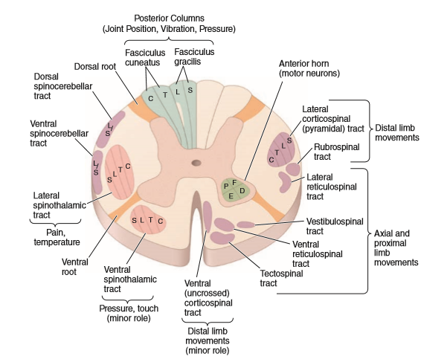
All sensory modalities- impaired below the level of the lesion
Pin-prick loss below a segmental level- most valuable
A sensory level may be easily missed
Extramedullary lesions -sensory level may be many segments below the level of the lesion
eg: high thoracic lesions may present with levels in the upper lumbar segments

Slide 6
Motor disturbances
Paraplegia or quadriplegia- interruption of the descending corticospinal tracts
Acute lesions- ﬂaccid and areﬂexic because of hypoexcitability of the spinal cord (spinal shock)
Eventually, hypertonic, hyperreﬂexic paraplegia or tetraplegia, with bilateral Babinski signs, loss of superﬁcial abdominal and cremasteric reﬂexes, extensor and ﬂexor spasms
At the level of the lesion- segmental LMN signs (paresis, atrophy, fasciculations, and areﬂexia) due to damage to AHC’s or roots

Slide 7
Autonomic disturbances
Urinary or rectal dysfunction- bilateral lesion
Urgency of micturition, urinary retention or incontinence/ constipation
Initially atonic → spastic rectal and bladder sphincter dysfunction (lesions at any spinal level)
Orthostatic hypotension
Anhidrosis
Trophic skin changes
Impaired temperature control
Vasomotor instability
Sexual dysfunction

Slide 8
Compressive and noncompressive myelopathy
Exclude treatable compression of the cord by a mass lesion
Common causes -tumor, epidural abscess or hematoma, herniated disk, spondylitic vertebral pathology
Epidural compression due to malignancy or abscess- warning signs (neck or back pain, bladder disturbances, sensory symptoms) that precede the development of paralysis
Spinal subluxation, hemorrhage, and noncompressive etiologies -produce myelopathy without antecedent symptoms
Magnetic resonance imaging (MRI) with gadolinium- to exclude compressive
Evaluate for noncompressive causes of acute myelopathy (vascular, inflammatory, infectious etiologies)

Slide 9
Non compressive causes
Spinal cord infarction
Systemic inflammatory disorders- SLE, sarcoidosis
Demyelinating diseases-multiple sclerosis, neuromyelitis optica
Post infectious
Idiopathic transverse myelitis- immune condition related to acute disseminated encephalomyelitis and infectious causes

Slide 10
Inflammatory & immune myelopathy (myelitis)
Demyelinating
Systemic inflammatory
Post infectious
One quarter cases of myelits- no cause can be identified
Recurrent episodes of myelitis - immune mediated disease, HSV-2

Slide 11
Multiple sclerosis
Can present as acute myelitis- Asians, Africans
In Caucasians – partial cord syndrome
Symptoms
MRI spine - mild swelling of cord
-diffuse or multifocal shoddy areas of abnormal signal (T2WI)
-contast enhancement (disruption of BBB associated with inflammation)

Slide 12
In one study 68% patients presenting with partial myelitis developed MS after mean follow up of 4 yrs
Risk factors for conversion to MS
age <40
inflammatory CSF
>3 periventricular lesions in brain MRI
Treatment
iv methylprednisolone (500 mg qd for 3 days) followed by oral prednisone (1 mg/kg/d for several weeks, then gradual taper)
plasma exchange -for severe cases if glucocorticoids are ineffective

Slide 13
Neuromyelitis optica
immune-mediated demyelinating disorder
severe myelopathy - typically longitudinally extensive (the lesion spans three or more vertebral segments)
Other involvement -optic neuritis (often bilateral) may precede or follow myelitis by weeks or months
-Brainstem
-Hypothalamic
-Focal cerebral white matter involvement
Recurrent myelitis without optic nerve or other involvement

Slide 14
CSF studies -variable mononuclear pleocytosis (several hundred cells per microliter), oligoclonal bands are absent
Diagnostic serum autoantibodies against the water channel protein aquaporin-4 → 60–70% of patients with NMO
Less commonly autoantibodies against the CNS myelin protein myelin oligodendrocyte glycoprotein (MOG)

Slide 15
No definitive treatment
Acute relapses – glucocorticoids
Refractory cases- plasma exchange
Prophylactic treatment with azathioprine, mycophenylate, or rituximab may protect against subsequent relapses (5 years or longer is generally recommended)

Slide 16
Systemic immune mediated disorders
SLE
Sarcoidosis
Antiphospholipid antibody syndrome
Mixed connective tissue disease
Behçet’s syndrome
Vasculitis related to polyarteritis nodosa, p-ANCA, or primary CNS vasculitis

Slide 17
SLE related
Myelitis- small number of patients with SLE
Many cases are associated with antibodies to aquaporin-4, meets diagnostic criteria for NMO-spectrum disorder
High risk of developing future episodes of myelitis and/or optic neuritis
In others the etiology of SLE-associated myelitis- uncertain
APLA ab may be seen- but not significant
CSF in NMO-associated myelitis typically shows a pleocytosis with polymorphonuclear leukocytes, no oligoclonal bands
In cases not due to NMO a mild lymphocytic pleocytosis and oligoclonal bands
Treatment
Based on limited data, high-dose glucocorticoids followed by cyclophosphamide
plasma exchange

Slide 18
Sjogren’s syndrome
Associated with NMO-spectrum disorder
Cases of chronic progressive myelopathy

Slide 19
Sarcoid myelopathy
Present as a slowly progressive or relapsing disorder
Systemic manifestations of sarcoid
Typical neurologic manifestations- cranial neuropathy, hypothalamic involvement, or meningeal enhancement on MRI
CSF profile- mild lymphocytic pleocytosis, mildly elevated protein level. In some reduced glucose and oligoclonal bands are found

Slide 20
MRI - edematous swelling of the spinal cord that may mimic tumor
Gadolinium enhancement of active lesions
Nodular enhancement of the adjacent surface of the cord
Lesions may be single or multiple
On axial images- enhancement of the central cord
Diagnosis
Difficult when systemic manifestations of sarcoid are minor or absent (nearly 50% of cases) or when other typical neurologic manifestations of the disease are lacking

Slide 21
CSF study
MRI spine
Slit-lamp examination of the eye to search for uveitis
Chest x-ray and CT to assess pulmonary involvement and mediastinal lymphadenopathy
Serum or CSF angiotensin-converting enzyme (ACE)
Serum calcium
Gallium scan

Slide 22
Treatment
oral glucocorticoids- initially
Resistant cases -immunosuppressant drugs, including TNF-α inhibitor infliximab

Slide 23
POSTINFECTIOUS MYELITIS
postinfectious or postvaccinal myelitis follow an infection or vaccination
Implicated- EBV, CMV, mycoplasma, influenza, measles, varicella, mumps, yellow fever
As in the related disorder acute disseminated encephalomyelitis, postinfectious myelitis often begins as the patient appears to be recovering from an acute febrile infection, or in the subsequent days or weeks, but an infectious agent cannot be isolated from the nervous system or CSF
Presumption is myelitis represents an autoimmune disorder triggered by infection and not due to direct infection of the spinal cord
No definitive therapy
Treatment- glucocorticoids, in fulminant cases plasma exchange

Slide 24
Infectious myelitis
Viral
Herpes zoster, HSV types 1 and 2, EBV, CMV, rabies virus, Zika virus
HSV-2 (less commonly HSV-1) - distinctive syndrome of recurrent sacral cauda equina neuritis in association with outbreaks of genital herpes (Elsberg’s syndrome)
Poliomyelitis is the prototypic viral myelitis, but it is restricted to the anterior gray matter of the cord containing the spinal motoneuron
Polio-like syndrome- enteroviruses (enterovirus 71 and coxsackie), JE, West Nile virus
Chronic viral myelitic infections- HIV or HTLV-1

Slide 25
In suspected viral myelitis, appropriate to begin specific therapy
Herpes zoster, HSV, and EBV myelitis-
iv acyclovir (10 mg/kg q8h) or
oral valacyclovir (2 g tid) for 10–14 days
CMV-
ganciclovir (5 mg/kg IV bid) plus foscarnet (60 mg/kg IV tid) or
cidofovir (5 mg/kg per week for 2 weeks)

Slide 26
Bacterial and mycobacterial myelitis
Most are essentially abscesses, are less common than viral causes
Less frequent than cerebral bacterial abscess
Borrelia burgdorferi (Lyme disease)
Listeria monocytogenes
Mycobacterium tuberculosis
Treponema pallidum (syphilis)
Mycoplasma pneumoniae

Slide 27
Parasitic myelitis
Schistosomiasis- endemic areas
Intensely inflammatory and granulomatous reaction, caused by a local response to tissue-digesting enzymes from the ova of the parasite
Schistosoma hematobium or Schistosoma mansoni
Toxoplasmosis -occasionally cause a focal myelopathy
-should especially be considered in patients with AIDS
Cysticercosis- another consideration, far less common than parenchymal brain or meningeal involvement

Slide 28
High voltage electrical injury
Spinal cord injuries are prominent following electrocution from lightning strikes or other accidental electrical exposures
Syndrome consists of transient weakness acutely (often with an altered sensorium and focal cerebral disturbances)
After several days or even weeks - severe and permanent myelopathy
Rare injury type
Limited data incriminate a vascular pathology involving ASA and its branches in some cases
Therapy- supportive

Slide 29
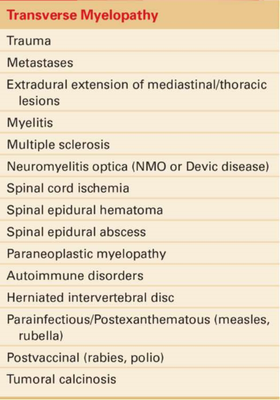

Slide 30
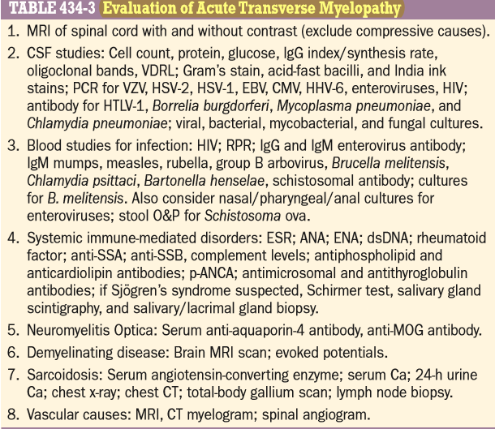

Slide 31
THANK YOU

