Slide 1
‘HUNT’ED BY DUAL INFECTION: A CASE OF VARICELLA ZOSTER AND TUBERCULOUS MENINGITIS IN AN IMMUNOCOMPETENT ADULT

Slide 2
ABSTRACT
Varicella Zoster Virus – can cause Polyneuritis Cranialis and Aseptic meningitis
VZV meningitis overlaps with Tuberculous meningitis with clinical and lab features
We present a case of an elderly female with Ramsay Hunt Syndrome evolving into a neuroinfection of dual etiology with TB and VZV, confirmed by the same CSF study
The initial response to antiviral and steroid was ill-sustained
TB co-infection confirmed by CSF-CBNAAT – ATT started
Further clinical evolution - gratifying

Slide 3
CASE REPORT
65 year old female, hypertensive on CCB
Vertigo, tinnitus, left ear pain x 2 days, headache x 1 day
O/E –
Day 1 : febrile.
Day 2 : neck stiffness +, drowsiness +
MRI Brain - ?meningitis, CSF study – Aseptic meningitis, High ADA, protein; Steroid, Antiviral initiated.
Day 3: LMN facial palsy, vesicular eruptions on left external ear – Ramsay Hunt Syndrome
Day 4: Dysphagia – IX,X palsy – Polyneuritis Cranialis
Day 5: Dyspnea, desaturation – Pneumonia – ICU care given

Slide 4
Day 8: Clinical improvement started
Day 14: Discharged home with residual CN palsy (VII,IX,X)
Day 21: Readmitted due to severe headache.
O/E: Febrile. No CN palsy.
CSF CBNAAT result – Positive for MTb
Repeat CSF study – Aseptic Meningitis
ATT and steroid initiated – Symptomatically improved

Slide 5
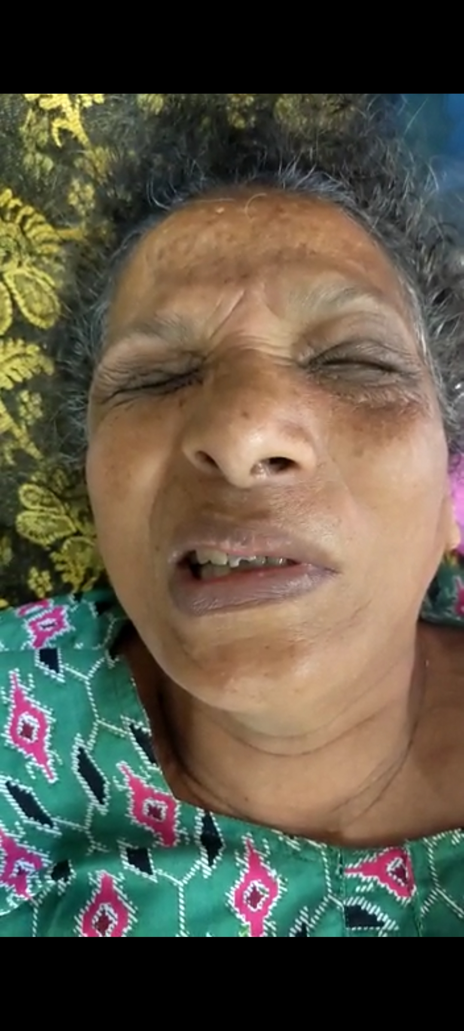
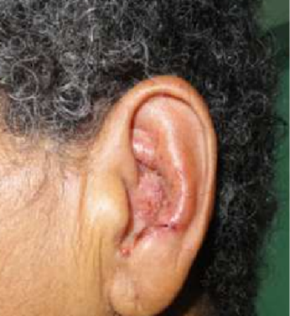
Investigations and Management
TC – 7300, DC N61L31
Day 2 : CSF –
        TC 125, DC – N10,L90;
        Protein – 120mg/dL, ADA – 26 (<12)
      CEMRI Brain – sulcal hyperintensities with post contrast leptomeningeal enhancement in b/l frontoparietal sulci left paramedian occipital sulci - ? meningitis
Day 5 : CXR – B/l lower zone infiltrates
Viral markers including HIV - negative
Day 10 : CSF report – VZV PCR Positive
Day 21 : CSF CBNAAT – Positive
Sputum C&S, CBNAAT - Negative
Management : IV Acyclovir, Steroid, ATT

Slide 6
DISCUSSION
Ramsay Hunt Syndrome – rare manifestation of VZV reactivation in the geniculate ganglion
The immunocompetetent often escapes VZV reactivation; rarely contracts VZV meningitis
Polyneuritis cranialis –
  rare and severe manifestation of VZV – may be part of RHS
    Complicated anastomoses + between cranial nerves – allow VZV to progress further
  TB meningitis has skull base predilection (CN VI,III,IV,VII,II,X,XI,XII)
Our patient’s clinical course of VZV reactivation was complicated further by:
  Polyneuritis cranialis
  Pneumonia - VZV
  TB co-infection in the brain

Slide 7
Neurological sequelae of both TB and VZV – high morbidity and mortality
High index of suspicion warranted
Empirical ATT may be initiated in appropriate clinical settings
TAKE HOME MESSAGE
When initial therapy ineffective - consider dual infection of brain
Atypical CSF findings (very high CSF protein,TC, ADA) in the setting of proven VZV neuroinfection warrants search for mimicking etiologies
One infection may lead to an immunocompromised state in an earlier immunocompetent person – can lead to activation of latent infection

Slide 8
REFERENCES
1. Hong SI, Kim T, Jung J, Park SY, Chong YP, Lee SO, et al. Tuberculous meningitis-mimicking varicella-zoster meningitis. Infect Chemother 2017;49:123-9. Back to cited text no. 1
2.Gupta P, Ranjan R, Agrawal CS, Muralikrishnan K, Dave N, Rana DS. Meningitis with polymerase chain reaction for varicella zoster positivity in cerebrospinal flid of a young immunocompetent adult. J Neurosci Rural Pract 2016;7:591-3. Back to cited text no. 3
3.Harrison's Principles of Internal Medicine - 20th edition

