Slide 1
Trial of Intensive Blood-Pressure Control
in Older Patients with Hypertension
ORIGINAL ARTICLE
Zhang W et. al

Slide 2
INTRODUCTION
Hypertension is a common risk factor for death from cardiovascular causes worldwide and in China.
With aging of the population, determination of the treatment target for systolic blood pressure in older patients with hypertension has become a focus of research.
Current guideline-based recommendations for the syst BP target in older patients remain inconsistent.
For the American College of Physicians–American Academy of Family Physicians guideline target is less than 150mm of Hg
The European guideline - 130 to 139 mm of Hg
The American College of Cardiology–American Heart Association guideline - <130 mm of Hg

Slide 3
Impressive cardiovascular benefits were observed with intensive blood-pressure control (SBP target, <120 mm Hg), as compared with standard BP control (target, <140 mm Hg), in the Systolic BP Intervention Trial (SPRINT), even in patients 75 years of age or older.
A meta-analysis showed that a SBP target of less than 130 mm Hg was associated with a decreased risk of cardiovascular events and death, especially in high-risk patients.
Recent large-scale observational studies have suggested that a reduction in the systolic blood pressure to less than 130 mm Hg in older patients should be applied with caution.

Slide 4
AIM
Whether intensive blood-pressure control offers a greater cardiovascular benefit than standard blood-pressure control in older patients with hypertension.

Slide 5
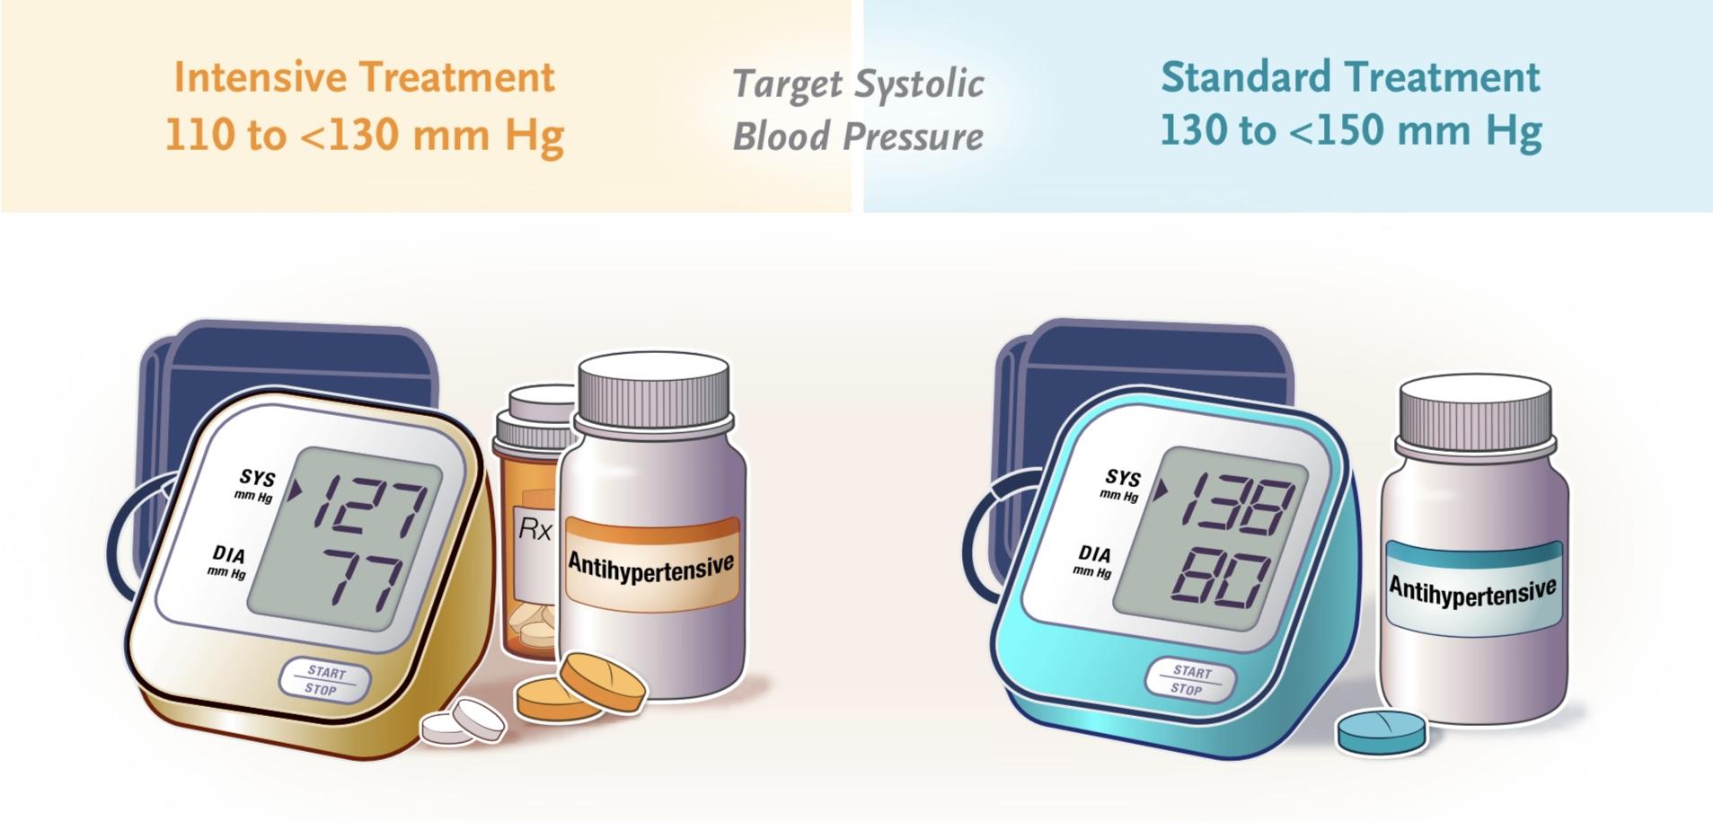
OBJECTIVE
To assess whether intensive treatment (systolic blood-pressure target, 110 to <130 mm Hg) would reduce cardiovascular risk to a greater extent than standard treatment (target, 130 to <150 mm Hg) in Chinese patients 60 to 80 years of age with hypertension.

Slide 6
TYPE OF STUDY
In this multicenter, randomized, controlled trial, they assigned Chinese patients 60 to 80 years of age with hypertension to a systolic blood-pressure target of 110 to less than 130 mm Hg (intensive treatment) or a target of 130 to less than 150 mm Hg (standard treatment).
They also conducted the STEP (Strategy of Blood Pressure Intervention in the Elderly Hypertensive Patients) trial. Moreover , used a smartphone-based application (app) to examine home blood pressure as an adjunct to office blood pressure during the follow-up period.

Slide 7
SAMPLE SIZE
Of the 9624 patients screened for eligibility, 8511 were enrolled in the trial
4243 intensive-treatment group
4268 standard treatment group
Study Period - January 10 to December 31 2017
Follow up period - 4 years upto December 31 2021

Slide 8
Inclusion criteria
All eligible patients -
60 to 80 years of age , Han ethnicity.
With hypertension
Systolic blood pressure of 140 to 190 mm Hg during three screening visits or to be taking antihypertensive medication.
All the patients provided written informed consent.

Slide 9
Exclusion criteria
Subjects were excluded from the trial if any of the following criteria apply:
1.Did not complete screening
2. SBP ≥ 190 mm Hg, or diastolic blood pressure (DBP) < 60 mm Hg.
3.Diagnosed secondary hypertension.
4. History of large atherosclerotic cerebral infarction or hemorrhagic stroke (not including lacunar infarction and transient ischemic attack [TIA]).
5. Hospitalization for myocardial infarction (MI) within the last 6 months.
6. Coronary revascularization (percutaneous coronary intervention [PCI] or coronary artery bypass grafting [CABG]) within the last 12 months

Slide 10
7. Planned to perform PCI or CABG in the next 12 months.
8. History of sustained atrial fibrillation or ventricular arrhythmias at entry influencing the measurement of electronic blood pressure.
9. NYHA class III-IV heart failure or hospitalization for exacerbation of chronic heart failure at entry.
10. Severe valvular disease or valvular disease likely to require surgery or percutaneous valve replacement during the trial.
11. Hypertrophic cardiomyopathy (HCM)
12. Dilated cardiomyopathy, rheumatic heart disease, or congenital heart disease
13. Uncontrolled diabetes mellitus (serum fasting glucose ≥ 200 mg/dl , glycated hemoglobin [HbA1] > 8%).

Slide 11
14. Severe liver or kidney dysfunction (Alanine aminotransferase [ALT] ≥ 3 times the upper limit of normal value, or end stage renal disease on dialysis or estimated glomerular filtration rate [eGFR] < 30 mL/min/1.73 m2, or serum creatinine > 2.5 mg/dl
15. Severe somatic disease such as cancer.
16. Severe cognitive impairment or mental disorders.
17. Participating in other clinical trials.

Slide 12
Safety monitoring
Each participating investigator had primary responsibility for the safety of the individual participants under his/her care.
In our current study, adverse event (AE) was defined as any intervention related unfavourable medical outcomes, including any clinical symptom, abnormal sign, or disease. In our current study, we monitored AE including hypotension, dizziness, angioedema, headache, cough and hives.
Adverse event was considered as serious adverse event (SAE) only when it met following criteria: fatal or life-threatening, result in significant or persistent disability, or require hospitalization or surgical intervention. In our current study, we monitored SAE including syncope and fracture.
The definitions of safety outcomes are listed here:
(1) Hypotension, defined as SBP < 110 mm Hg or DBP < 50 mm Hg [10];
(2) Dizziness

Slide 13
3) Angioedema
(4) Headache
(5) Cough
(6) Hives- skin rash with red itchy bumps.
(7) Syncope
(8) Fracture
(9) Renal outcomes, defined as below three conditions;
≥ 50% reduction in eGFR in patients with CKD at baseline,
≥ 30% reduction in eGFR to < 60 ml/ min/1.73 m2 in patients without CKD at baseline.
Or, Serum creatinine increases 1.5 mg/dL or more in men, > 1.3 mg/dL or more in women. Or eGFR < 30ml/min/1.73 m2.

Slide 14
METHODOLOGY
TRIAL PROCEDURE
After randomization, all patients were scheduled for follow-up visits at 1, 2, and 3 months and every 3 months thereafter until 48 months.
The patients were provided with antihypertensive drugs, T.Olmesartan 20 mg od (an angiotensin-receptor blocker), T. Amlodipine 5-10 mg od (a calcium-channel blocker), and Hydrochlorothiazide (a diuretic).
For patients in the intensive-treatment group, drug doses were increased and/or additional antihypertensive treatment was added carefully at each visit until the target of SBP 110 mm Hg - 130 mm Hg was reached.
Medication adjustment to targeted SBP was based on the office BP measurements during the screening phase and the entire follow-up visit.

Slide 15
Trial assessments
At the time of recruitment, baseline data were collected by physicians at face-to-face visits with the use of a standardized questionnaire.
The 10-year risk of cardiovascular disease was estimated with the use of the Framingham Risk Score.
At each follow-up visit, the office BP and HR were measured and information was collected regarding concomitant medication use, antihypertensive-drug adherence, adverse events, and trial outcomes (with outcomes data ascertained by trained investigators).
Laboratory data were obtained at and every year thereafter..

Slide 16
Measurement of the office blood pressure was performed by a trained trial staff member (physician or nurse).
Patients were required to rest for at least 5 minutes in a seated position, and then the blood pressure was measured by trial staff (observed) three times at 1-minute intervals.
This process was standardized and the same validated office blood-pressure monitor (Omron Healthcare) was used at all participating centers during all baseline and follow-up clinic visits.

Slide 17
TRIAL OUTCOMES
PRIMARY OUTCOMES :
Definition-
A composite of the first occurrence of stroke (ischemic or hemorrhagic), acute coronary syndrome (myocardial infarction and hospitalization for unstable angina), acute decompensated heart failure, coronary revascularization (PCI or CABG), atrial fibrillation, or death from cardiovascular causes.

Slide 18
TRIAL OUTCOMES
SECONDARY OUTCOMES
1. First occurrence of symptomatic stroke (ischemic or hemorrhagic stroke).
2. Acute coronary syndrome (myocardial infarction and hospitalization for unstable angina)
3. Hospitalization for acute decompensated heart failure.
4. Coronary revascularization (PCI or CABG)
5. Atrial fibrillation
6. Cardiovascular death
7. Major adverse cardiac events
8. Decline in renal function or development of end stage renal disease
9. Decline in cognitive function
10. Major artery stiffness
11. First occurrence of diabetes mellitus

Slide 19
STATISTICAL ANALYSIS
Analyses were performed with R software, version 3.6.3 (R Foundation for Statistical Computing).
A two-sided P value of less than 0.05 was considered to indicate significance. There was no prespecified plan to adjust for multiple comparisons. Therefore, only 95% confidence intervals are reported for secondary outcomes, and definitive treatment effects cannot be inferred.

Slide 20
Results
Of the 9624 patients screened at 42 clinical centers throughout China, 1113 (11.6%) were excluded.
A total of 8511 patients 60 to 80 years of age were randomly assigned to the intensive-treatment group (4243 patients) or the standard-treatment group (4268 patients)
A total of 234 patients (2.7%) were lost to follow-up before the end of the trial
At the third interim analysis, performed on December 22, 2019, a total of 272 primary-outcome events had been reported &
At the fourth interim analysis, performed on December 31, 2020, after 343 primary-outcome events had been reported, the intensive-treatment group still had a significantly lower incidence of primary-outcome events than the standard-treatment group.

Slide 21
The results for most of the secondary outcomes also favored intensive treatment
After randomization, results were similar to the results of the primary analysis, which suggests that intensive treatment did not adversely affect these patients .
The incidences of dizziness, syncope, and fracture and the results for renal outcomes did not differ significantly between the two trial groups nor did the incidences of angioedema ,headache, cough, and urticaria.
The incidence of hypotension was significantly higher in the intensive-treatment group than in the standard-treatment group (3.4% vs. 2.6%, P = 0.03).

Slide 22
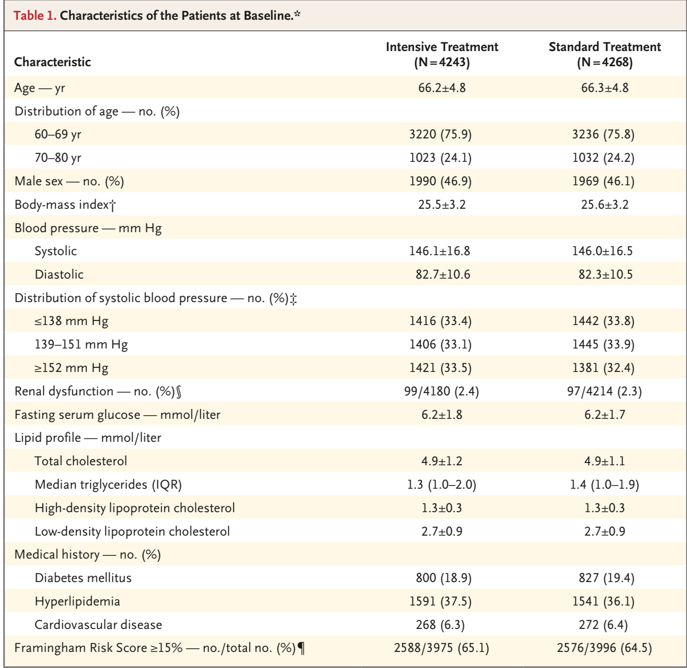

Slide 23
 | INTENSIVE TREATMENT GROUP | STANDARD TREATMENT GROUP
1YEAR FOLLOW Up | Mean SBP = 127.5 mm Hg | 135.3 mmHG
4year follow up | SBP = 126.7 mm Hg DBP = 76.4 mmHg | SBP = 135.9mmHg DBP= 79.2 mmHg
The mean decrease in systolic blood pressure from baseline was 19.4 mm Hg in the intensive-treatment group and 10.1 mm Hg in the standard-treatment group.

Slide 24
DISCUSSION
Primary-outcome events occurred in 3.5% of the patients in the intensive-treatment group, as compared with 4.6% of the patients in the standard-treatment group
The risk of death from any cause did not differ significantly between the two trial groups.
Hypotension occurred more frequently in the intensive-treatment group than in the standard-treatment group
Dizziness, syncope, and fracture and the results for renal outcomes remains the same in both trial groups.

Slide 25
COMPARATIVE STUDY
STEP TRIAL | SPRINT TRIAL
Office BP taken by trained staff using sphygmomanometer | Office Bp with Automated system , no trained staff
Only Uncontrolled DM pateints wee excluded | All diabetic patients were excluded
No incidence of AKI in pts with BP <110 - 130 mm Hg | Increased incidence of AKI with SBP < 120 mmHg in pts without CKD history
Decreased risk of cardiovascular events and stroke in older patients | No similar findings
Stroke patients were excluded in both studies
Increased incidence of hypotension

Slide 26
STRENGTH OF THE STUDY
1. Large sample size - generalized study
2. Diverse patient population (60- 80 years)
3. High rate of follow up.
Home BP measured .

Slide 27
CONCLUSION
In older patients with hypertension, intensive treatment with a systolic blood- pressure target of 110 to less than 130 mm Hg resulted in a lower incidence of cardiovascular events than standard treatment with a target of 130 to less than 150 mm Hg
Pvalue < 0.05

Slide 28
Recommendation
Hypertension is one of the most common lifestyle disease.
So In Our practice , we can implement the results of the study that is , to intensively reduce BP in older patients to decrease the incidence of cardiovascular eventsbut also taking into consideration about the physical status and BMI of Indians .

